Slide 1
Using reduced-order models to study dynamic legged locomotion:
Parameter identification and model validation
Sam Burden, Shai Revzen, Talia Moore,
Shankar Sastry, and Robert Full

Slide 2
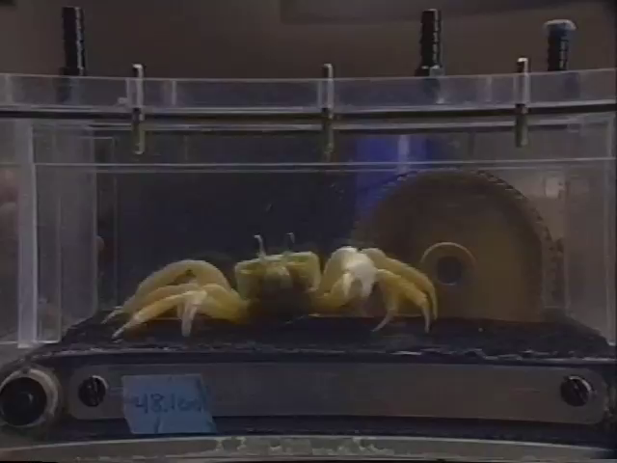
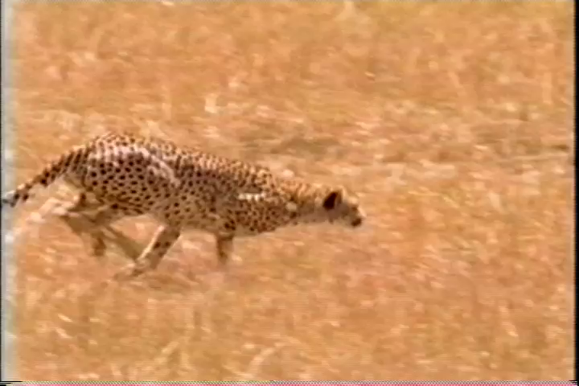
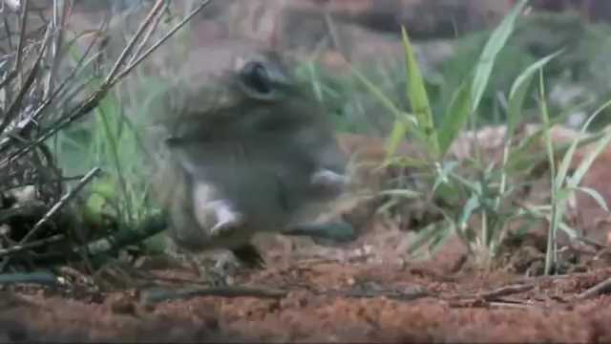
Generating testable hypotheses is challenging
slowed 20x
Mechanical system has many degrees-of-freedom
Motion imposes changing reference frames
Perturbations induce nonlinear effects

Slide 3
Identifying parameters and validating models
Reduced-order models possess unknown parameters
Applying nonlinear regression to piecewise-defined dynamics
Validating a dynamic model’s response to a perturbation – the Lateral Leg Spring

Slide 4
Identifying parameters and validating models
Reduced-order models possess unknown parameters
Applying nonlinear regression to piecewise-defined dynamics
Validating a dynamic model’s response to a perturbation – the Lateral Leg Spring

Slide 5
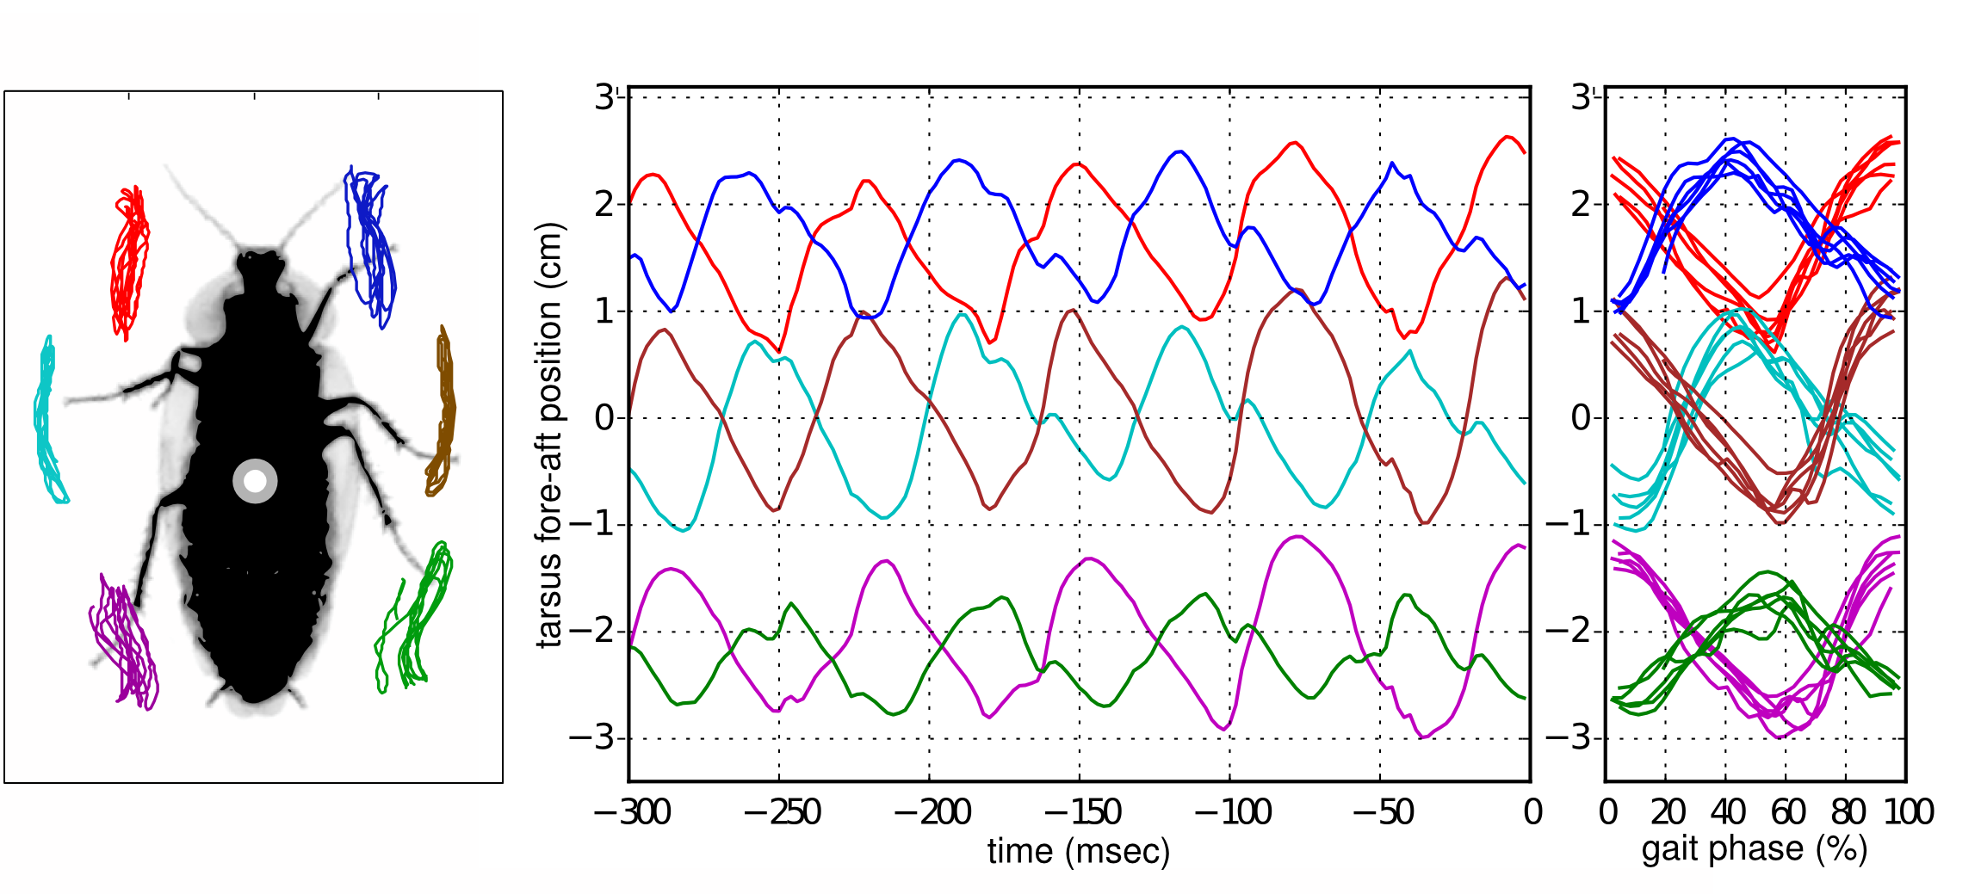
Rhythmic motion is stereotyped & low-dimensional
Revzen, Koditschek, & Full 2009; Revzen & Guckenheimer 2011
Mechanisms are partially understood
  synchronization
  symmetry
  synergy
  solidification
Cohen, Holmes, & Rand 1982
Ting & Macpherson 2005
Golubitsky, Stuart, Buono, & Collins 1999
Li, Umbanhower, Komsuoglu, Koditschek, & Goldman 2009

Slide 6

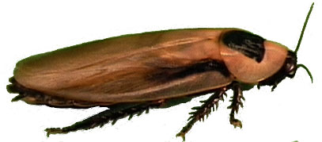

Gait dynamics described by reduced-order model
TEMPLATE
ANCHOR
Simple model of behavior used as control target
Representative model with preferred posture
~10¹ DOF
10? DOF
Collapse dimensions by trimming away complexity
Reveal mechanisms by adding legs, joints, muscles
Full & Koditschek 1999

Slide 7
Relative leg stiffness shared across morphology, scale
2 legs
6 legs
F
m
g
L
ΔL
n
= vertical force
= mass
= acceleration due to gravity
= leg length
= change in leg length
= # of legs
Cockroach
Human
Full and Tu 1990
Cavagn, Heglund,
& Taylor 1977
8 legs
4 legs
Crab
Dog
Blickhan and Full 1987
Blickhan & Full 1993

Slide 8
Parameter identification and model validation
2 legs
6 legs
Cockroach
Human
Model parameters not known a priori
  leg length L and stiffness k; body mass m
Model validity depends on parameter values
  gait stability, parameter sensitivity, etc.
m
L, k
Full, Kubow, Schmitt, Holmes, & Koditschek 2002; Seipel & Holmes 2007; Srinivasan & Holmes 2008; Lipfert, Günther, Renjewski, Grimmer, & Seyfarth 2012
Need statistical tools to estimate unknown parameters from data

Slide 9
Identifying parameters and validating models
Reduced order models possess unknown parameters
Applying nonlinear regression to piecewise-defined dynamics
Validating a dynamic model’s response to a perturbation – the Lateral Leg Spring

Slide 10
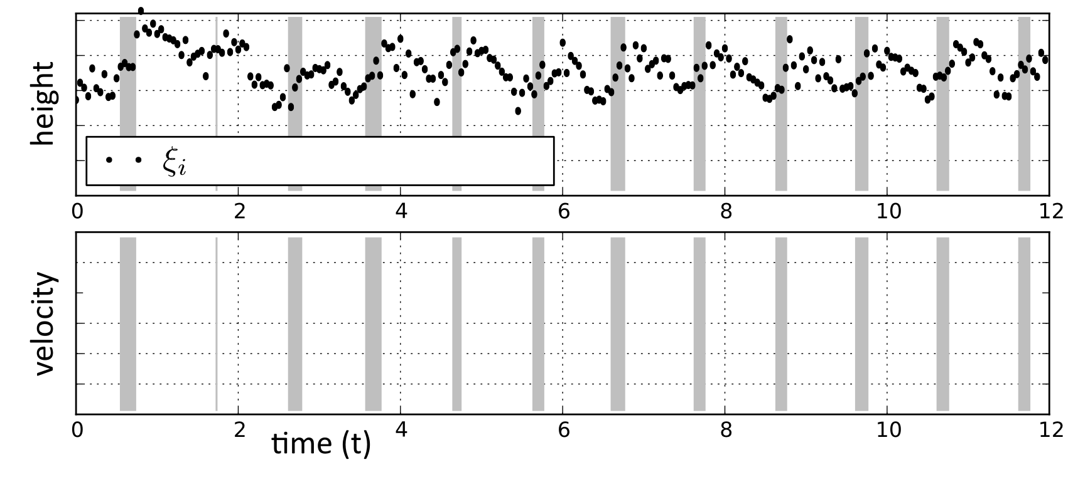
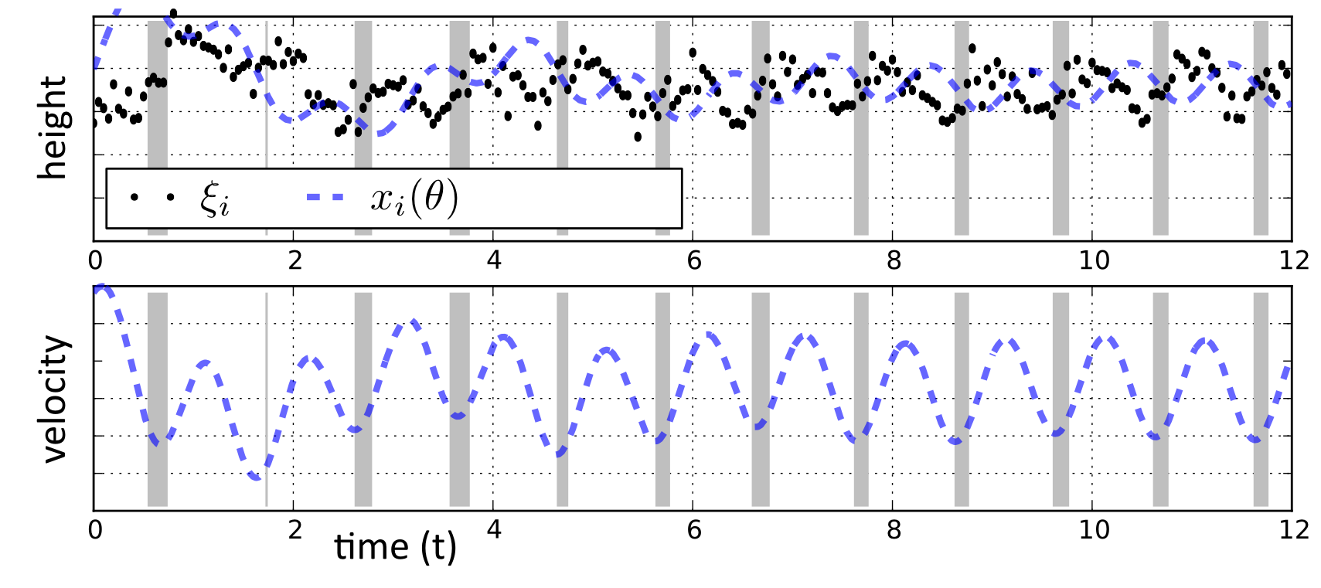
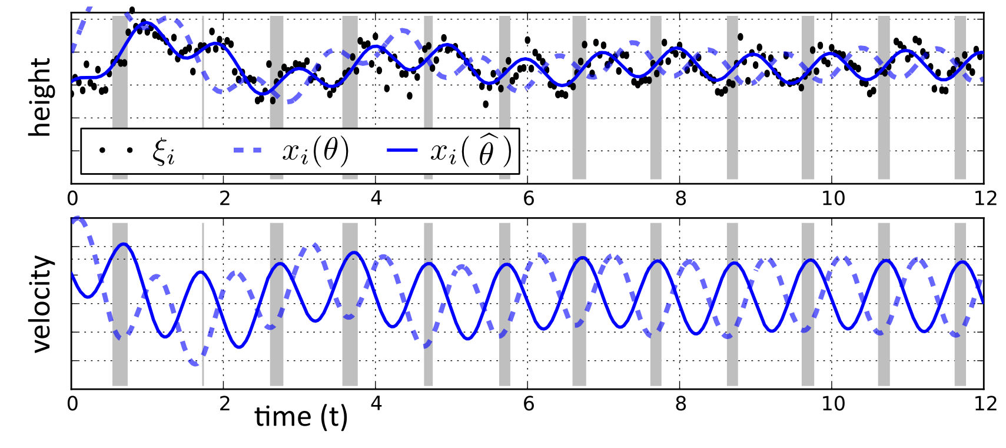
Parameter identification from empirical data
observed
θ = (m, k, l, x₀, v₀)
unobserved
Choose θ to make x_{i}(θ) close to ξ_{i}

Slide 11



Proposed technique: nonlinear regression
Problem setup
  empirical time series data
  (e.g. kinematic & dynamic data for body and limbs)
  model time series data as a function of initial condition
  (initial condition includes unknown model state & parameters)
Minimize prediction error
  (ε is, e.g., mean square error)
data
time (t)
Dempster, Laird, & Rubin 1977; Ljung 1999

Slide 12
Problem: computationally prohibitive in general
Problem setup
  empirical time series data
  model time series data as a function of initial condition
Minimize prediction error
Computational challenges for terrestrial locomotion:
body-limb interaction yields nonlinear dynamics, non-convex prediction error
  linear system ID not applicable
  must approximate parameters
limb-substrate interaction introduces discontinuities in parameters
  combinatorial (mixed-integer) optimization problem in general
(a)
(b)
Dempster, Laird, & Rubin 1977; Ljung 1999; Tugnait 1981; Paoletti, Juloski, Ferrari-Trecate, & Vidal 2007

Slide 13
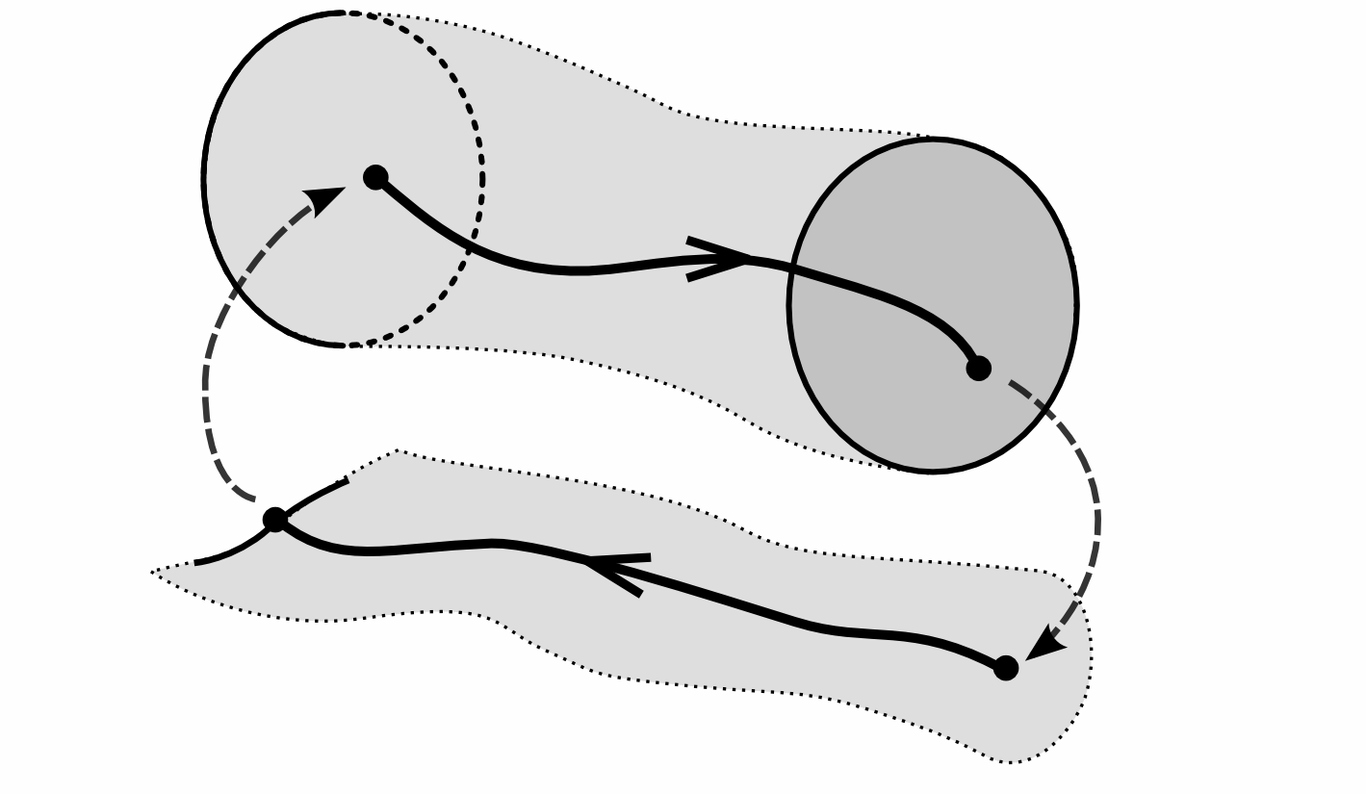
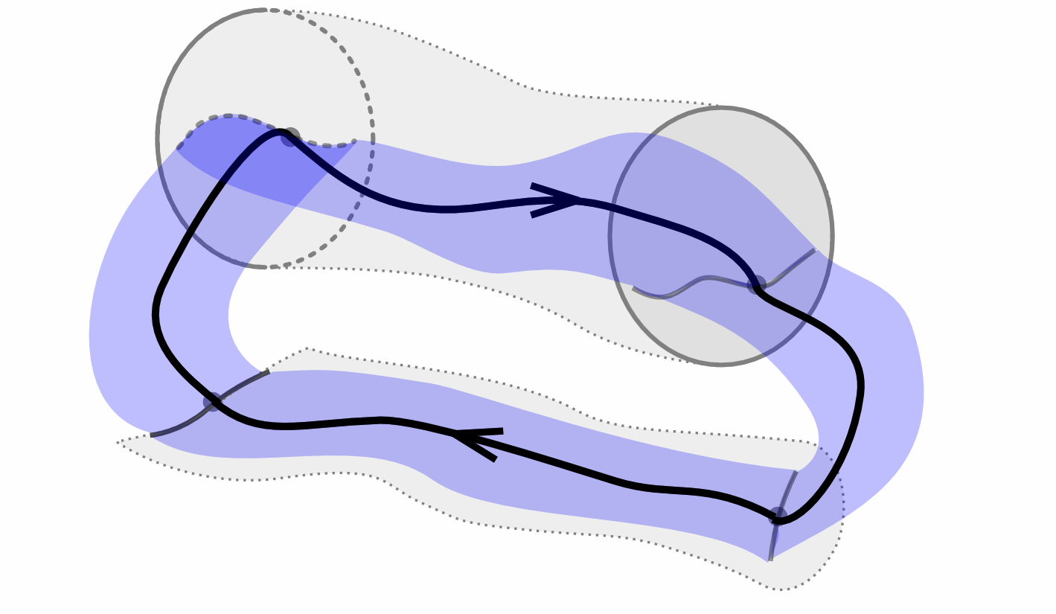
Solution: smooth piecewise-defined dynamics
Problem setup
  empirical time series data
  model time series data as a function of initial condition
Minimize prediction error
global search needed
first-order (gradient) methods apply
  limited to ~10 parameters
  can support ~100 parameters
  applicable to rhythmic gaits
Burden, Revzen, & Sastry, IEEE CDC 2011; Burden, Ohlsson, & Sastry, IFAC SysID 2012

Slide 14
Identifying parameters and validating models
Reduced-order models possess unknown parameters
Applying nonlinear regression to piecewise-defined dynamics
Validating a dynamic model’s response to a perturbation – the Lateral Leg Spring

Slide 15
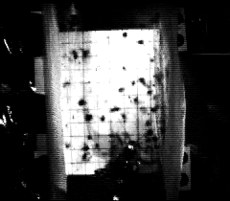
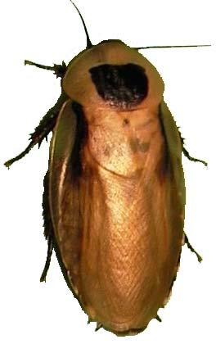
Evidence for mechanical self-stabilization
Rapid Impulse Perturbation Device
Recovery begins <13ms after perturbation
Challenges fastest neural reflexes
slowed 30x
When does neural feedback alter recovery?
Jindrich & Full 2002

Slide 16
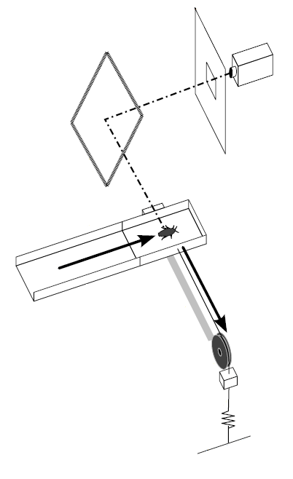
Lateral perturbation experimental setup
Platform accelerates laterally at 0.6 ± 0.1 g in a 0.1 sec interval providing a 50 ± 3 cm/sec specific impulse, then maintains velocity.
camera
diffuser
mirror
magnetic lock
Cockroach running speed:
36 ± 8 cm/sec
Stride frequency:
12.6 ± 2.9 Hz
(~80ms per stride)
animal motion
cart
trackway
cart motion
pulley
rail
mass
cable
elastic
ground
Revzen, Burden, Moore, Mongeau, & Full, Biol. Cyber. (to appear) 2013

Slide 17
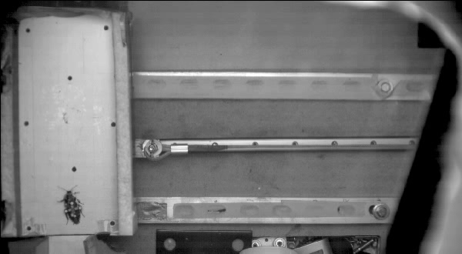
Lateral perturbation experiment
real-time

Slide 18
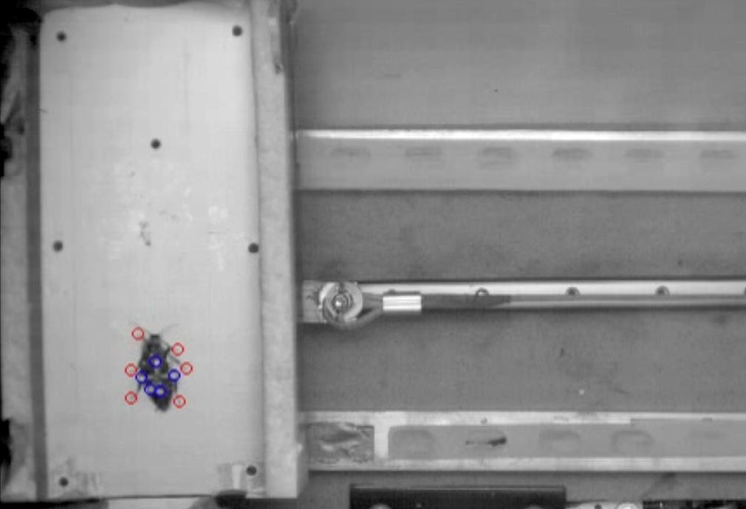
Lateral perturbation experimental setup
Measured:
Heading, body orientation
Linear, rotational velocity
Distal tarsal (foot) position
Cart acceleration induces equal & opposite animal acceleration

Slide 19
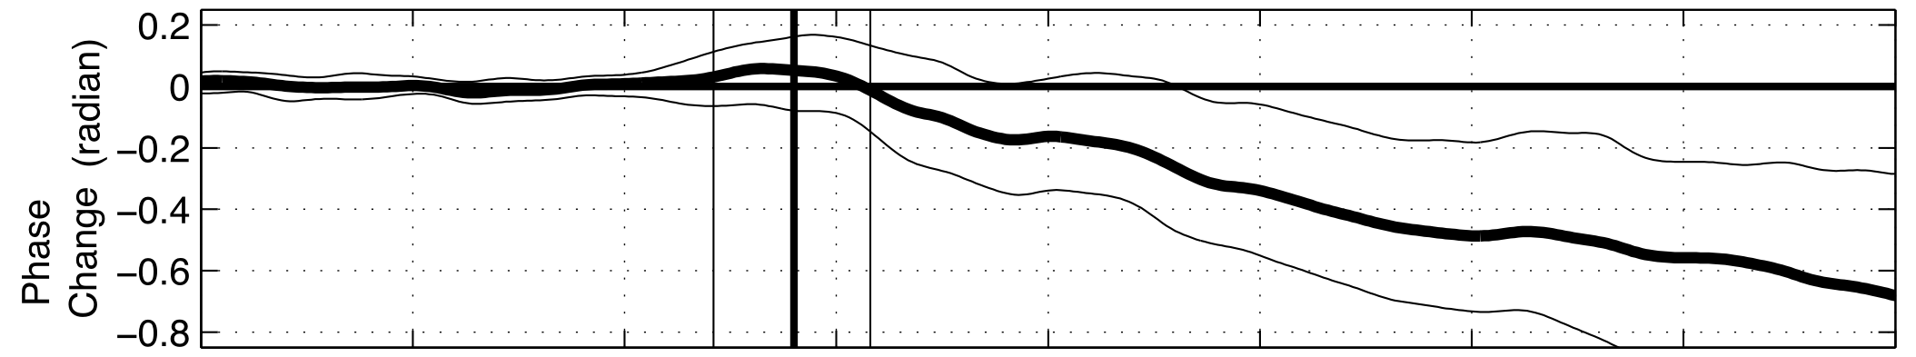
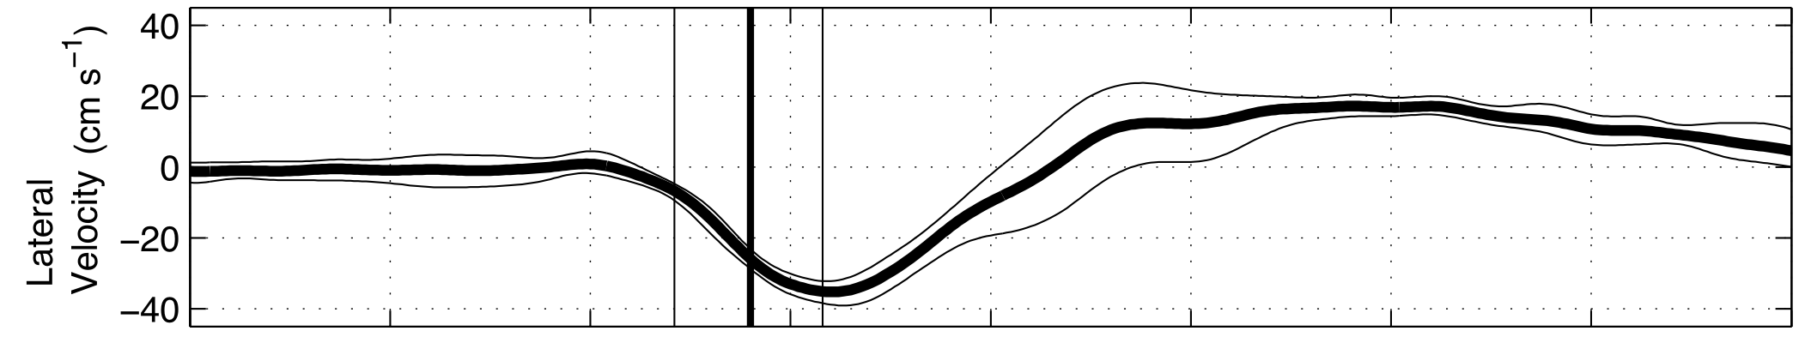
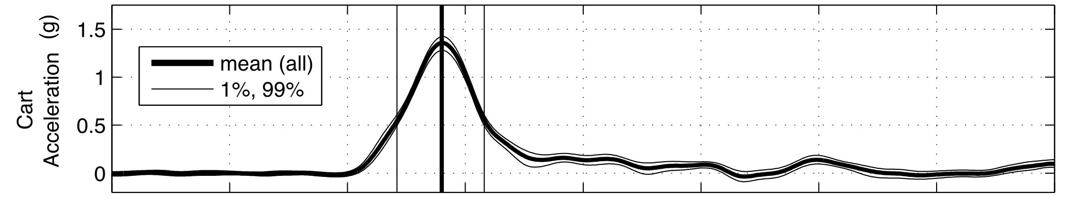
Lateral perturbation experimental results
constant frequency
frequency change
real-time
How does neural feedback alter recovery?
Revzen, Burden, Moore, Mongeau, & Full, Biol. Cyber. (to appear) 2013

Slide 20
Model for mechanical self-stabilization
Animal
Lateral Leg Spring (LLS)
Schmitt & Holmes 2000
3 legs act as one
Cart acceleration induces equal & opposite animal acceleration
Apply measured acceleration directly to model
Quantitative predictions for purely mechanical feedback

Slide 21
Models for mechanical self-stabilization
Animal
Lateral Leg Spring (LLS)
Schmitt & Holmes 2000
Apply measured acceleration directly to model
Cart acceleration induces equal & opposite animal acceleration
Inertial Disc

Slide 22
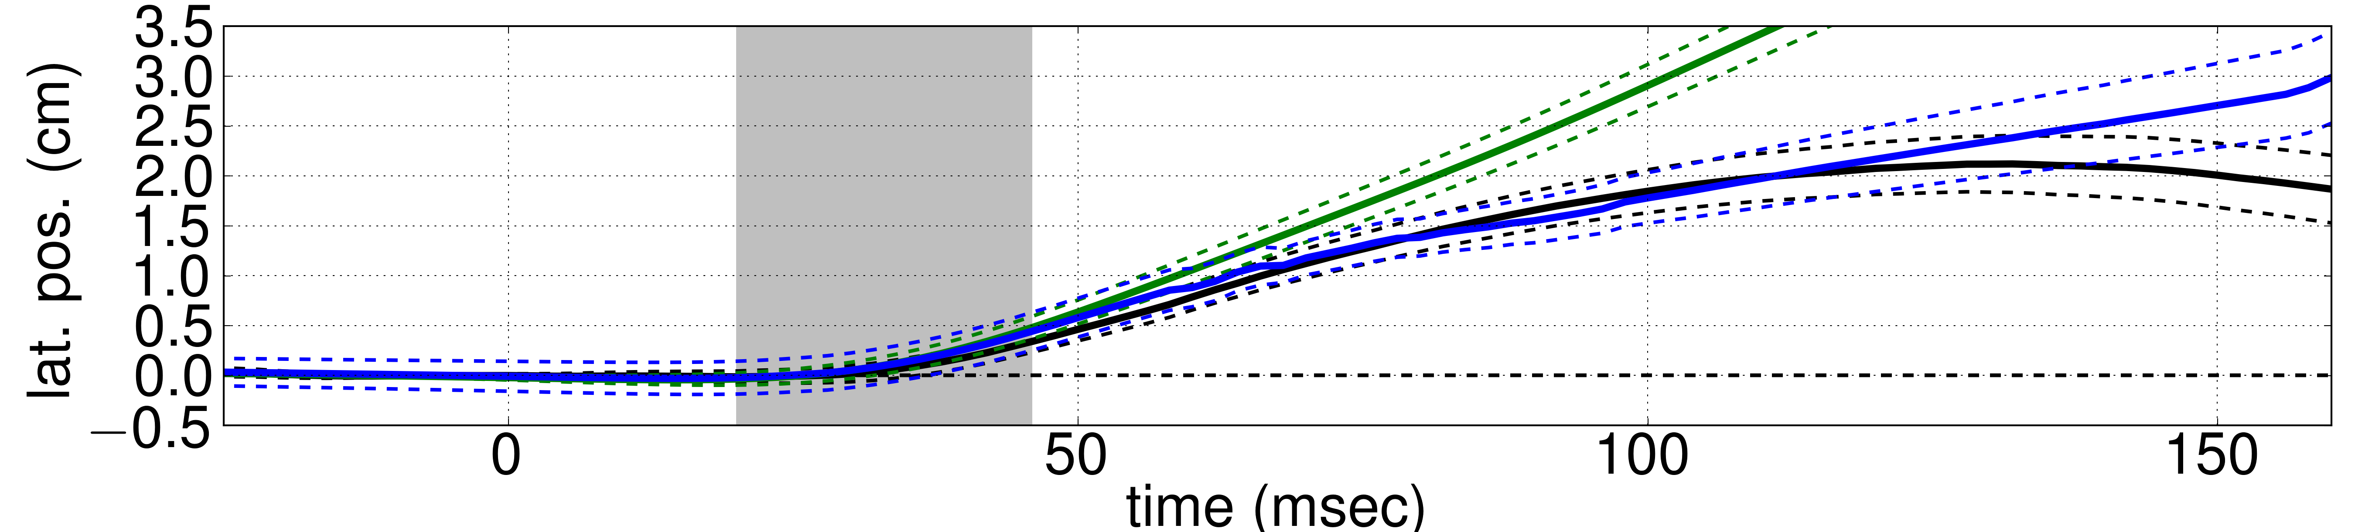
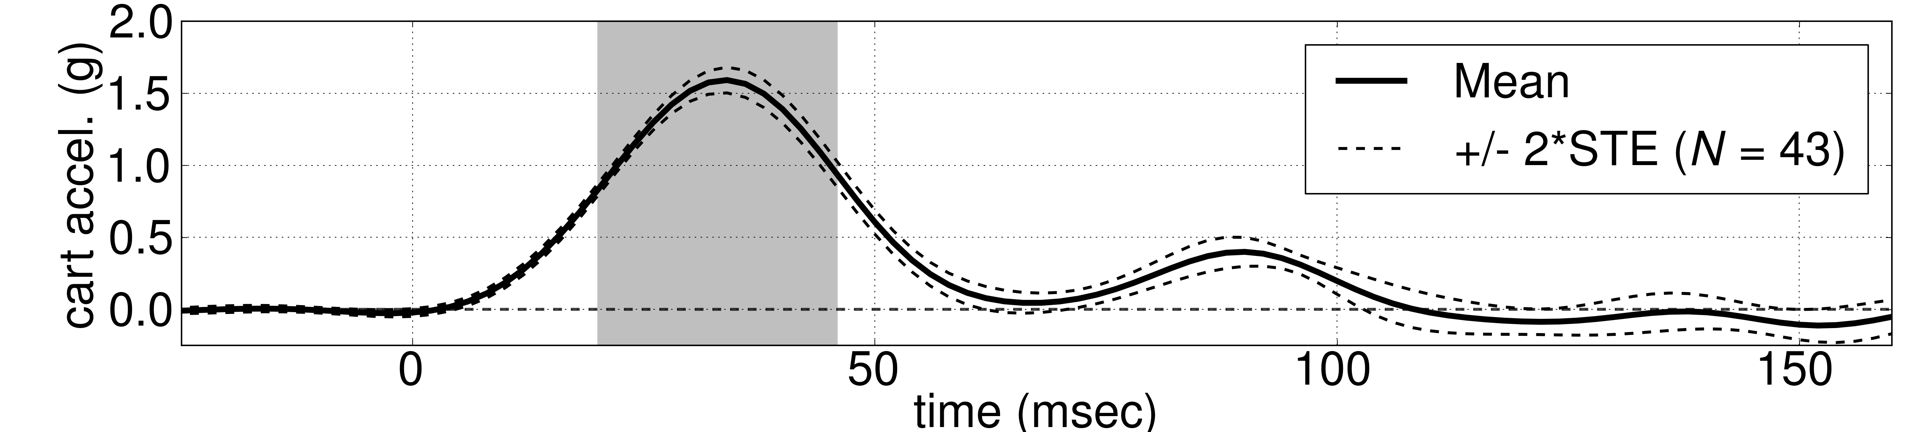
Preliminary results identifying LLS and Disc
Animal
Inertial Disc
Lateral Leg Spring (LLS)

Slide 23
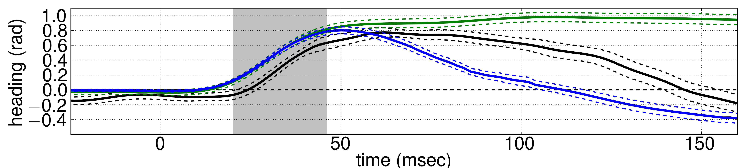
Preliminary results identifying LLS and Disc
Animal
Inertial Disc
Lateral Leg Spring (LLS)

Slide 24
Conclusions for modeling dynamic locomotion
Reduced-order models must be identified & validated using data
Scalable algorithm for estimating parameters in piecewise-defined models using nonlinear regression
Validated model can provide novel quantitative predictions for experimental outcomes

Slide 25
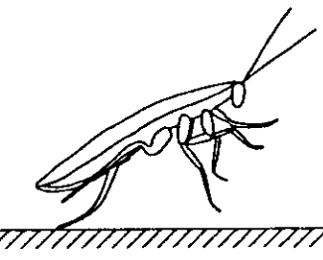
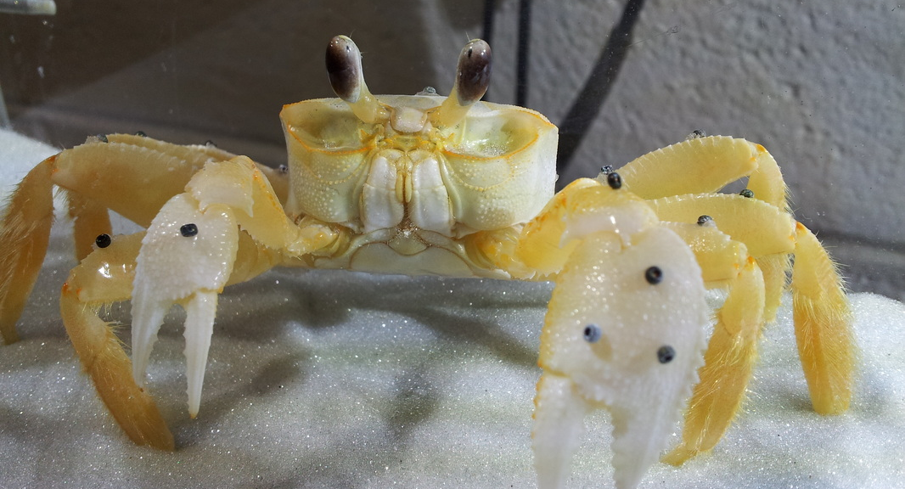
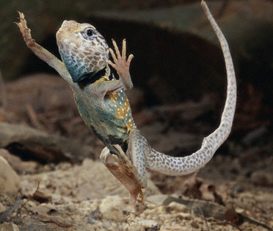
Applications in comparative biomechanics
neuromechanical control architecture
limb loss & ontogeny
gait transition
dynamic maneuver
Pfeiffenberger & Hsieh SICB 2013
Full & Tu 1991
Libby, Gudenus, Harrington, & Full SICB 2013
2:40pm Imperial B
Reduced-order models support comparison across morphology & scale

Slide 26








Acknowledgements
Collaborators
Prof. Shai Revzen
Talia Moore
Prof. Shankar Sastry
Prof. Robert Full
Sponsors
Affiliations
– PolyPEDAL Lab
– Biomechanics Group
– Autonomous Systems Group
– NSF GRF – ARL MAST
Thank you for your time!

Slide 27
Open problems and future directions
choosing prediction error
representing perturbations in reduced-order models
model reduction (“template”-ing)
model embedding (“anchor”-ing)
asymptotic consistency of parameter estimates
accurate, efficient simulation of piecewise-defined dynamics
experimental biomechanics
dynamical systems theory
Burden, Ohlsson, & Sastry, IFAC SysID 2012
Burden, Revzen, & Sastry, IEEE CDC 2011
Burden, Gonzalez, Vasudevan, Bajcsy, & Sastry, IEEE CDC 2011

Slide 28
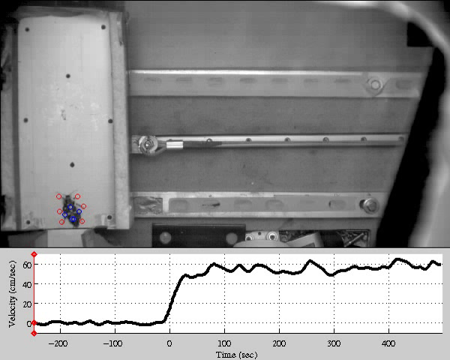
Lateral perturbation experiment
slowed 20x
real-time
cart velocity

Slide 29
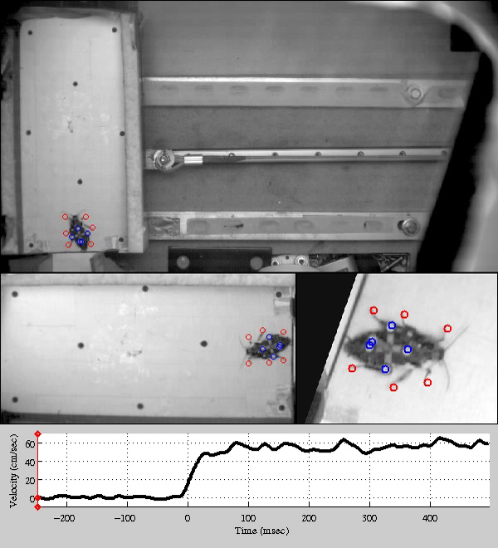
Lateral perturbation reference frames
lab
slowed 20x
cart
animal
real-time

