Slide 1
Optimization for models of legged locomotion:
Parameter estimation, gait synthesis, and experiment design
Sam Burden, Shankar Sastry, and Robert Full

Slide 2
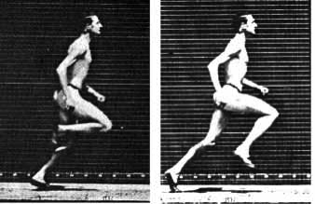
Optimization provides unified framework
estimation
design
?
Blickhan & Full 1993
synthesis
?
?
?
?
Seyfarth, Geyer, Herr 2003
Srinivasan & Ruina 2005, 2007
Vejdani, Blum, Daley, & Hurst 2013
Estimation of unknown parameters for reduced-order models
Synthesis of dynamic gaits to extremize performance criteria
Design of experiments to distinguish competing hypotheses

Slide 3
Estimation of unknown parameters in simple models
human
model
cockroach
m
L, k
Lumped parameters ρ = (L,k,m) not known a priori
  leg length L and stiffness k; body mass m
Model validity depends on parameter values
  gait stability, parameter sensitivity, etc.
Estimate parameters ρ by minimizing prediction error ε
Full, Kubow, Schmitt, Holmes, & Koditschek 2002; Seipel & Holmes 2007; Srinivasan & Holmes 2008
Burden, Revzen, Moore, Sastry, & Full SICB 2013

Slide 4
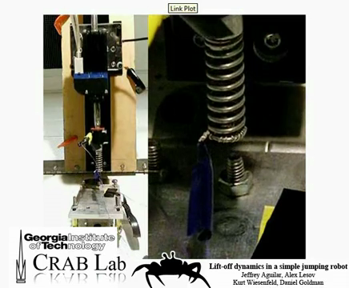
Synthesis of optimal dynamic gaits & maneuvers
Impulses u in idealized walking and running gaits minimize work W
Srinivasan & Ruina 2005, 2007
u
u
walking gait
running gait
“Stutter jump” sinusoidal input u maximizes jumping height h
Aguilar, Lesov, Wiesenfeld, & Goldman 2012, SICB 2013

Slide 5
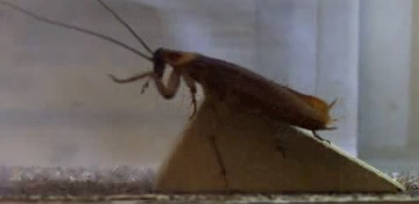
Experiment design to maximally separate predictions
Simple spring-mass unstable for high speeds or irregular terrain
Various extensions proposed to improve stability
  H1: leg retraction or reciprocation
  H2: axial leg actuation
Seyfarth, Geyer, Herr 2003; Seipel & Holmes 2007
Vejdani, Blum, Daley, & Hurst 2013
Design treatment τ to maximally distinguish d hypotheses H1, H2
  τ specifies, e.g., terrain height, inertial load, perturbation

Slide 6
Optimization provides unified framework
estimation
design
?
Blickhan & Full 1993
synthesis
?
?
?
?
Seyfarth, Geyer, Herr 2003
Srinivasan & Ruina 2005, 2007
Vejdani, Blum, Daley, & Hurst 2013
Need tractable computational tool applicable to legged locomotion
Estimation of unknown parameters for reduced-order models
Synthesis of dynamic gaits to extremize performance criteria
Design of experiments to distinguish competing hypotheses

Slide 7
Optimization for models of legged locomotion
Parameter estimation, gait synthesis, and experiment design posed as optimization problems
Existing techniques for optimization applicable to legged locomotion
Scalable algorithm based on computable first-order variation

Slide 8
Simple illustrative model: jumping robot
Mass moves vertically in a gravitational field
Forces generated from leg spring and actuator when foot in contact with ground
Damping, impact losses yield discontinuous dynamics
This simple model contains essential challenges for optimization – approach generalizes to complex models

Slide 9
Translation to canonical optimization problem
Estimation of lumped parameters ρ from experimental data
Synthesis of inputs u for dynamic gaits that extremize performance
Design of experimental treatments τ to distinguish hypotheses
Mathematically equivalent to extremizing generalized performance J at final condition x(T) by searching over initial conditions x(0)
  x(0) incorporates parameters ρ, inputs u, and treatments τ
  J integrates error ε, work W, or prediction difference d_{H1,H2} along x(t)
parameters
ρ – (k,l,b,m,g)
input
u – (actuator input)
treatment
τ – (e.g. spring law)

Slide 10
Translation to canonical optimization problem
Each of these optimization problems:
Estimation of parameters ρ
Synthesis of inputs u
Design of treatments τ
Is equivalent to extremizing final performance J(x(T)) over initial conditions x(0):
Optimization of initial state x(0)
parameters
ρ – (k,l,b,m,g)
input
u – (actuator input)
treatment
τ – (e.g. spring law)

Slide 11
Typical jump: height, velocity, input versus time
γ

Slide 12
Continuous optimization with fixed discrete sequence
γ
P
x(T)=P(x(0))
x(0)
  Fix footfall sequence corresponding to particular trajectory γ
  Define discrete event function P (e.g. apex) near γ
  Optimize near γ using event function P
x(T)=P(x(0))

Slide 13
Continuous optimization with fixed discrete sequence
γ
P
x(T)=P(x(0))
x(0)
Tractable, but restricted to footfall sequence for γ
  inappropriate for multi-legged gaits or irregular terrain
Srinivasan & Ruina 2005, 2007; Phipps, Casey, & Guckenheimer 2006; Remy 2011;
Burden, Ohlsson, & Sastry 2012; Burden, Revzen, Moore, Sastry, & Full SICB 2013

Slide 14
Discrete optimization of footfall sequence
Naïvely, can optimize over all possible footfall sequences:
  enumerate footfall sequences, S
  apply continuous optimization to each sequence σ in S
  choose sequence with best performance
x(T)
x(T)
x(0)
x(0)
,
, …
single jump
double jump
Combinatorial explosion in number of sequences
  intractable for multiple legs or irregular terrain
Golubitsky, Stewart, Buono, & Collins 1999; Johnson & Koditschek 2013

Slide 15
Optimization for models of legged locomotion
Parameter estimation, gait synthesis, and experiment design as optimization problems
Existing techniques for optimization applicable to legged locomotion
Scalable algorithm based on computable first-order variation

Slide 16
Iteratively improve performance: initial trajectory

Slide 17
Iteratively improve performance: step 1

Slide 18
Iteratively improve performance: step 3

Slide 19
Iteratively improve performance: step 5

Slide 20
Key observation: performance criteria varies smoothly
smooth
discontinuous/non-smooth
Can apply gradient ascent using dJ/dx(0) to solve:
Elhamifar, Burden, & Sastry 2014

Slide 21
Key advantage: unnecessary to optimize footfall seq.
T = 160ms
T = 100ms
Initialize optimization from equilibrium
With final time T = 100ms, yields single jump
With final time T = 160ms, yields “stutter” (double) jump

Slide 22
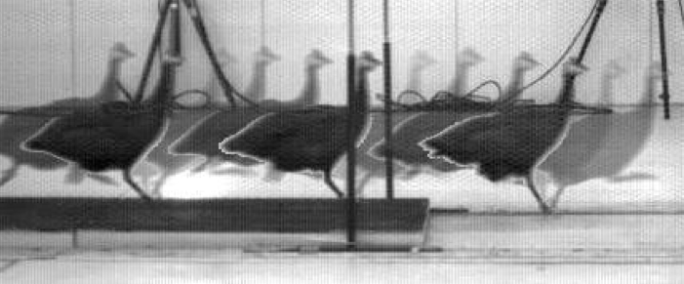
Continuous optimization can vary discrete sequence
Footfall sequence optimization is unnecessary
  continuous initial condition implicitly determines discrete sequence
Scalable algorithm is applicable to optimization of:
  multi-legged gaits
  aperiodic maneuvers
  irregular terrain
  multiple simultaneous models
?
?
Enables estimation, synthesis, & design in unified framework applicable to terrestrial biomechanics

Slide 23
Conclusions for optimization of legged locomotion
Provides unified framework for parameter estimation, gait synthesis, experiment design
Previous techniques impose restrictive assumptions, scale poorly with dimension
Computing first-order variation yields scalable algorithm applicable to hybrid models

Slide 24
Conclusions for optimization of legged locomotion
Provides unified framework for parameter estimation, gait synthesis, experiment design
Previous techniques impose restrictive assumptions, scale poorly with dimension
Computing first-order variation yields scalable algorithm applicable to hybrid models
Optimization provides practical link between model-based and data-driven studies

Slide 25
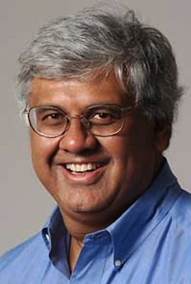


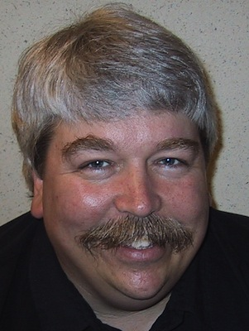
Acknowledgements
Collaborators
Sponsors
Affiliations
– Shankar Sastry
– Robert Full
– NSF GRF
– ARL MAST
– PolyPEDAL Lab
– Biomechanics Group
– Autonomous Systems Group
– UC Berkeley
Thank you for your time!

Slide 26
Open problems and future directions
empirical validation of reduced-order models
continuous parameterization of experimental treatments, outcomes
generating hypotheses from models
data-driven models
local vs global optimization
properties of piecewise-defined models for multi-legged gaits
experimental biomechanics
dynamical sys & control theory
Elhamifar, Burden, & Sastry, IFAC 2014
Burden, Revzen, & Sastry, 2013 (arXiv:1308.4158)
Burden, Revzen, Moore, Sastry, & Full, SICB 2013
Burden, Ohlsson, & Sastry, IFAC SysID 2012

Slide 27
Technical assumption to enable scalable algorithm
Assume: performance criteria J depends smoothly on final condition x(T) (i.e. derivative dJ/dx(T) exists)
Optimization of initial state x(0)

