Slide 1

Predictive dynamical models for sensorimotor control
Sam Burden
Assistant Professor
Electrical Engineering
University of Washington
Seattle, WA USA
http://faculty.washington.edu/sburden

Slide 2
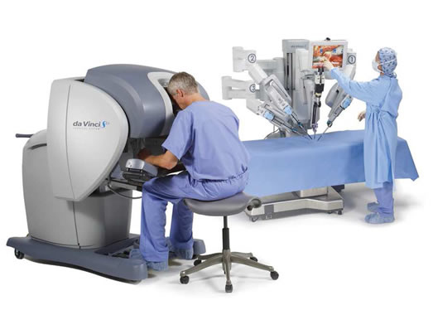
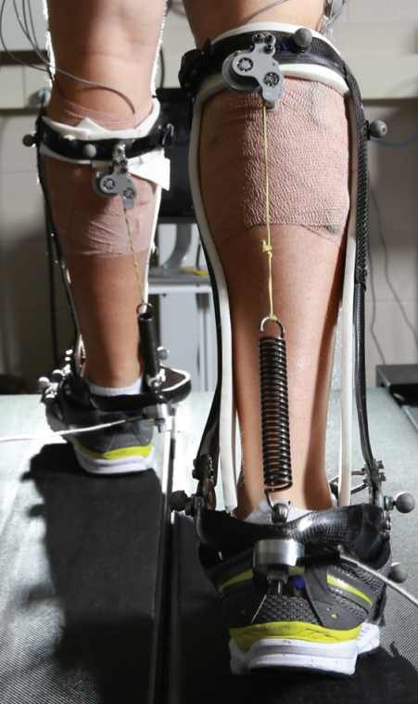
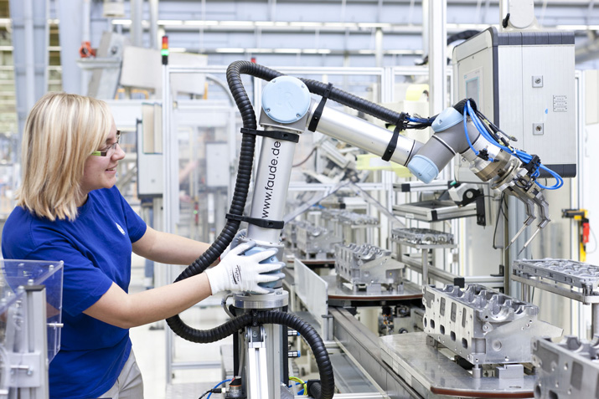
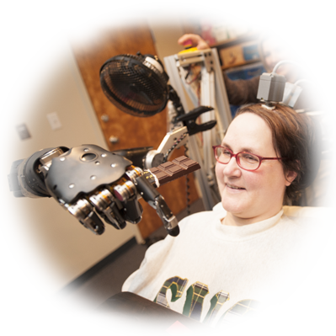
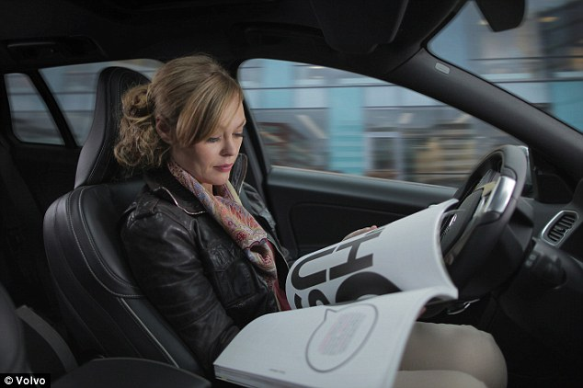
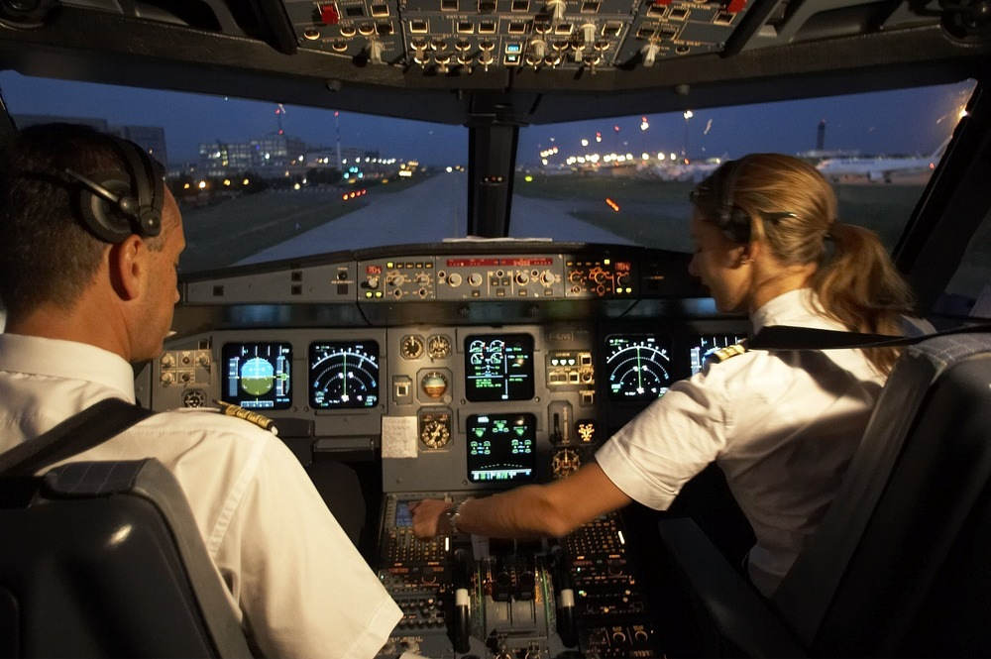
Human interaction with the physical world
is increasingly mediated by automation
Human-Cyber-Physical Systems (HCPS)

Slide 3

Human-Cyber-Physical System:
robotic teleoperation
sensory feedback
sensory feedback
motor control inputs
Chiawakum Creek Fire near Lake Wenatchee, WA © Michael Stanford 2015 http://yourshot.nationalgeographic.com/photos/4181903/

Slide 4
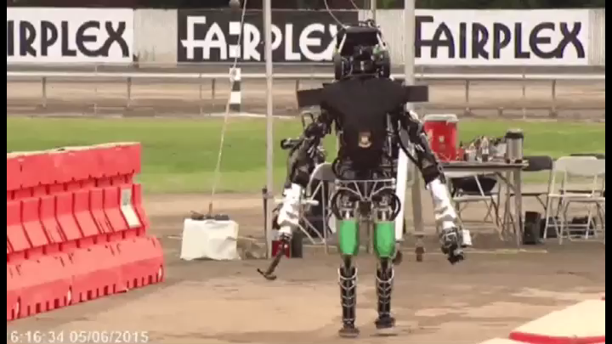

Slide 5
Human-Cyber-Physical System:
robotic teleoperation
sensory feedback
sensory feedback
motor control inputs
Chiawakum Creek Fire near Lake Wenatchee, WA © Michael Stanford 2015 http://yourshot.nationalgeographic.com/photos/4181903/

Slide 6
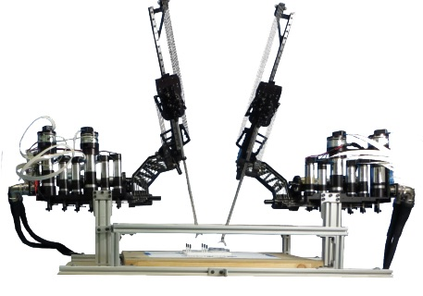
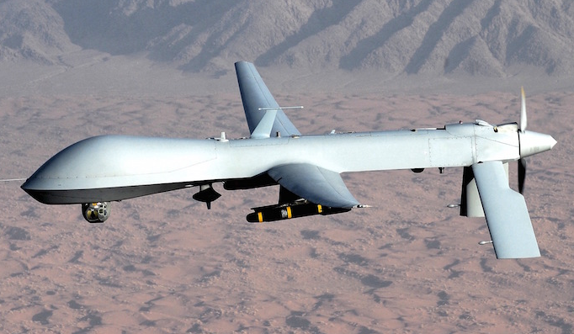
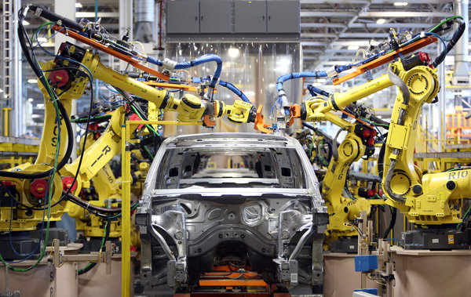
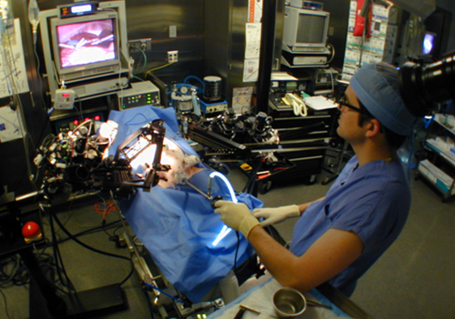
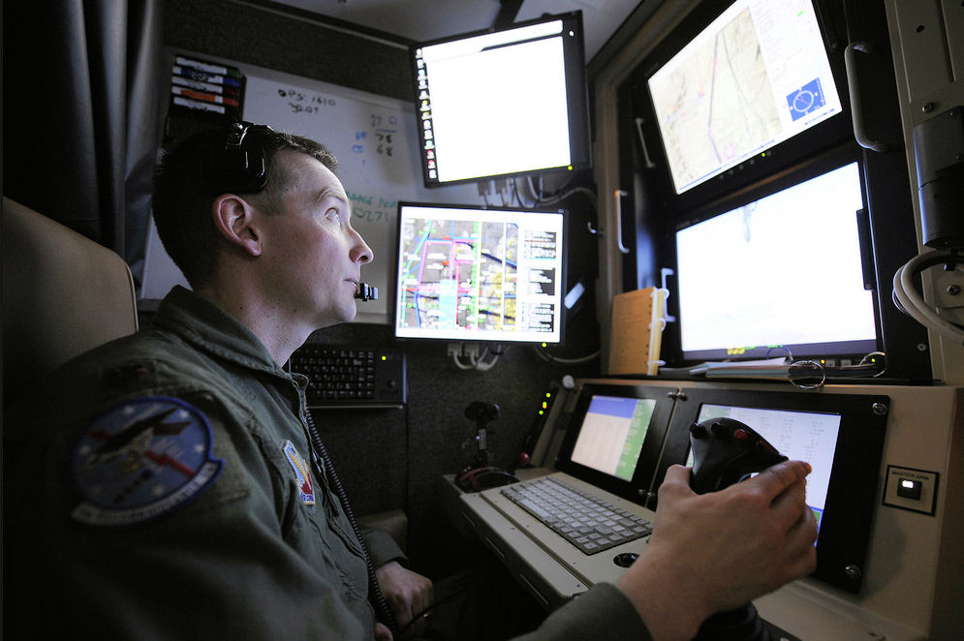

Roles for humans and automation
legal, ethical, and political concerns
ensure humans will remain in-the-loop

Slide 7
Human-Cyber-Physical System:
robotic teleoperation
sensory feedback
sensory feedback
motor control inputs
two decision-making agents in a dynamic world
Chiawakum Creek Fire near Lake Wenatchee, WA © Michael Stanford 2015 http://yourshot.nationalgeographic.com/photos/4181903/

Slide 8
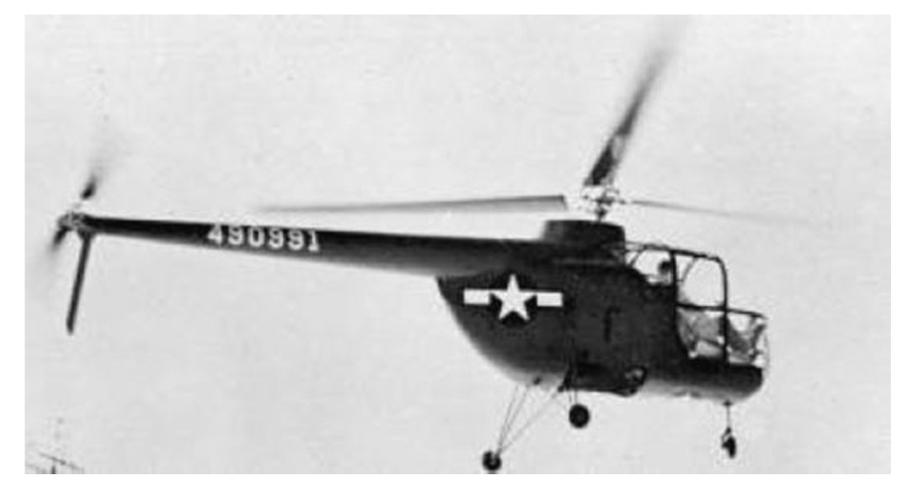
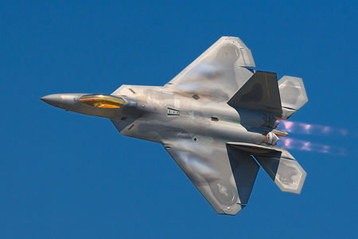

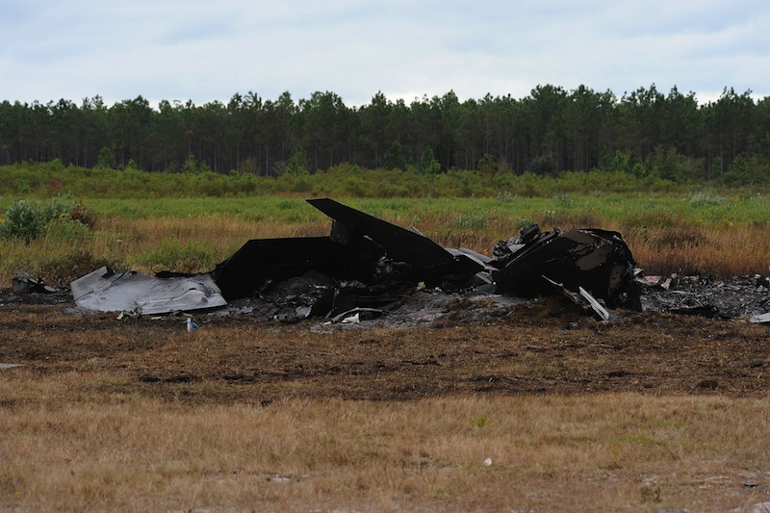
Embedding humans amid automation
  pilot-induced oscillations in rotory & fixed-wing aircraft
    McRuer, Krendal 1974; Hess J. Guid. Cont. Dyn. 1997
    Pavel et al. Prog. Aero. Sci. 2013
  overreliance on enhanced safety features in cars
    Rudin-Brown, Parker Traffic Psych. Behav. 2004;
    Moore, Zuby Proc. Enhanced Safety Vehicles 2013

Slide 10
Embedding humans amid automation
  pilot-induced oscillations in rotory & fixed-wing aircraft
    McRuer, Krendal 1974; Hess J. Guid. Cont. Dyn. 1997
    Pavel et al. Prog. Aero. Sci. 2013
  overreliance on enhanced safety features in cars
    Rudin-Brown, Parker Traffic Psych. Behav. 2004;
    Moore, Zuby Proc. Enhanced Safety Vehicles 2013
naïve coupling can lead to performance loss
ranging from mild to catastrophic

Slide 11
Intervening in Human-Cyber-Physical Systems
any intervention alters the sensorimotor loop
sensory feedback
sensory feedback
motor control inputs
provably-safe interventions will require predictive models for sensorimotor loops

Slide 12
Today’s talk:
predictive dynamical models
for sensorimotor control
M, M⁻¹
internal models
terra-dynamics

Slide 13
Today’s talk:
predictive dynamical models
for sensorimotor control
M, M⁻¹
internal models
terra-dynamics

Slide 14
Predictable behavior from internal models
forward model
  predicts sensory effects of motor actions
    Sutton, Barto Psych. Rev. 1981
    Jordan, Rumelhart Cog. Sci. 1992
    Wolpert, Ghahramani, Jordan Science 1995
inverse model
  computes action expected to yield desired behavior
    Kawato Curr. Opin. Neurobio. 1999
    Thoroughman, Shadmehr Nature 2000
    Conditt, Mussa-Ivaldi PNAS 1999
Notes:
replace text with cartoon

Slide 15
Predictable behavior from internal models
  theoretical and empirical evidence for pairing of forward + inverse models
    Bhushan, Shadmehr Bio. Cybern. 1999; Sanner, Kosha Bio. Cybern. 1999
forward model
+
inverse model
  parallels in control theory, robotics, artificial intelligence: adaptive control, internal model principle, learning
    Francis, Wonham Automatica 1976; Sastry, Bodson Prentice Hall 1989
    Sutton, Barto, Williams IEEE CSM 1992; Atkeson, Schaal ICML 1997
    Papavassiliou, Russell IJCAI 1999
Notes:
replace text with cartoon

Slide 16
Instantiating internal models
Forward model ( M : U → Y ): static vs. dynamic
  static map (linear or nonlinear)
    Hanuschkin, Ganguli, Hahnloser Front. Neural Circ. 2013
    Giret, Kornfeld, Ganguli, Hahnloser PNAS 2014
  dynamic map depends on
  intermediate state
    Thoroughman, Shadmehr Science 2000
    Wolpert, Diedrichsen, Flanagan Nature Neurosci. 2011
Inverse model ( M⁻¹ : Y → U ): hard to define
  static map may fail to be one-to-one or onto
  dynamic map may be acausal or need state estimate

Slide 17
Dynamic forward model
  start with forward model in control-affine form
  under a technical condition* we change coordinates to
  forward model is simpler in (ξ,ζ) coordinates
*strict relative degree – easily satisfied for mechanical systems

Slide 18
Dynamic inverse model
  start with simplified forward model
  to obtain inverse model, apply input u_{d} that matches* γ—th derivative of desired output y_{d} :
*augment with feedback to correct for initial condition error

Slide 19



Pairing forward + inverse models
  closed-loop dynamics have undesirable property:
  states in ζ are unobservable
  generally impossible to compute inverting input u_{d} using sensor data
  by restricting system dynamics, can bypass this issue:
Theorem (Robinson, Scobee, Burden, Sastry): If forward M and inverse M⁻¹ are stable models, then feedforward input from internal model asymptotically inverts system’s dynamics.
Robinson, Scobee, Burden, Sastry Proc. SPIE-DSS (to appear, 2016)
Dynamic inverse models in human-cyber-physical systems

Slide 20



Inversion with stable model pair (M, M⁻¹)
M, M⁻¹
output y
input u_{d}
Theorem implies:
  for stable model pair, trajectories x₁ and x₂ converge to
  feedforward input “asymptotically inverts” dynamics
Robinson, Scobee, Burden, Sastry Proc. SPIE-DSS (to appear, 2016)
Dynamic inverse models in human-cyber-physical systems

Slide 21
If inverse model predicts human’s behavior
  by measuring human’s input u_{H}, can infer task η_{H}
  task η_{H} is an input to the unobservable dynamics ζ
  automation can solve optimal control problem to improve performance as measured by

Slide 22
Application: provably-safe interventions
any intervention alters the sensorimotor loop
sensory feedback
sensory feedback
motor control inputs
if inverse model predicts human’s behavior,
the above intervention is provably-safe

Slide 23
Today’s talk:
predictive dynamical models
for sensorimotor control
M, M⁻¹
internal models
terra-dynamics

Slide 24
Today’s talk:
predictive dynamical models
for sensorimotor control
M, M⁻¹
internal models
terra-dynamics

Slide 25
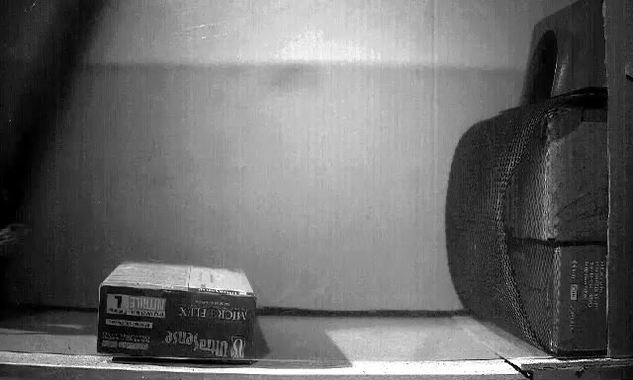
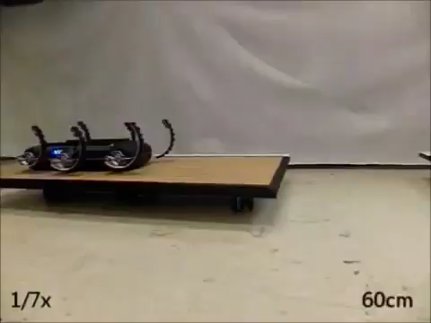

Legged locomotion involves intermittent interaction
  locomotion through fluid governed by continuous hydro- and aero-dynamics
  locomotion on land governed by intermittent terra-dynamics
Tytell, Standen, Lauder JEB 2008
Cory, Moore, Tedrake B&B 2014
Libby, Moore, Chang-Siu, Cohen, Jusufi, Full Nature 2012
Johnson, Koditschek ICRA 2013

Slide 26
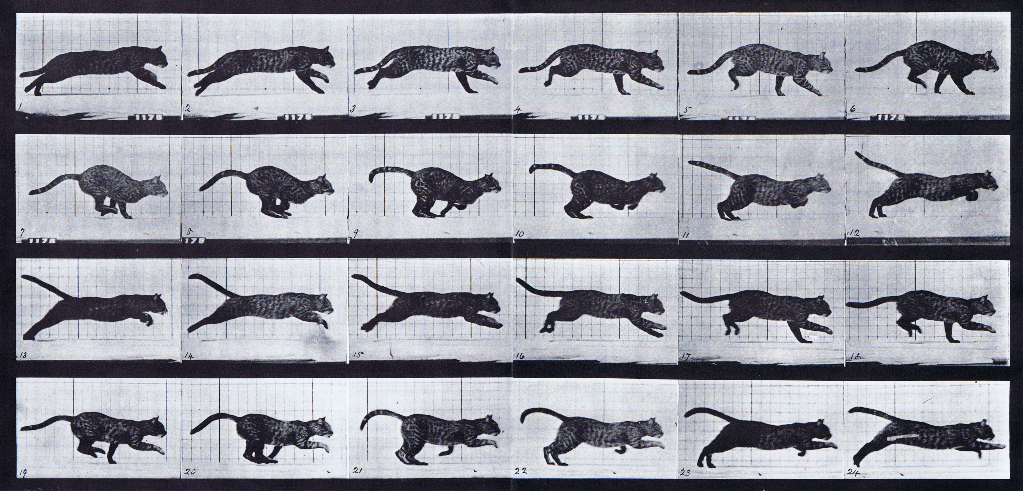
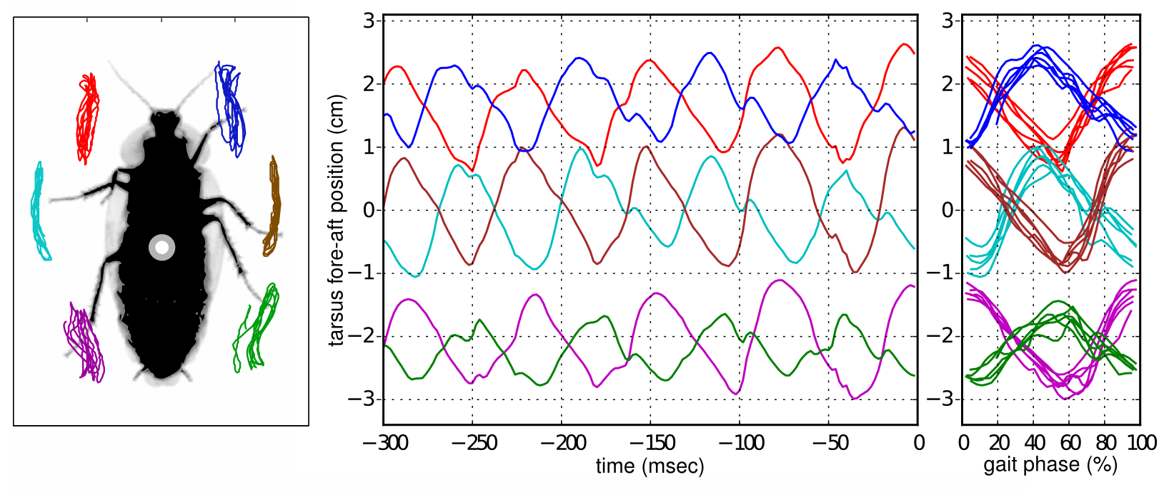
Two observations about terra-dynamics
parsimonious models are piecewise-defined
near-simultaneous footfalls are ubiquitous

Slide 27
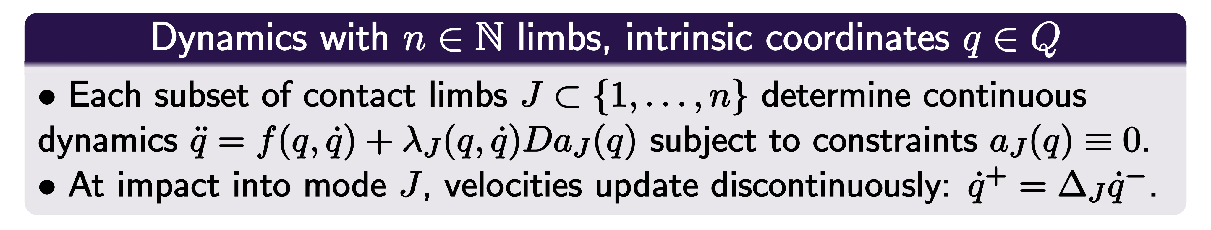


1. Parsimonious models are piecewise-defined
Muybridge 1887 (reprinted by Dover in 1957)
Johnson, Burden, Koditschek IJRR (in review, 2016)
A hybrid systems model for simple manipulation and self-manipulation systems

Slide 28
2. Near-simultaneous footfalls are ubiquitous

Slide 29
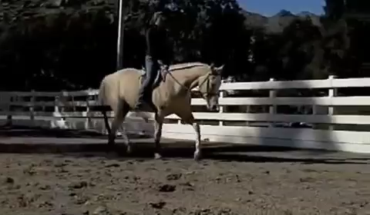
2. Near-simultaneous footfalls are ubiquitous

Slide 30
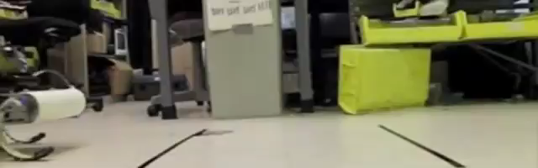

2. Near-simultaneous footfalls are ubiquitous
Galloway, Haynes, Ilhan, Johnson, Knopf, Lynch, Plotnick, White, Koditschek UPenn 2010
Hyun, Seok, Lee, Kim IJRR 2014

Slide 31
Two observations about terra-dynamics
parsimonious models are piecewise-defined
near-simultaneous footfalls are ubiquitous

Slide 32
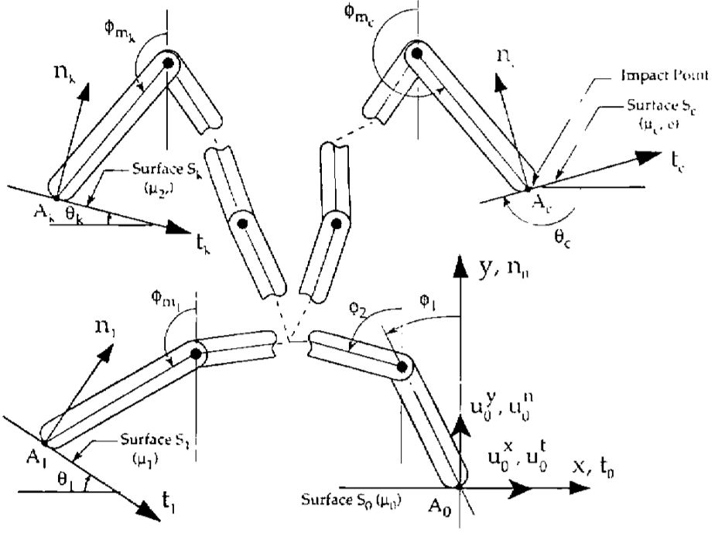
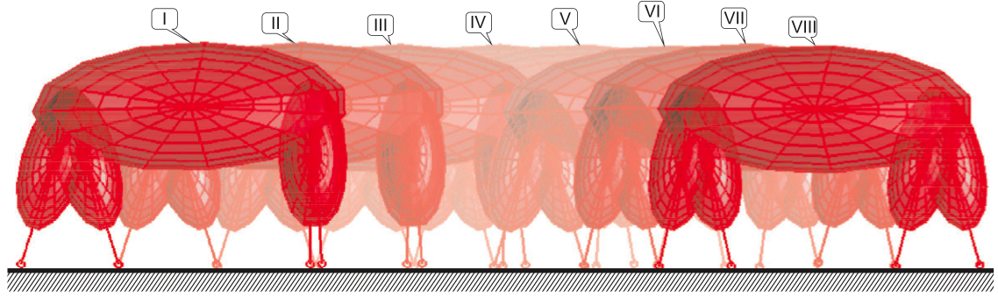
Inconsistencies arise when limbs are rigid
  Hand with rigid fingers exhibits 5 different post-grasp outcomes
Hürmüzlü and Marghitu IJRR 1994, JAM 1995
Rigid limbs yield inconsistent terra-dynamics
  Quadruped with rigid legs exhibits 3 distinct trot gaits
Remy, Buffington, Siegwart IJRR 2010

Slide 33
Rigid vs elastic limbs
rigid limbs
elastic limbs
Elastic limbs yield consistent terra-dynamics

Slide 34
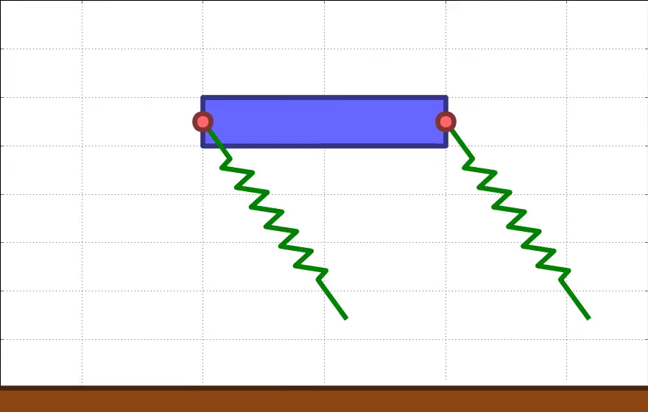

Slide 35
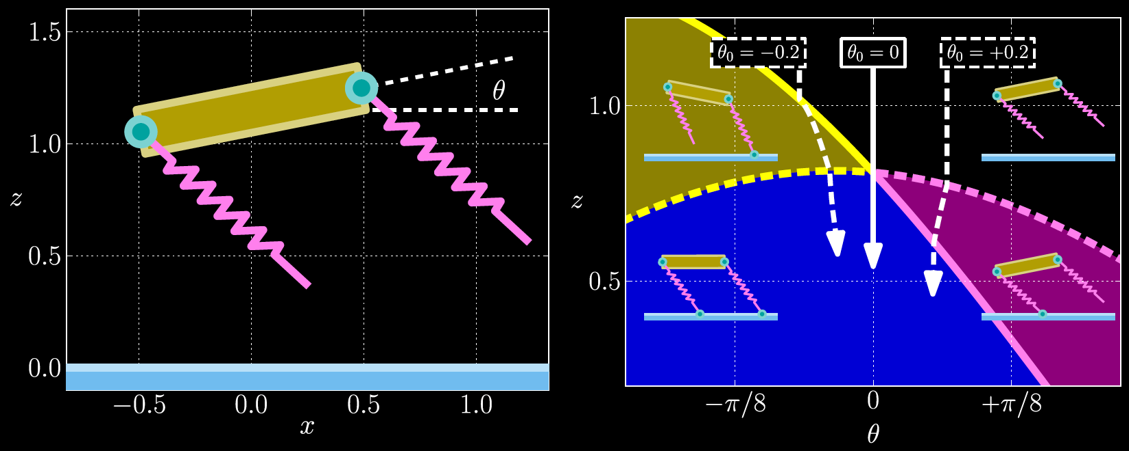
Consistent terra-dynamics

Slide 36
Consistent terra-dynamics
Novel passive stability mechanism

Slide 37
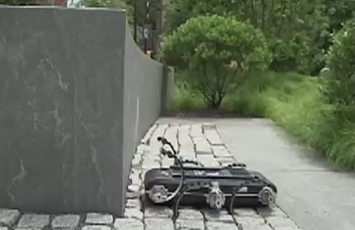
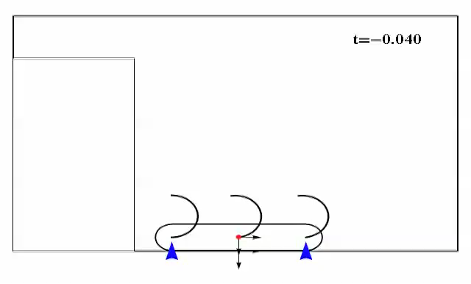
Application: automated maneuver synthesis
  state-of-the-art: dynamic maneuvers tuned via exhaustive experiments
  can pose gait / maneuver synthesis via optimization:
Johnson, Koditschek ICRA 2013
  mixed-integer program is generally intractable
consistent terra-dynamics enable scalable (nonsmooth) optimization algorithms

Slide 38
Today’s talk:
predictive dynamical models
for sensorimotor control
M, M⁻¹
internal models
terra-dynamics

Slide 39
Robotic teleoperation

Slide 40
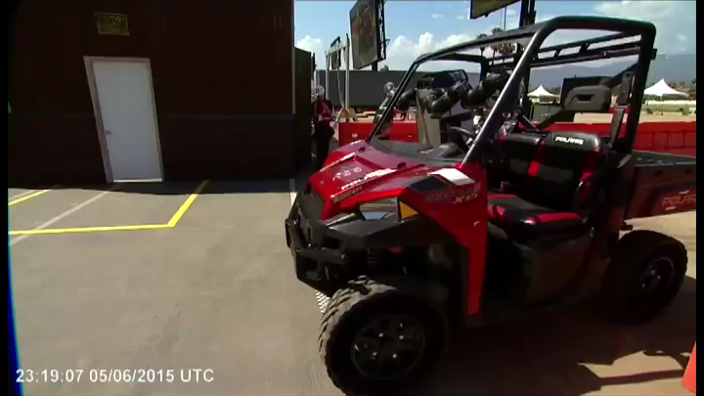

Slide 41
Robotic teleoperation
Future work:
dynamic tele-manipulation & tele-locomotion

Slide 42
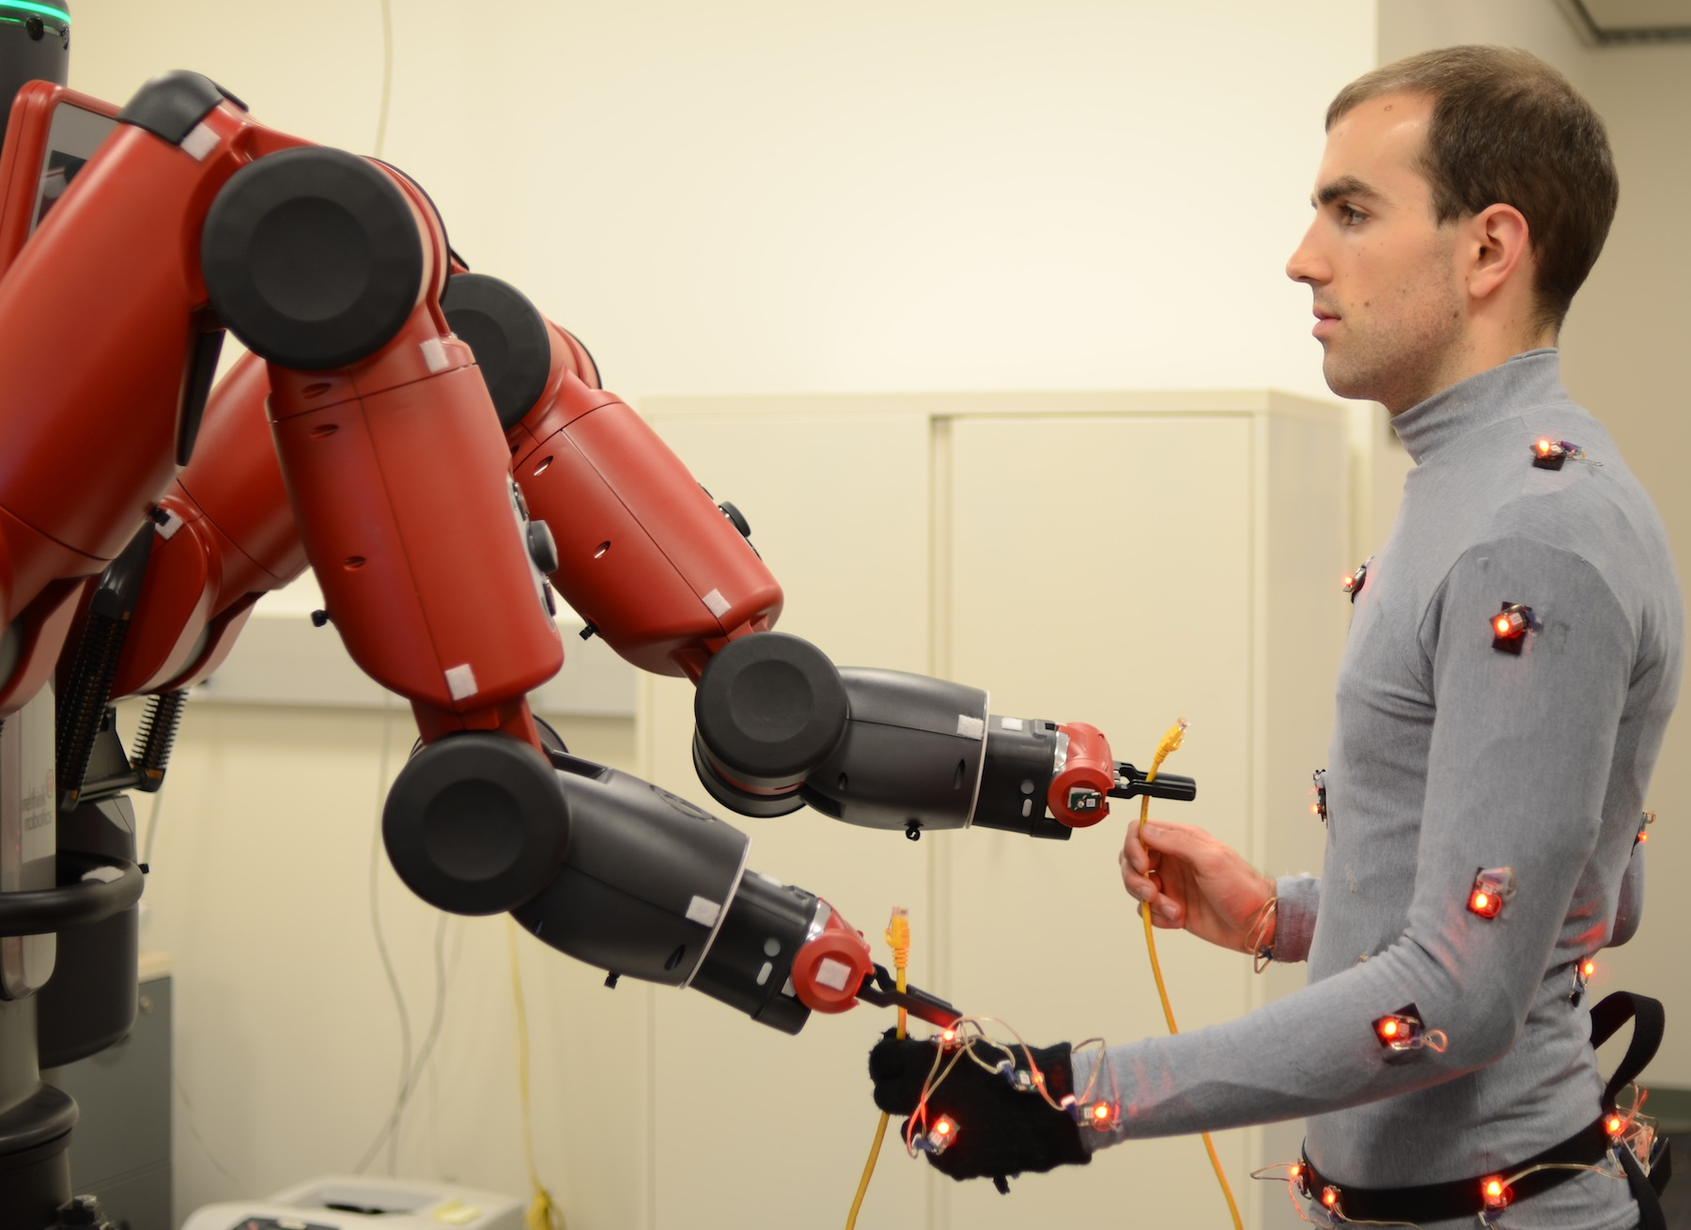




Human-robot collaboration
Future work:
provably-safe human-robot teams
  personalized models improve human-robot collaboration
Bestick, Burden, Willits, Naikal, Bajcsy, Sastry IROS 2015
Personalized kinematics for human-robot collaborative manipulation

Slide 43
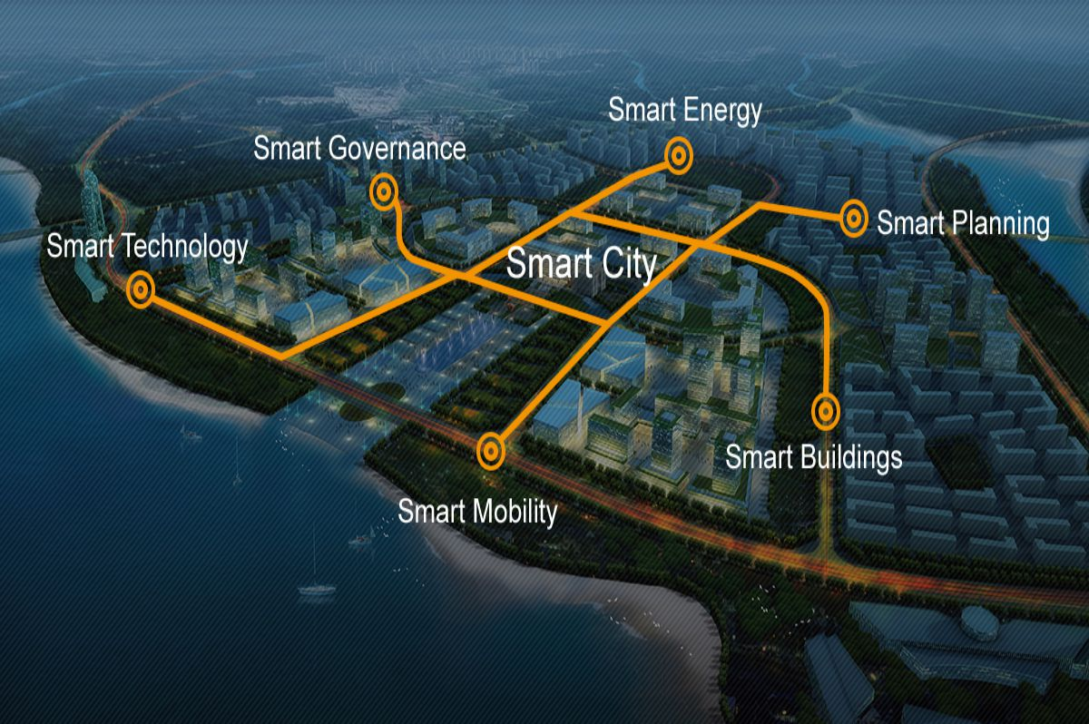
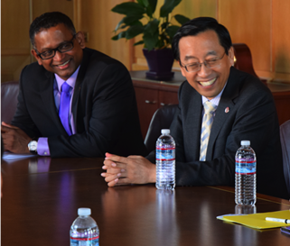


Safe semiautonomy in a Smart City
Future work:
monitor & maintain critical infrastructure

Slide 44
Human-Cyber-Physical Systems
Humans are the enabling technology

Slide 45







Ryan Robinson
Dexter Scobee
Aaron Bestick
Giorgia Willits
Nikhil Naikal
Support
Collaborators
Ruzena Bajcsy
Shankar Sastry
Aaron Johnson
Dan Koditschek
Shai Revzen

