Slide 1

Predictive dynamical models
for legged locomotion
Sam Burden
Assistant Professor
Electrical Engineering
University of Washington
Seattle, WA USA
http://faculty.uw.edu/sburden

Slide 2
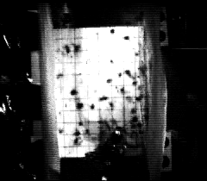
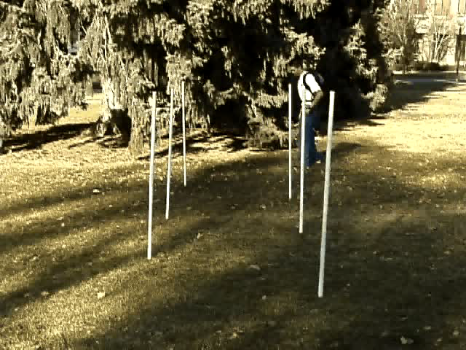
Jindrich, Full Journal of Experimental Biology 205(18):2803-2823 2002
Carrier, Walter, Lee Journal of Experimental Biology 204(22):3917-3926 2001
(how) can we predict experimental outcomes?
Notes:
As a dynamicist and control theorist, I find the kinds of perturbations and treatments employed by experimentalists fascinating.
I’ve spent my career modeling and controlling systems whose dynamics are poorly-understood; neuromechanics is a rich frontier for unmodeled dynamics.

Slide 3
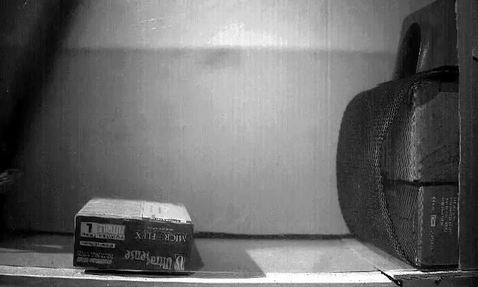
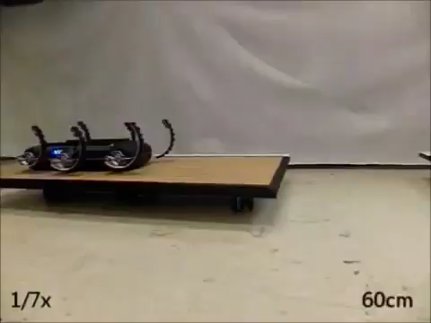
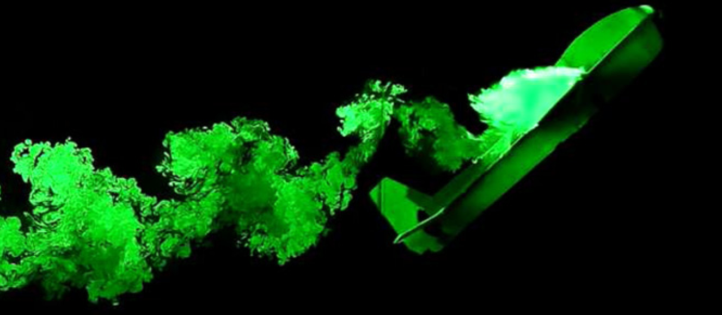
  locomotion through fluid governed by continuous hydro- and aero-dynamics
  locomotion on land governed by intermittent terra-dynamics
Vogel Life in moving fluids 1996
Li, Zhang, Goldman Science 2015
legged locomotion involves intermittent interaction
Tytell, Standen, Lauder JEB 2008
Cory, Moore, Tedrake B&B 2014
Libby, Moore, Chang-Siu, Cohen, Jusufi, Full Nature 2012
Johnson, Koditschek ICRA 2013

Slide 4
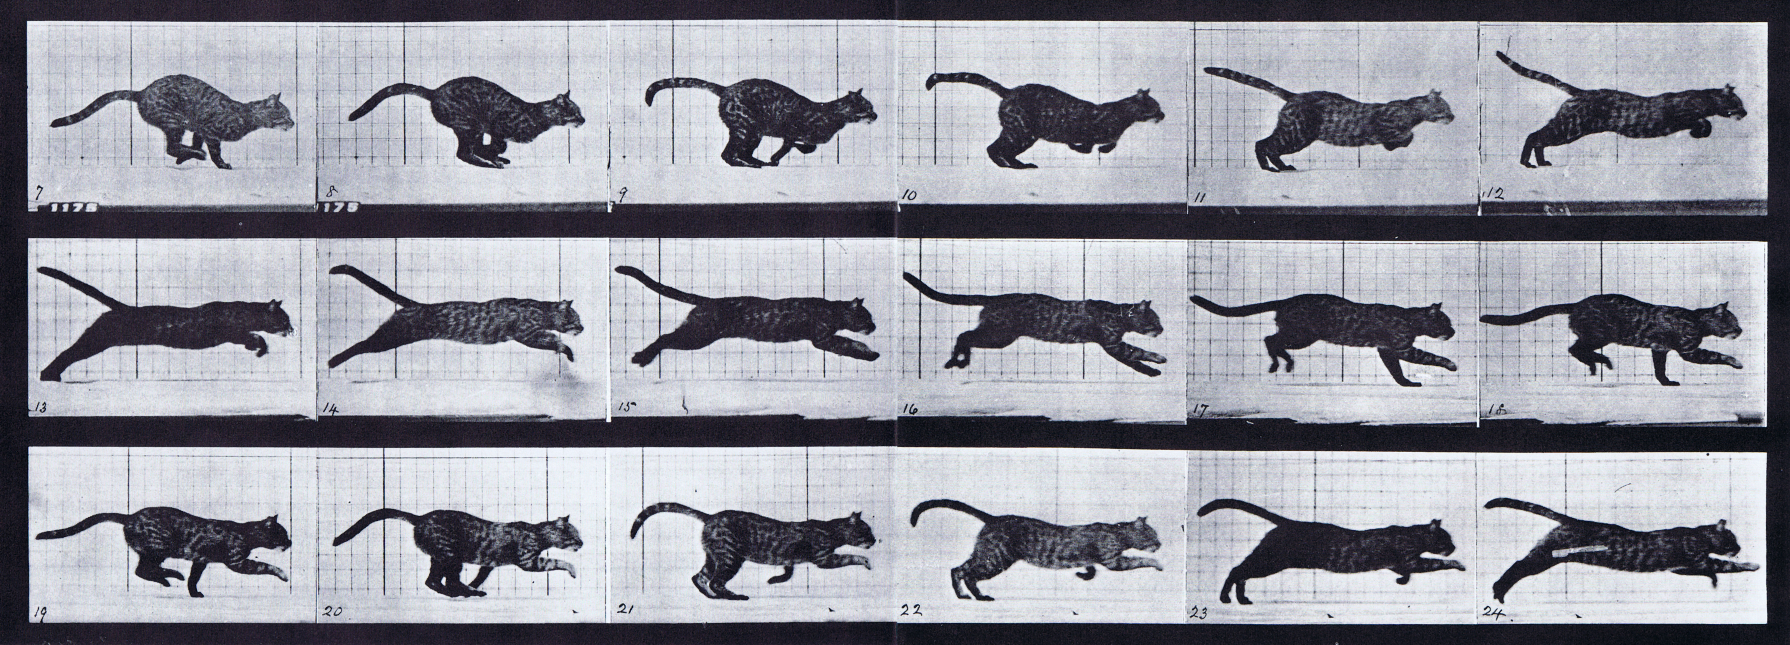
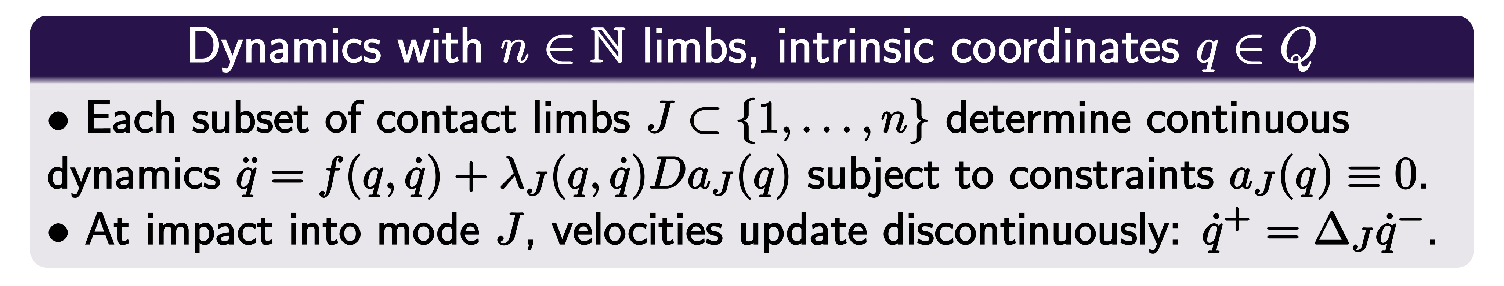


parsimonious models are piecewise-defined
Muybridge 1887 (reprinted by Dover in 1957)
Johnson, Burden, Koditschek IJRR (in review, 2016; arXiv:1502.01538)
A hybrid systems model for simple manipulation and self-manipulation systems

Slide 5
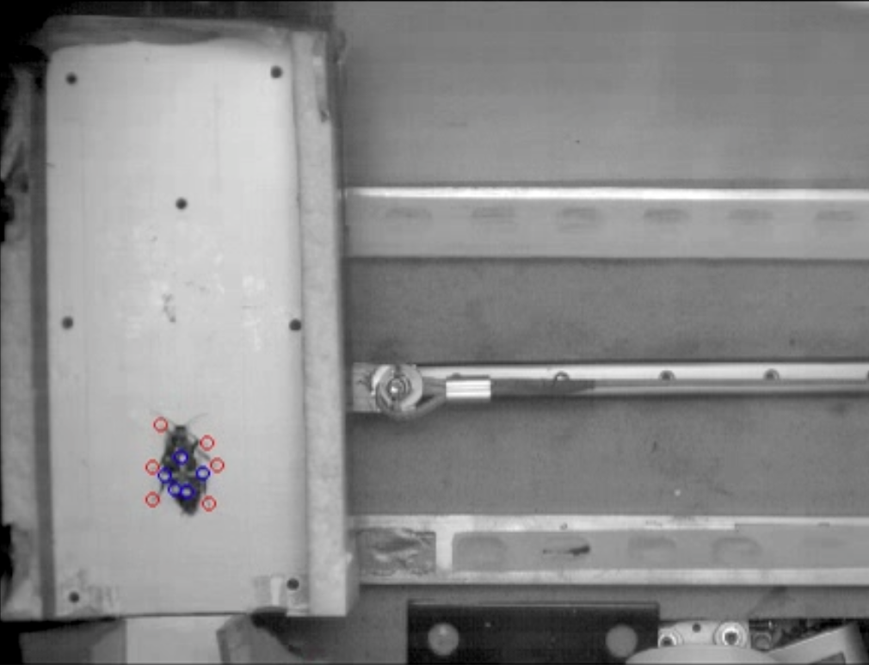
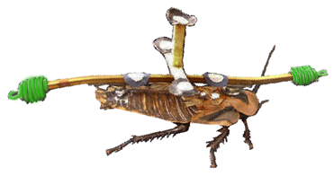
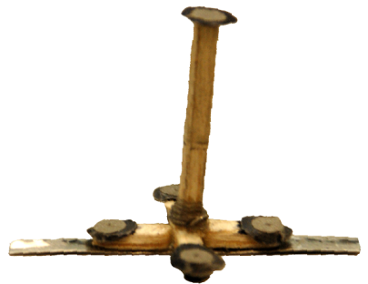
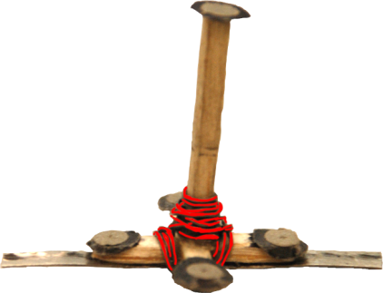
predictive dynamical models for legged locomotion
1. parsimoniously encode mechanisms
stabilization
reduction
2. generate testable hypotheses
treatments
perturbations

Slide 6
predictive dynamical models for legged locomotion
1. parsimoniously encode mechanisms
stabilization
reduction
2. generate testable hypotheses
treatments
perturbations

Slide 7
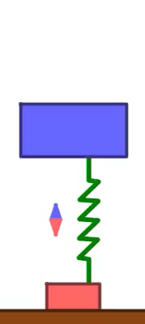

Slide 12


Theorem: periodic gaits of legged locomotors generically reduce dimension
Burden, Revzen, Sastry IEEE TAC 2015 (arXiv:1308.4158)
Model reduction near periodic orbits of hybrid dynamical systems

Slide 13
Interpretation: effect of ground contact constraint persists after liftoff
Burden, Revzen, Sastry IEEE TAC 2015 (arXiv:1308.4158)
Model reduction near periodic orbits of hybrid dynamical systems

Slide 14
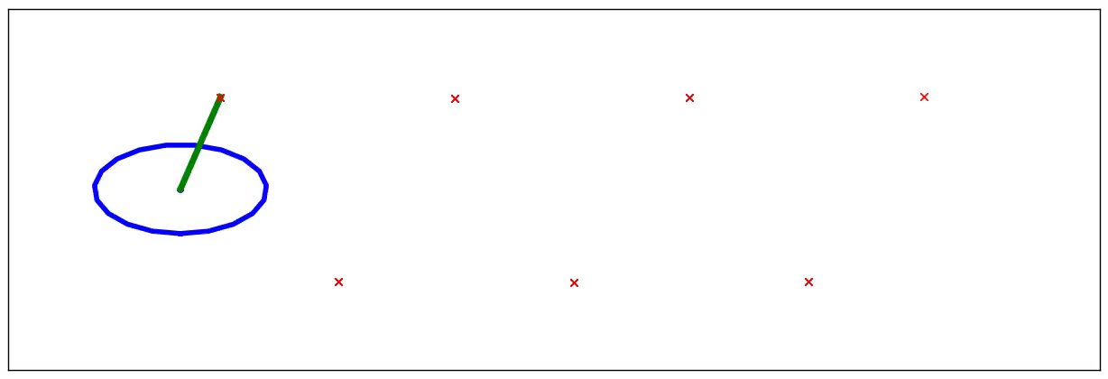
reduction
Application: n-leg polyped reduces to lateral leg-spring (LLS) after 1 stride
Burden, Revzen, Sastry IEEE TAC 2015 (arXiv:1308.4158)
Model reduction near periodic orbits of hybrid dynamical systems

Slide 15
predictive dynamical models for legged locomotion
1. parsimoniously encode mechanisms
stabilization
reduction
2. generate testable hypotheses
treatments
perturbations

Slide 16
predictive dynamical models for legged locomotion
1. parsimoniously encode mechanisms
stabilization
reduction
2. generate testable hypotheses
treatments
perturbations

Slide 17
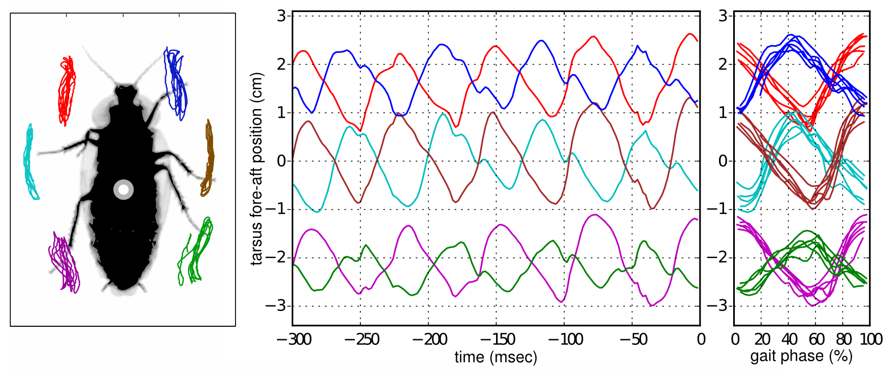
near-simultaneous footfalls are ubiquitous

Slide 18
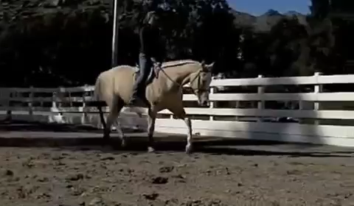
near-simultaneous footfalls are ubiquitous

Slide 19
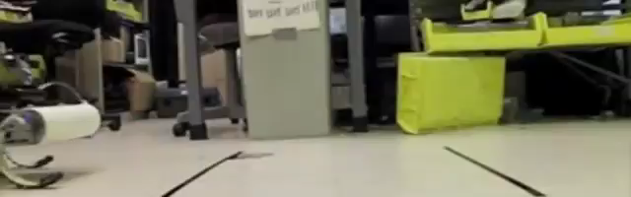

near-simultaneous footfalls are ubiquitous
Galloway, Haynes, Ilhan, Johnson, Knopf, Lynch, Plotnick, White, Koditschek UPenn 2010
Hyun, Seok, Lee, Kim IJRR 2014

Slide 20
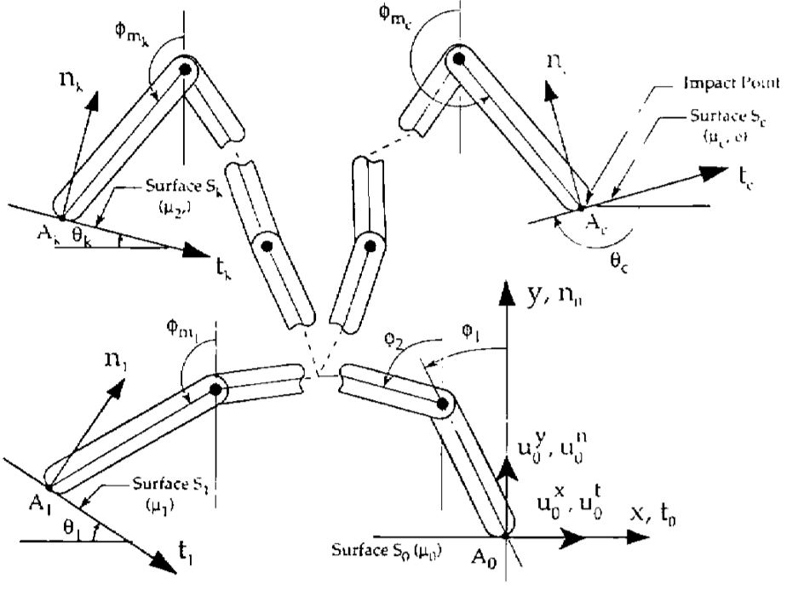
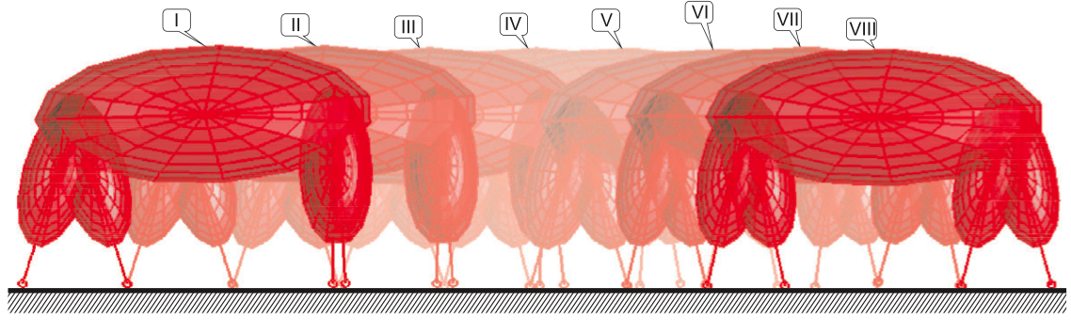
inconsistencies arise when limbs are rigid
  hand with rigid fingers exhibits 5 different post-grasp outcomes
Hürmüzlü and Marghitu IJRR 1994, JAM 1995
rigid limbs yield inconsistent terra-dynamics
  quadruped with rigid legs exhibits 3 distinct trot gaits
Remy, Buffington, Siegwart IJRR 2010

Slide 21
rigid vs elastic limbs
rigid limbs
elastic limbs
elastic limbs yield consistent terra-dynamics

Slide 22
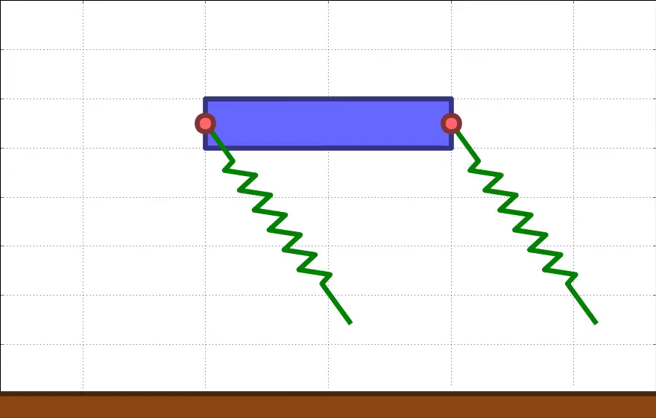

Slide 23
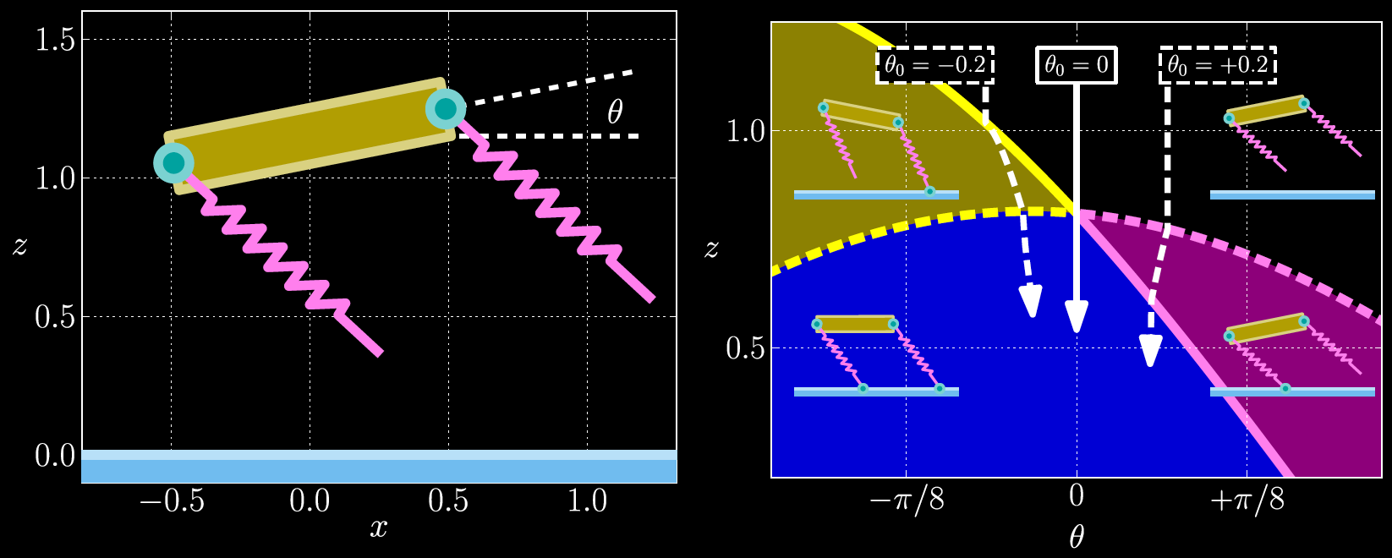
stabilization
Theorem: near-simultaneous footfalls passively stabilize rotations (e.g. pitch)
Burden, Sastry, Koditschek, Revzen SIADS (in review, 2016; arXiv:1407.1775)
Event-Selected Vector Field Discontinuities Yield Piecewise-Differentiable Flows

Slide 24
predictive dynamical models for legged locomotion
1. parsimoniously encode mechanisms
stabilization
reduction
2. generate testable hypotheses
treatments
perturbations

Slide 25
predictive dynamical models for legged locomotion
1. parsimoniously encode mechanisms
stabilization
reduction
2. generate testable hypotheses
treatments
perturbations

Slide 26
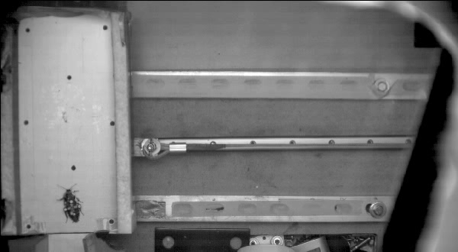
real-time

Slide 27
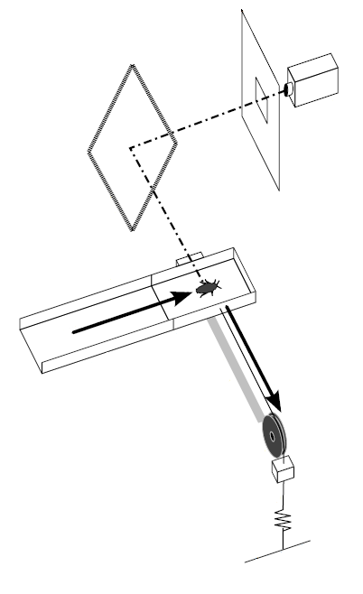
lateral perturbation experimental setup
platform accelerates laterally at 0.6 ± 0.1 g in a 0.1 sec interval providing a 50 ± 3 cm/sec specific impulse, then maintains velocity.
camera
diffuser
mirror
magnetic lock
cockroach running speed:
36 ± 8 cm/sec
stride frequency:
12.6 ± 2.9 Hz
(~80ms per stride)
animal motion
cart
trackway
cart motion
pulley
rail
mass
cable
elastic
ground
Revzen, Burden, Moore, Mongeau, Full Biological Cybernetics 107(2):179-200 2013

Slide 28
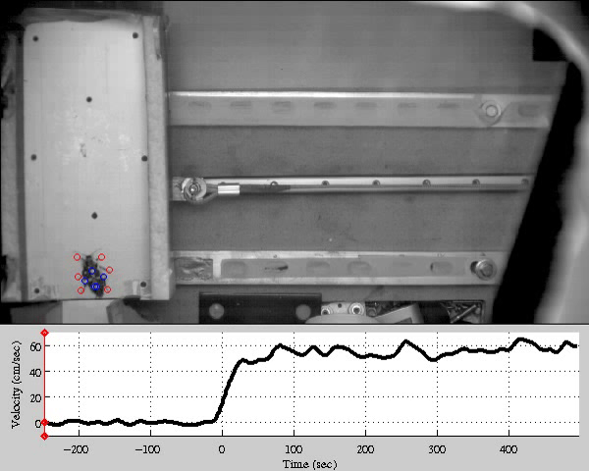
20x

Slide 29
measurements:
position, orientation of body
distal position of foot (tarsi)
position of cart in lab frame

Slide 30

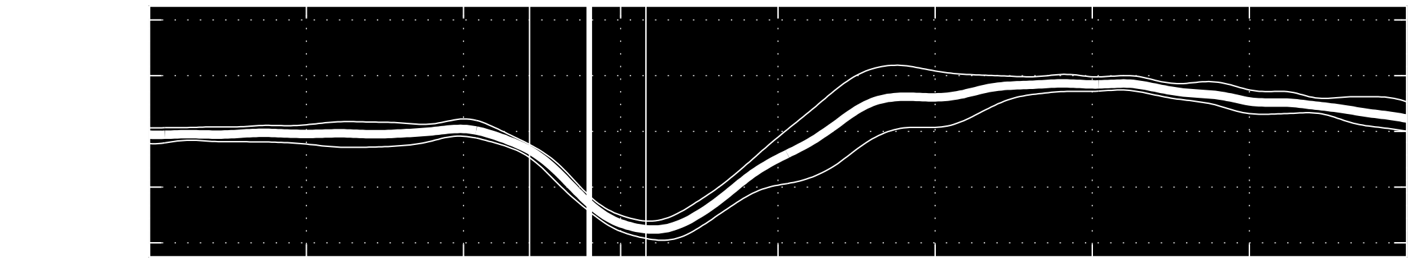
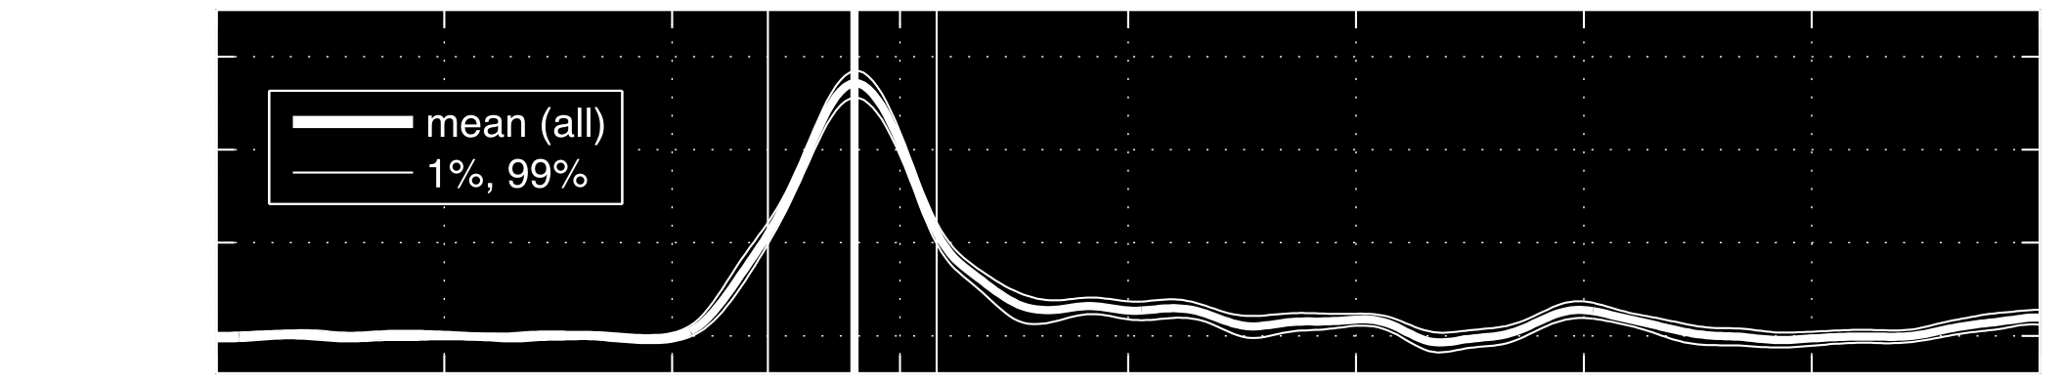



frequency change
constant frequency
neural feedback occurs at a delay;
how does feedback alter recovery?
real-time
Revzen, Burden, Moore, Mongeau, Full Bio. Cyber. 2013
Instantaneous kinematic phase reflects neuromechanical response to lateral perturbations of running cockroaches

Slide 31
(how) can we predict experimental outcomes?
cart acceleration induces equal & opposite animal acceleration
perturbations
treatments

Slide 32
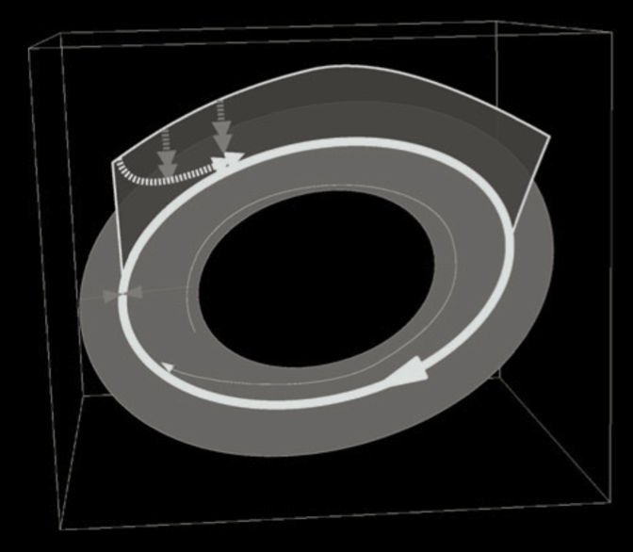
models of dynamic legged locomotion
data-driven
analytical
1.0
Perturbation remaining per stride
0.8
Animal
Less Stable
0.6
0.4
More Stable
0.2
0
0.5
1
1.5
2
Nondimensional Moment of Inertia
Revzen & Guckenheimer
J. Royal Society Interface 9(70) 2012
Full, Kubow, Schmitt, Holmes, Koditschek Integ and Comp Bio 42(1) 2002

Slide 33
perturbing data-driven model
?
perturbations
treatments
Revzen, Guckenheimer J. Roy. Soc. Int. 2012
Revzen, Guckenheimer Phys. Rev. E 2008
Notes:
For example the previous empirical results are a simple data-driven model. In that model we estimate a phase statistic so that phase then becomes your predictor. So in this picture at any point along the periodic behavior we get a distribution of animal state.

Slide 34
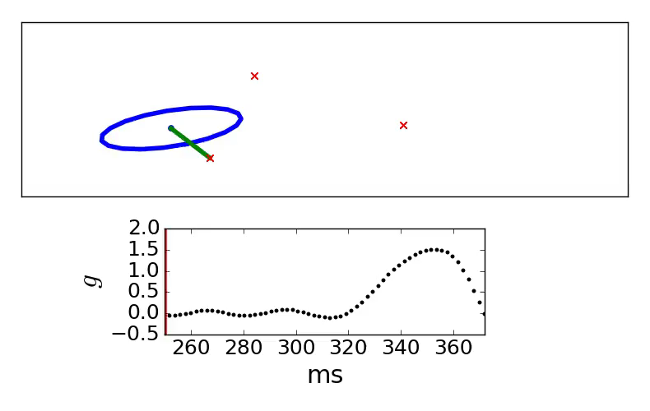
perturbing analytical model
experimental perturbation overwhelms LLS
Notes:
Limitation of simple analytical models: predictions become invalid away from steady-state behavior
LLS made to steady-state periodic locomotion. The perturbation takes the model into a regime where we cant even keep simulating.
We tried to make this model work with minor alterations, but with no success the experimental perturbation overwhelms the model.

Slide 35
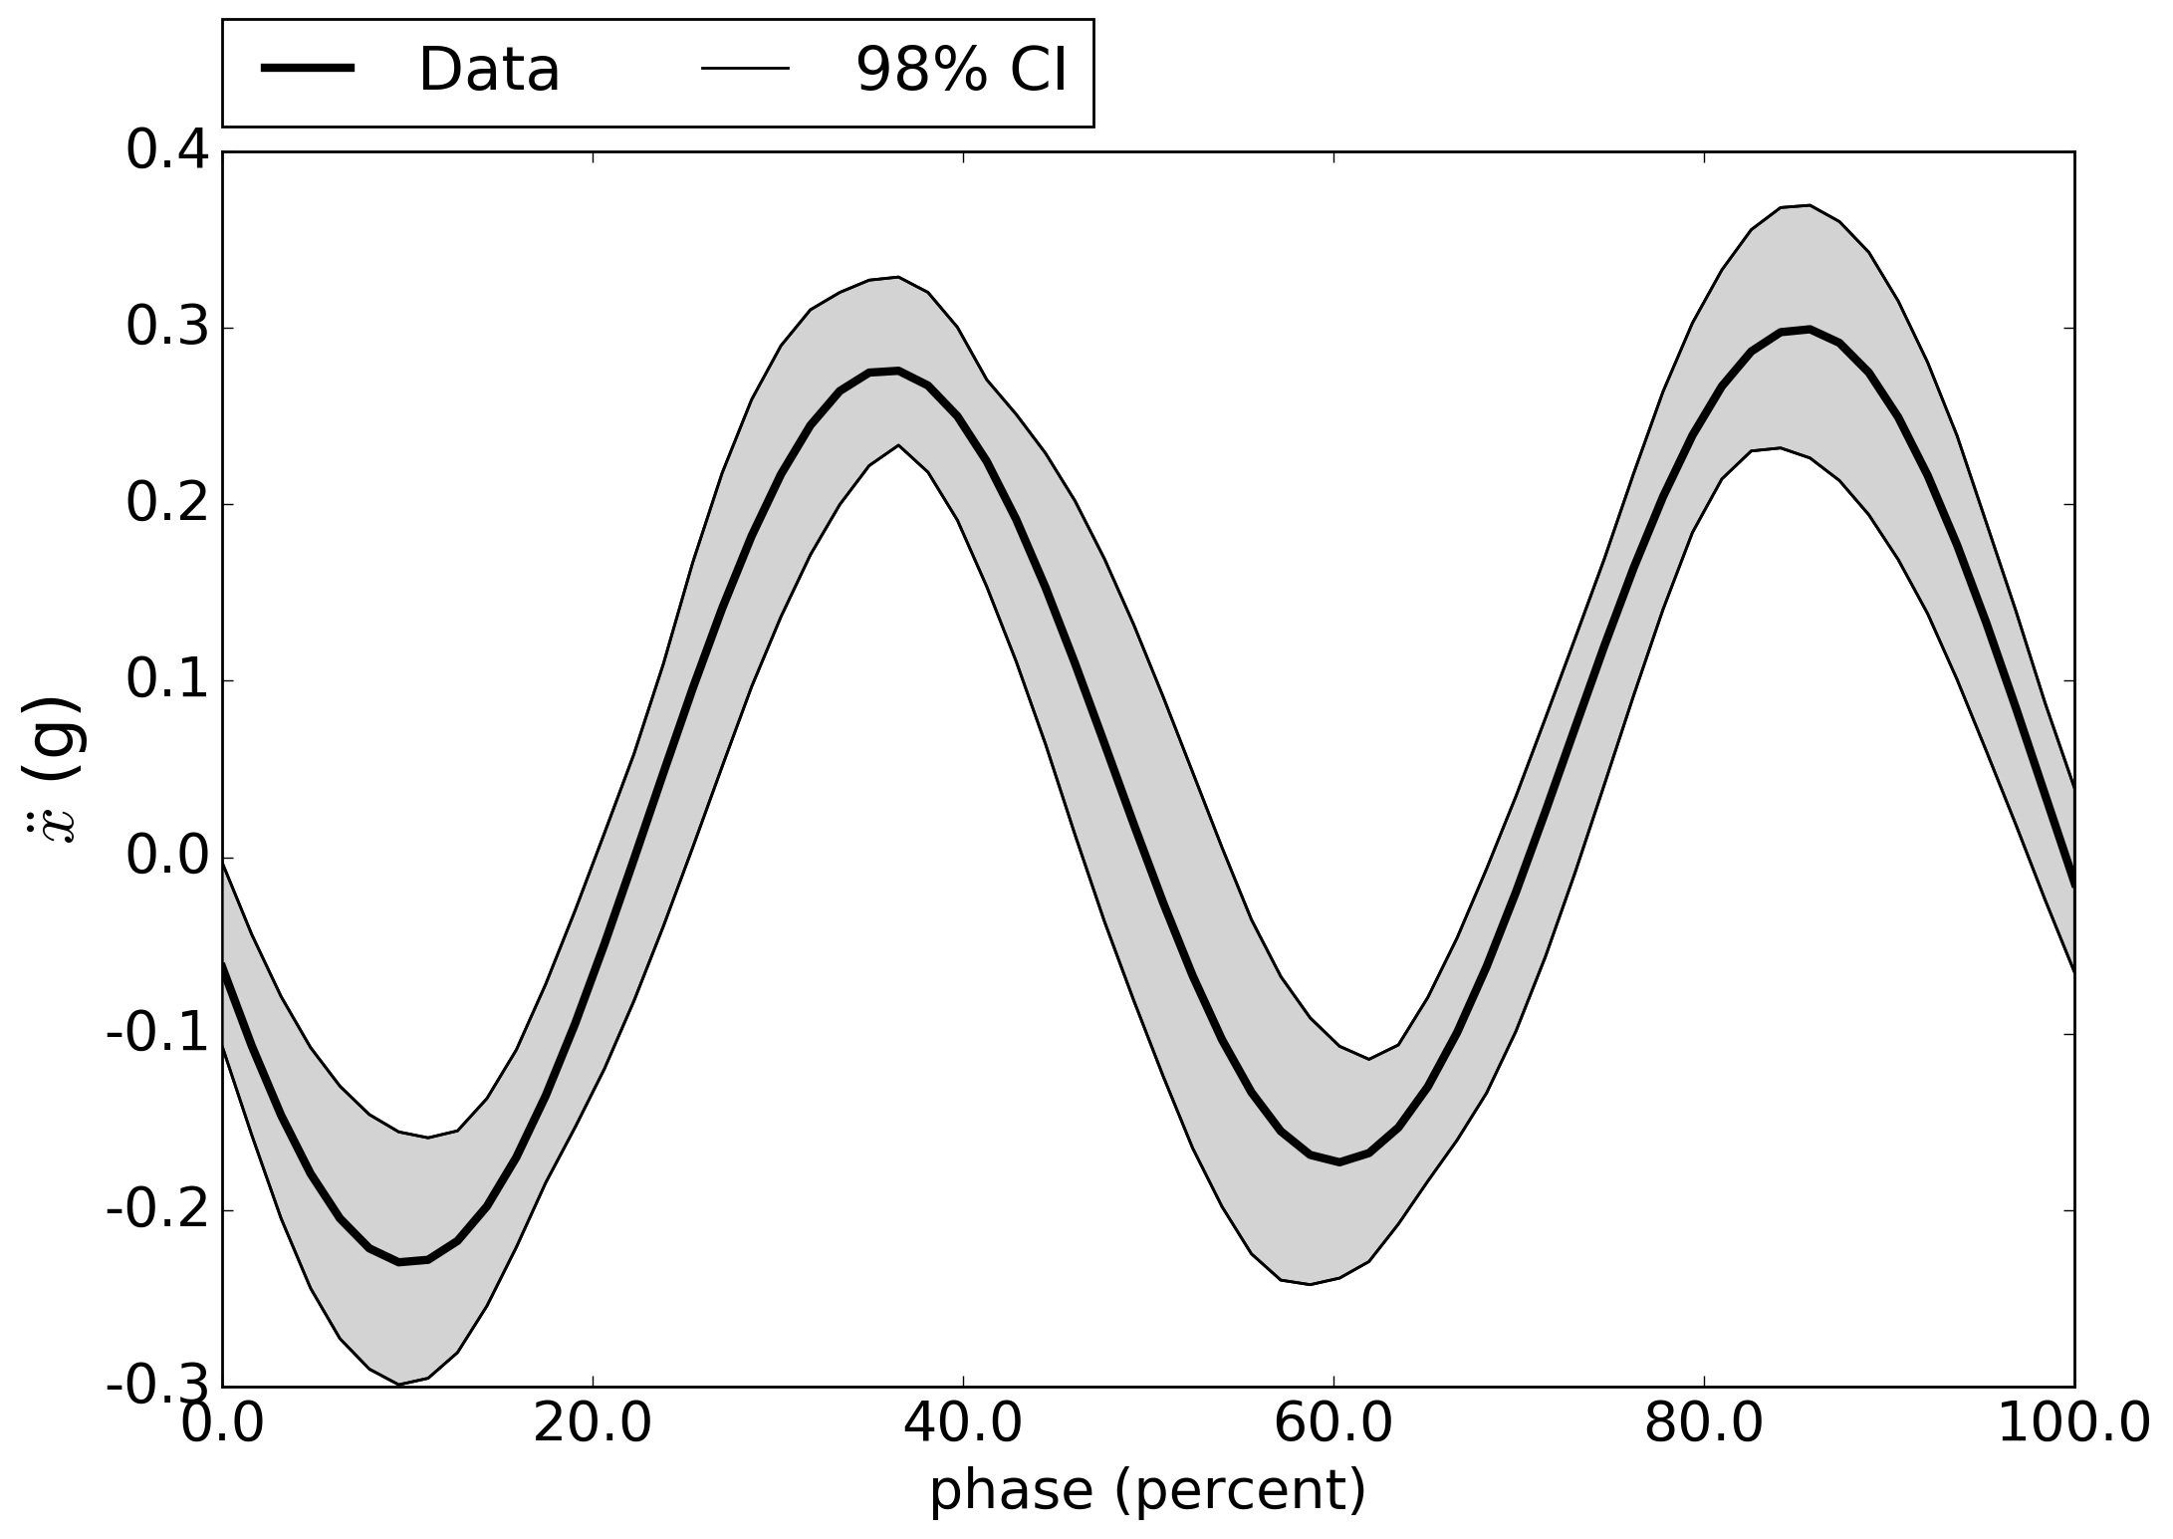
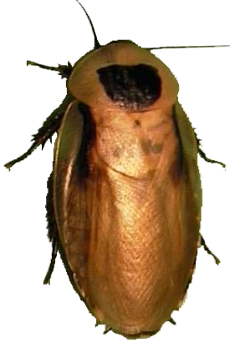
fore-aft acceleration

Slide 36
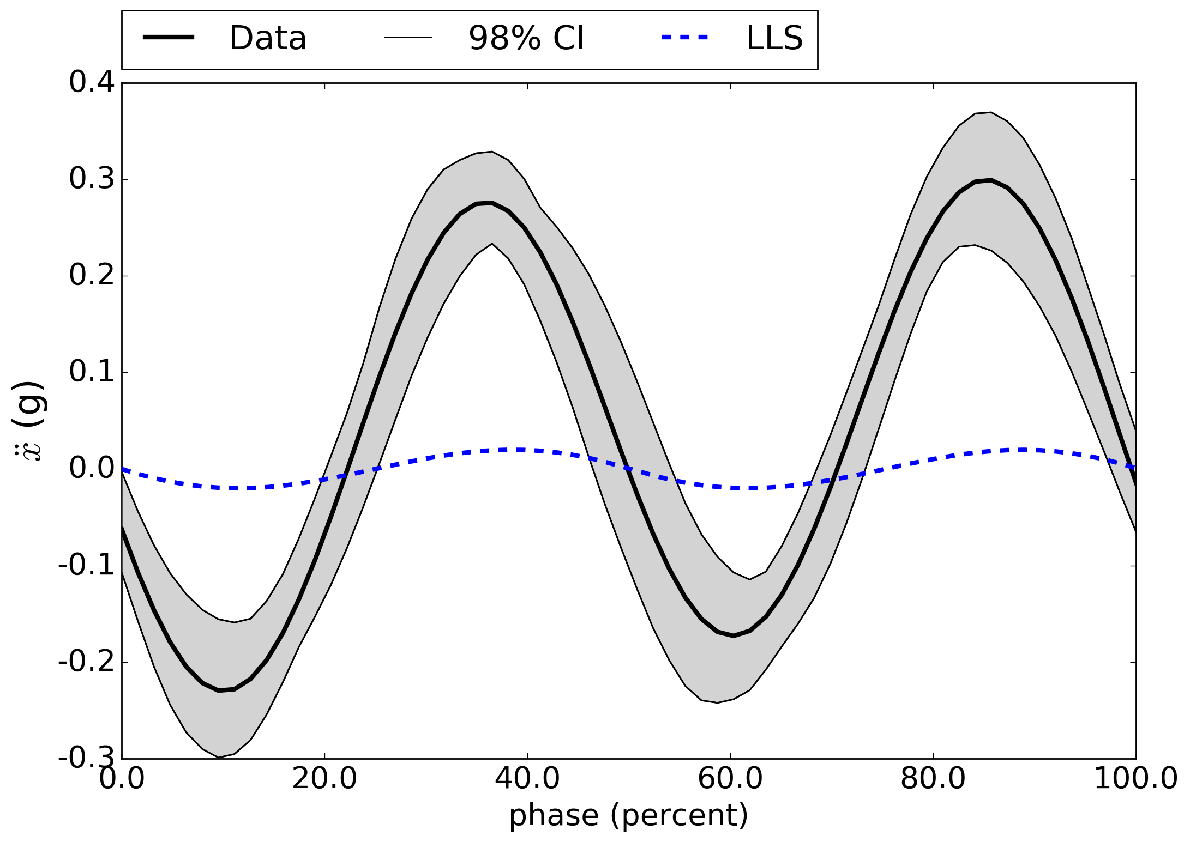
fore-aft acceleration
LLS predicts phasing, not magnitude

Slide 37
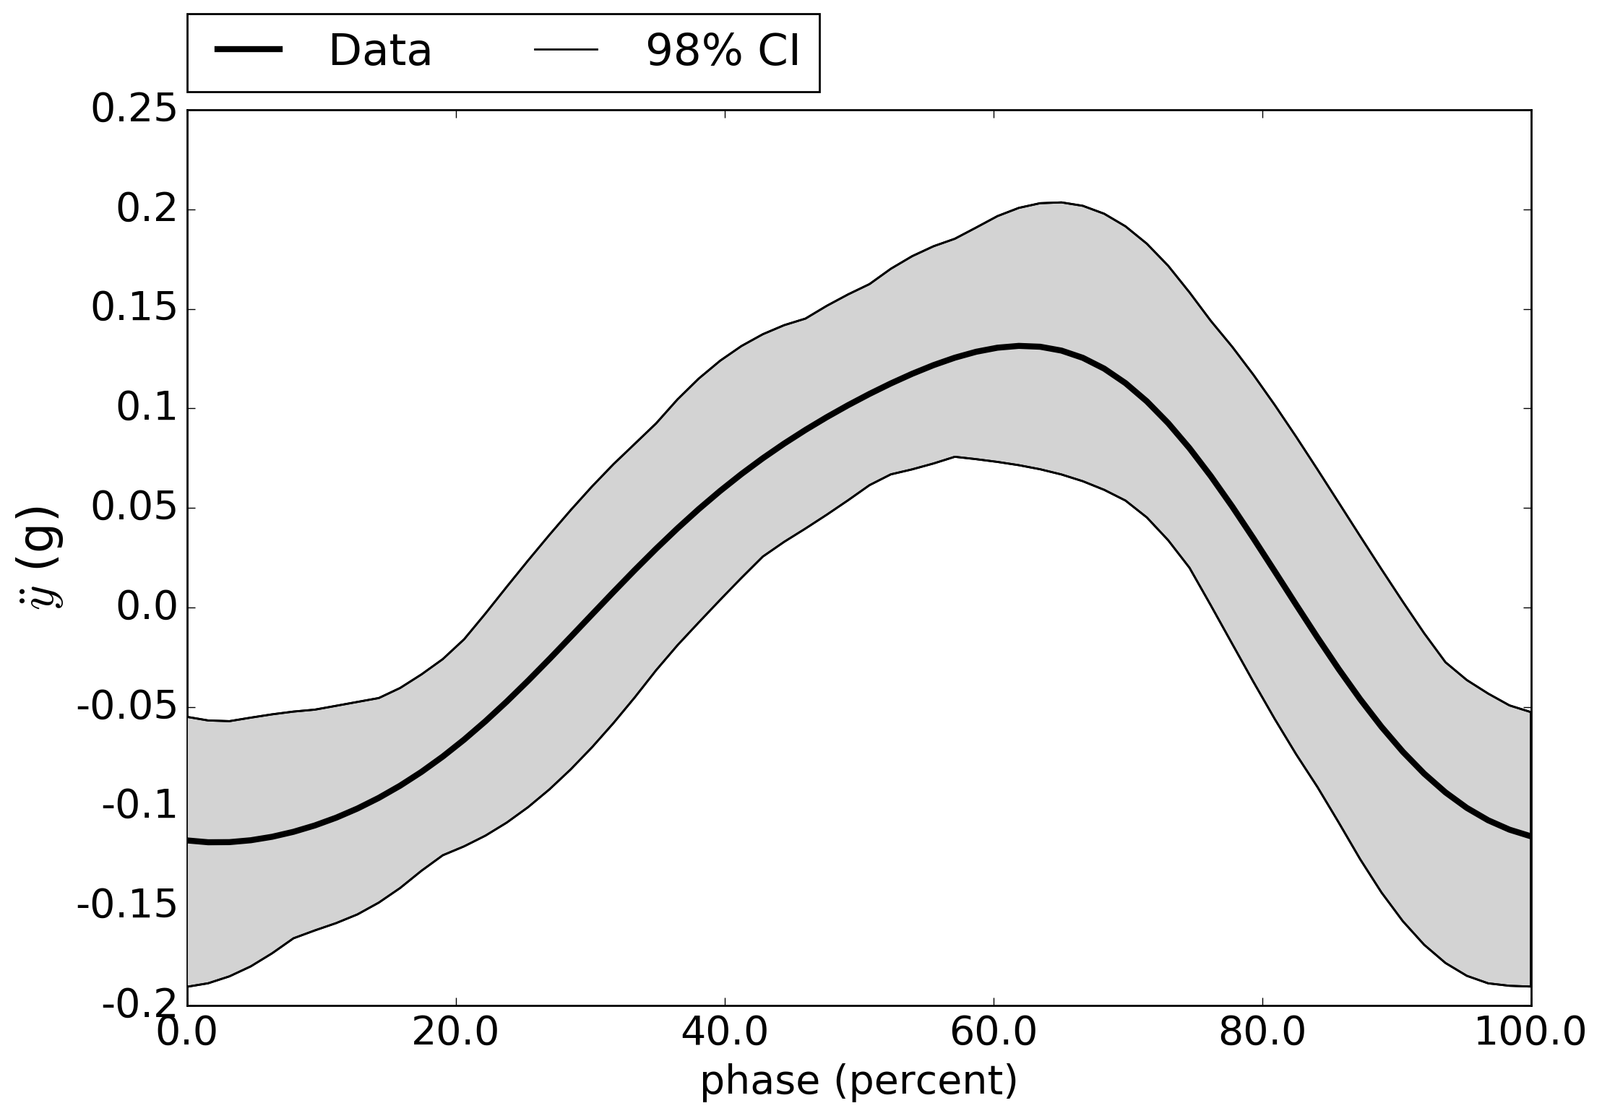
lateral acceleration

Slide 38
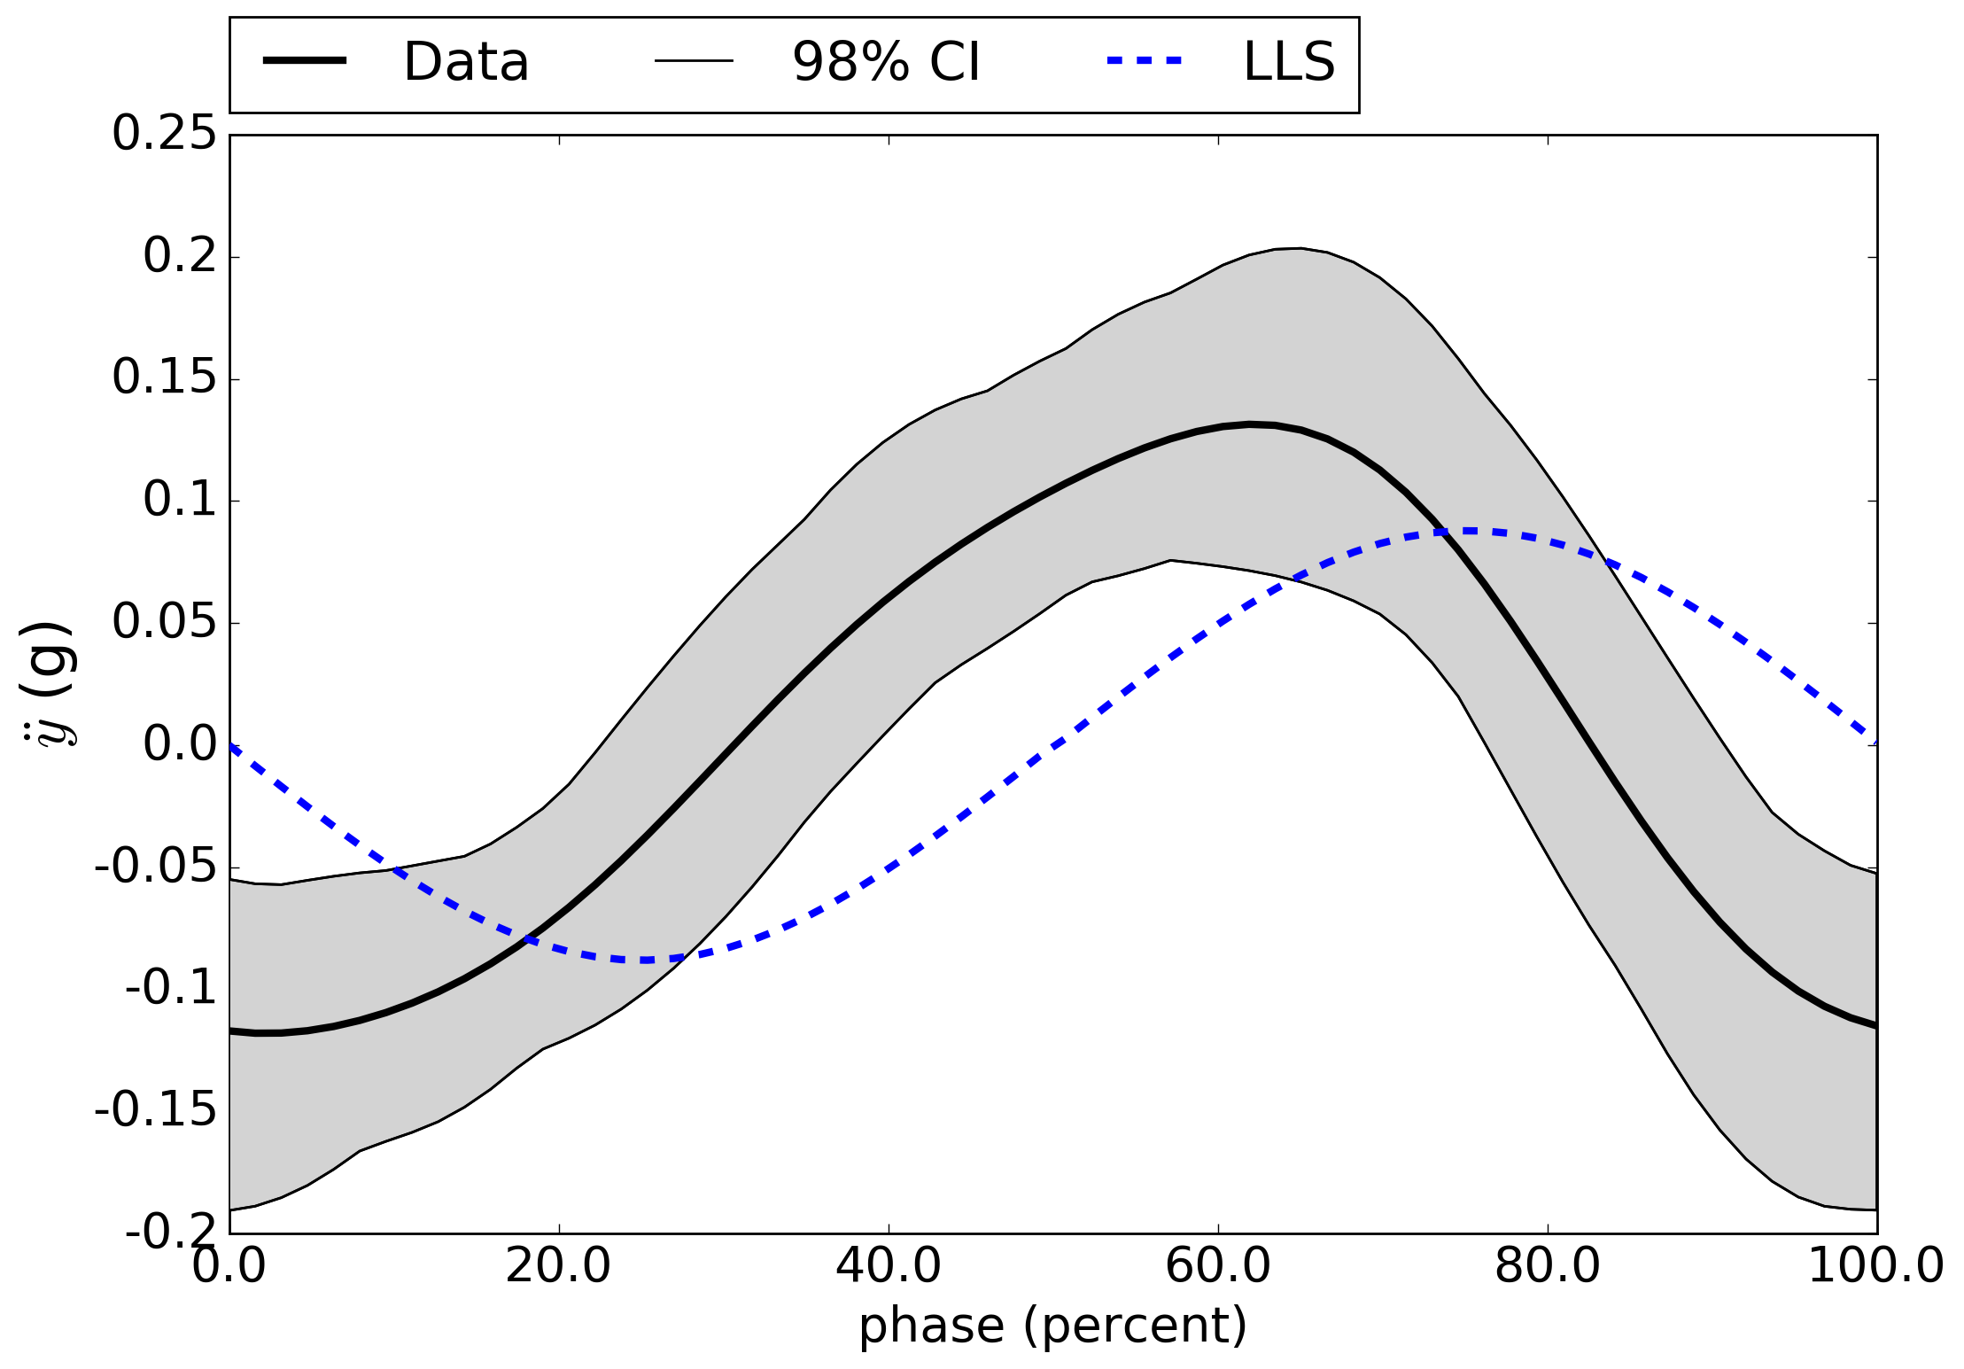
lateral acceleration
non-zero acceleration at step transition

Slide 39
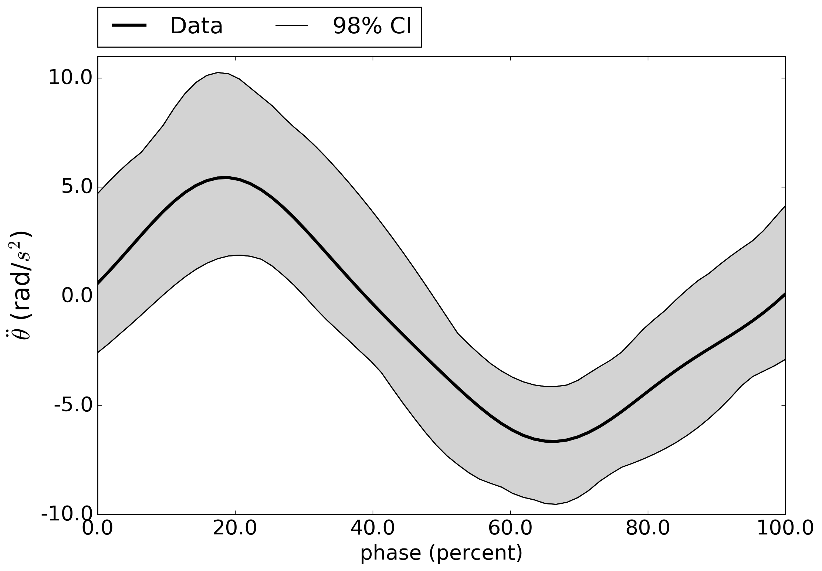
angular acceleration

Slide 40
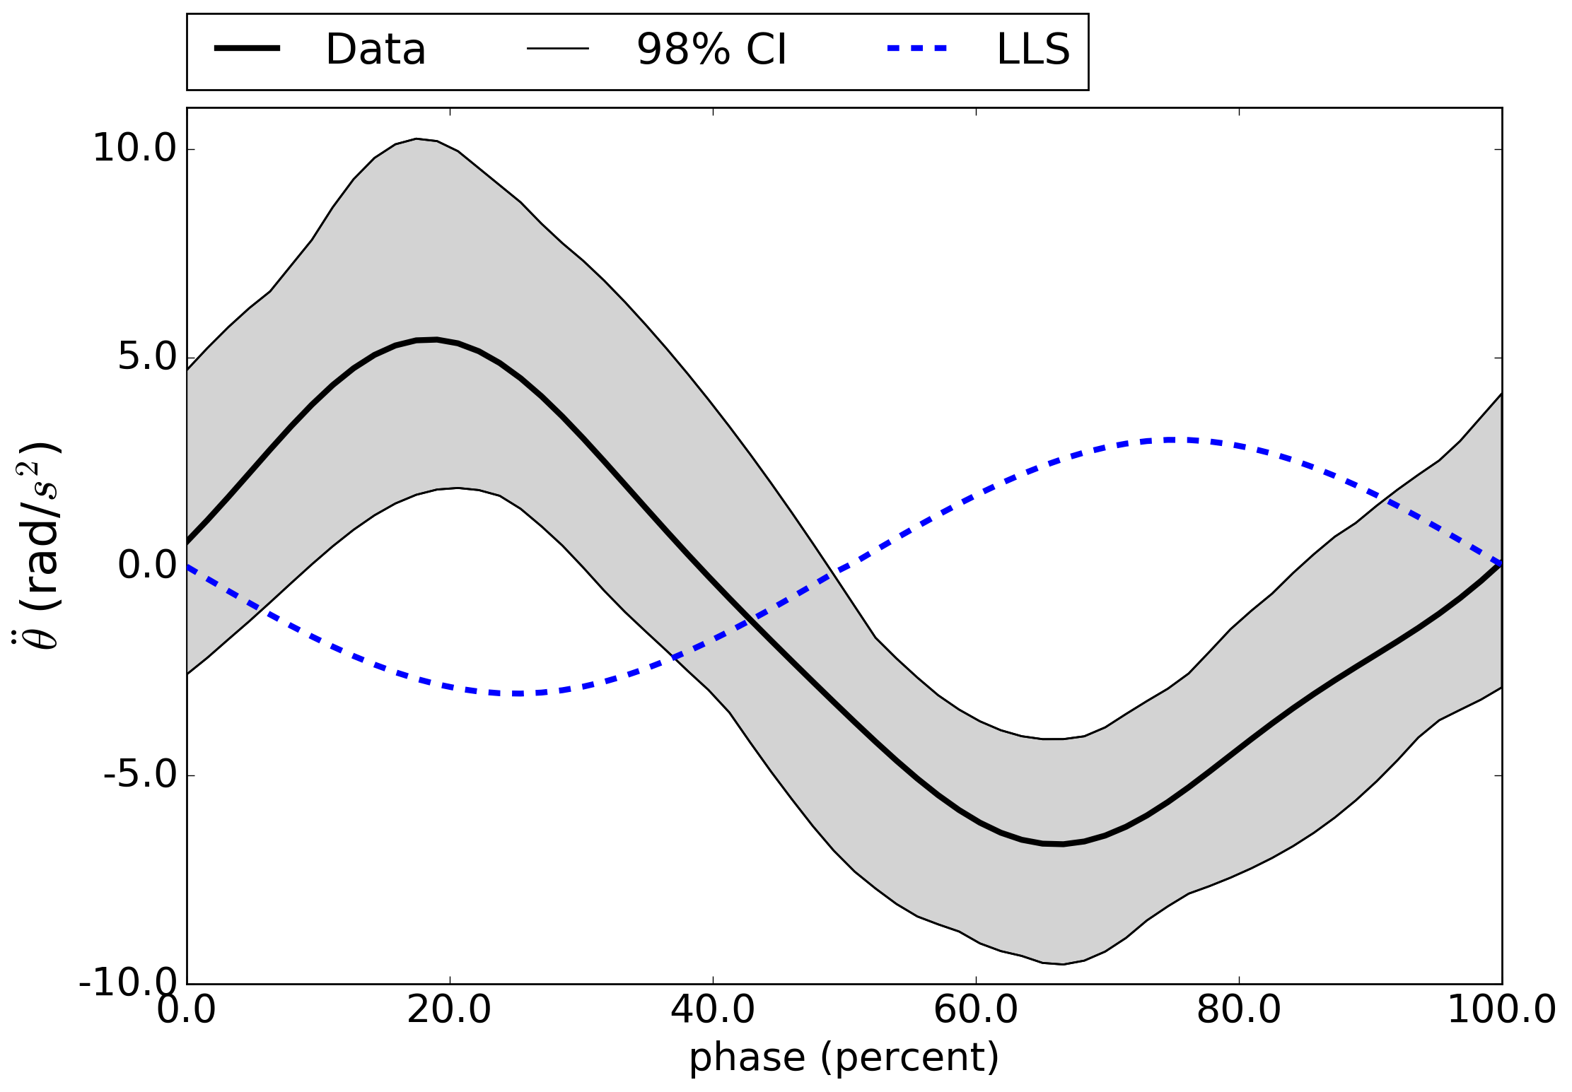
angular acceleration
LLS is anti-phase with data

Slide 41
Hypothesis: body acceleration determined
by pose relative to stance tripod

Slide 42
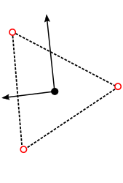
proposed model structure
body state comprised of:
  forward position
  lateral position
  body orientation
body acceleration arises from spring-like potential

Slide 43
introducing perturbations and treatments
  forward position
  lateral position
  body orientation
body acceleration influenced by
  perturbation (e.g. lateral acceleration a(t) )
  treatment (e.g. inertia distribution M )

Slide 44
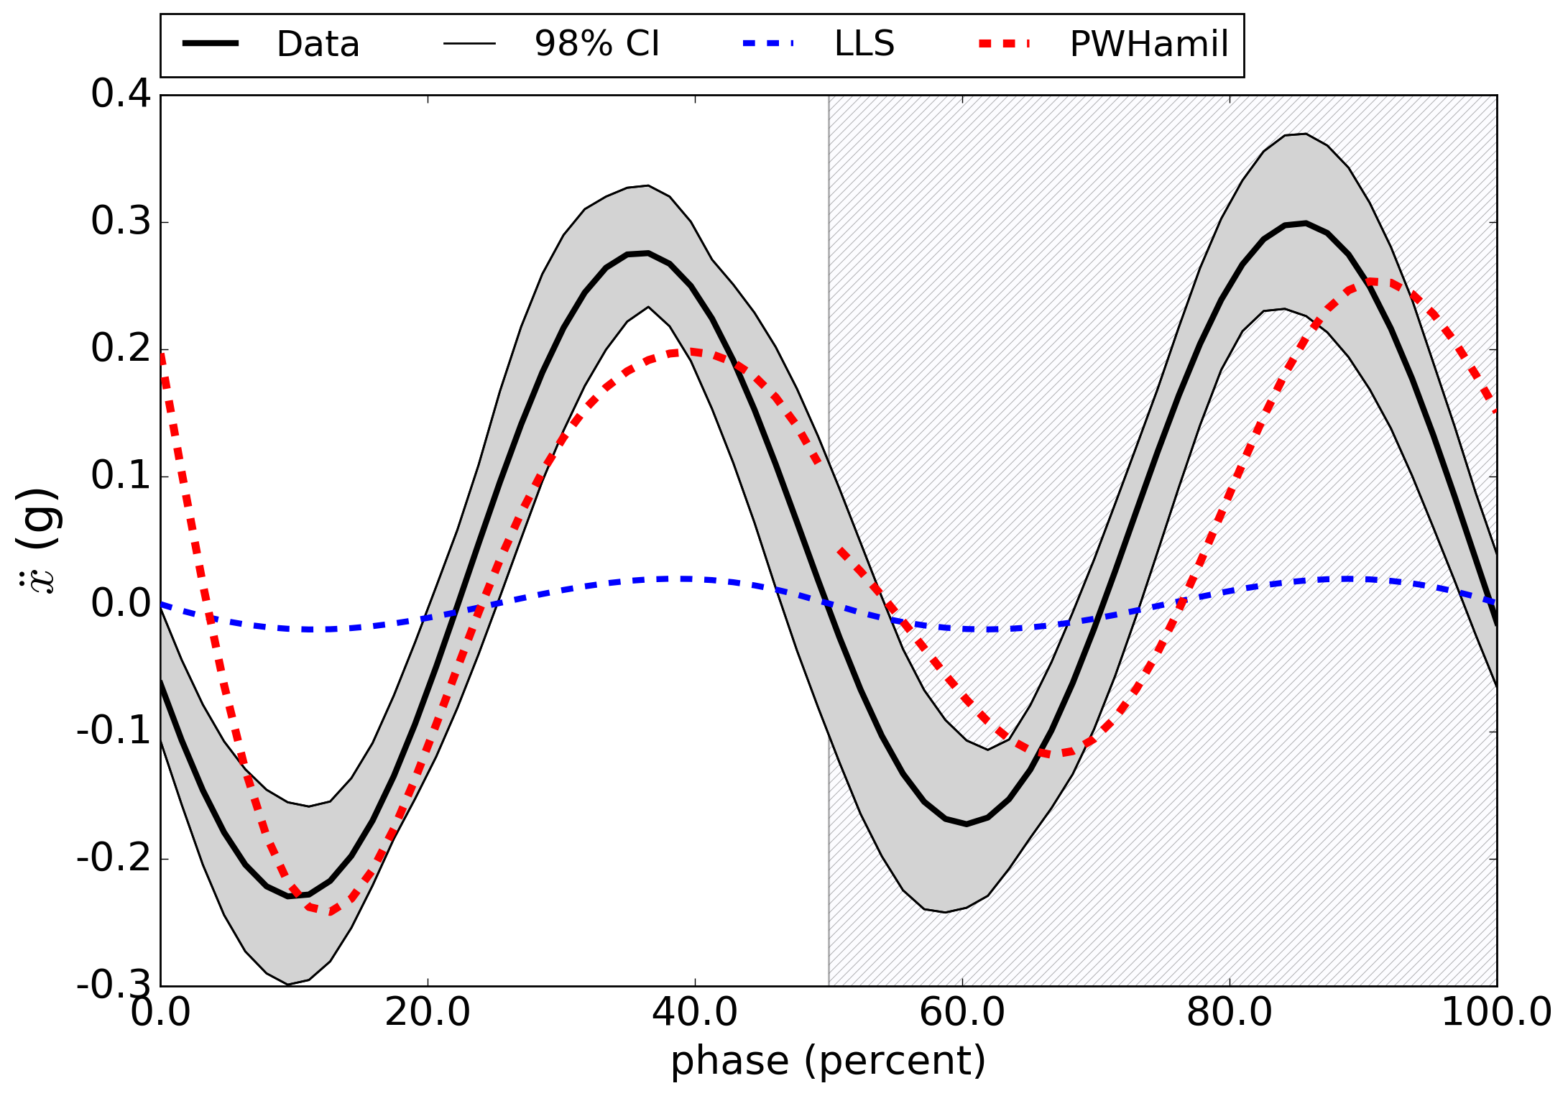
fore-aft acceleration
continuity not enforced at step transition

Slide 45
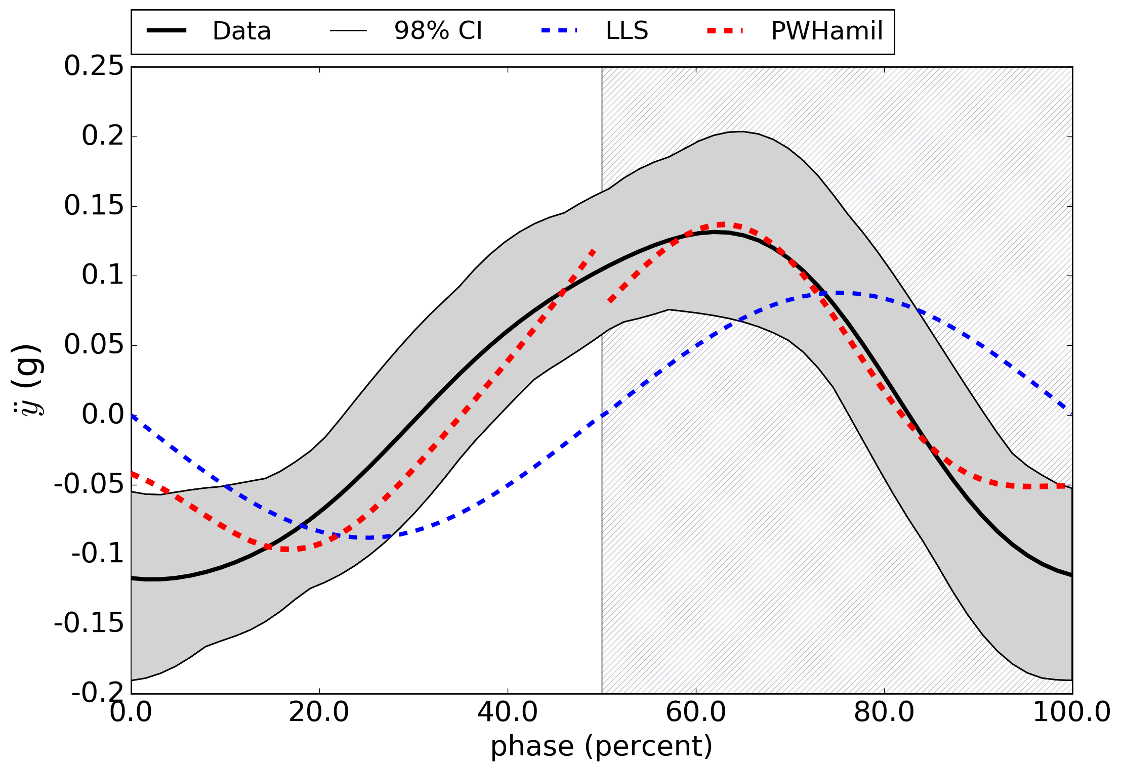
lateral acceleration
non-zero acceleration at step transition

Slide 46
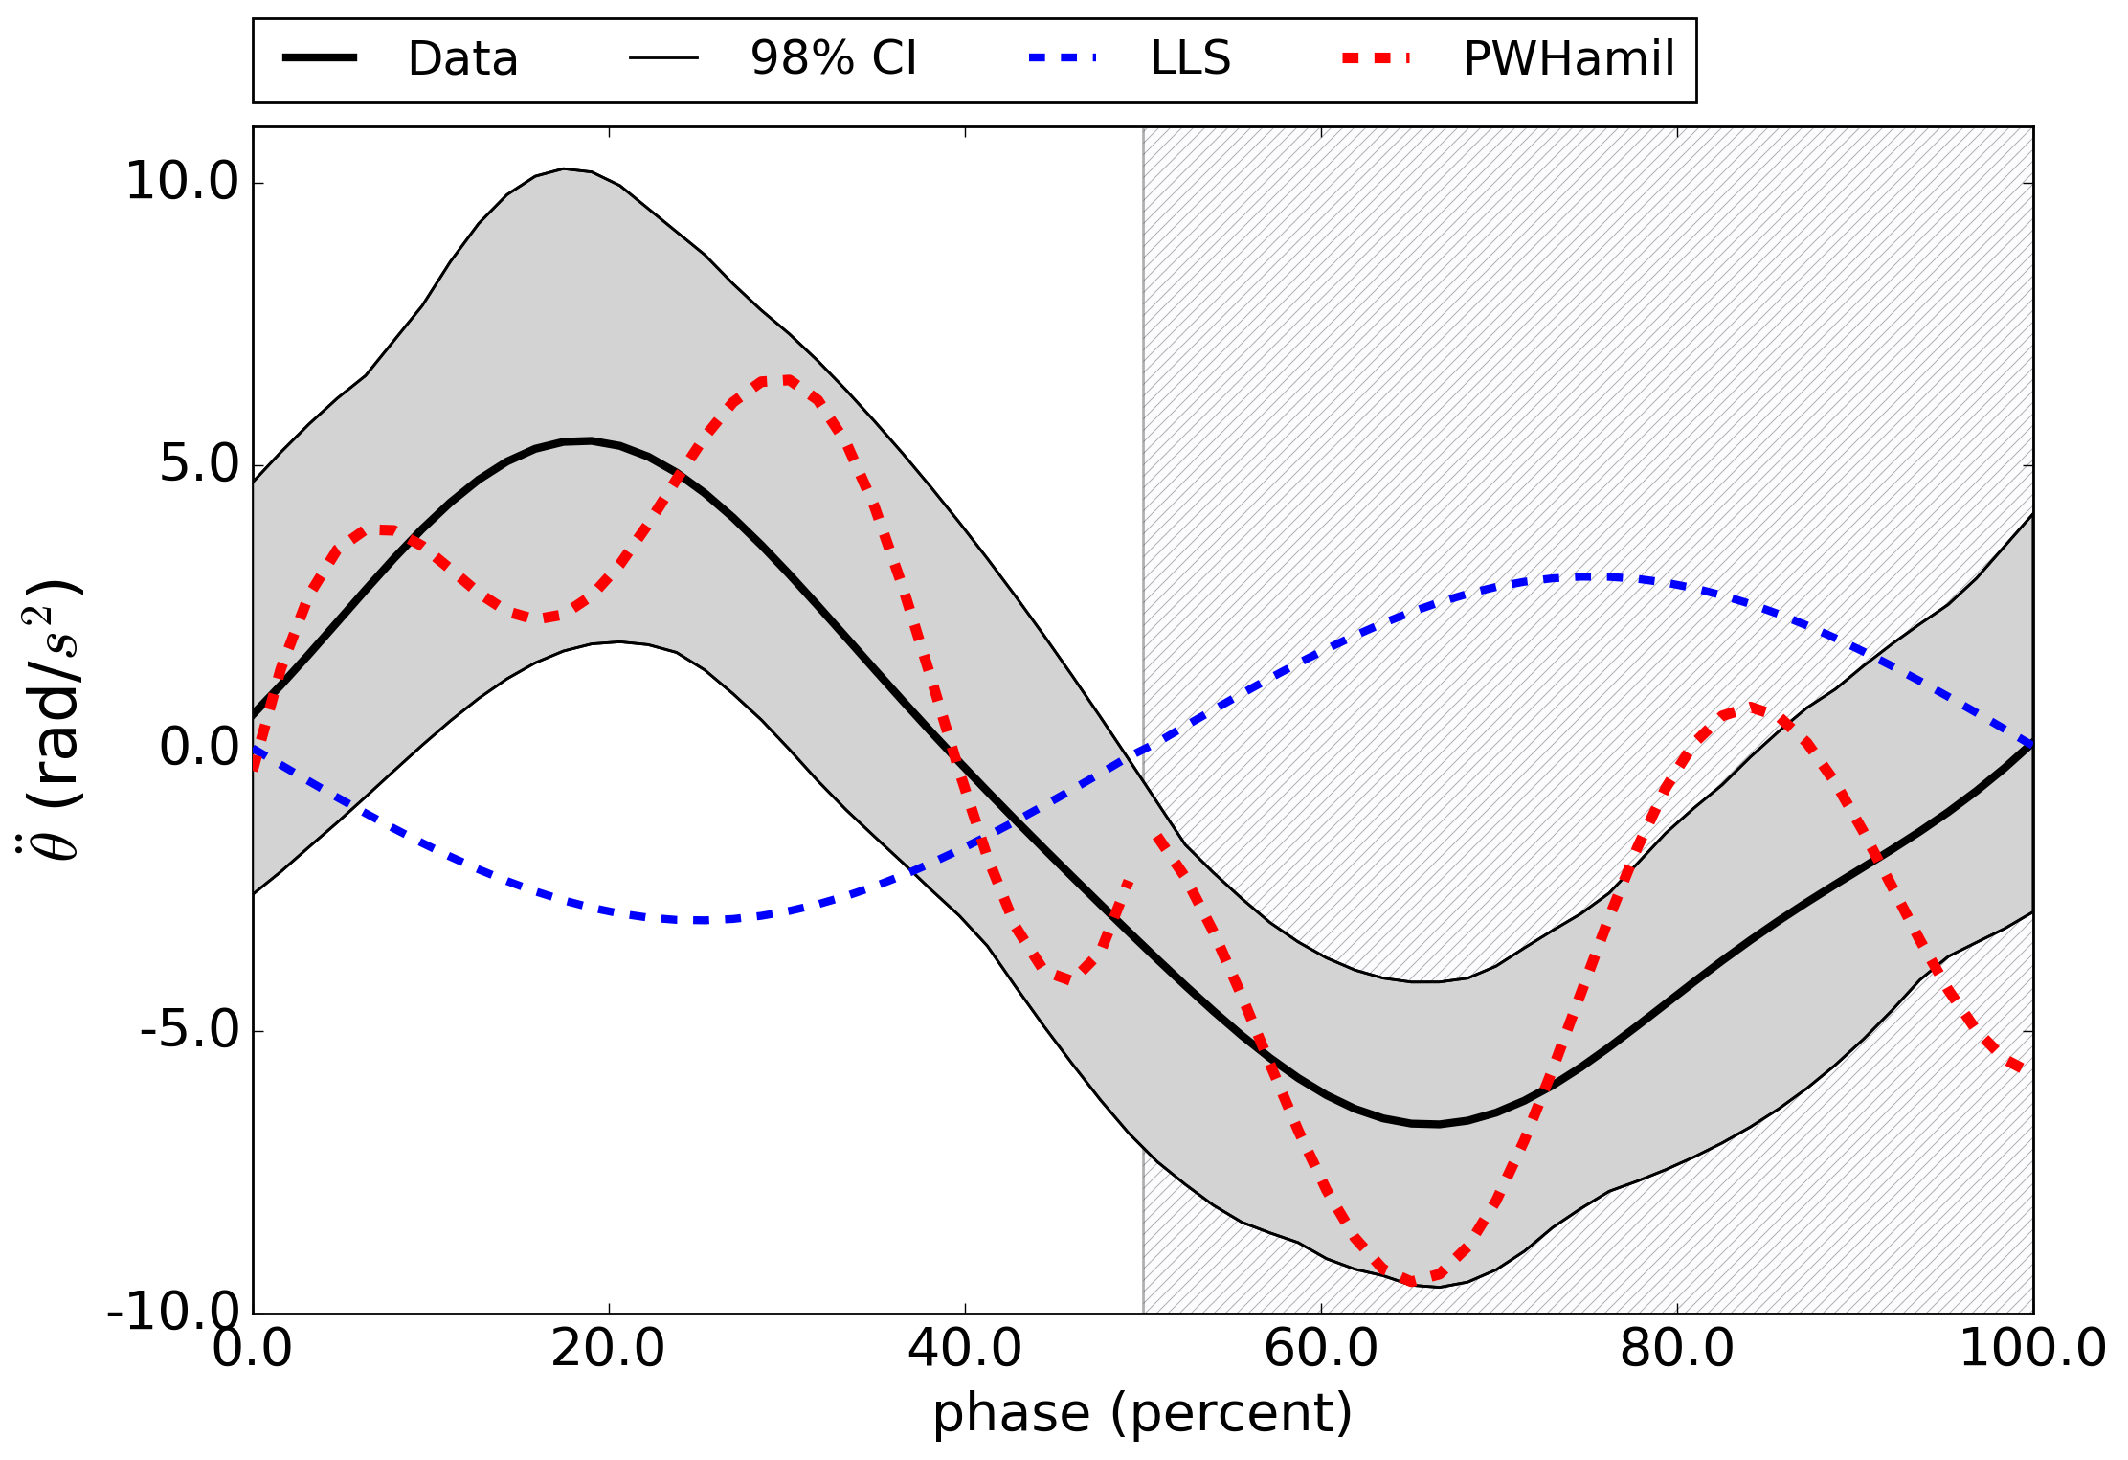
angular acceleration
phasing recovered; harmonics introduced

Slide 47
predictive dynamical models for legged locomotion
1. parsimoniously encode mechanisms
stabilization
reduction
2. generate testable hypotheses
treatments
perturbations

Slide 48







collaborators
thank you!
Bora Banjanin
Talia Moore
sburden@uw.edu
http://faculty.uw.edu/sburden
J-M Mongeau
Bob Full
support
Shankar Sastry
Aaron Johnson
Dan Koditschek
Shai Revzen

