Slide 1

Predictive dynamical models for sensorimotor control
Sam Burden
Assistant Professor
Electrical Engineering
University of Washington
Seattle, WA USA
http://faculty.uw.edu/sburden

Slide 2
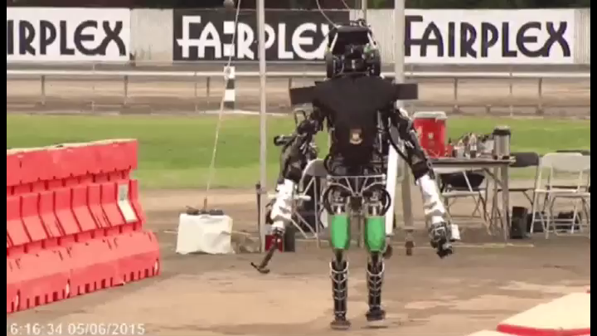
sensorimotor integration is hard!

Slide 3

sensorimotor control system:
robotic teleoperation
sensory feedback
sensory feedback
motor control inputs
two decision-making agents in a dynamic world
Chiawakum Creek Fire near Lake Wenatchee, WA © Michael Stanford 2015 http://yourshot.nationalgeographic.com/photos/4181903/

Slide 4
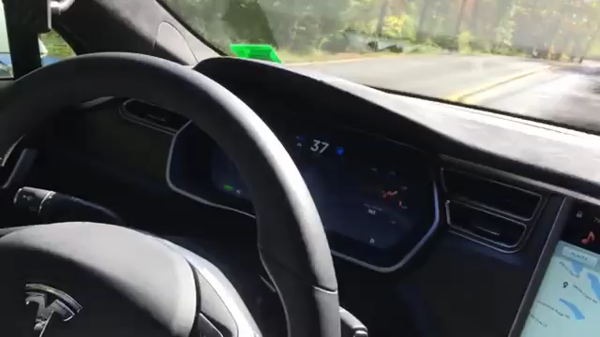

Slide 5
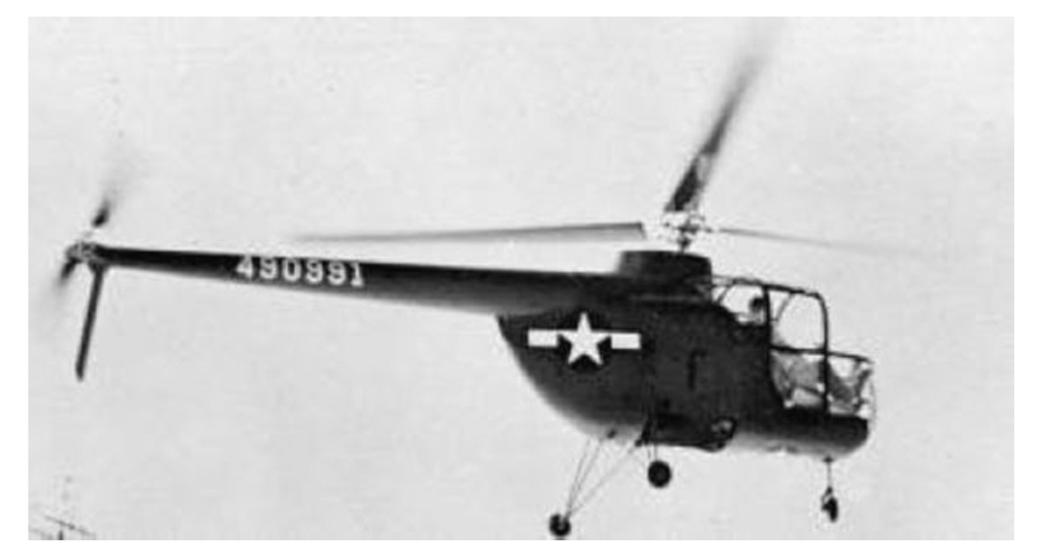
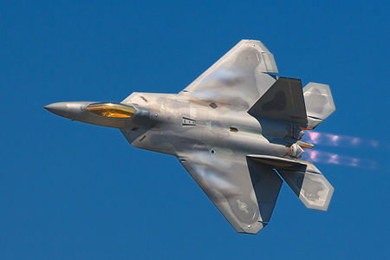
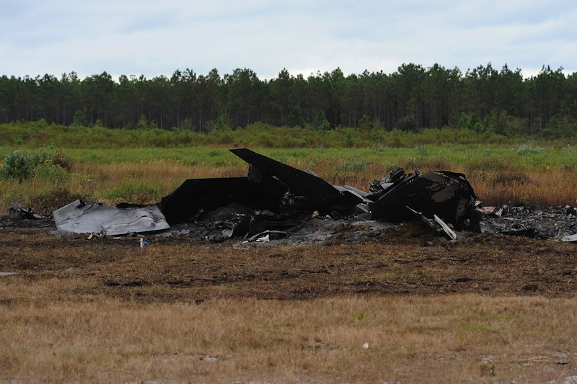
embedding humans amid automation
  pilot-induced oscillations in rotory & fixed-wing aircraft
    McRuer, Krendal 1974; Hess J. Guid. Cont. Dyn. 1997
    Pavel et al. Prog. Aero. Sci. 2013
  overreliance on enhanced safety features in cars
    Rudin-Brown, Parker Traffic Psych. Behav. 2004;
    Moore, Zuby Proc. Enhanced Safety Vehicles 2013
naïve coupling can lead to performance loss
ranging from mild to catastrophic

Slide 6
intervening in a sensorimotor control system
any intervention alters the sensorimotor loop
sensory feedback
sensory feedback
motor control inputs
provably-safe interventions will require predictive models for sensorimotor loops

Slide 7
today’s talk:
predictive dynamical models
for sensorimotor control
M, M⁻¹
internal models
terra-dynamics

Slide 8
today’s talk:
predictive dynamical models
for sensorimotor control
M, M⁻¹
internal models
terra-dynamics

Slide 9
predictable behavior from internal models
forward model
  predicts sensory effects of motor actions
    Sutton, Barto Psych. Rev. 1981
    Jordan, Rumelhart Cog. Sci. 1992
    Wolpert, Ghahramani, Jordan Science 1995
inverse model
  computes action expected to yield desired behavior
    Kawato Curr. Opin. Neurobio. 1999
    Thoroughman, Shadmehr Nature 2000
    Conditt, Mussa-Ivaldi PNAS 1999
Notes:
replace text with cartoon

Slide 10
predictable behavior from internal models
  theoretical and empirical evidence for pairing of forward + inverse models
    Bhushan, Shadmehr Bio. Cybern. 1999; Sanner, Kosha Bio. Cybern. 1999
forward model
+
inverse model
  parallels in control theory, robotics, artificial intelligence: adaptive control, internal model principle, learning
    Francis, Wonham Automatica 1976; Sastry, Bodson Prentice Hall 1989
    Sutton, Barto, Williams IEEE CSM 1992; Atkeson, Schaal ICML 1997
    Papavassiliou, Russell IJCAI 1999
Notes:
replace text with cartoon

Slide 11
instantiating internal models
Forward model ( M : U → Y ): static vs. dynamic
  static map (linear or nonlinear)
    Hanuschkin, Ganguli, Hahnloser Front. Neural Circ. 2013
    Giret, Kornfeld, Ganguli, Hahnloser PNAS 2014
  dynamic map depends on
  intermediate state
    Thoroughman, Shadmehr Science 2000
    Wolpert, Diedrichsen, Flanagan Nature Neurosci. 2011
Inverse model ( M⁻¹ : Y → U ): hard to define
  static map may fail to be one-to-one or onto
  dynamic map may be acausal or need state estimate

Slide 12
dynamic forward model
  start with forward model in control-affine form
  under a technical condition* we change coordinates to
  forward model is simpler in (ξ,ζ) coordinates
*strict relative degree – easily satisfied for mechanical systems

Slide 13
dynamic inverse model
  start with simplified forward model
  to obtain inverse model, apply input u_{d} that matches* γ—th derivative of desired output y_{d} :
*augment with feedback to correct for initial condition error

Slide 14

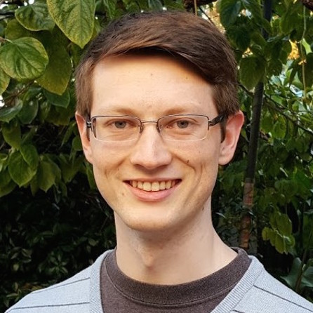

pairing forward + inverse models
  closed-loop dynamics have undesirable property:
  states in ζ are unobservable
  generally impossible to compute inverting input u_{d} using sensor data
  by restricting system dynamics, can bypass this issue:
Theorem (Robinson, Scobee, Burden, Sastry):
If forward M and inverse M⁻¹ are stable models,
then feedforward input from internal model
asymptotically inverts system’s dynamics.
Robinson, Scobee, Burden, Sastry Proc. SPIE-DSS (to appear, 2016)
Dynamic inverse models in human-cyber-physical systems

Slide 15



inversion with stable model pair (M, M⁻¹)
M, M⁻¹
output y
input u_{d}
Theorem implies:
  for stable model pair, trajectories x₁ and x₂ converge to
  feedforward input “asymptotically inverts” dynamics
Robinson, Scobee, Burden, Sastry Proc. SPIE-DSS (to appear, 2016)
Dynamic inverse models in human-cyber-physical systems

Slide 16
if inverse model predicts human’s behavior
  by measuring human’s input u_{H}, can infer task η_{H}
  task η_{H} is an input to the unobservable dynamics ζ
  automation can solve optimal control problem to improve performance as measured by

Slide 17
application: provably-safe interventions
any intervention alters the sensorimotor loop
sensory feedback
sensory feedback
motor control inputs
if inverse model predicts human’s behavior,
the above intervention is provably-safe

Slide 18
today’s talk:
predictive dynamical models
for sensorimotor control
M, M⁻¹
internal models
terra-dynamics

Slide 19
today’s talk:
predictive dynamical models
for sensorimotor control
M, M⁻¹
internal models
terra-dynamics

Slide 20
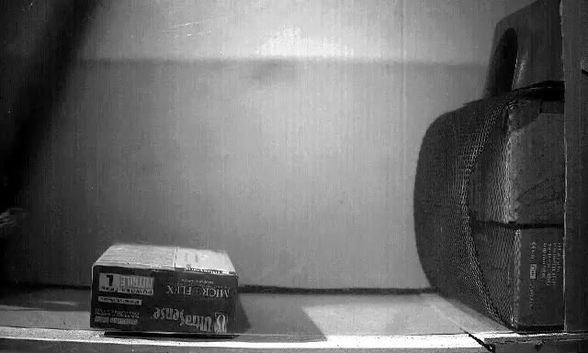
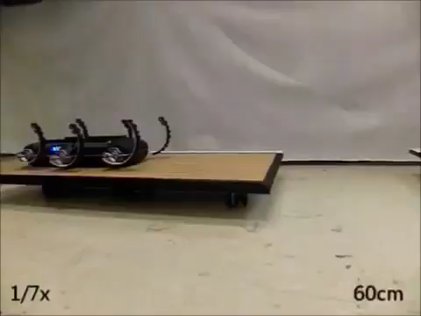
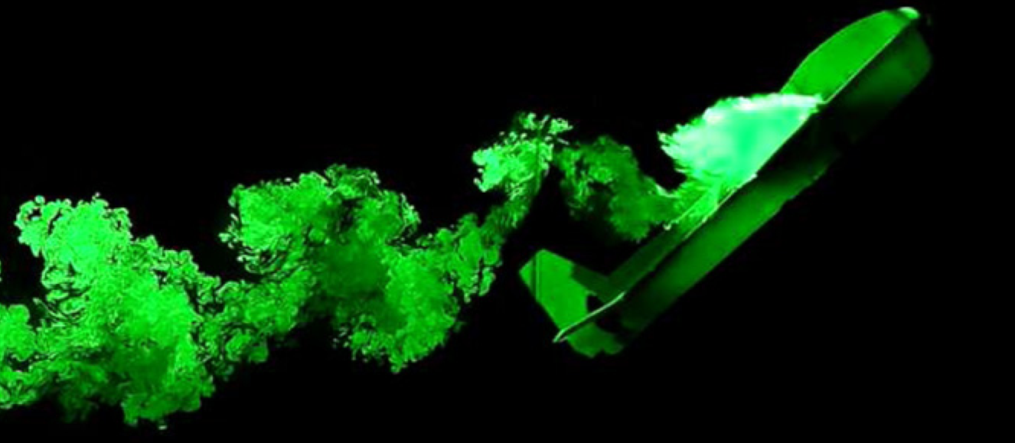
  locomotion through fluid governed by continuous hydro- and aero-dynamics
  locomotion on land governed by intermittent terra-dynamics
Vogel Life in moving fluids 1996
Li, Zhang, Goldman Science 2015
legged locomotion involves intermittent interaction
Tytell, Standen, Lauder JEB 2008
Cory, Moore, Tedrake B&B 2014
Libby, Moore, Chang-Siu, Cohen, Jusufi, Full Nature 2012
Johnson, Koditschek ICRA 2013

Slide 21
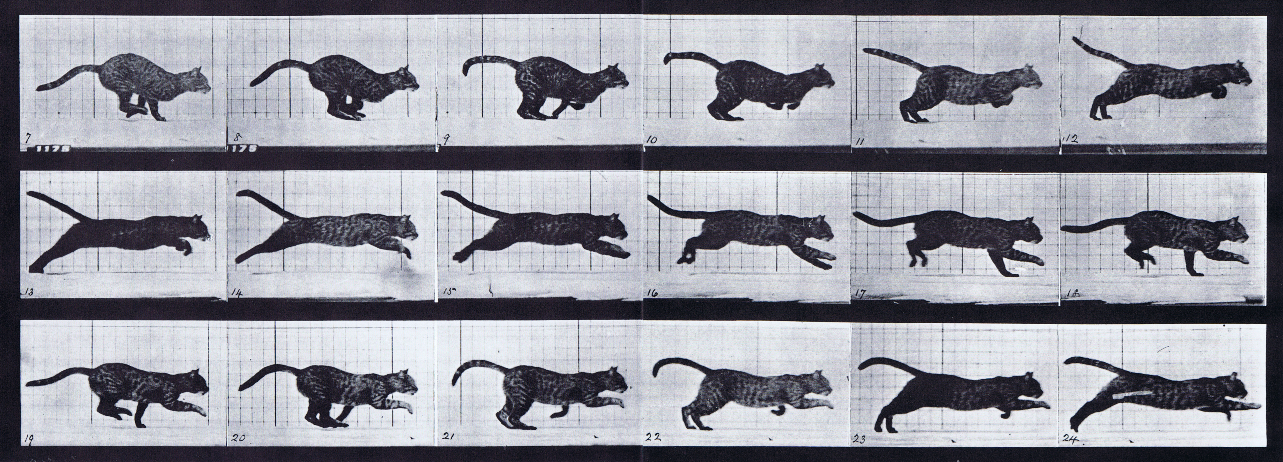
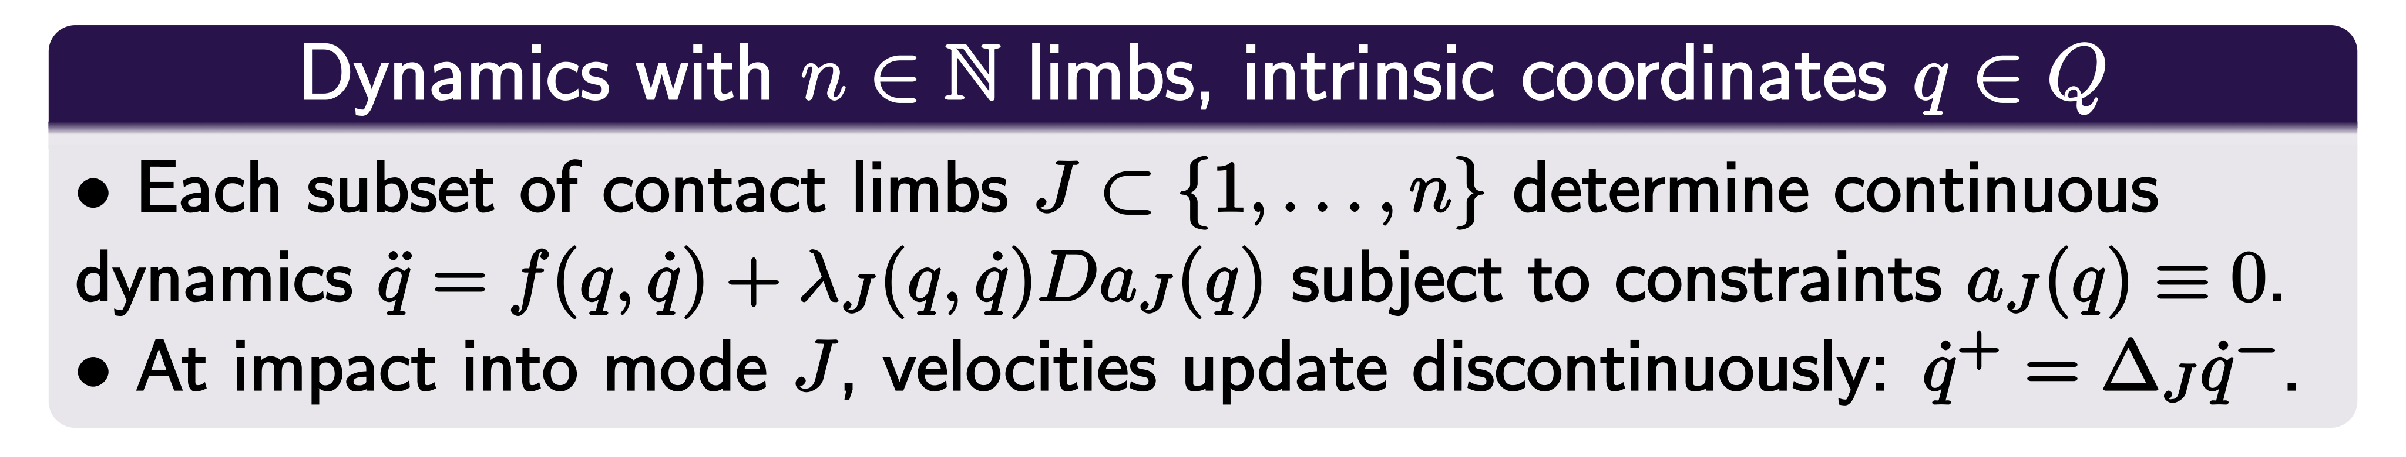

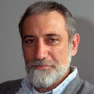
parsimonious models are piecewise-defined
Muybridge 1887 (reprinted by Dover in 1957)
Johnson, Burden, Koditschek IJRR (in review, 2016)
A hybrid systems model for simple manipulation and self-manipulation systems

Slide 22
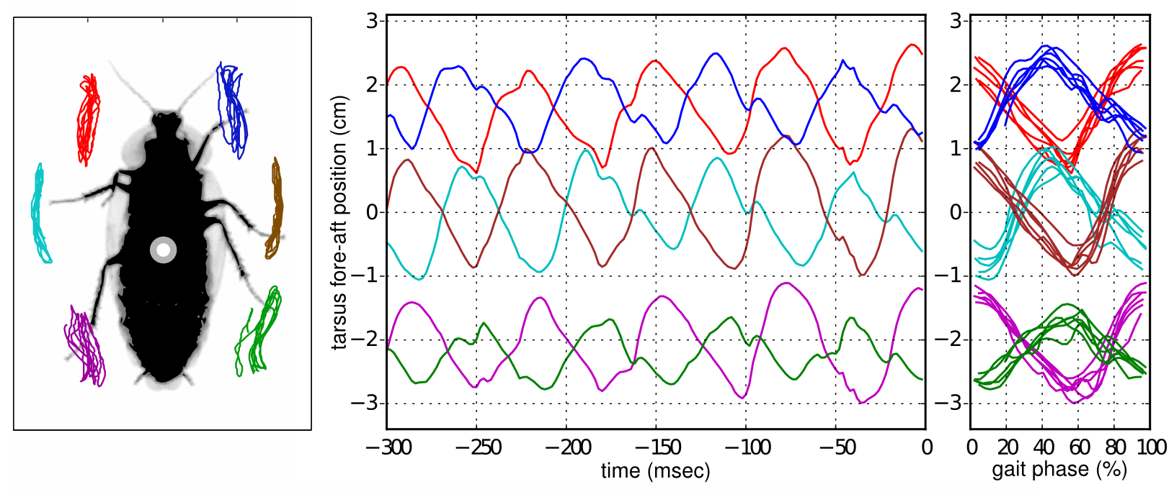
near-simultaneous footfalls are ubiquitous

Slide 23
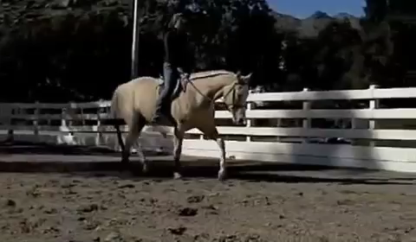
near-simultaneous footfalls are ubiquitous

Slide 24
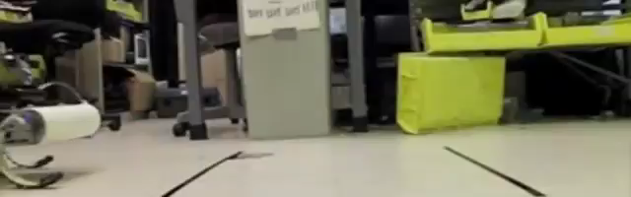
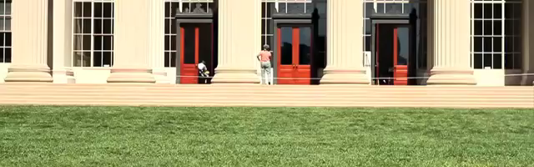
near-simultaneous footfalls are ubiquitous
Galloway, Haynes, Ilhan, Johnson, Knopf, Lynch, Plotnick, White, Koditschek UPenn 2010
Hyun, Seok, Lee, Kim IJRR 2014

Slide 25
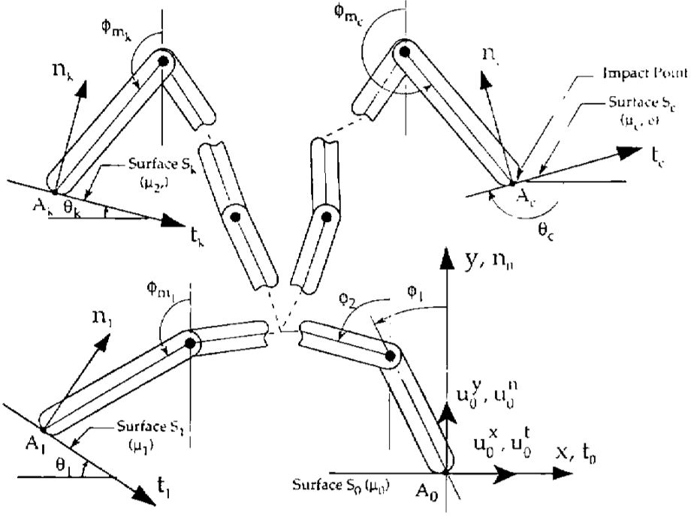
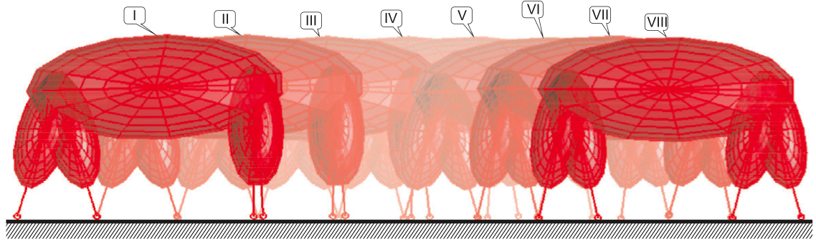
inconsistencies arise when limbs are rigid
  hand with rigid fingers exhibits 5 different post-grasp outcomes
Hürmüzlü and Marghitu IJRR 1994, JAM 1995
rigid limbs yield inconsistent terra-dynamics
  quadruped with rigid legs exhibits 3 distinct trot gaits
Remy, Buffington, Siegwart IJRR 2010

Slide 26
rigid vs elastic limbs
rigid limbs
elastic limbs
elastic limbs yield consistent terra-dynamics

Slide 27
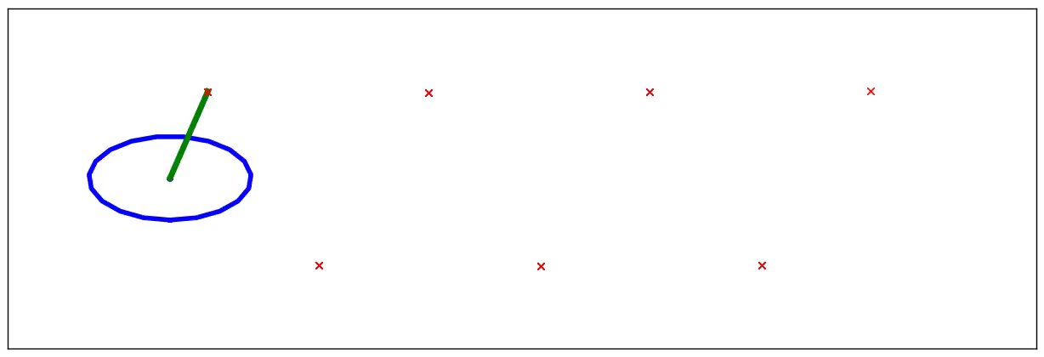

reduction
Theorem: n-leg polyped reduces to lateral leg-spring (LLS) after 1 stride
Burden, Revzen, Sastry IEEE TAC 2015 (arXiv:1308.4158)
Model reduction near periodic orbits of hybrid dynamical systems

Slide 28
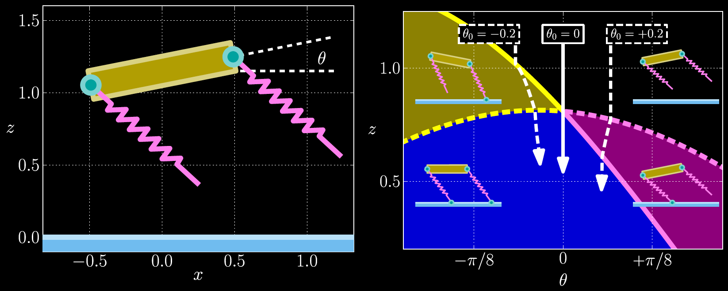
stabilization
Theorem: near-simultaneous footfalls passively stabilize rotations (e.g. pitch)
Burden, Sastry, Koditschek, Revzen SIADS (in review, 2016; arXiv:1407.1775)
Event-Selected Vector Field Discontinuities Yield Piecewise-Differentiable Flows

Slide 29
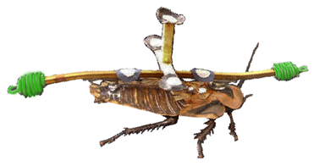
today’s talk:
predictive dynamical models
for sensorimotor control
M, M⁻¹
internal models
terra-dynamics

Slide 30
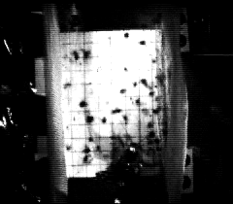
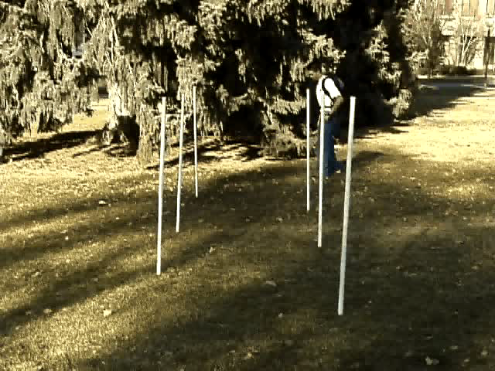
Jindrich, Full Journal of Experimental Biology 205(18):2803-2823 2002
Carrier, Walter, Lee Journal of Experimental Biology 204(22):3917-3926 2001
(how) can we predict experimental outcomes?
Notes:
As a dynamicist and control theorist, I find the kinds of perturbations and treatments employed by experimentalists fascinating.
I’ve spent my career modeling and controlling systems whose dynamics are poorly-understood; neuromechanics is a rich frontier for unmodeled dynamics.

Slide 31
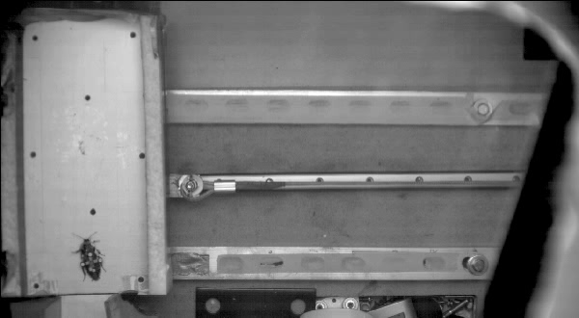
real-time

Slide 32
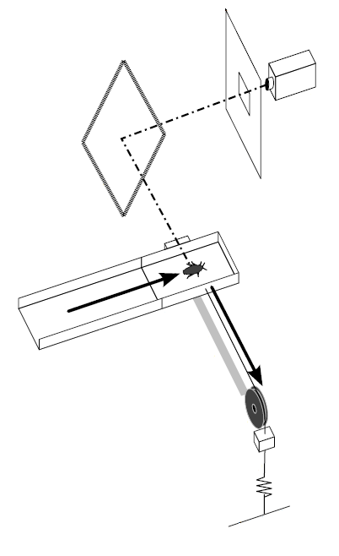
lateral perturbation experimental setup
platform accelerates laterally at 0.6 ± 0.1 g in a 0.1 sec interval providing a 50 ± 3 cm/sec specific impulse, then maintains velocity.
camera
diffuser
mirror
magnetic lock
cockroach running speed:
36 ± 8 cm/sec
stride frequency:
12.6 ± 2.9 Hz
(~80ms per stride)
animal motion
cart
trackway
cart motion
pulley
rail
mass
cable
elastic
ground
Revzen, Burden, Moore, Mongeau, Full Biological Cybernetics 107(2):179-200 2013

Slide 33
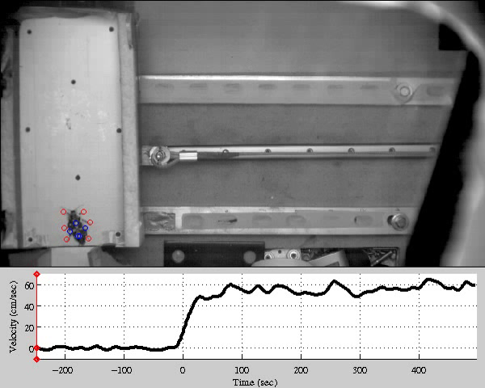
20x

Slide 34

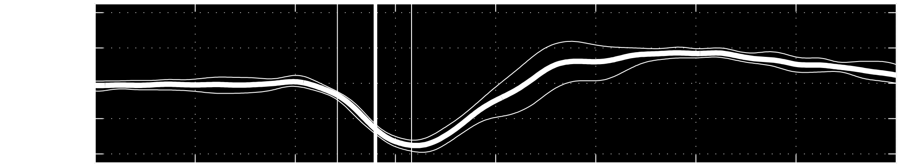
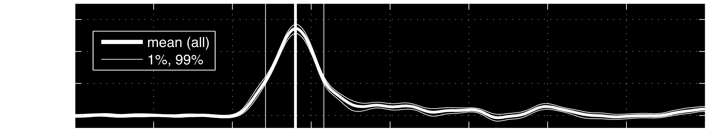
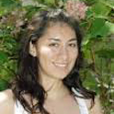


frequency change
constant frequency
neural feedback occurs at a delay;
how does feedback alter recovery?
real-time
Revzen, Burden, Moore, Mongeau, Full Bio. Cyber. 2013
Instantaneous kinematic phase reflects neuromechanical response to lateral perturbations of running cockroaches

Slide 35
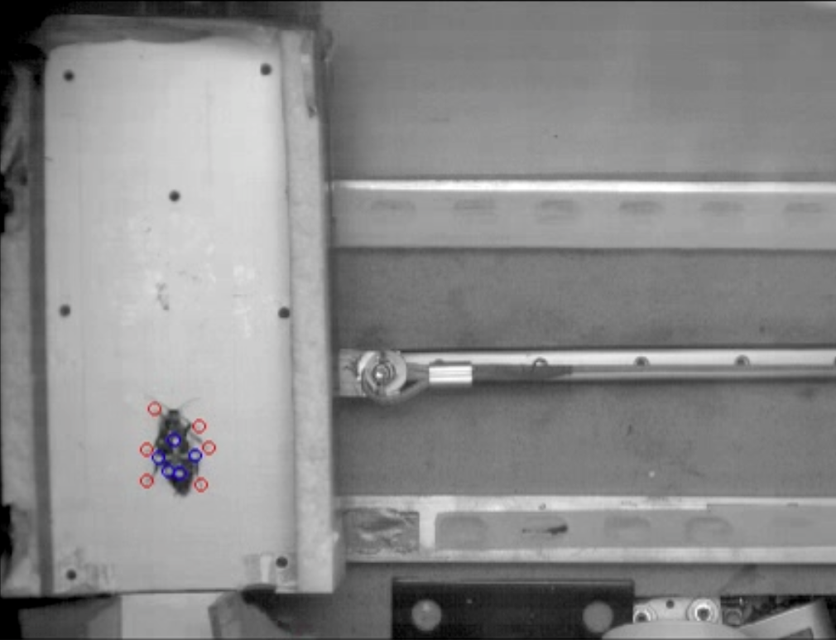
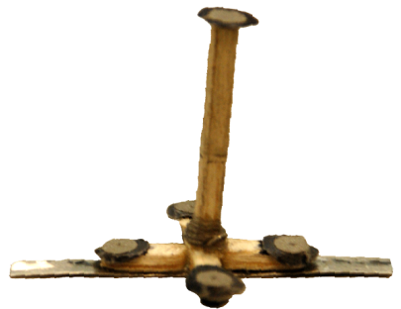
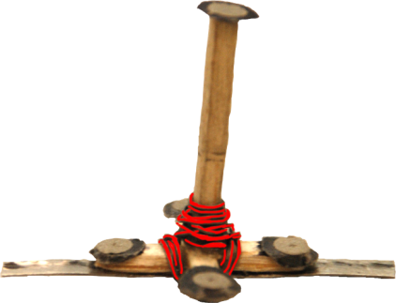
(how) can we predict experimental outcomes?
cart acceleration induces equal & opposite animal acceleration
perturbations
treatments

Slide 36
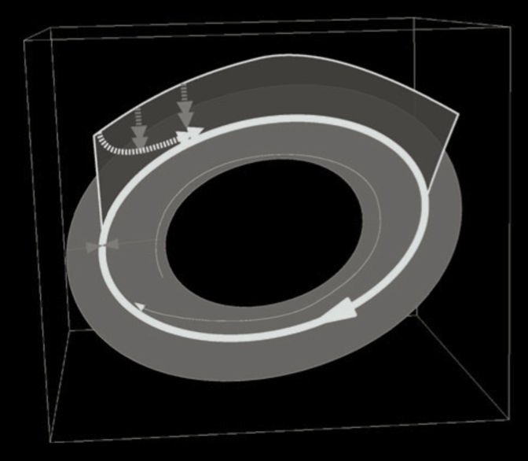
models of dynamic legged locomotion
data-driven
analytical
1.0
Perturbation remaining per stride
0.8
Animal
Less Stable
0.6
0.4
More Stable
0.2
0
0.5
1
1.5
2
Nondimensional Moment of Inertia
Revzen & Guckenheimer
J. Royal Society Interface 9(70) 2012
Full, Kubow, Schmitt, Holmes, Koditschek Integ and Comp Bio 42(1) 2002

Slide 37
perturbing data-driven model
?
perturbations
treatments
Revzen, Guckenheimer J. Roy. Soc. Int. 2012
Revzen, Guckenheimer Phys. Rev. E 2008
Notes:
For example the previous empirical results are a simple data-driven model. In that model we estimate a phase statistic so that phase then becomes your predictor. So in this picture at any point along the periodic behavior we get a distribution of animal state.

Slide 38
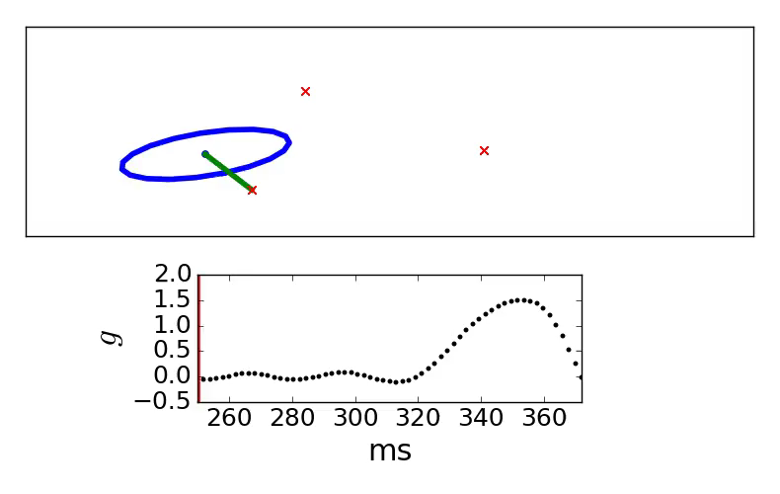
perturbing analytical model
overwhelming experimental perturbation
Notes:
Limitation of simple analytical models: predictions become invalid away from steady-state behavior
LLS made to steady-state periodic locomotion. The perturbation takes the model into a regime where we cant even keep simulating.
We tried to make this model work with minor alterations, but with no success the experimental perturbation overwhelms the model.

Slide 39
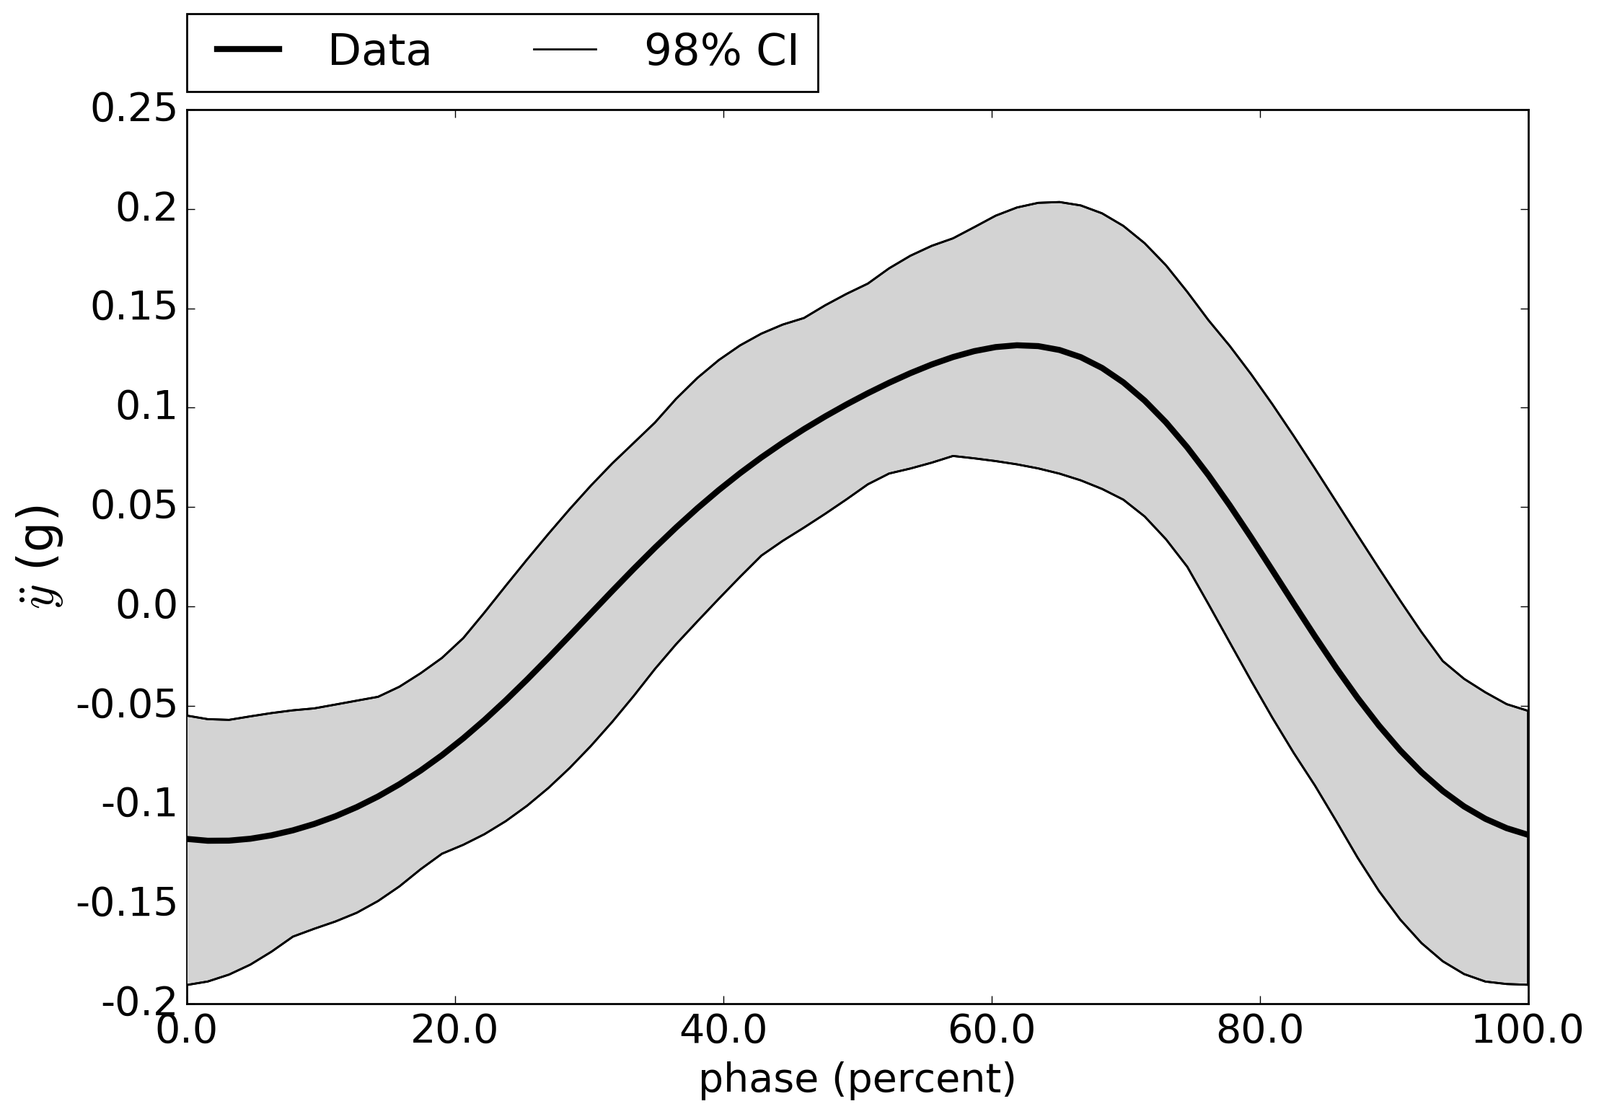
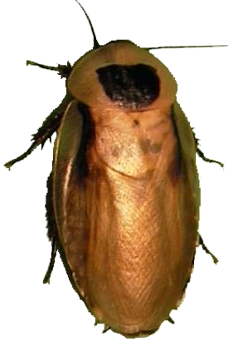
lateral acceleration

Slide 40
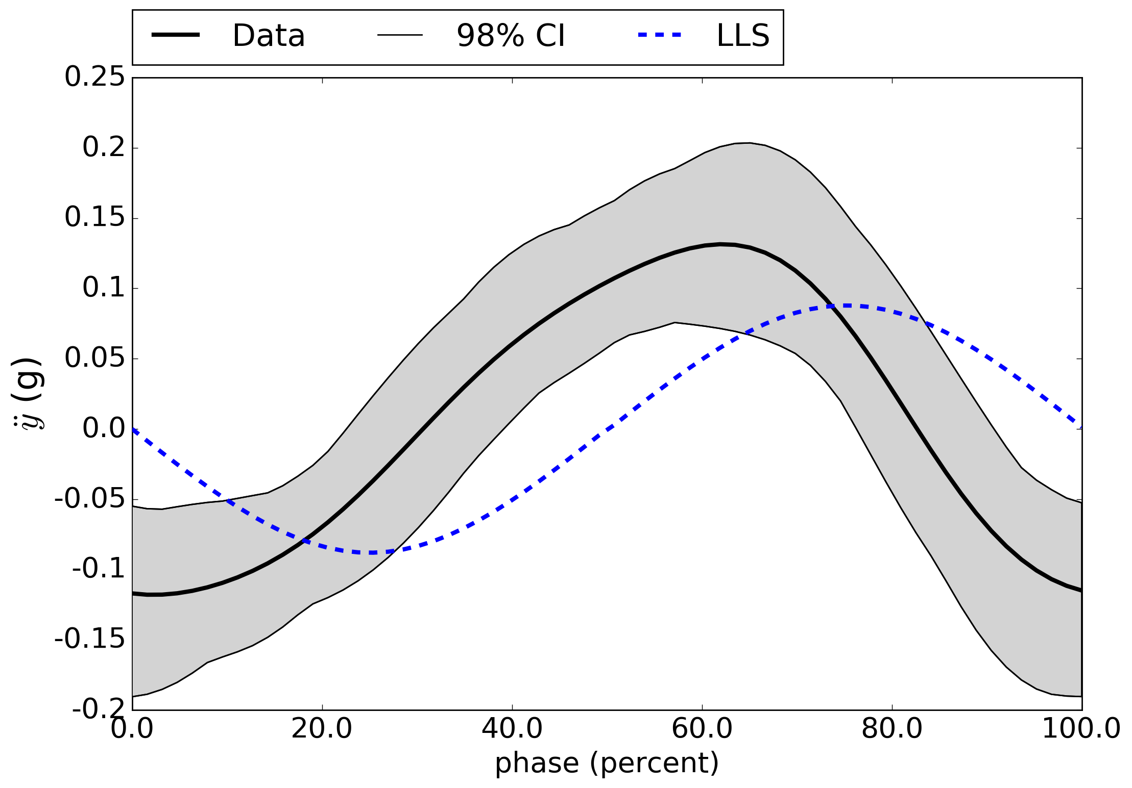
lateral acceleration
non-zero acceleration at step transition

Slide 41
Hypothesis: body acceleration determined
by pose relative to stance tripod

Slide 42
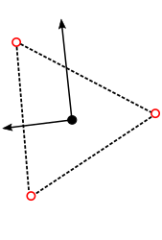
proposed model structure
body state comprised of:
  forward position
  lateral position
  body orientation
body acceleration arises from spring-like potential

Slide 43
introducing perturbations and treatments
  forward position
  lateral position
  body orientation
body acceleration influenced by
  perturbation (e.g. lateral acceleration a(t) )
  treatment (e.g. inertia distribution M )

Slide 44
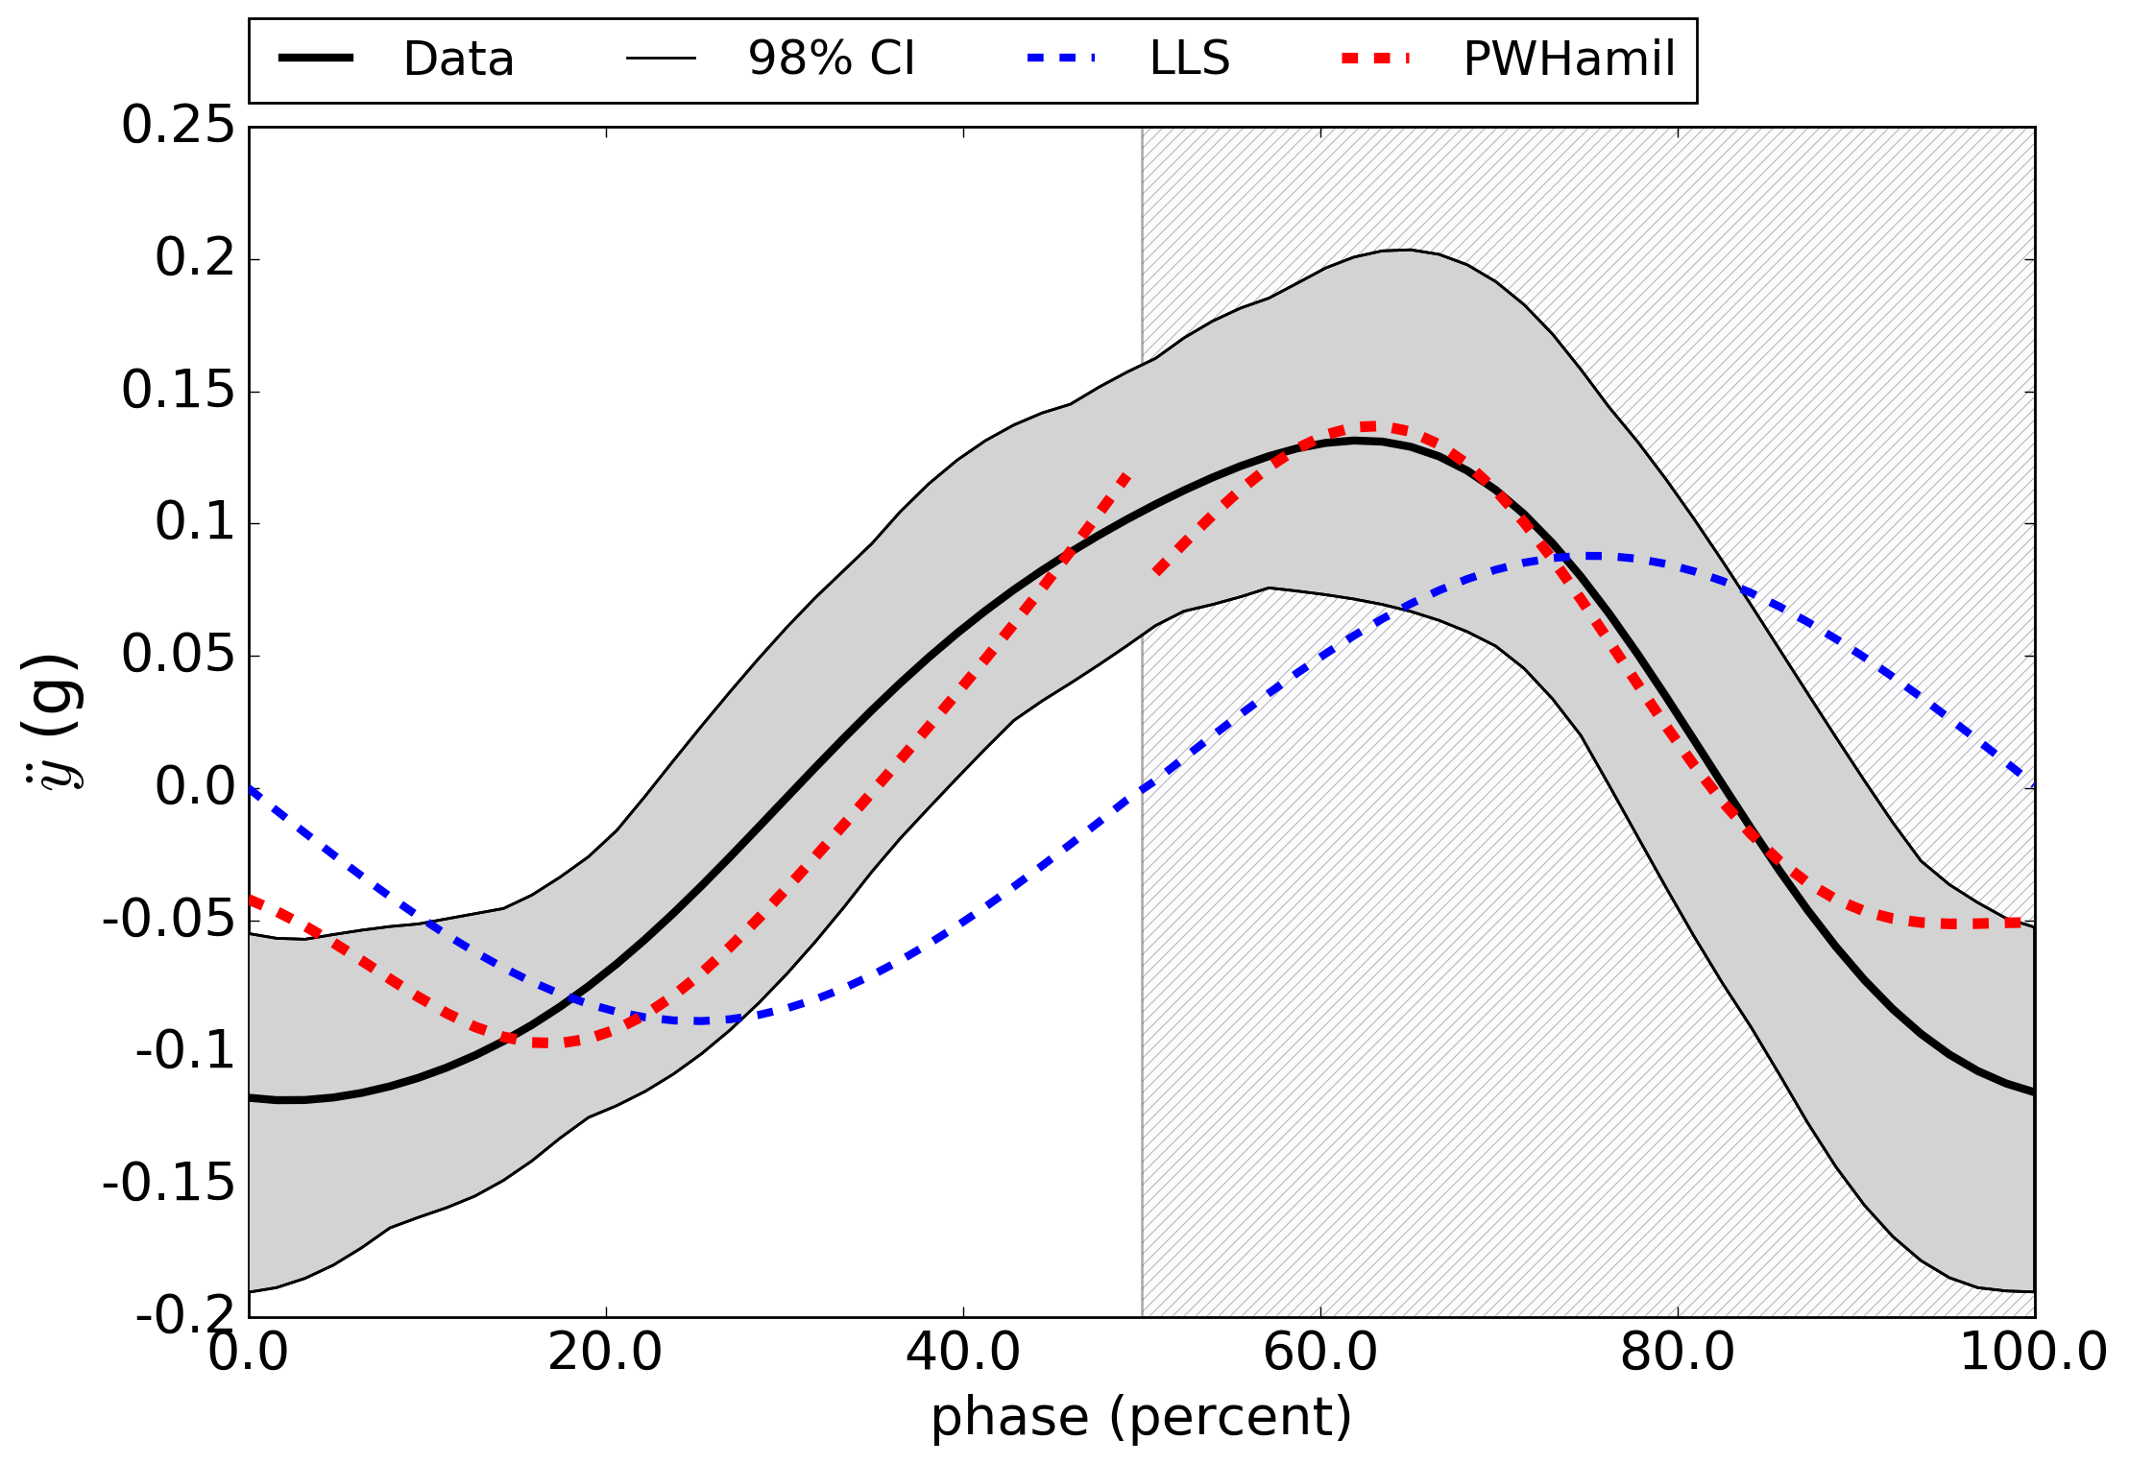
lateral acceleration
non-zero acceleration at step transition

Slide 45
Today’s talk:
predictive dynamical models
for sensorimotor control
M, M⁻¹
internal models
terra-dynamics

Slide 46
robotic teleoperation

Slide 47
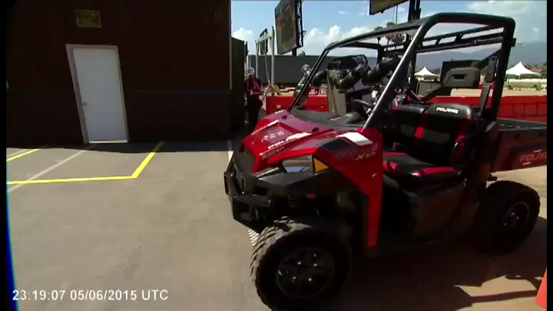

Slide 48
robotic teleoperation
future work:
dynamic tele-manipulation & tele-locomotion

Slide 49
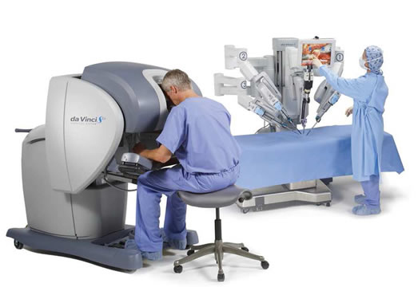
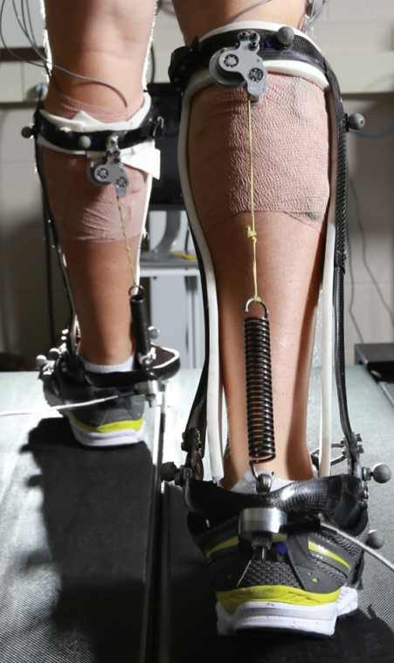
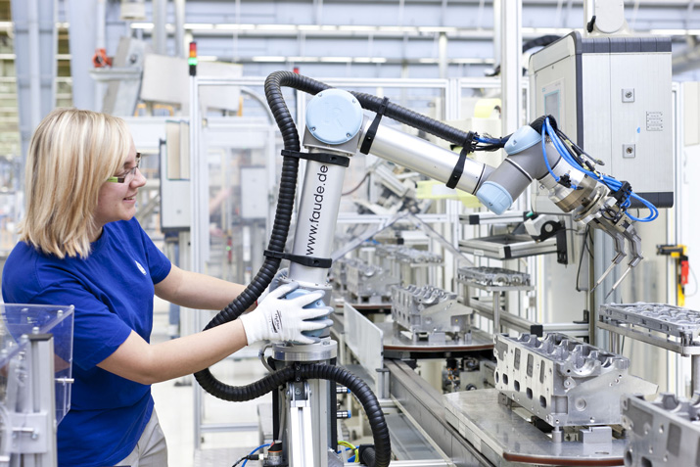
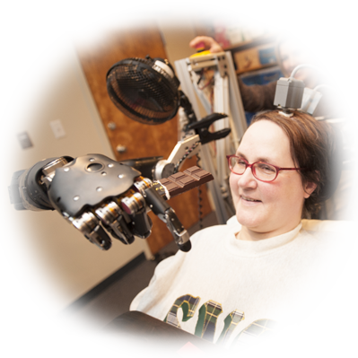
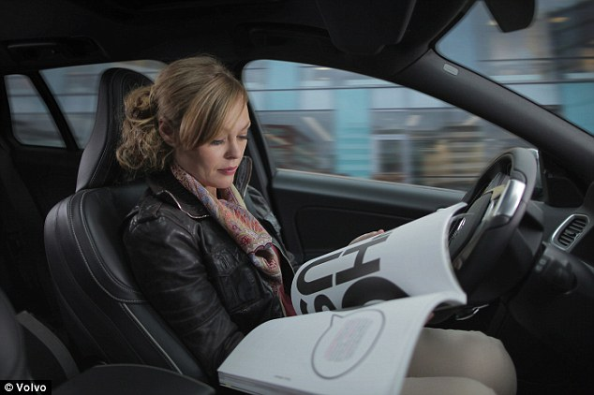
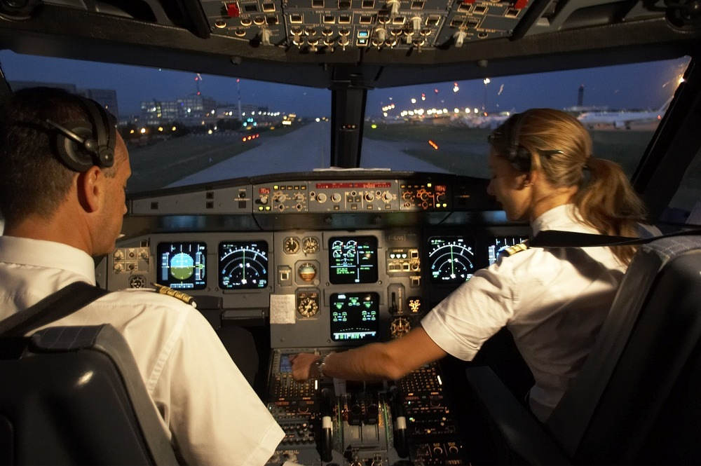
human interaction with the physical world
is increasingly mediated by automation
humans are the enabling technology

Slide 50








Ryan Robinson
Dexter Scobee
thank you!
Bora Banjanin
sburden@uw.edu
http://faculty.uw.edu/sburden
Talia Moore
J-M Mongeau
support
Bob Full
Shankar Sastry
Shai Revzen
Aaron Johnson
Dan Koditschek

