Slide 1

Predictive dynamical models
for human sensorimotor control
of teleoperated robots
Sam Burden
Assistant Professor
Electrical Engineering
University of Washington
Seattle, WA USA
http://faculty.uw.edu/sburden
AMP Lab
http://depts.washington.edu/amplify
BioRobotics Lab
http://brl.ee.washington.edu

Slide 2
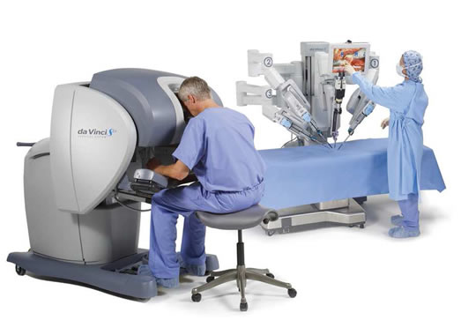
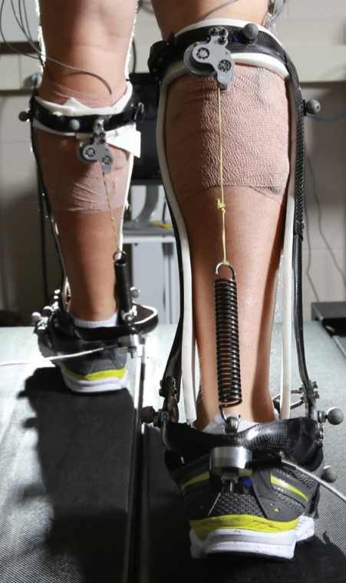
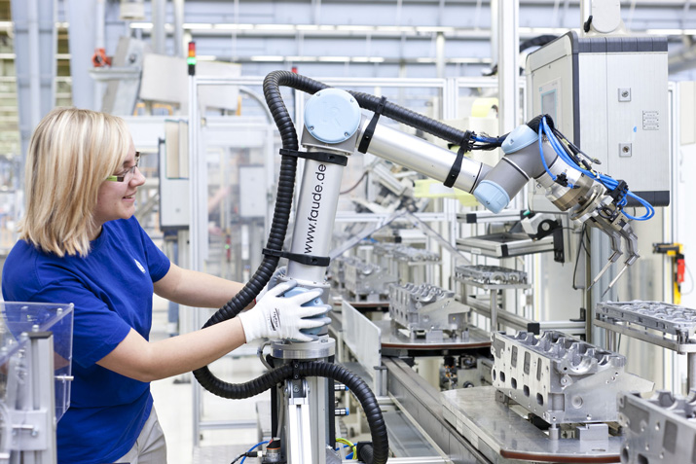
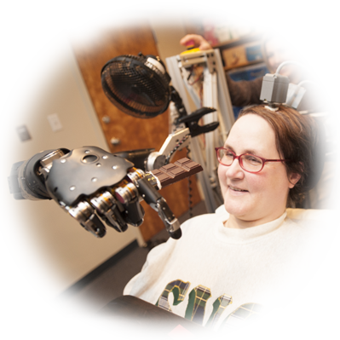
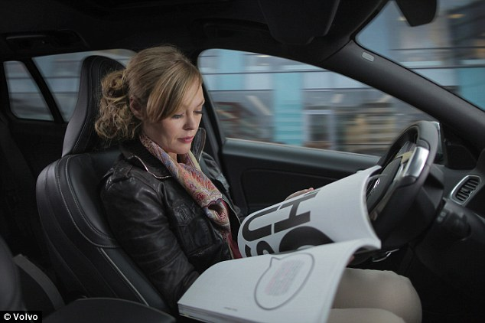

human interaction with the physical world
is increasingly mediated by automation
Human-Cyber-Physical Systems (HCPS)

Slide 3

Human-Cyber-Physical System:
robotic teleoperation
sensory feedback
sensory feedback
motor control inputs
Chiawakum Creek Fire near Lake Wenatchee, WA © Michael Stanford 2015 http://yourshot.nationalgeographic.com/photos/4181903/

Slide 4
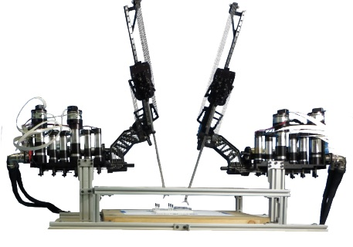
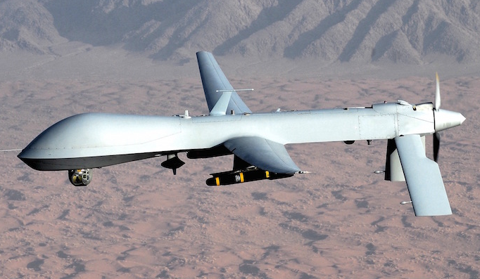
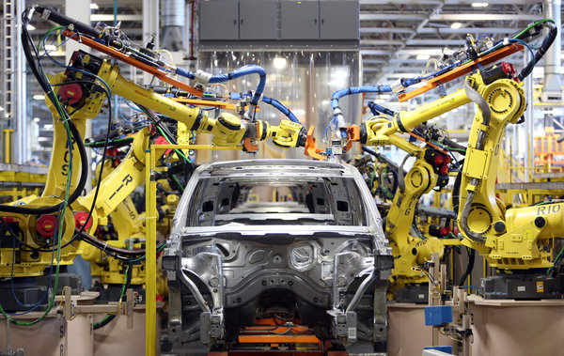
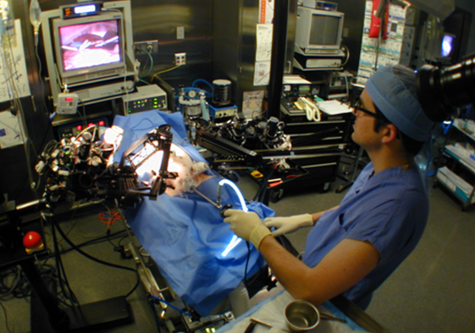
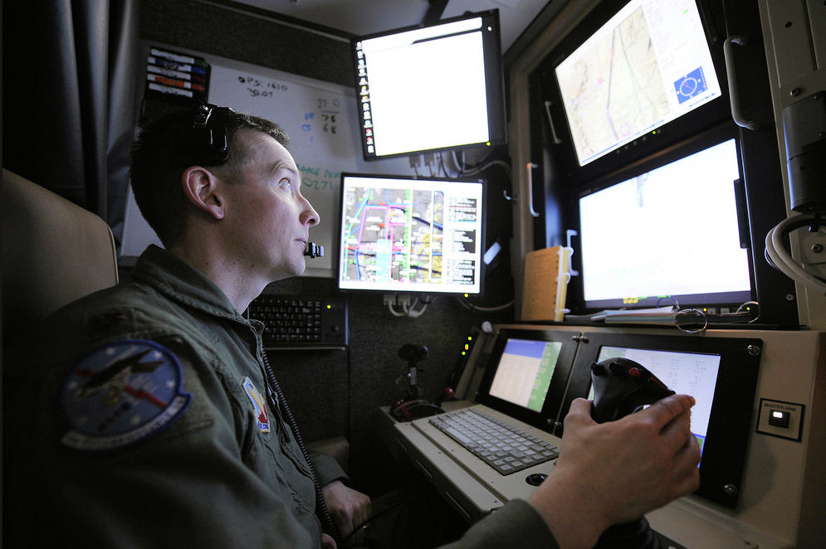




roles for humans and automation
legal, ethical, and political concerns
ensure humans will remain in-the-loop
Nothwang, Robinson, Burden, McCourt, Curtis IEEE Resilience Week 2016
The Human Should be Part of the Control Loop?

Slide 5
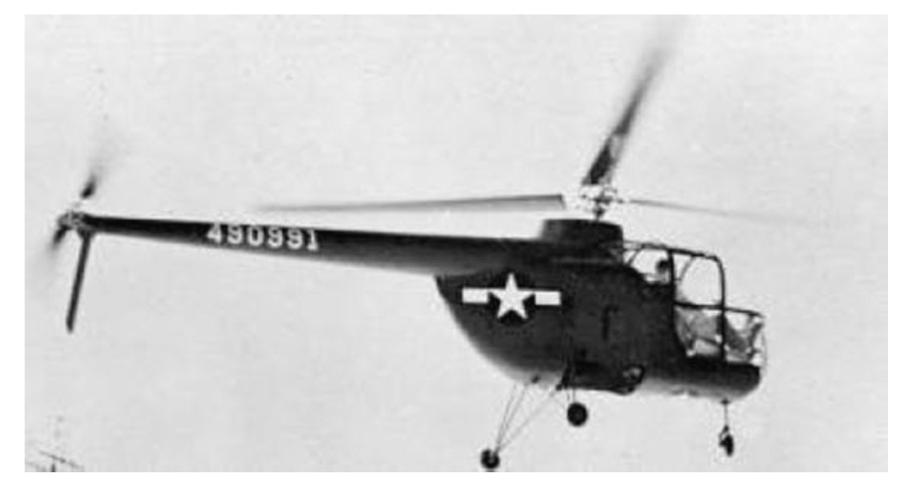
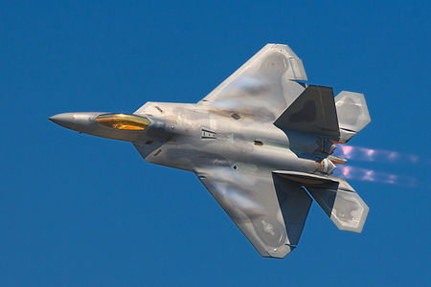

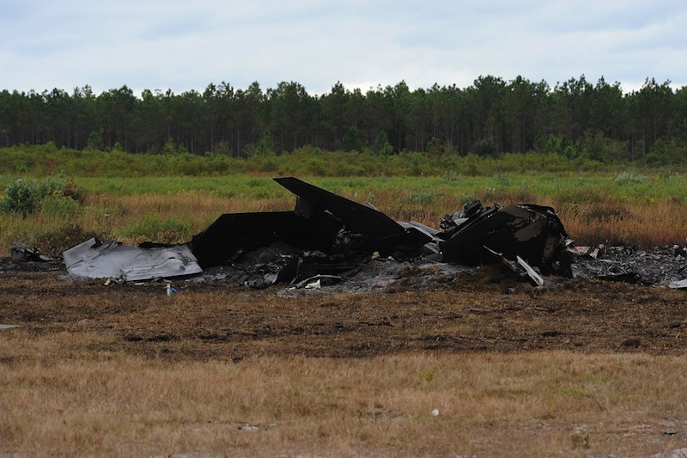
embedding humans amid automation
  pilot-induced oscillations in rotory & fixed-wing aircraft
    McRuer, Krendal 1974; Hess J. Guid. Cont. Dyn. 1997
    Pavel et al. Prog. Aero. Sci. 2013
  overreliance on enhanced safety features in cars
    Rudin-Brown, Parker Traffic Psych. Behav. 2004;
    Moore, Zuby Proc. Enhanced Safety Vehicles 2013
naïve coupling can lead to performance loss
ranging from mild to catastrophic

Slide 6
intervening in Human-Cyber-Physical Systems
any intervention alters the sensorimotor loop
sensory feedback
sensory feedback
motor control inputs
safe intervention requires validated
predictive models for sensorimotor loops

Slide 7
predictable behavior from internal models
forward model
  predicts sensory effects of motor actions
    Sutton, Barto Psych. Rev. 1981
    Jordan, Rumelhart Cog. Sci. 1992
    Wolpert, Ghahramani, Jordan Science 1995
inverse model
  computes action expected to yield desired behavior
    Kawato Curr. Opin. Neurobio. 1999
    Thoroughman, Shadmehr Nature 2000
    Conditt, Mussa-Ivaldi PNAS 1999
Notes:
replace text with cartoon

Slide 8
predictable behavior from internal models
  theoretical and empirical evidence for pairing of forward + inverse models
    Bhushan, Shadmehr Bio. Cybern. 1999; Sanner, Kosha Bio. Cybern. 1999
forward model
+
inverse model
  parallels in control theory, robotics, artificial intelligence: adaptive control, internal model principle, learning
    Francis, Wonham Automatica 1976; Sastry, Bodson Prentice Hall 1989
    Sutton, Barto, Williams IEEE CSM 1992; Atkeson, Schaal ICML 1997
    Papavassiliou, Russell IJCAI 1999
Notes:
replace text with cartoon

Slide 9
instantiating internal models
Forward model ( M : U → Y ): static vs. dynamic
  static map (linear or nonlinear)
    Hanuschkin, Ganguli, Hahnloser Front. Neural Circ. 2013
    Giret, Kornfeld, Ganguli, Hahnloser PNAS 2014
  dynamic map depends on
  intermediate state
    Thoroughman, Shadmehr Science 2000
    Wolpert, Diedrichsen, Flanagan Nature Neurosci. 2011
Inverse model ( M⁻¹ : Y → U ): hard to define
  static map may fail to be one-to-one or onto
  dynamic map may be acausal or need state estimate

Slide 10
dynamic forward model
  start with forward model in control-affine form
  under a technical condition* we change coordinates to
  forward model is simpler in (ξ,ζ) coordinates
*strict relative degree – easily satisfied for mechanical systems

Slide 11
dynamic inverse model
  start with simplified forward model
  to obtain inverse model, apply input u_{d} that matches* γ—th derivative of desired output y_{d} :
*augment with feedback to correct for initial condition error

Slide 12


pairing forward + inverse models
  closed-loop dynamics have undesirable property:
  states in ζ are unobservable
  generally impossible to compute inverting input u_{d} using sensor data
  by restricting system dynamics, can bypass this issue:
Theorem (Robinson, Scobee, Burden, Sastry):
If forward M and inverse M⁻¹ are stable models,
then feedforward input from internal model
asymptotically inverts system’s dynamics.
Robinson, Scobee, Burden, Sastry SPIE-DSS 2016
Dynamic inverse models in human-cyber-physical systems

Slide 13



inversion with stable model pair (M, M⁻¹)
M, M⁻¹
output y
input u_{d}
Theorem implies:
  for stable model pair, trajectories x₁ and x₂ converge to
  feedforward input “asymptotically inverts” dynamics
Robinson, Scobee, Burden, Sastry SPIE-DSS 2016
Dynamic inverse models in human-cyber-physical systems

Slide 14
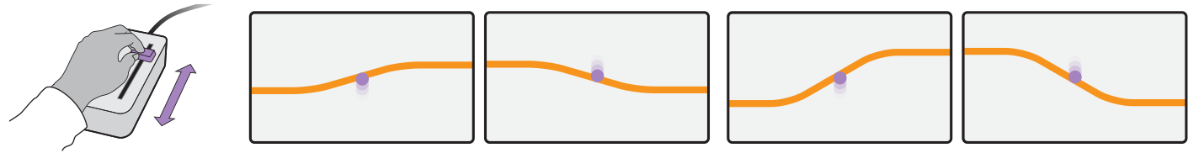

testing forward + inverse models
  subjects use 1-dimensional input device to control vertical cursor position to track specified reference

Slide 15
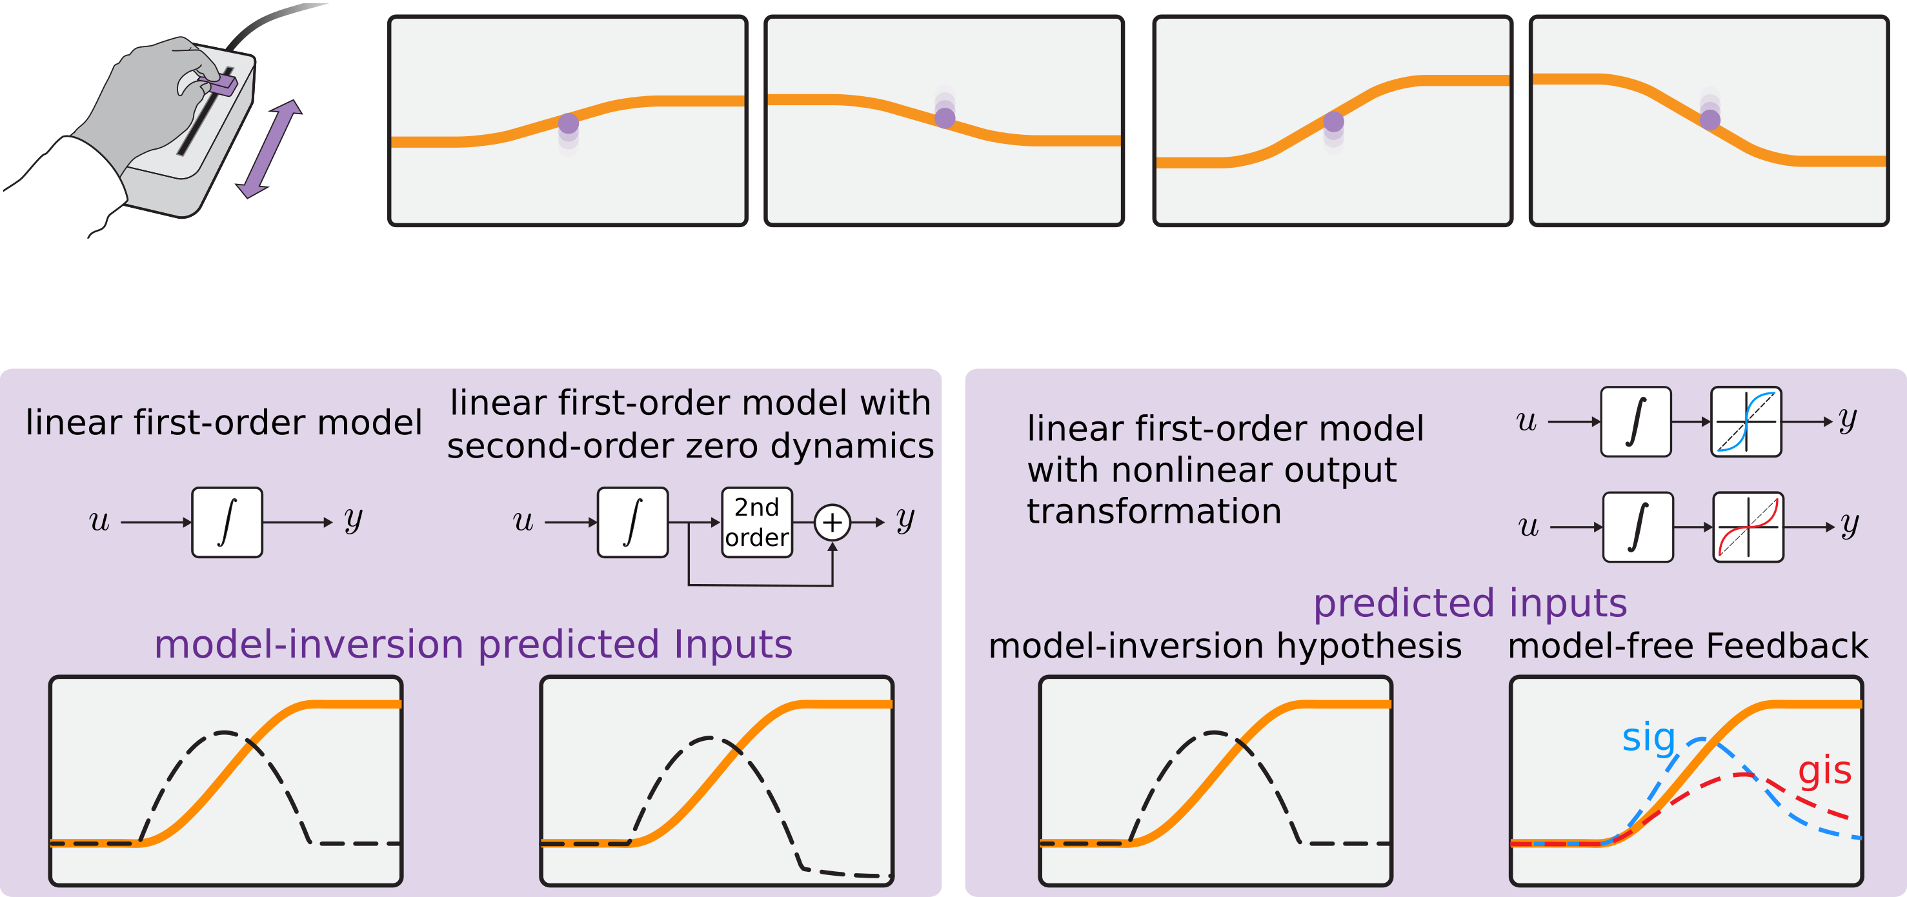
do humans use inverse models?

Slide 16
do humans use PD control?

Slide 17
do humans use PD control?
  output nonlinearity changes learned model, leaves predicted input unaffected

Slide 18
data analysis and visualization
  each assay consists of 10 up and down references with each of 2 magnitudes (10%, 20% display height)

Slide 19
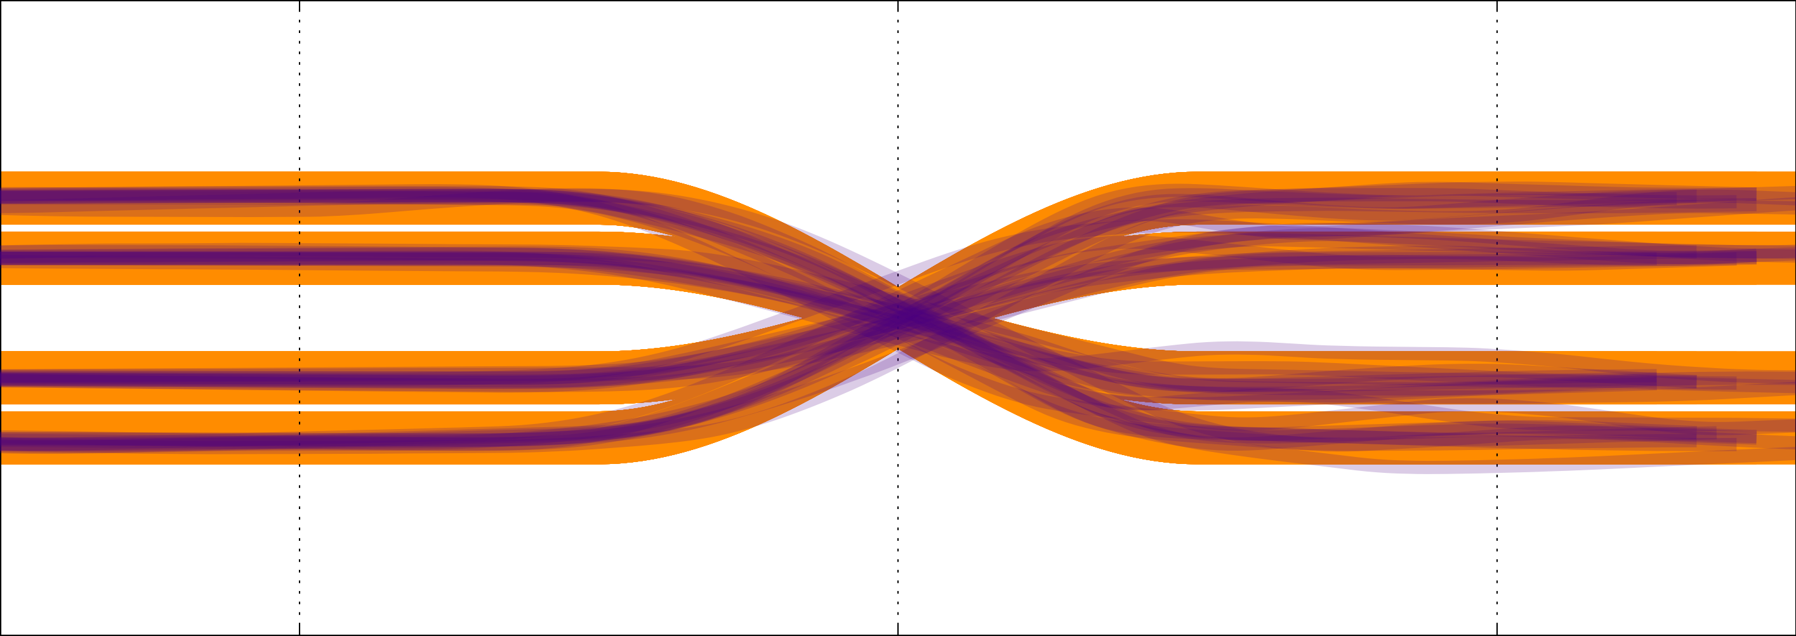
data analysis and visualization
  each assay consists of 10 up and down references with each of 2 magnitudes (10%, 20% display height)

Slide 20

data analysis and visualization
  to visualize the data, we flip down trials and shift the baseline to coincide for all trials

Slide 21
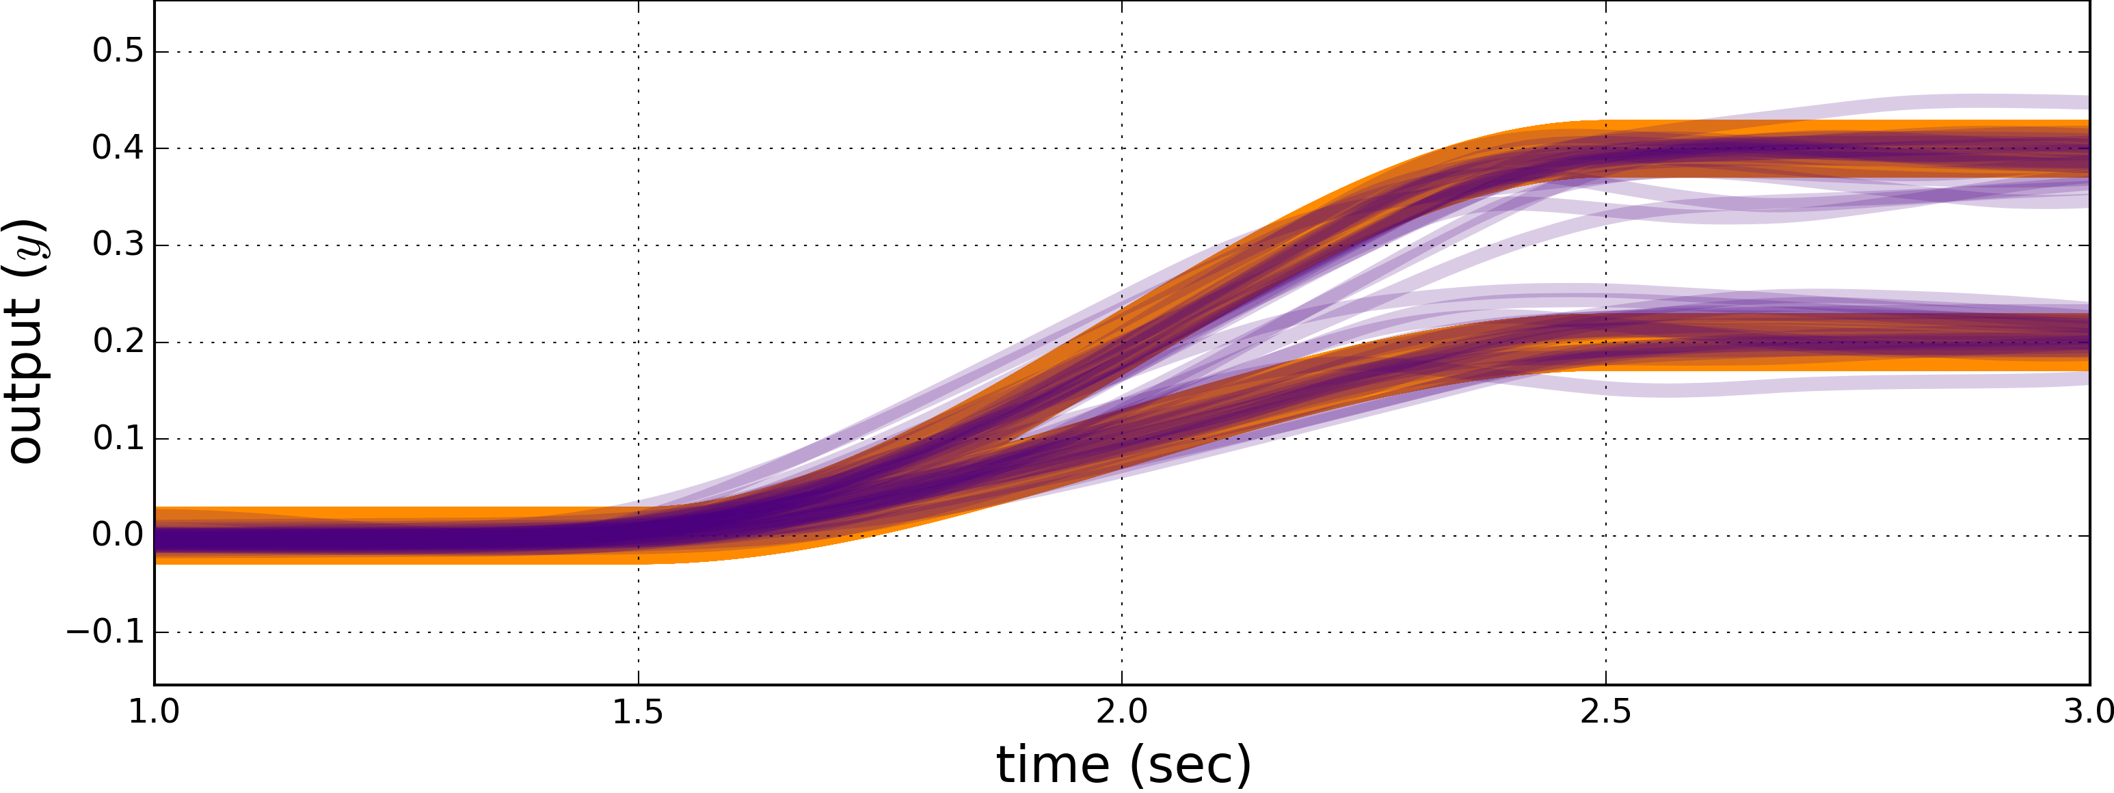
data analysis and visualization
  to visualize the data, we flip down trials and shift the baseline to coincide for all trials

Slide 22
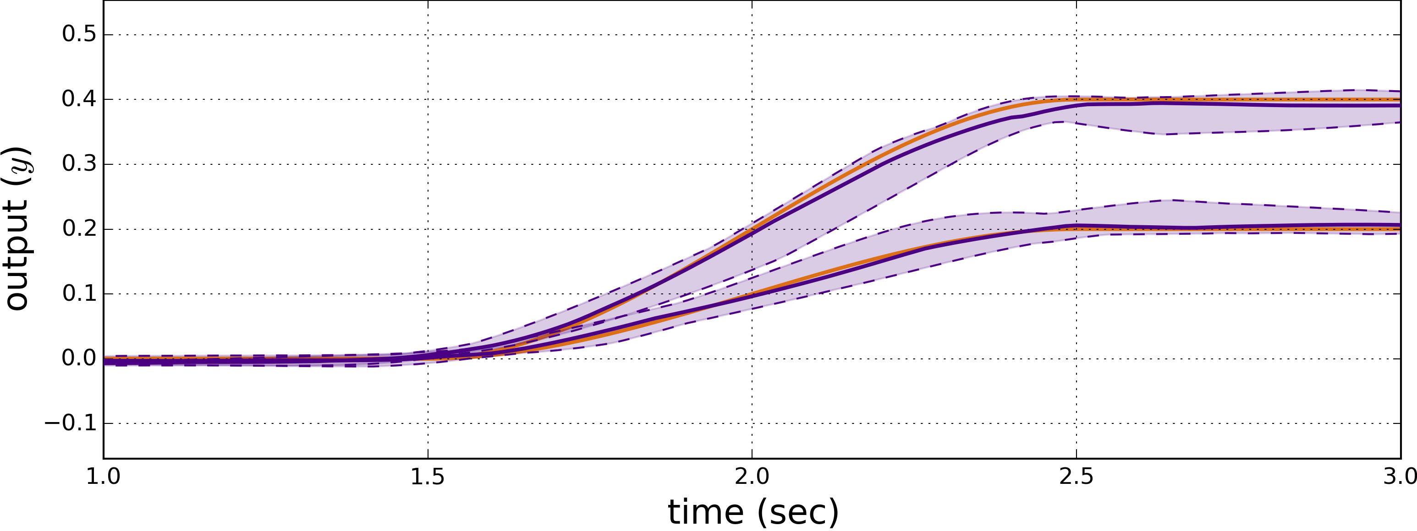
data analysis and visualization
  to assess subject performance, we visualize the interquartile range (i.e. 25th—75th percentiles)

Slide 23
results: first-order model
operator outputs enclose reference,
but operator inputs do not

Slide 24
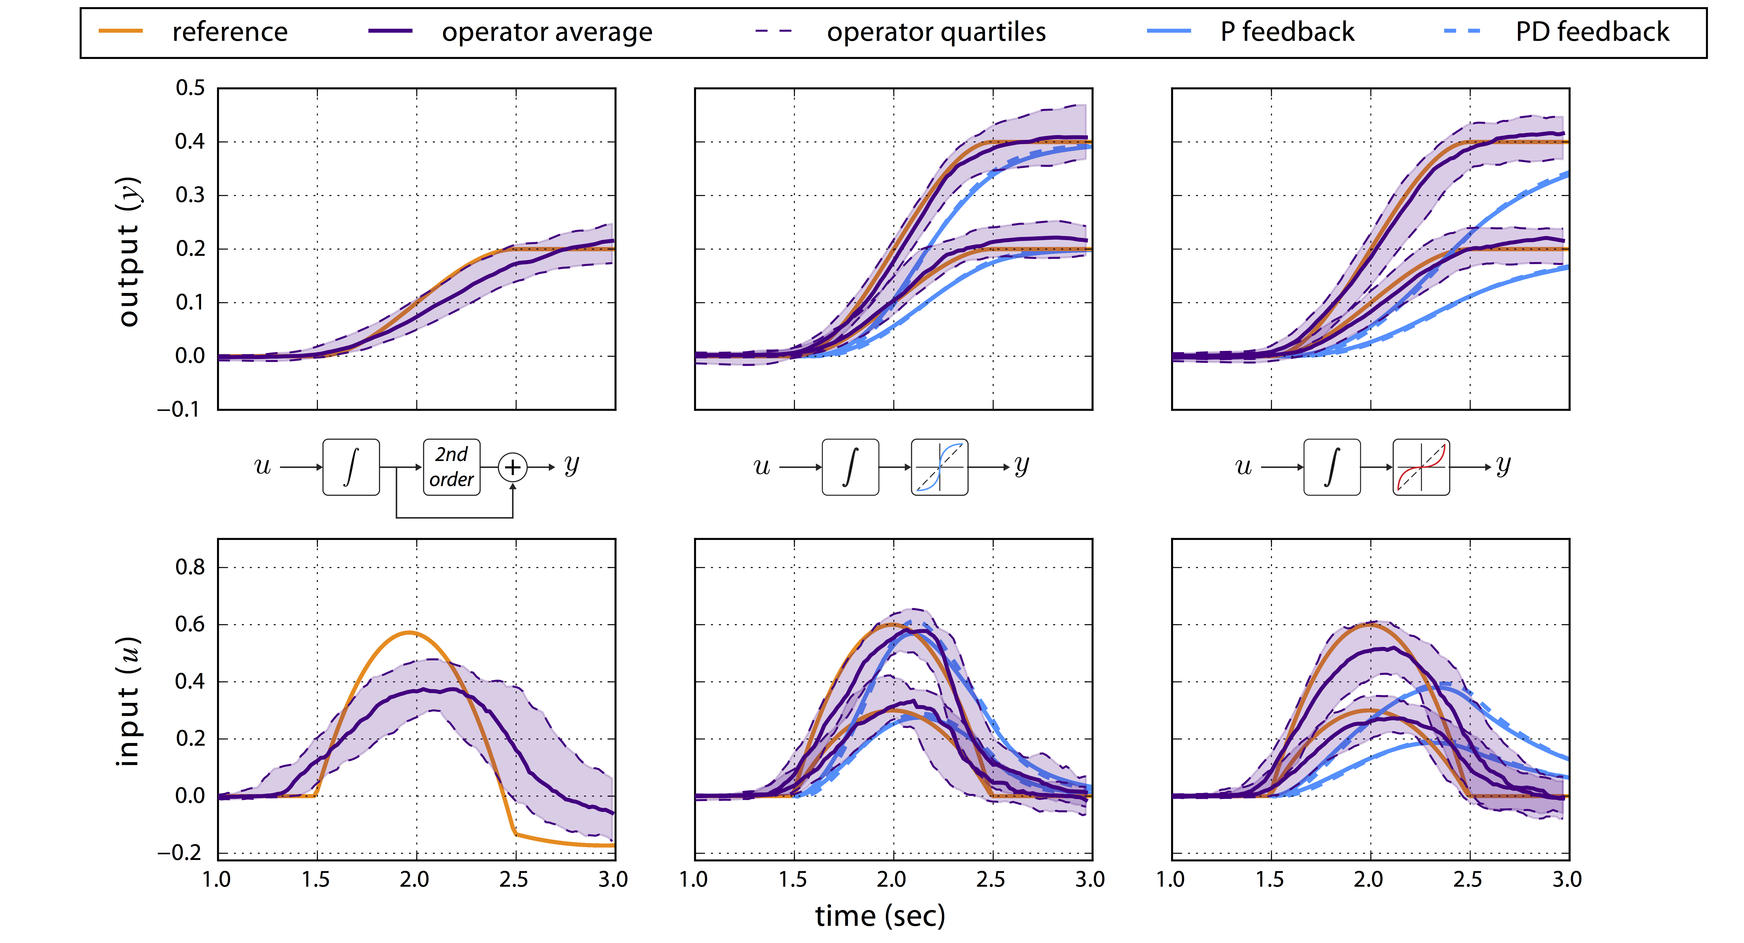
results: zero dynamics, nonlinearities
zero dynamics increase input error;
nonlinearities decrease input error (?)

Slide 25
Human-Cyber-Physical System:
robotic teleoperation

Slide 26
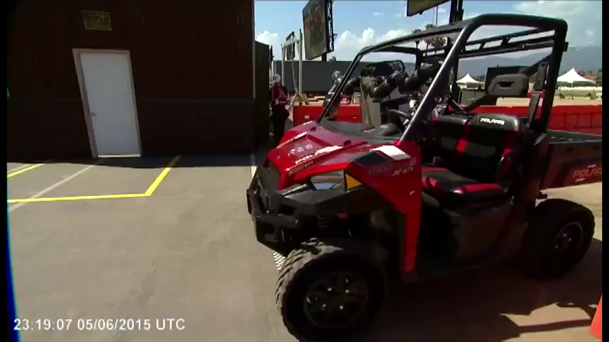

Slide 27
Human-Cyber-Physical System:
robotic teleoperation
future:
dynamic tele-manipulation & tele-locomotion

Slide 28









thank you!
sburden@uw.edu
http://faculty.uw.edu/sburden
Eatai Roth
Will Nothwang
Darrin Howell
Mike McCourt
Cydney Beckwith
Dexter Scobee
Ryan Robinson
Shankar Sastry
ONR #N00014-13-1-0341:
Embedded Humans MURI
CPS #1565529: Provably-safe interventions for Human-Cyber-Physical Systems

