Slide 1







Provably-safe interventions for
Human-Cyber-Physical Systems (HCPS)
Sam Burden
Assistant Professor
Electrical Engineering
University of Washington
Seattle, WA USA
http://faculty.uw.edu/sburden
CNS #1565529
Eatai
Roth
Darrin
Howell
Momona
Yamagami
Cydney
Beckwith

Slide 2

Human-Cyber-Physical System:
robotic teleoperation
sensory feedback
sensory feedback
motor control inputs
Chiawakum Creek Fire near Lake Wenatchee, WA © Michael Stanford 2015 http://yourshot.nationalgeographic.com/photos/4181903/

Slide 3
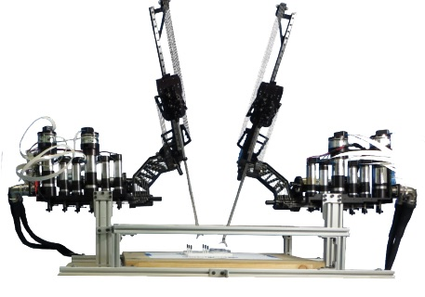
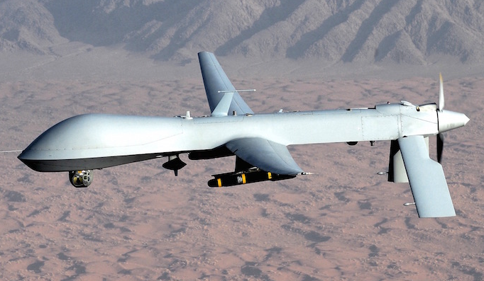

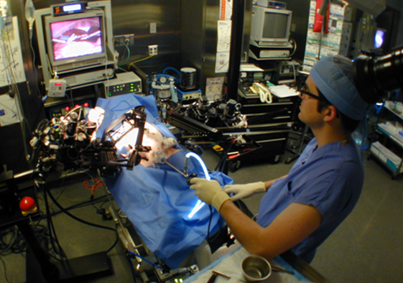
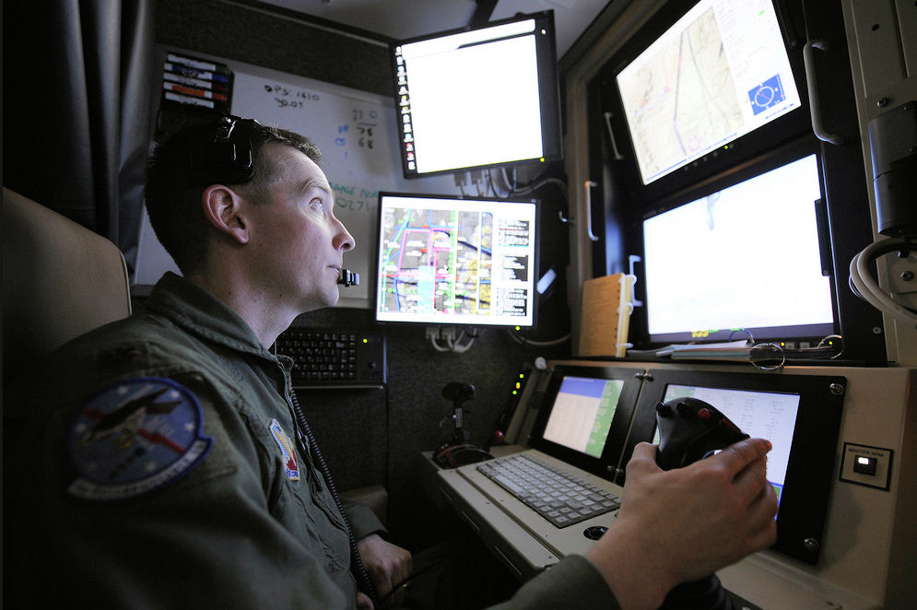




roles for humans and automation
legal, ethical, and political concerns
ensure humans will remain in-the-loop
Nothwang, Robinson, Burden, McCourt, Curtis IEEE Resilience Week 2016
The Human Should be Part of the Control Loop?

Slide 4
intervening in Human-Cyber-Physical Systems
any intervention alters the sensorimotor loop
sensory feedback
sensory feedback
motor control inputs
safe intervention requires validated
predictive models for sensorimotor loops

Slide 5
predictable behavior from internal models
  theoretical and empirical evidence for pairing of forward + inverse models
    Bhushan, Shadmehr Bio. Cybern. 1999; Sanner, Kosha Bio. Cybern. 1999
forward model
+
inverse model
  parallels in control theory, robotics, artificial intelligence: adaptive control, internal model principle, learning
    Francis, Wonham Automatica 1976; Sastry, Bodson Prentice Hall 1989
    Sutton, Barto, Williams IEEE CSM 1992; Atkeson, Schaal ICML 1997
    Papavassiliou, Russell IJCAI 1999
Notes:
replace text with cartoon

Slide 6





theory for forward + inverse models
M, M⁻¹
output y
input u_{d}
do humans learn forward + inverse models?
Theory results:
  for stable model pair, trajectories x₁ and x₂ converge to
  feedforward input “asymptotically inverts” dynamics
Robinson, Scobee, Burden, Sastry SPIE-DSS 2016
Dynamic inverse models in human-cyber-physical systems

Slide 7
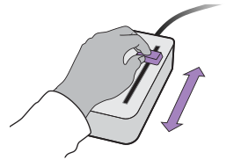


experiments with forward + inverse models
  subjects use 1-dimensional input device to control cursor motion to track specified reference
Roth, Howell, Beckwith, Burden SPIE 2017
Toward experimental validation of a model for human sensorimotor learning and control in teleoperation

Slide 8
experiments with forward + inverse models
  subjects use 1-dimensional input device to control cursor motion to track specified reference
human
-cyber-physical system
d
F
u
+
+
M
y
e
r
+
B
-
Roth, Howell, Beckwith, Burden SPIE 2017
Toward experimental validation of a model for human sensorimotor learning and control in teleoperation

Slide 9
empirically estimating learned model
human
-cyber-physical system
d
F
u
+
+
M
y
e
r
+
B
-
  by varying reference (r) and disturbance (d), can estimate human feedforward (F), feedback (B)
  human learns to invert specified model (M): feedforward approximates the inverse (F≈M⁻¹)
Roth, Howell, Beckwith, Burden SPIE 2017
Toward experimental validation of a model for human sensorimotor learning and control in teleoperation

