Slide 1

Why (or, more specifically, when) do feedforward inputs yield stable behaviors?
Sam Burden
Assistant Professor
Electrical Engineering
University of Washington
Seattle, WA USA
http://faculty.uw.edu/sburden
AMP Lab
http://depts.washington.edu/amplify
BioRobotics Lab
http://brl.ee.washington.edu

Slide 2



collaborators
Sam Coogan*
Asst Prof, GATech
*NOT Sam Burden
(but I see why you got us confused …)
Tom Libby
Postdoc, UW Seattle
(i.e. needs a job)
DW talk: 12p Wed

Slide 3
Why (or, more specifically, when) do feedforward inputs yield stable behaviors?
part 1: vignettes
feedforward inputs can yield stable behaviors

Slide 4
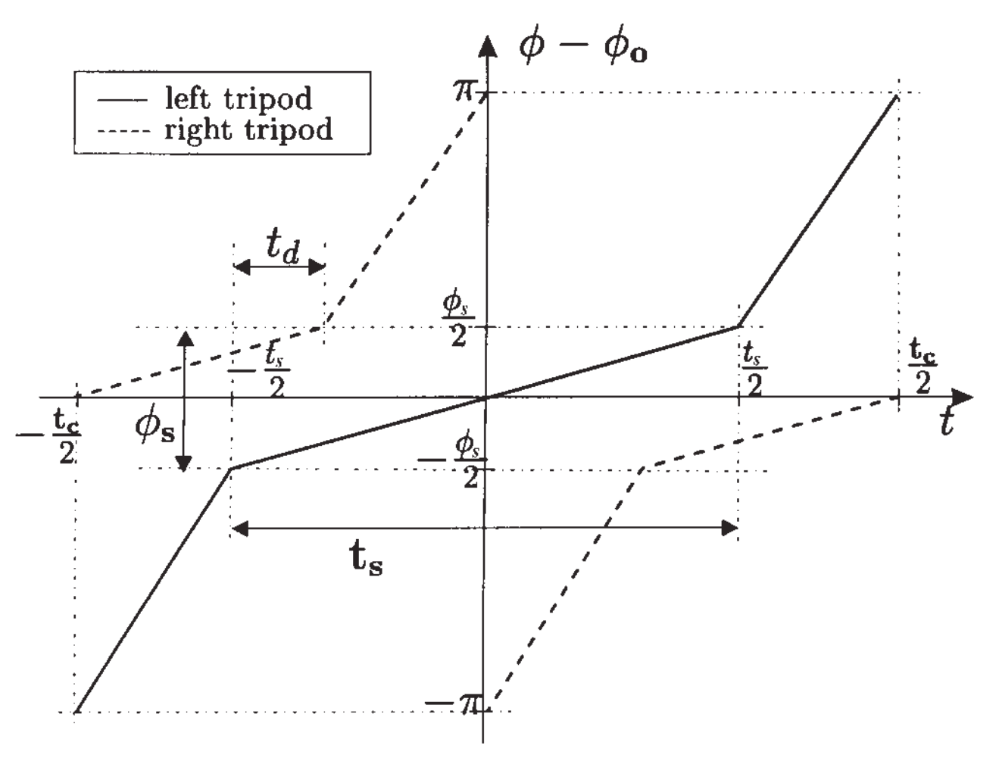
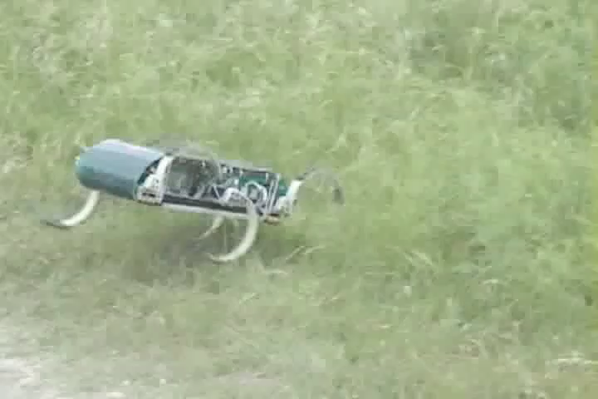
vignette 1: RHex
feedforward input
(Buehler clock)
leg angle
stance (slow)
swing (fast)
Observation: stable running gait emerges from tracking feedforward leg angle reference
time
stable behavior
(running RHex)
Saranli, Buehler, Koditschek IJRR 2001
RHex: a simple and highly mobile hexapod robot

Slide 5
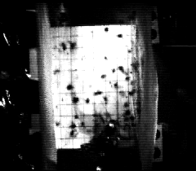
vignette 2: cockroach (impulsive perturbation)
feedforward input (neural oscillator)
Observation: stabilization begins faster than neural feedback could alter recovery
stable behavior (perturbation rejection)
Jindrich, Full JEB 2002
Dynamic stabilization of rapid hexapedal locomotion

Slide 6
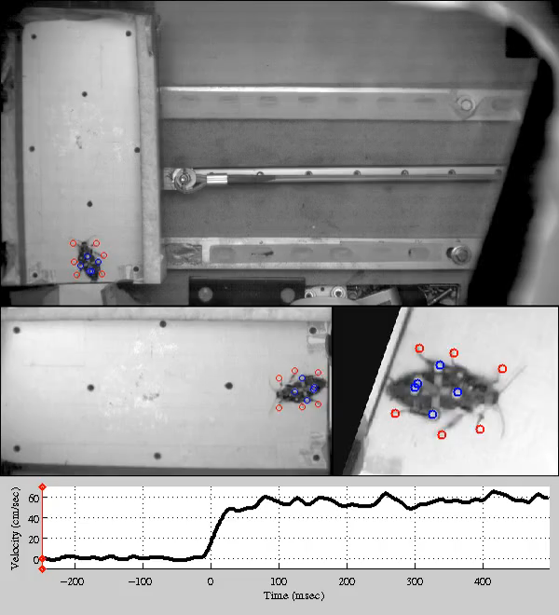
slowed 20x

Slide 7

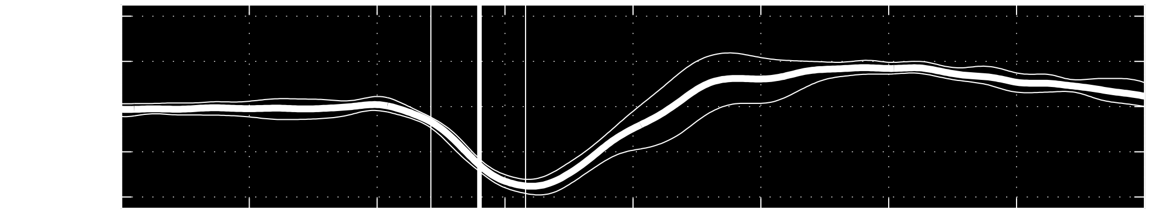
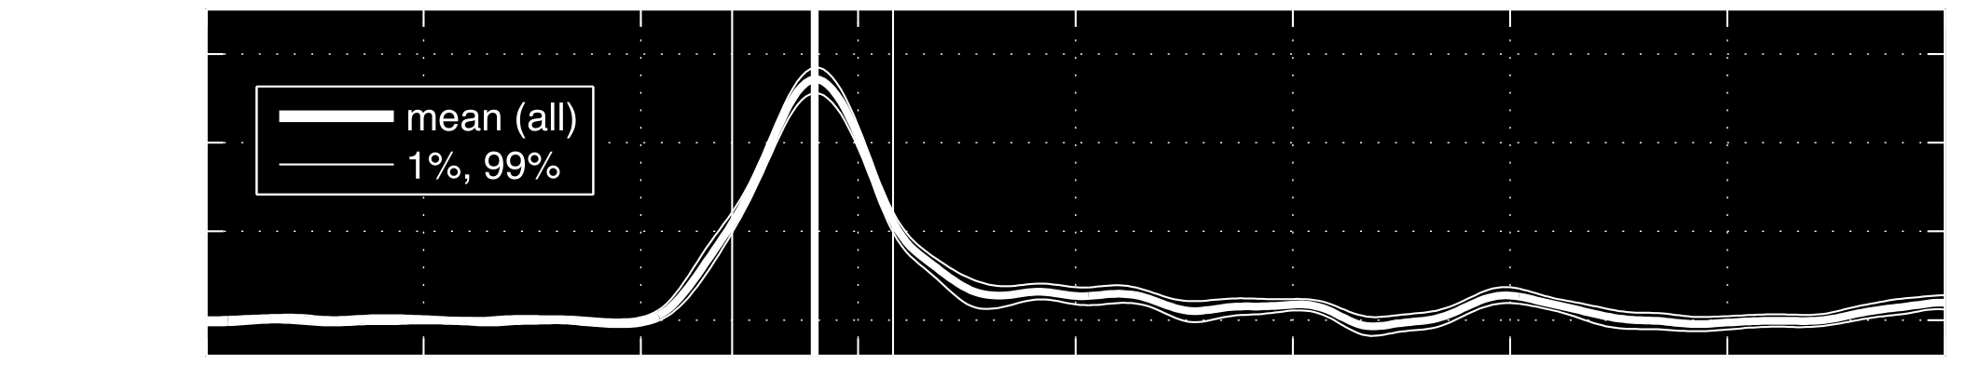




vignette 3: cockroach (extended perturbation)
feedback occurs at a delay
feedforward input
Observation: feedforward input persists for
> 1 stride after perturbation onset
real-time
Revzen, Burden, Moore, Mongeau, Full Bio Cyber 2013
Instantaneous kinematic phase reflects neuromechanical response to lateral perturbations of running cockroaches

Slide 8
Why (or, more specifically, when) do feedforward inputs yield stable behaviors?
part 1: vignettes
feedforward inputs can yield stable behaviors

Slide 9
Why (or, more specifically, when) do feedforward inputs yield stable behaviors?
part 1: vignettes
feedforward inputs can yield stable behaviors

Slide 10
Why (or, more specifically, when) do feedforward inputs yield stable behaviors?
part 1: vignettes
feedforward inputs can yield stable behaviors
part 2: analysis
predict when feedforward inputs yield stable behaviors

Slide 11
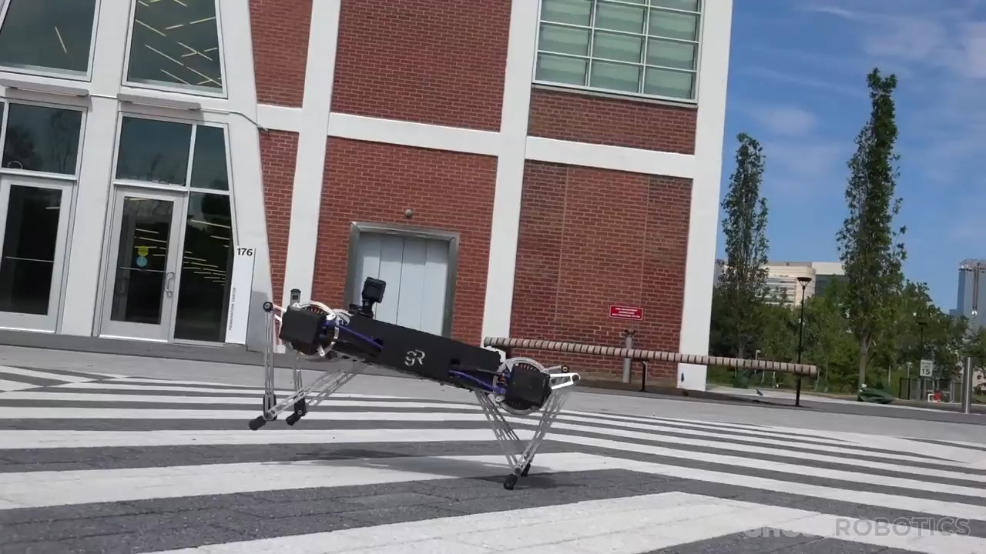



Kenneally, De, Koditschek IEEE RAL 2016; http://ghostrobotics.io

Slide 12
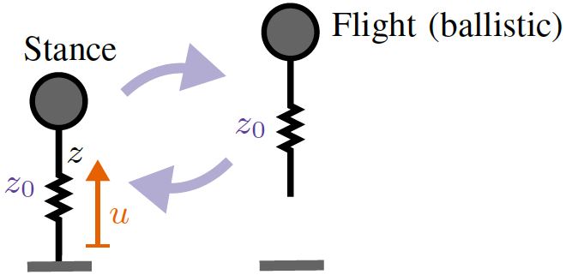
  ≈
  height
  steps
Theorem: feedforward input u averages to a proportional controller on total energy
De, Koditschek IJRR 2018
Vertical hopper compositions for preflexive and feedback-stabilized quadrupedal bounding, pacing, pronking and trotting
De, Burden, Koditschek IJRR 2018
A hybrid dynamical extension of averaging and its application to the analysis of legged gait stability

Slide 13
End of slide show. Swipe forward to exit.

Slide 14
Why (or, more specifically, when) do feedforward inputs yield stable behaviors?
part 1: vignettes
feedforward inputs can yield stable behaviors
part 2: analysis
predict when feedforward inputs yield stable behaviors

Slide 15
Why (or, more specifically, when) do feedforward inputs yield stable behaviors?
part 1: vignettes
feedforward inputs can yield stable behaviors
part 2: analysis
predict when feedforward
inputs yield stable behaviors
¯\_(ツ)_/¯

Slide 16











thank you!
sburden@uw.edu
http://faculty.uw.edu/sburden
Tom Libby
Sam Coogan
Bora Banjanin
Shankar Sastry
Andrew Pace
Avik De
Talia Moore
Aaron Johnson
J-M Mongeau
Dan Koditschek
Bob Full
Shai Revzen
ARO YIP #W911NF-16-1-0158: Predictive models for sensorimotor control of legged locomotion

Slide 17
Why (or, more specifically, when) do feedforward inputs yield stable behaviors?
part 1: vignettes
feedforward inputs can yield stable behaviors
part 2: analysis
predict when feedforward
inputs yield stable behaviors
¯\_(ツ)_/¯

