Slide 1

Toward telelocomotion:
contact-rich robot dynamics
and human sensorimotor control
follow along: http://bit.ly/2020-burden
Sam Burden
Assistant Professor
Electrical & Computer Engineering
University of Washington
Seattle, WA USA
http://faculty.uw.edu/sburden
AMP Lab
http://depts.washington.edu/amplify
BioRobotics Lab
http://brl.ee.washington.edu

Slide 2
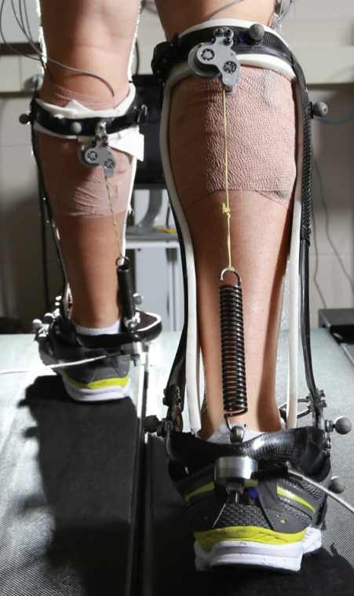
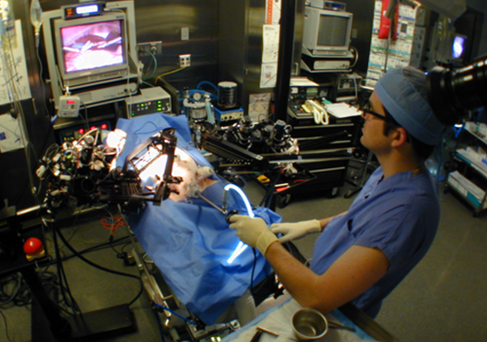
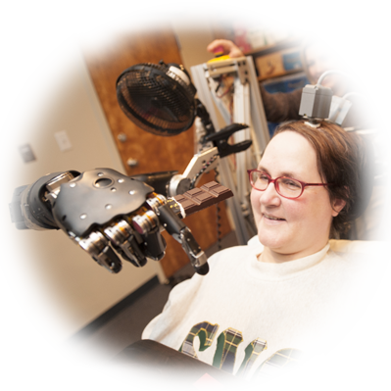



human interaction with the physical world
is increasingly mediated by machines
legal, ethical, and political concerns
ensure humans will remain in-the-loop
Hannaford, Rosen, Friedman, King, Roan, Cheng, Glozman, Ma, Kosari, White IEEE Tran Biomed Eng 2013 Raven-II: An Open Platform for Surgical Robotics Research
Wodlinger, Downey, Tyler-Kabara, Schwartz, Boninger, Collinger J Neural Eng 2015
Ten-Dimensional Anthropomorphic Arm Control in a Human Brain-Machine Interface
Collins, Wiggin, Sawicki Nature 2015
Reducing the Energy Cost of Human Walking Using an Unpowered Exoskeleton
Nothwang, Robinson, Burden, McCourt, Curtis IEEE Resilience Week 2016
The Human Should be Part of the Control Loop?

Slide 3

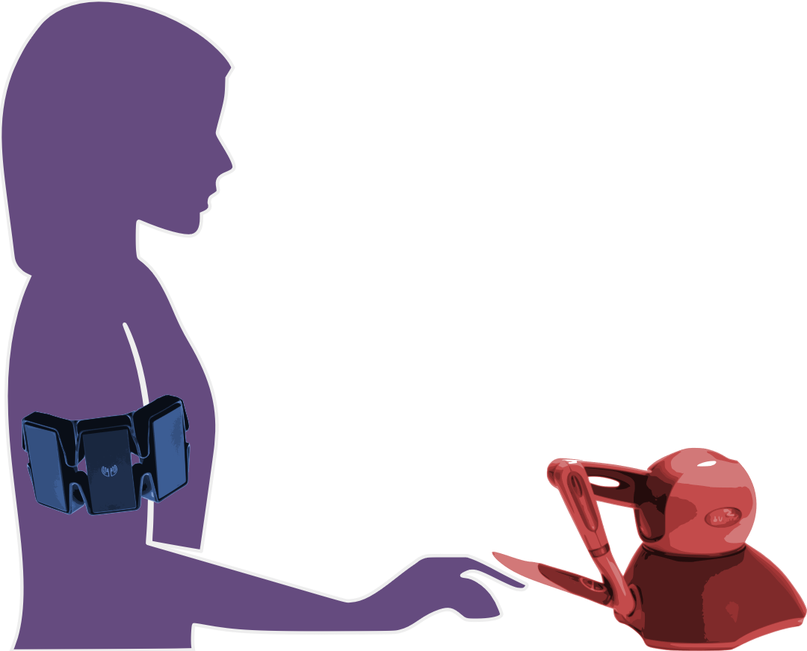
human/machine system:
robot teleoperation
human sensory inputs
human motor outputs
Chiawakum Creek Fire near Lake Wenatchee, WA © Michael Stanford 2015 http://yourshot.nationalgeographic.com/photos/4181903/

Slide 4
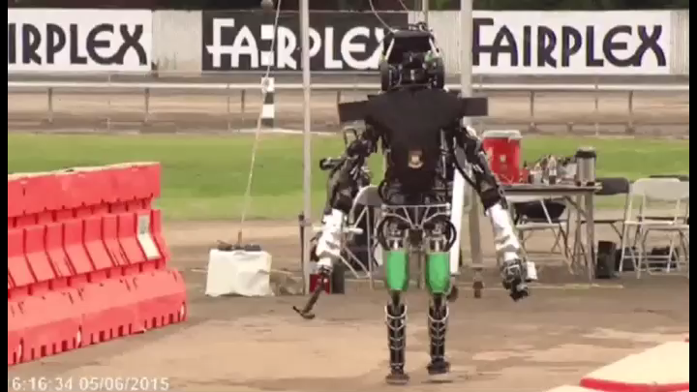
robots struggle with contact-rich dynamics
DARPA Robotics Challenge: A Compilation of Robots Falling Down https://spectrum.ieee.org/automaton/robotics/humanoids/darpa-robotics-challenge-robots-falling

Slide 5
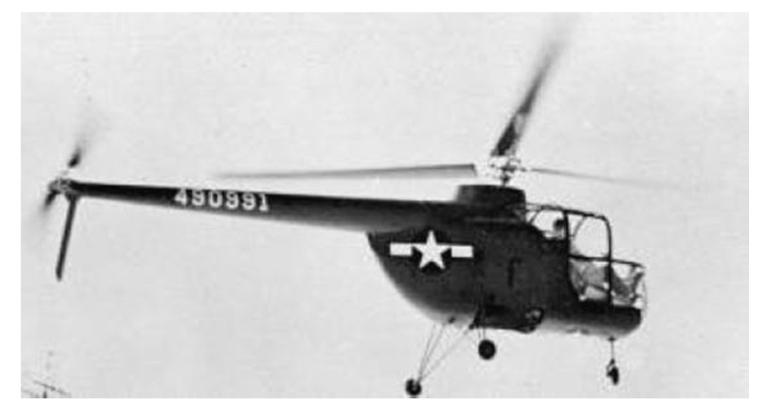
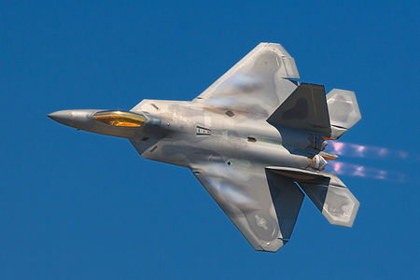
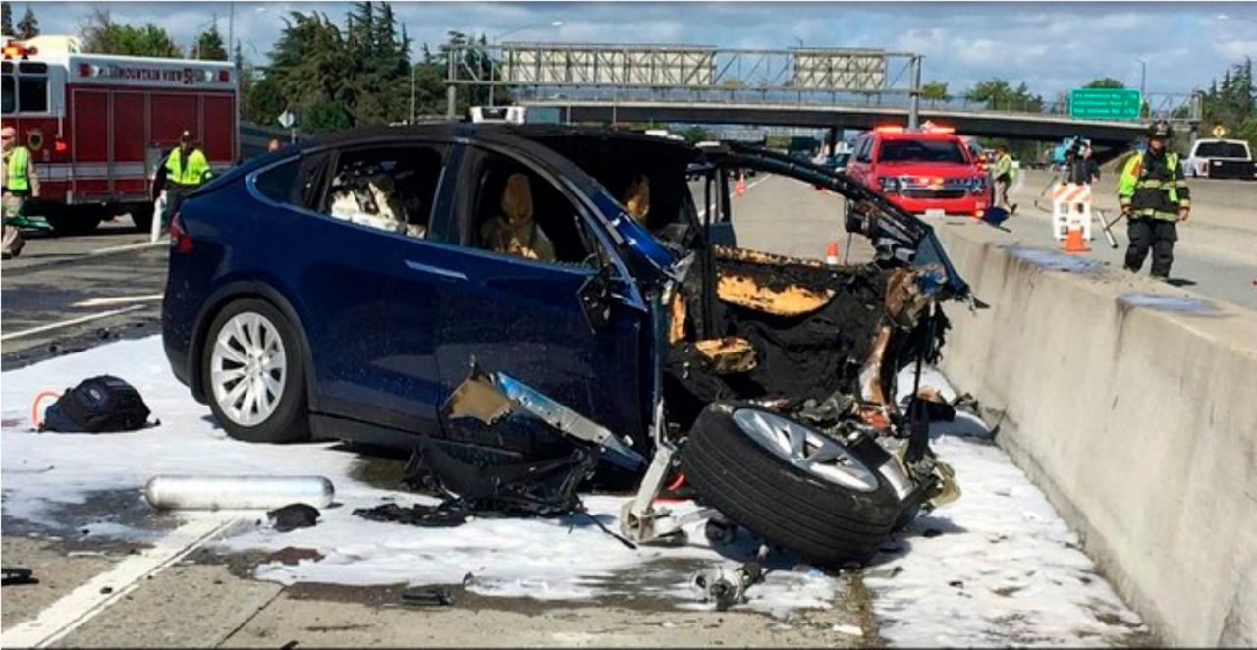
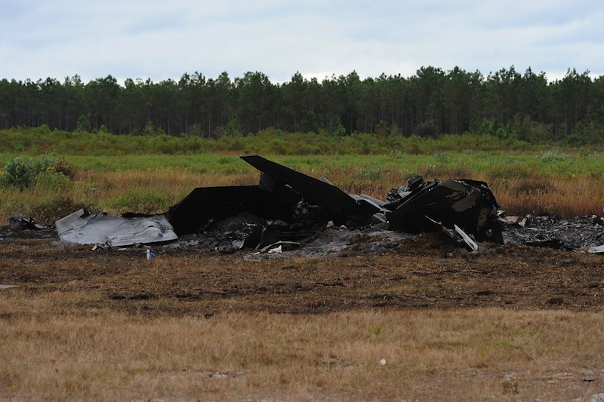
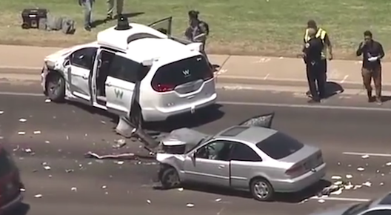
coupling humans and machines
  pilot-induced oscillations in rotory & fixed-wing aircraft
    McRuer, Krendel 1974; Hess J. Guid. Cont. Dyn. 1997
    Pavel et al. Prog. Aero. Sci. 2013
  overreliance on enhanced safety features in cars
    Rudin-Brown, Parker Traffic Psych. Behav. 2004;
    Moore, Zuby Proc. Enhanced Safety Vehicles 2013
naïve coupling can lead to performance loss
ranging from mild to catastrophic

Slide 6
human/machine system:
robot teleoperation
human sensory inputs
how do we enable humans to learn and control
contact-rich robot dynamics?
human motor outputs
Chiawakum Creek Fire near Lake Wenatchee, WA © Michael Stanford 2015 http://yourshot.nationalgeographic.com/photos/4181903/

Slide 7

ECE Colloquium Fall 2020
telelocomotion: contact-rich robot dynamics
and human-in-the-loop control systems
http://ece.uw.edu/colloquium

Slide 8
today’s talk:
how do we enable humans to learn and control
contact-rich robot dynamics?
contact-rich robot
terradynamics
human sensorimotor
learning and control

Slide 9
today’s talk:
how do we enable humans to learn and control
contact-rich robot dynamics?
contact-rich robot
terradynamics
human sensorimotor
learning and control

Slide 10
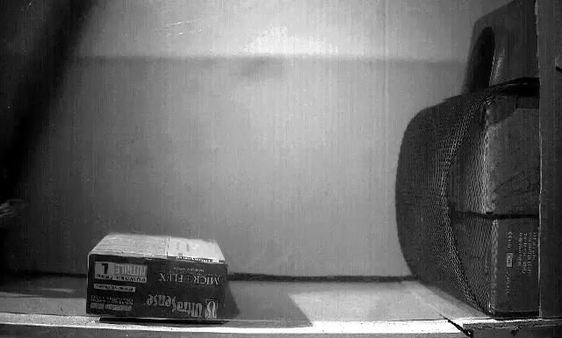
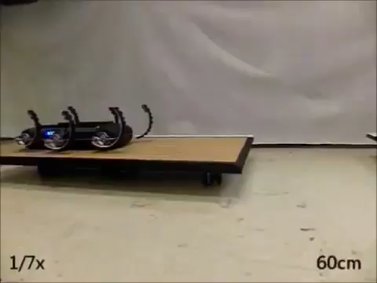
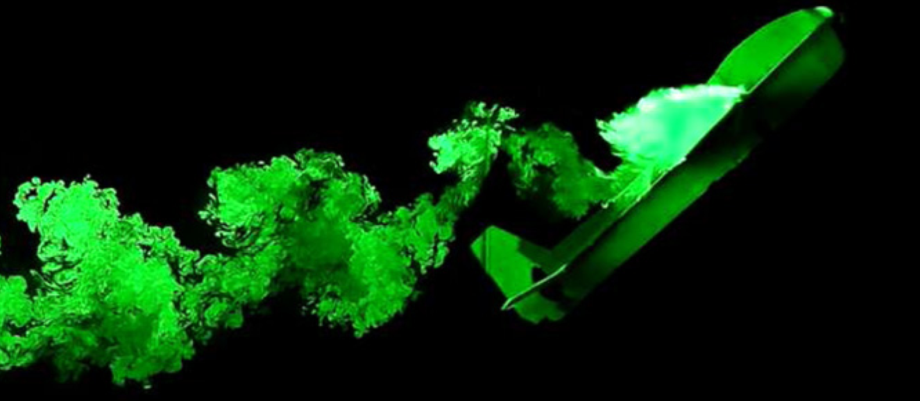
  locomotion through fluid governed by continuous hydro- and aero-dynamics
  locomotion on land governed by intermittent terra-dynamics
Vogel Life in moving fluids 1996
Li, Zhang, Goldman Science 2015
legged locomotion involves contact-rich dynamics
Tytell, Standen, Lauder JEB 2008
Cory, Moore, Tedrake B&B 2014
Libby, Moore, Chang-Siu, Cohen, Jusufi, Full Nature 2012
Johnson, Koditschek ICRA 2013

Slide 11
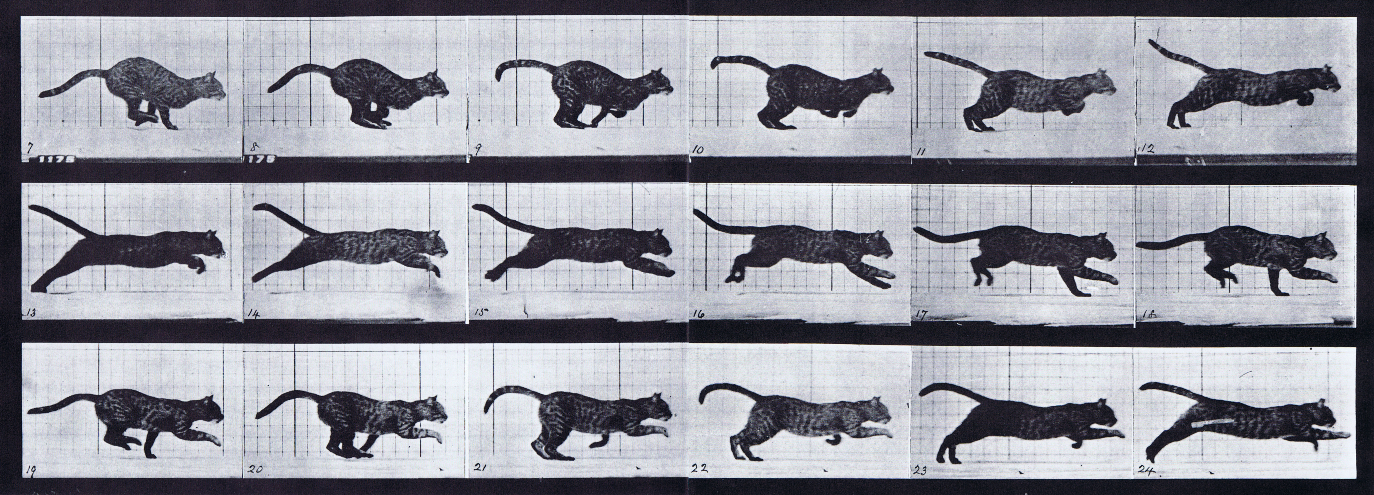

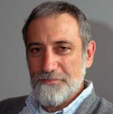
simple models are piecewise-defined (hybrid)
Muybridge 1887 (reprinted by Dover in 1957)
  limbs in contact with ground
  ground penetration constraints
  continuous dynamics
  impact dynamics
Johnson, Burden, Koditschek IJRR 2016 (arXiv:1502.01538)
A hybrid systems model for simple manipulation and self-manipulation systems

Slide 12
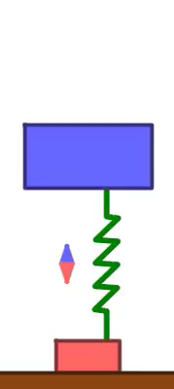

Slide 14
Theorem (Aizerman & Gantmacher et al):
if contact sequence doesn’t change,
final state varies differentiably w.r.t. initial state
Aizerman & Gantmacher 1958
Quarterly Journal of Mechanics and Applied Mathematics
Determination of Stability by Linear Approximation of a Periodic Solution of a System of Differential Equations with Discontinuous Right-Hand Sides
Grizzle, Abba, Plestan IEEE TAC 2002
Di Bernardo, Budd, Kowalczyk, Champneys Springer 2008
Burden, Revzen, Sastry IEEE TAC 2015

Slide 15
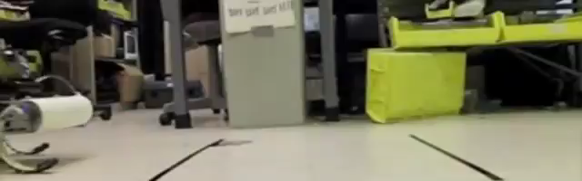

what if contact sequence can vary?
Galloway, Haynes, Ilhan, Johnson, Knopf, Lynch, Plotnick, White, Koditschek UPenn 2010
Hyun, Seok, Lee, Kim IJRR 2014

Slide 17
Theorem (Remy et al):
near simultaneous impacts, final state generally
varies discontinuously w.r.t. initial state
Hürmüzlü and Marghitu
International Journal of Robotics Research 1994
Rigid Body Collisions of Planar Kinematic Chains With Multiple Contact Points
Remy, Buffington, Siegwart
International Journal of Robotics Research 2010
Stability Analysis of Passive Dynamic Walking of Quadrupeds

Slide 18
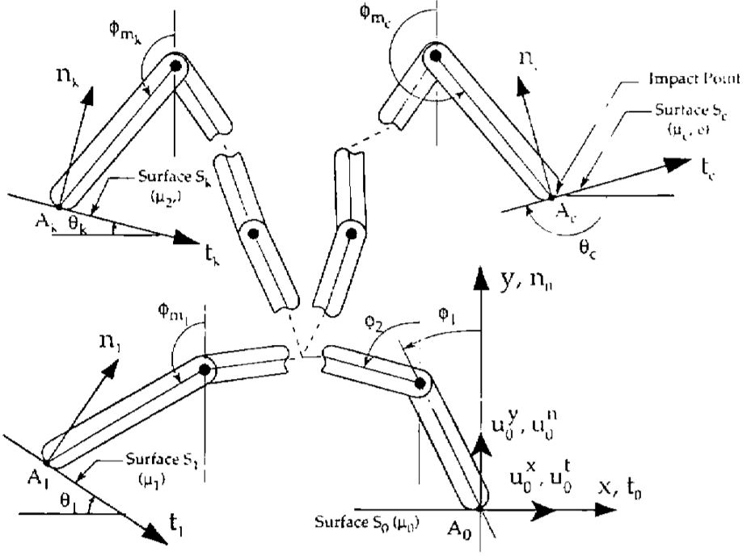
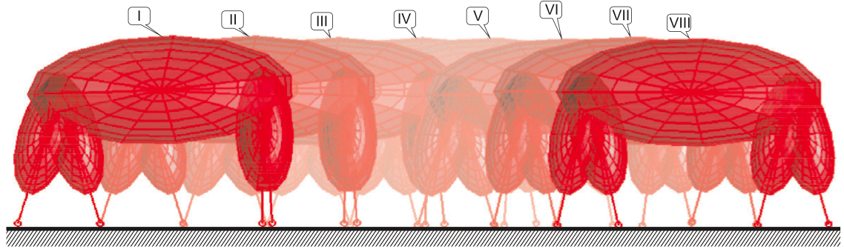
inconsistencies arise when limbs are coupled
  hand with rigid fingers exhibits 5 different post-grasp outcomes
Hürmüzlü and Marghitu IJRR 1994, JAM 1995
rigidly coupled limbs
→ post-impact inconsistencies
  quadruped with rigid legs exhibits 3 distinct (near-)trot gaits
Remy, Buffington, Siegwart IJRR 2010

Slide 19
coupled vs decoupled limbs
inertially decoupled limbs
→ post-impact consistency
coupled limbs
decoupled limbs

Slide 20
coupled
limbs

Slide 21
decoupled
limbs

Slide 22



Theorem (Pace & Burden):
if limbs are inertially decoupled, final state varies
piecewise-differentiably w.r.t. initial state
Pace & Burden HSCC 2017 (arXiv:1610.05645)
Piecewise-differentiable trajectory outcomes in mechanical systems subject to unilateral constraints
Pace & Burden ICRA 2017 (arXiv:1609.04056)
Decoupled limbs yield differentiable trajectory outcomes through intermittent contact
Burden, Sastry, Koditschek, Revzen SIADS 2016 (arXiv:1407.1775)
Event-Selected Vector Field Discontinuities Yield Piecewise-Differentiable Flows

Slide 23
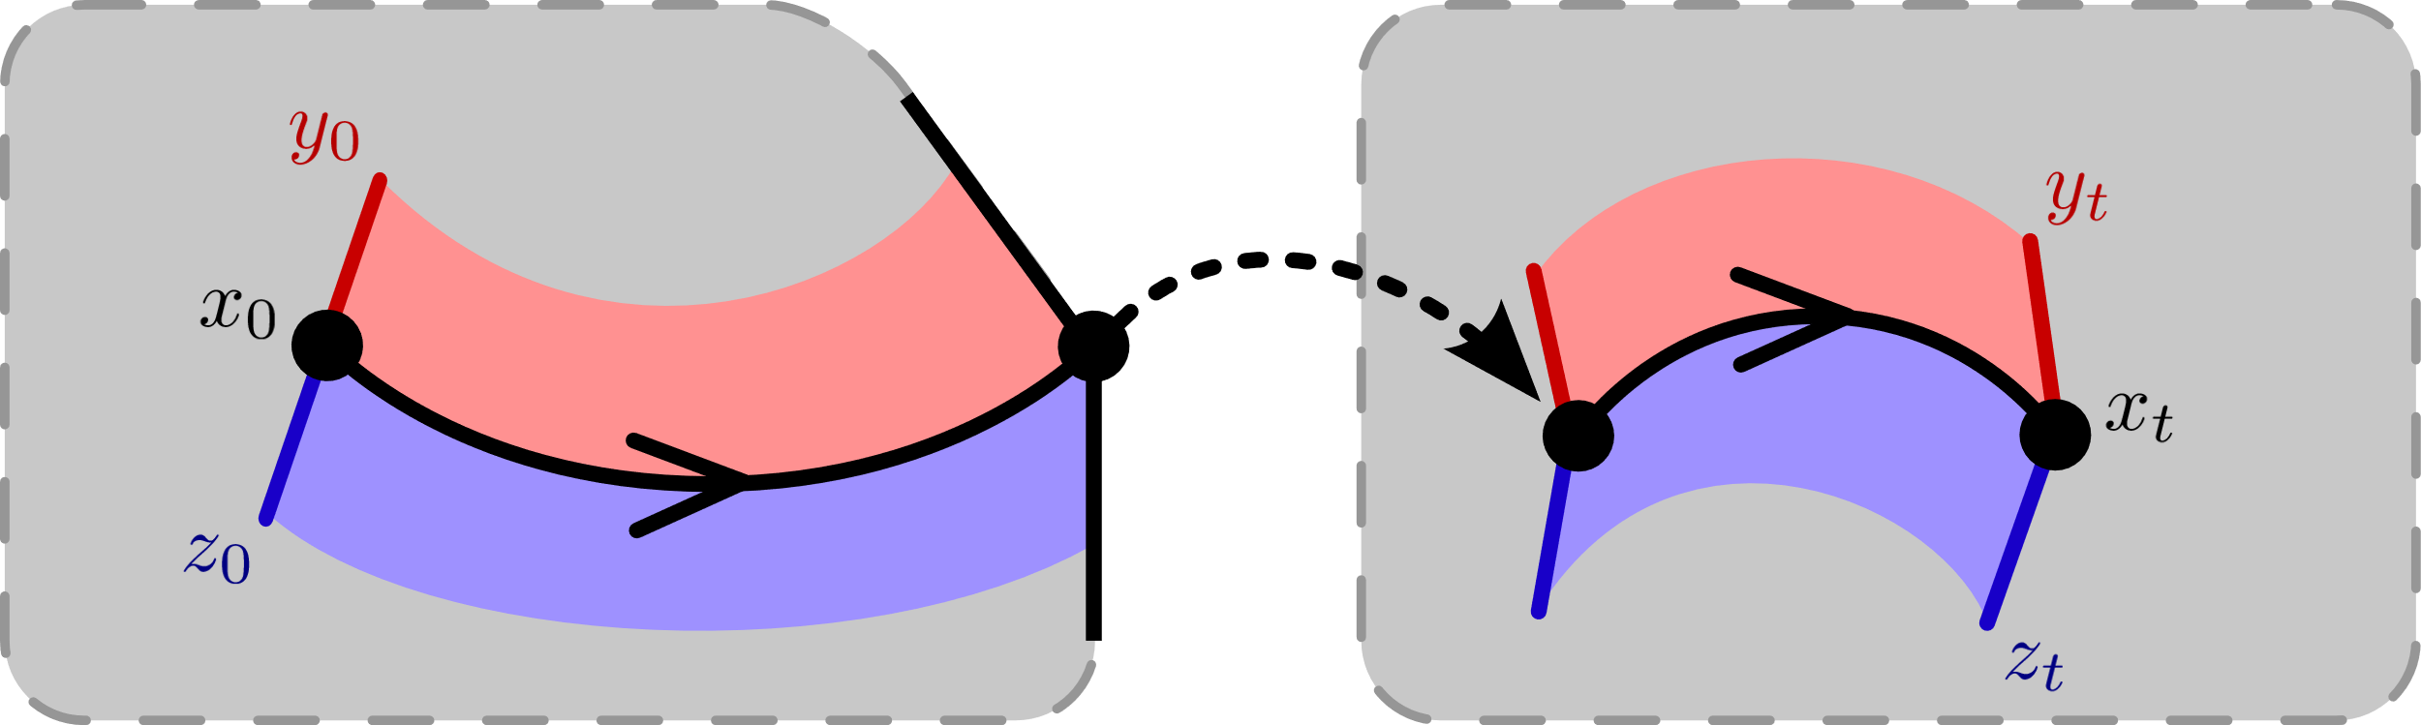
trajectories vary continuously ….

Slide 24
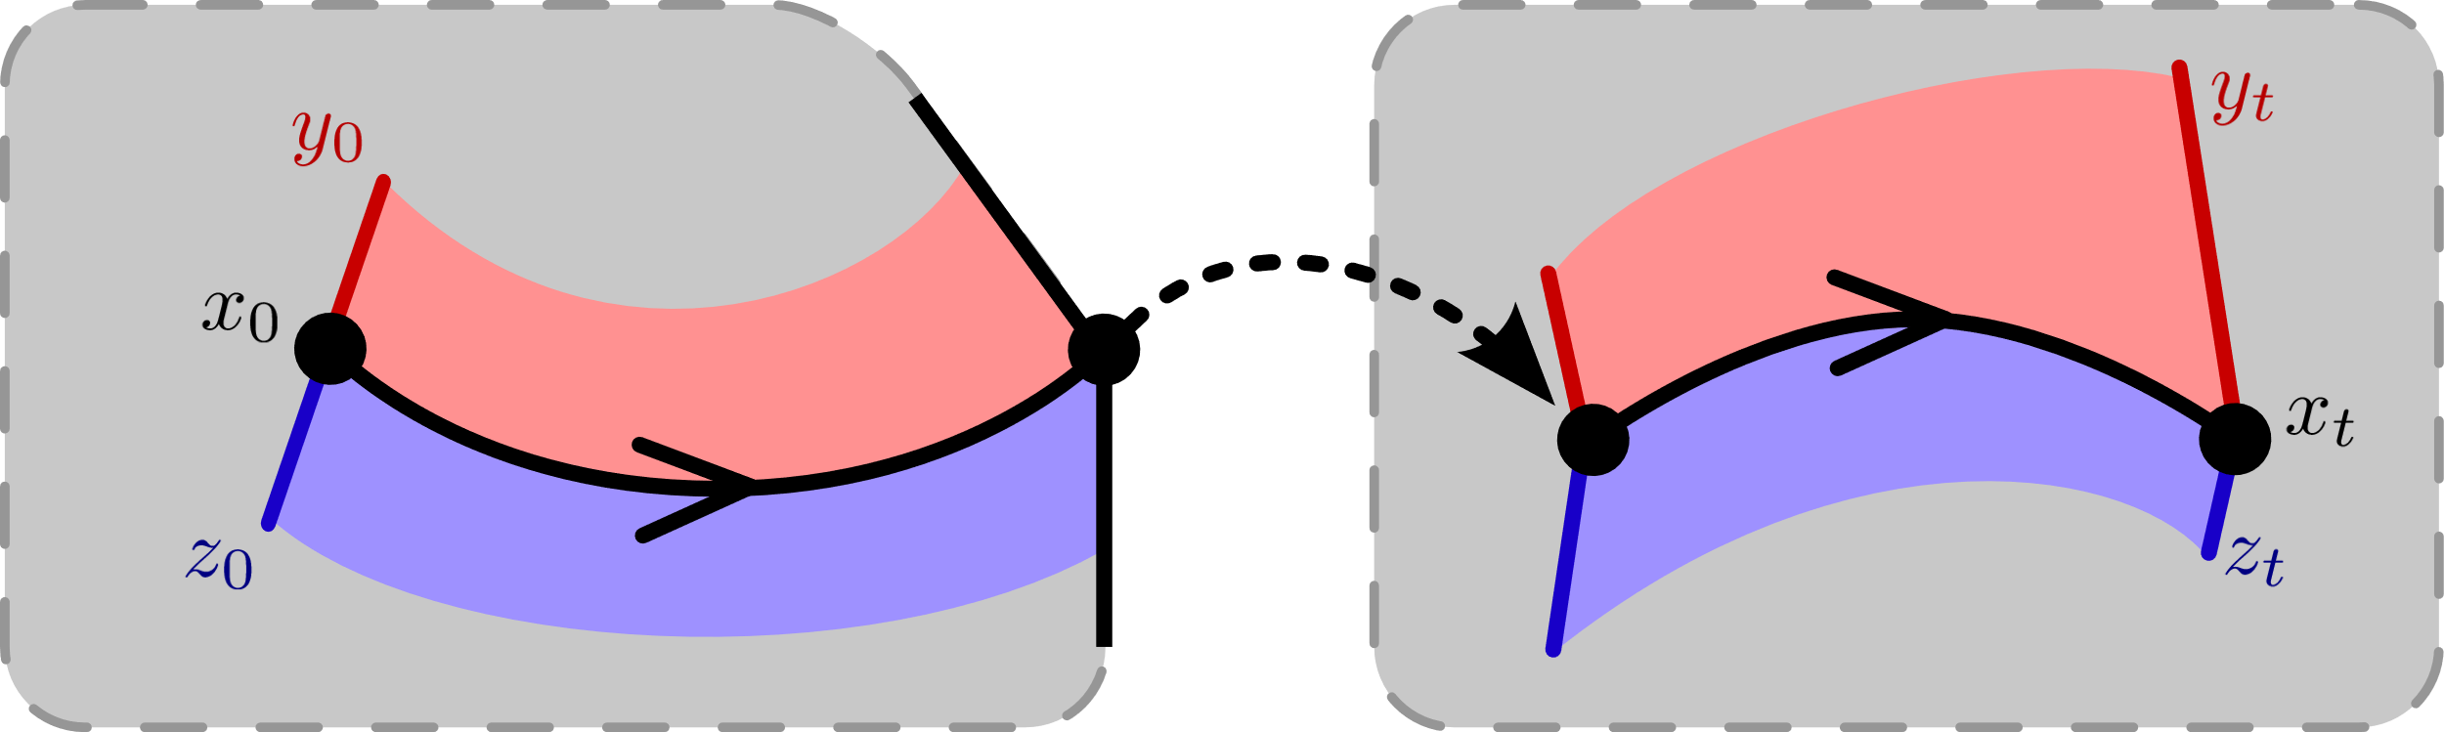
trajectories vary continuously ….
… do they
expand
or
contract?

Slide 25
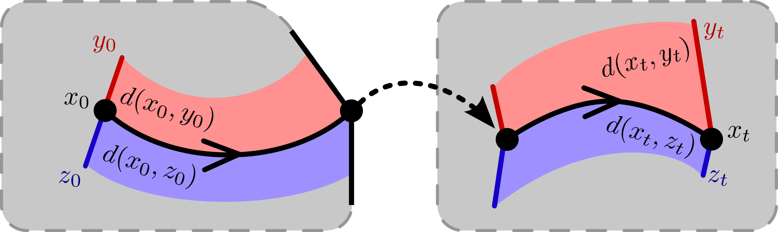


trajectories vary continuously ….
… do they
expand
or
contract?
$$d\left(x_{0},y_{0}\right)<d\left(x_{t},y_{t}\right)$$
$$d\left(x_{0},z_{0}\right)>d\left(x_{t},z_{t}\right)$$

Slide 26





aside: how to measure distance?
d(
)=0
,
Theorem (Burden, Gonzalez, Vasudevan, et al):
d(x ⁻, x ⁺) = 0 determines a distance metric
compatible with topological quotient x ⁻ ~ x ⁺
Burden, Gonzalez, Vasudevan, Bajcsy, Sastry IEEE TAC 2015
Metrization and simulation of controlled hybrid systems

Slide 27




contraction in classical dynamics
Theorem (Lohmiller & Slotine): if the
or
dynamics are infinitesimally contractive,
or
then the dynamics are globally contractive,
i.e. distances decrease at an exponential rate
continuous-time
discrete-time
Lohmiller, Slotine Automatica 1998
On contraction analysis for nonlinear systems

Slide 28
contact-rich dynamics
  limbs in contact with ground
  ground penetration constraints
  continuous-time
  discrete-time (impact)
continuous-time and discrete-time interact in contact-rich dynamics
Johnson, Burden, Koditschek IJRR 2016 (arXiv:1502.01538)
A hybrid systems model for simple manipulation and self-manipulation systems

Slide 29
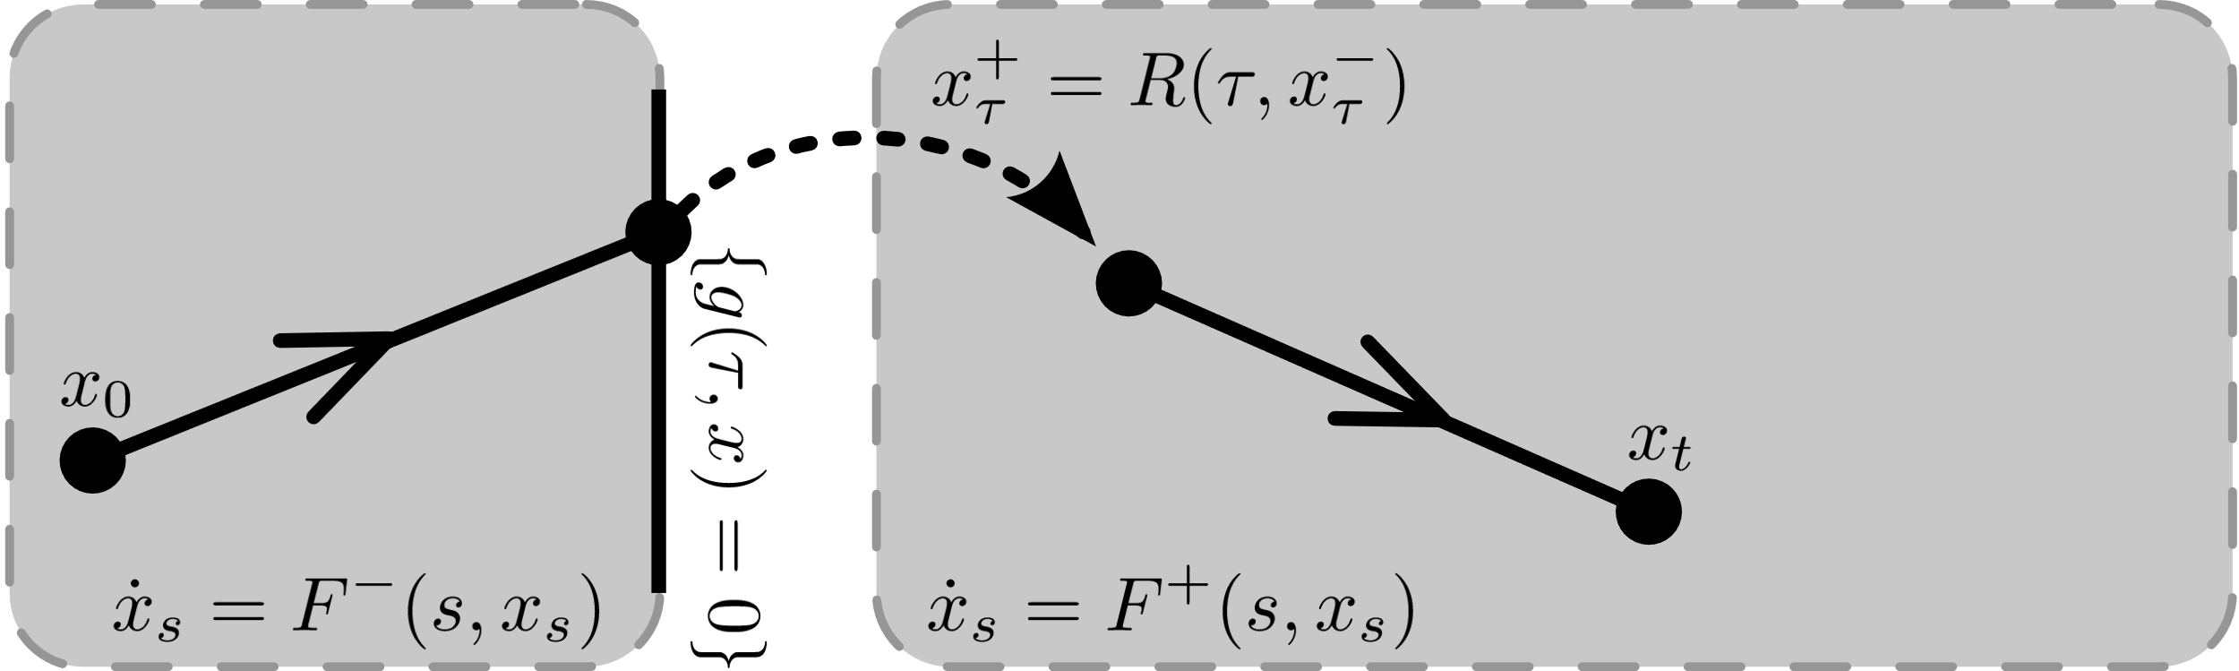

Slide 30
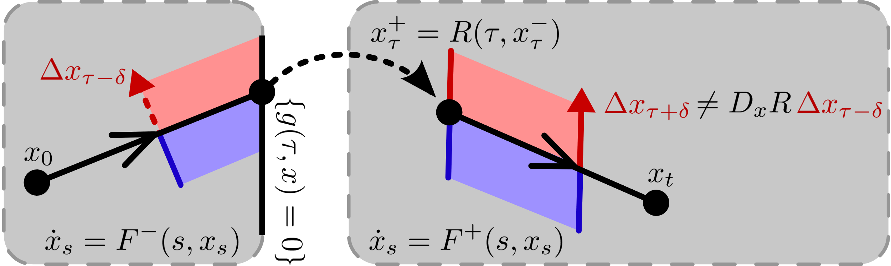
can’t look at discrete-time alone …

Slide 31
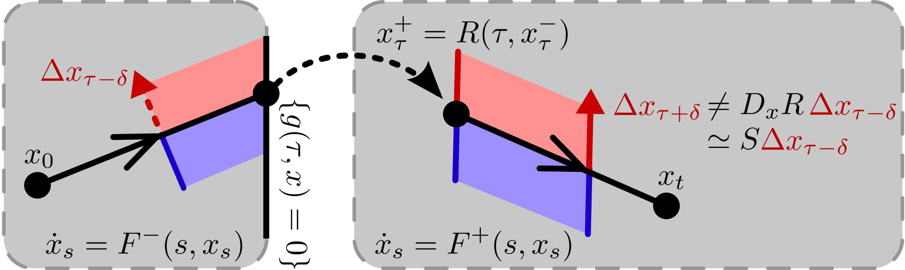
can’t look at discrete-time alone …
need interaction w/ continuous-time:
Aizerman & Gantmacher Quarterly Journal of Mechanics and Applied Mathematics 1958
Determination of Stability by Linear Approximation of a Periodic Solution of a System of Differential Equations with Discontinuous Right-Hand Sides

Slide 32




contraction in contact-rich dynamics
Theorem (Burden, Libby, Coogan): if the
and
dynamics are infinitesimally contractive,
and
then combined dynamics globally contractive,
i.e. distances decrease at an exponential rate
continuous-time
discrete-time
Burden, Libby, Coogan (arXiv: 1804.04122v2)
On infinitesimal contraction analysis for hybrid systems

Slide 33



rigid: discontinuous
elastic: expansive
viscoelastic: contractive
body
body
body
foot
foot
foot
decoupled how?
decoupled
limbs
Burden, Libby, Coogan (arXiv: 1804.04122v2)
On infinitesimal contraction analysis for hybrid systems

Slide 34
today’s talk:
how do we enable humans to learn and control
contact-rich robot dynamics?
takeaway:
contractive contact-rich robot dynamics
human sensorimotor
learning and control

Slide 35
today’s talk:
how do we enable humans to learn and control
contact-rich robot dynamics?
takeaway:
contractive contact-rich robot dynamics
human sensorimotor
learning and control

Slide 36
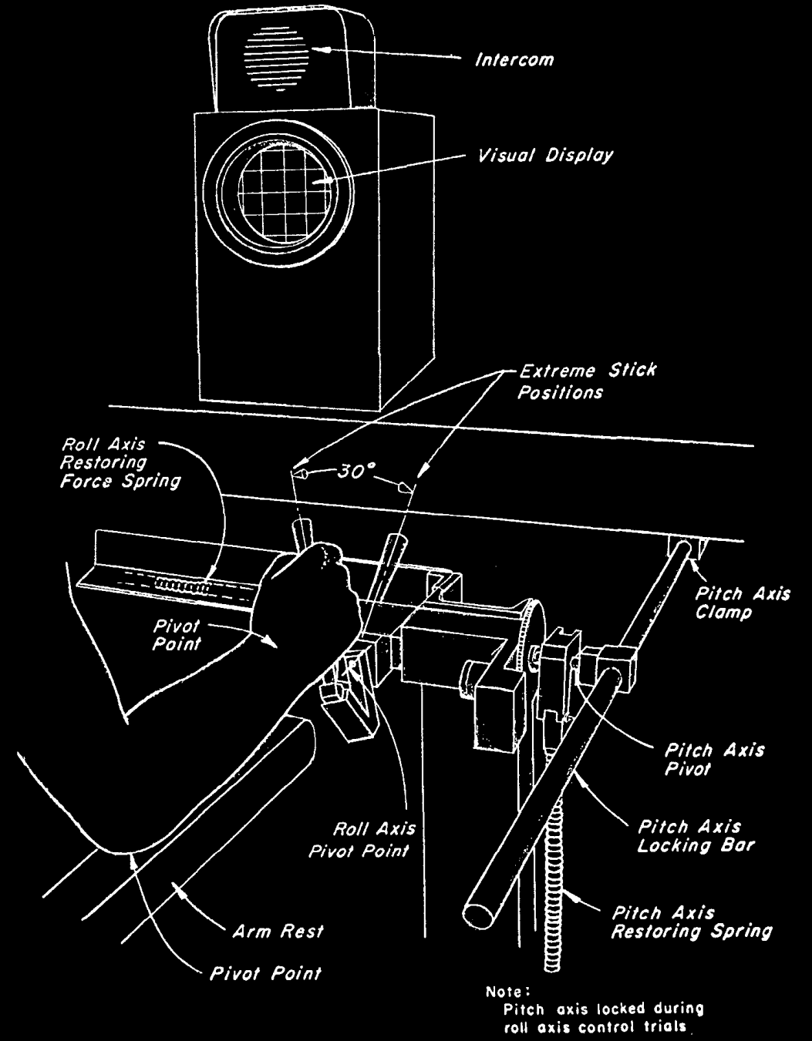
r
d
y
r
reference
y
output
u
disturbance
d
input
u
McRuer, Krendel J Franklin Institute 1959
The Human Operator as a Servo System Element
McRuer Automatica 1980
Human Dynamics in Man-Machine Systems

Slide 37
predicting behavior: what’s in ?
H
human/machine system
H
d
F
f
u
+
+
M
y
e
b
r
+
B
-
McRuer, Krendel J Franklin Institute 1959
The Human Operator as a Servo System Element
McRuer Automatica 1980
Human Dynamics in Man-Machine Systems

Slide 38

predicting behavior: what’s in ?
H
  theoretical and empirical evidence for pairing of system + inverse models
    Bhushan, Shadmehr Bio Cybern 1999;
    Sanner, Kosha Bio Cybern 1999
feedforward ${F≈M}^{−1}$
system model
+
inverse model
  parallels in control theory, artificial intelligence: adaptive control, internal model principle, reinforcement learning
    Francis, Wonham Automatica 1976; Sastry, Bodson Prentice Hall 1989
    Sutton, Barto, Williams IEEE CSM 1992; Atkeson, Schaal ICML 1997
    Papavassiliou, Russell IJCAI 1999
Notes:
replace text with cartoon

Slide 39
human/machine system
H
d
F
f
u
+
+
M
y
e
b
r
+
B
-

Slide 40



H: humans use feedforward and feedback
human/machine system
feedforward
d
F
f
u
+
+
M
y
e
b
r
+
B
-
feedback
McRuer, Jex IEEE Transactions on Human Factors in Electronics 1967
A Review of Quasi-Linear Pilot Models
Yu, Gillespie, Freudenberg, Cook IEEE CDC 2014
Human control strategies in pursuit tracking with a disturbance input
Yamagami, Howell, Roth, Burden IFAC CPHS 2018
Contributions of feedforward and feedback control in a manual trajectory-tracking task

Slide 41

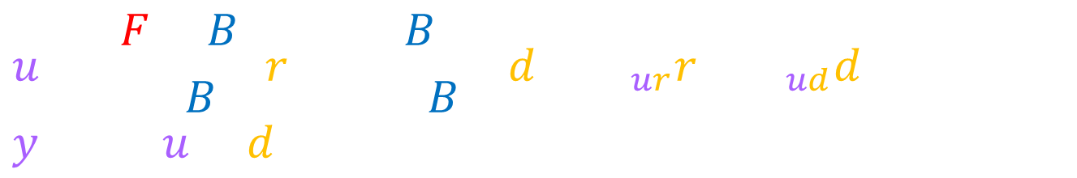
H: humans use feedforward and feedback
  test hypothesis:
  transcribe block diagram to algebraic equations
  solve equations for F, B
d
F
u
y
+
+
M
r
+
e
B
-
$$u=\frac{F+B}{1+BM}r+\frac{−BM}{1+BM}d=H_{ur}r+H_{ud}d, y=M(u+d)$$
  (1.)
$$F=\frac{H_{ur}+M^{−1}H_{ud}}{1+H_{ud}},B=\frac{−H_{ud}}{M(1+H_{ud})}$$
  (2.)
Roth, Hall, Daniel, Sponberg PNAS 2016
Integration of parallel mechanosensory and visual pathways resolved through sensory conflict
Yu, Gillespie, Freudenberg, Cook IEEE CDC 2014
Human control strategies in pursuit tracking with a disturbance input
Yamagami, Howell, Roth, Burden IFAC CPHS 2018
Contributions of feedforward and feedback control in a manual trajectory-tracking task

Slide 42
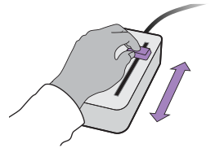


manual trajectory-tracking
  subjects use 1-dimensional joystick device to control cursor motion to track specified reference and reject invisible disturbance
Roth, Howell, Beckwith, Burden SPIE 2017
Toward experimental validation of a model for human sensorimotor learning and control in teleoperation
Yamagami, Howell, Roth, Burden IFAC CPHS 2018
Contributions of feedforward and feedback control in a manual trajectory-tracking task

Slide 43
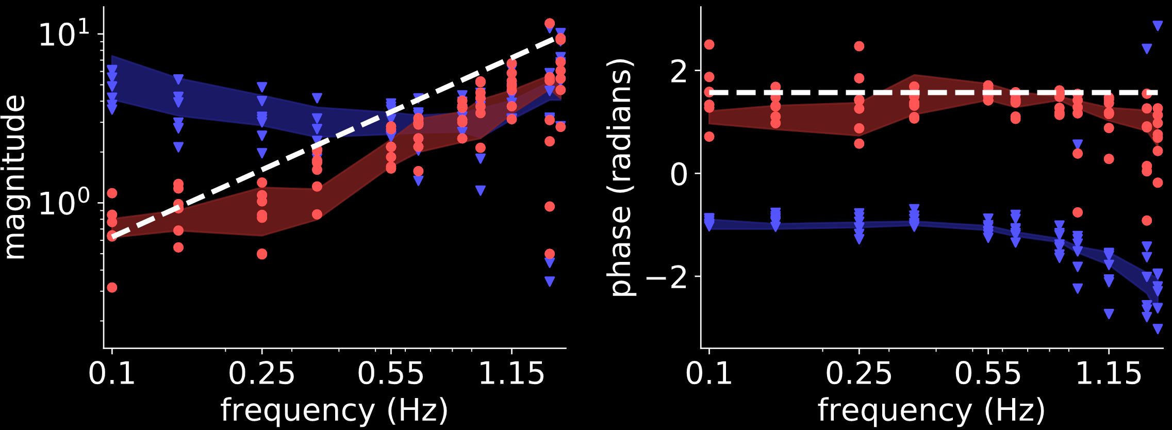





result: humans invert first-order model
$$(N=7)$$
d
$$M^{−1}$$
$$M=1/s$$
i.e. $\dot{y}=u$
(first-order)
F
u
y
+
+
M
$$F$$
r
+
e
B
-
$$B$$
Yamagami, Howell, Roth, Burden IFAC CPHS 2018
Contributions of feedforward and feedback control in a manual trajectory-tracking task

Slide 44
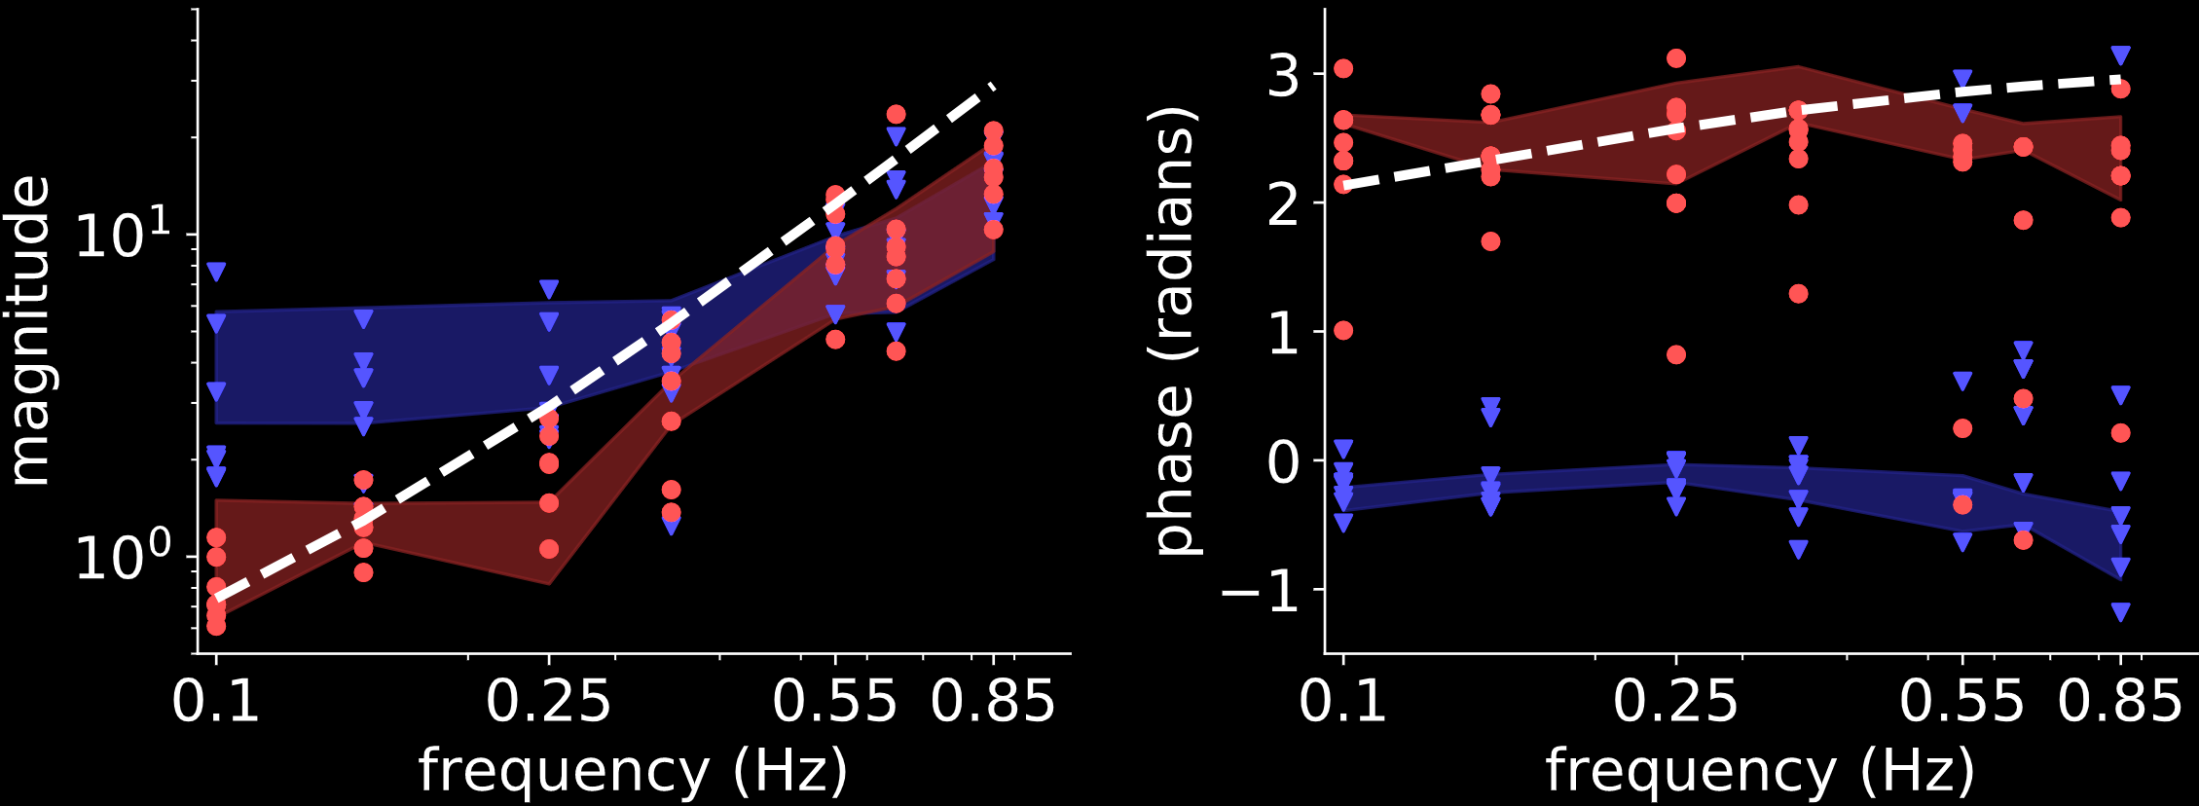


result: humans invert second-order model
$$(N=7)$$
d
$$M^{−1}$$
$$M=1/{s^{2}+s}$$
i.e. $\ddot{y}=u−\dot{y}$
(second-order)
F
u
y
+
+
M
$$F$$
r
+
e
B
-
$$B$$
Yamagami, Howell, Roth, Burden IFAC CPHS 2018
Contributions of feedforward and feedback control in a manual trajectory-tracking task

Slide 45
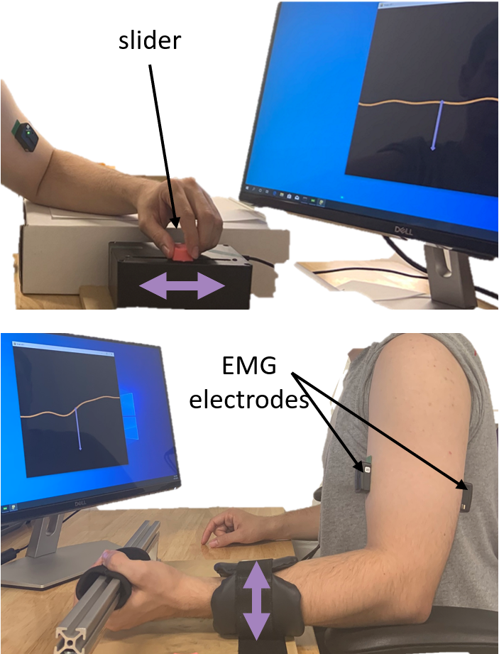
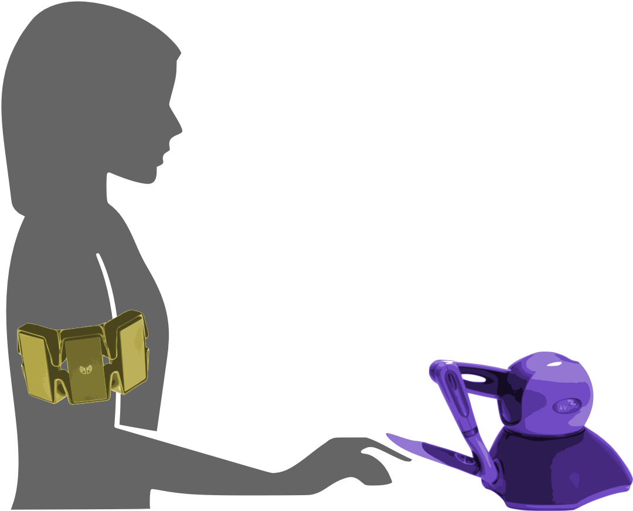

muscle vs manual
  manual: 1-dimensional joystick
  muscle: EMG on biceps/triceps
  task: reference tracking
  + disturbance rejection
Yamagami, Steele, Burden CHI 2020
Decoding intent with control theory: comparing muscle versus manual interface performance

Slide 46
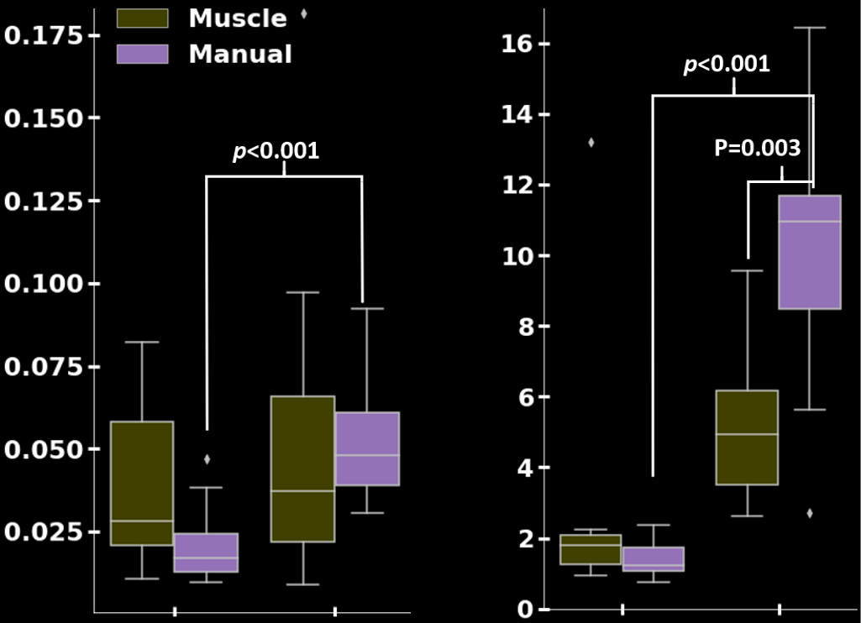









results:
muscle $≈$ manual
muscle $>$ manual
$$(N=11)$$
tracking error ${\left\|r−y\right\|}^{2}$
inversion error ${\left\|F−M^{−1}\right\| }^{2}$
$$\dot{y}=u$$
$$\ddot{y}=u−\dot{y}$$
$$\dot{y}=u$$
$$\ddot{y}=u−\dot{y}$$
Yamagami, Steele, Burden CHI 2020
Decoding intent with control theory: comparing muscle versus manual interface performance

Slide 47
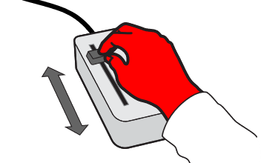
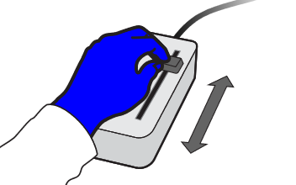

dominant vs non-dominant
  task: reference tracking + disturbance rejection
  group RL: dominant before non-dominant
  group LR: non-dominant before dominant
Yamagami, Peterson, Howell, Roth, Burden IEEE TCyb (submitted)
Effect of Handedness on Learned Controllers and Sensorimotor Noise During Trajectory-Tracking (bioRxiv DOI:10.1101/2020.08.01.232454)

Slide 48
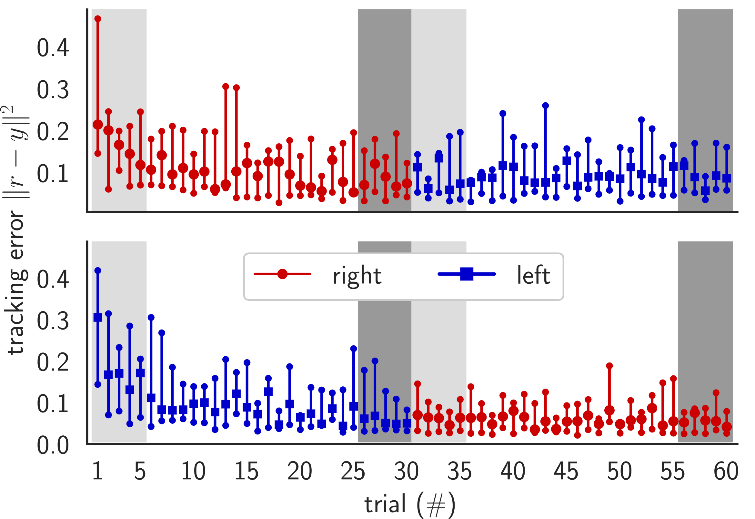
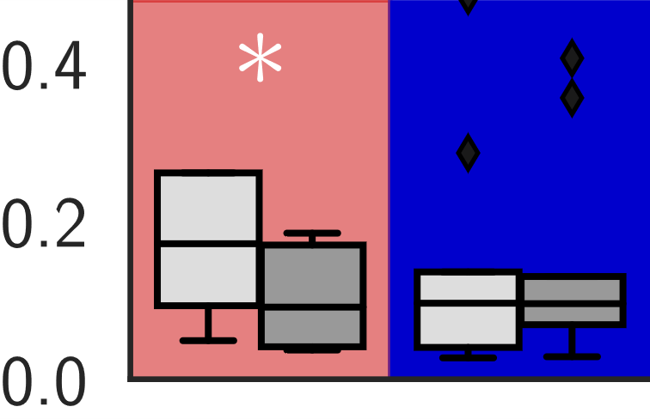
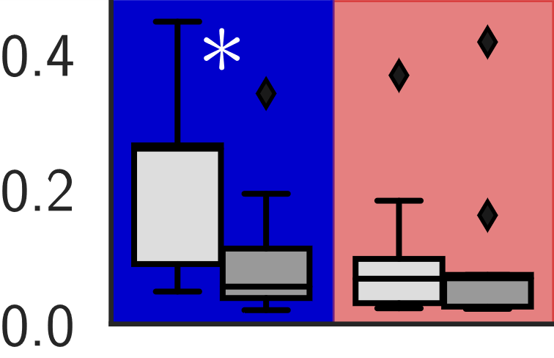




results:
dominant vs non-dominant
hands perform
the same
$${\left\|r−y\right\|}^{2}$$
RL
$$(N=9)$$
tracking transfers
$${\left\|r−y\right\|}^{2}$$
LR
$$(N=9)$$
Yamagami, Peterson, Howell, Roth, Burden IEEE TCyb (submitted)
Effect of Handedness on Learned Controllers and Sensorimotor Noise During Trajectory-Tracking (bioRxiv DOI:10.1101/2020.08.01.232454)

Slide 49
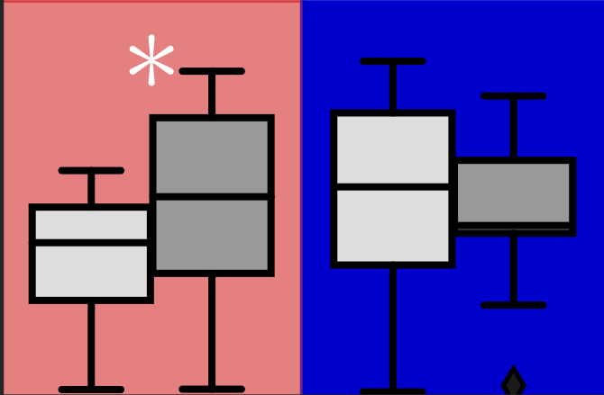
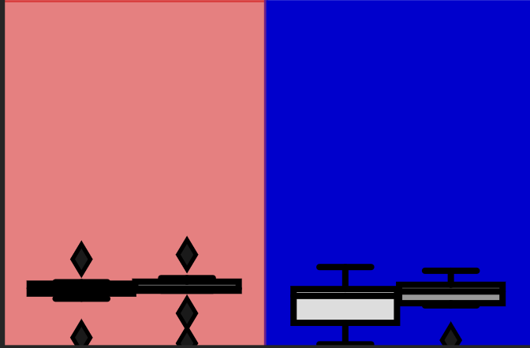
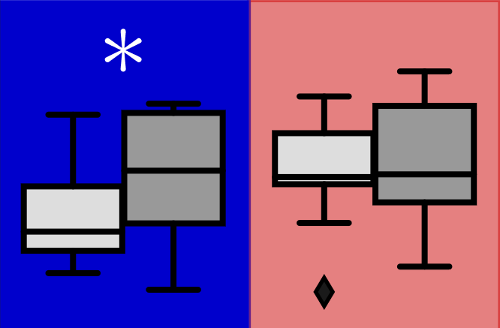
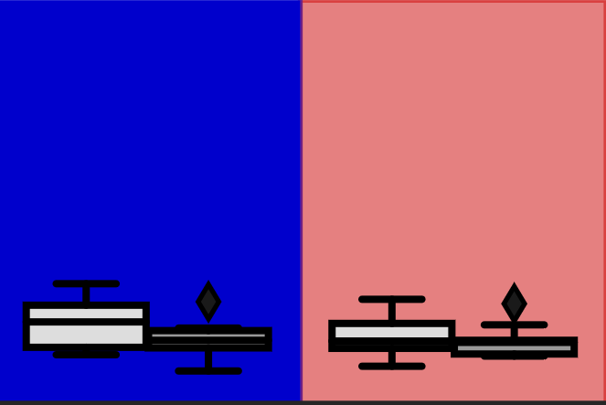








results:
feedback adapts …
… feedforward doesn’t
$$4$$
RL
$$2$$
$$(N=9)$$
$$0$$
$$\left\|B\right\|$$
$$\left\|F\right\|$$
$$4$$
LR
$$(N=9)$$
$$2$$
$$0$$
Yamagami, Peterson, Howell, Roth, Burden IEEE TCyb (submitted)
Effect of Handedness on Learned Controllers and Sensorimotor Noise During Trajectory-Tracking (bioRxiv DOI:10.1101/2020.08.01.232454)

Slide 50
today’s talk:
how do we enable humans to learn and control
contact-rich robot dynamics?
takeaway:
contractive contact-rich robot dynamics
takeaway:
humans can invert contractive dynamics with hands, muscles

Slide 51
today’s talk:
how do we enable humans to learn and control
contact-rich robot dynamics?
takeaway:
humans can invert contractive dynamics
takeaway:
contractive contact-rich robot dynamics
takeaway:
humans can invert contractive dynamics
future work: experimental integration

Slide 52














sburden@uw.edu
http://faculty.uw.edu/sburden
thank you!
ARO YIP #W911NF-16-1-0158: Predictive models for sensorimotor control of legged locomotion
NSF CPS CRII #1565529: Provably-safe interventions for human-cyber-physical systems
NSF CPS Medium #1836819:
Certifiable reinforcement learning for cyber-physical systems

Slide 53
today’s talk:
how do we enable humans to learn and control
contact-rich robot dynamics?
contact-rich robot
terradynamics
human sensorimotor
learning and control

Slide 54
today’s talk:
how do we enable humans to learn and control
contact-rich robot dynamics?
contact-rich robot
terradynamics
human sensorimotor
learning and control

Slide 55
parsimonious models are piecewise-defined
Muybridge 1887 (reprinted by Dover in 1957)
  limbs in contact with ground
  ground penetration constraints
  continuous dynamics
  impact dynamics
Johnson, Burden, Koditschek IJRR 2016 (arXiv:1502.01538)
A hybrid systems model for simple manipulation and self-manipulation systems

Slide 56
formal definitions
  limbs in contact with ground
  ground penetration constraints
  continuous dynamics
  impact dynamics
  state space is a complete Riemannian manifold with respect to the (nondegenerate) inertia tensor
  vector field is globally Lipschitz continuous:
  constraints are never tangent to one another:
  all the functions are sufficiently smooth:

Slide 57
formal definitions
  limbs in contact with ground
  ground penetration constraints
  continuous dynamics
  impact dynamics
  constraints are orthogonal:

Slide 58
formal definitions
  piecewise-differentiability:

Slide 59
  limbs in contact with ground
  ground penetration constraints
  continuous dynamics
  impact dynamics
  make the following assumptions:
  state space is a complete Riemannian manifold
  vector field is globally Lipschitz continuous
  constraints are never tangent to one another
  all the functions are sufficiently smooth
Theorem (Ballard):
trajectories exist and are unique in forward time
Ballard Archive for Rational Mechanics and Analysis 2000
The Dynamics of Discrete Mechanical Systems with Perfect Unilateral Constraints

Slide 60
Theorem (Ballard):
if limbs are compliant, final state varies continuously w.r.t. initial state
Ballard Archive for Rational Mechanics and Analysis 2000
The Dynamics of Discrete Mechanical Systems with Perfect Unilateral Constraints

Slide 61
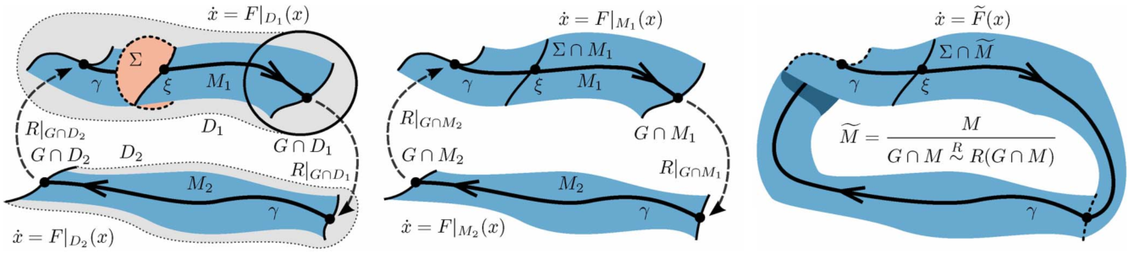
Theorem (Burden, Revzen, Sastry):
hybrid systems reduce dimension
near periodic orbits
Theorem (Burden, Revzen, Sastry): reduced dynamics can be smoothed
Burden, Revzen, Sastry IEEE TAC 2015 (arXiv:1308.4158)
Model reduction near periodic orbits of hybrid dynamical systems

Slide 62
Interpretation: ground contact performs morphological computation (reduction)
Burden, Revzen, Sastry IEEE TAC 2015 (arXiv:1308.4158)
Model reduction near periodic orbits of hybrid dynamical systems

Slide 63
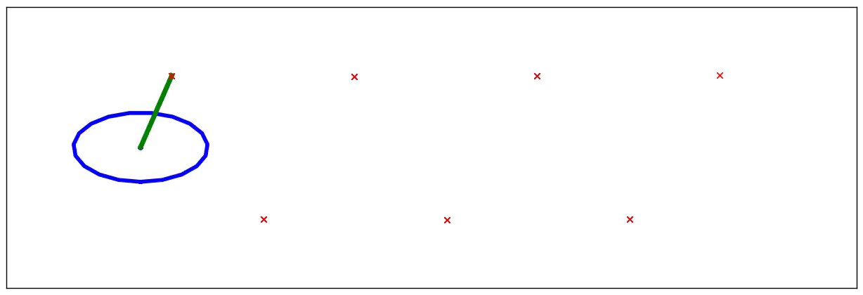
reduction
Application: n-leg polyped reduces to lateral leg-spring (LLS) after 1 stride
Burden, Revzen, Sastry IEEE TAC 2015 (arXiv:1308.4158)
Model reduction near periodic orbits of hybrid dynamical systems

Slide 64
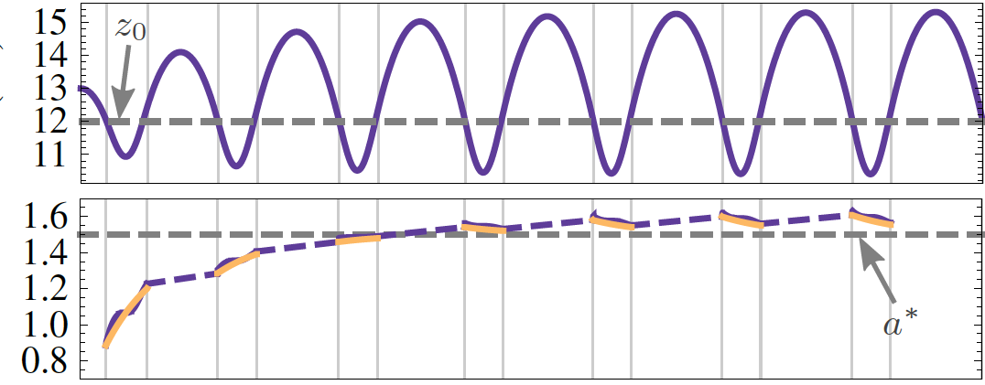
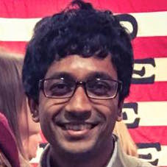
  height
  energy
Theorem: effect of many steps average to a proportional controller on total energy
De, Burden, Koditschek Submitted to IJRR (arXiv:1607.03795)
A hybrid dynamical extension of averaging

Slide 65
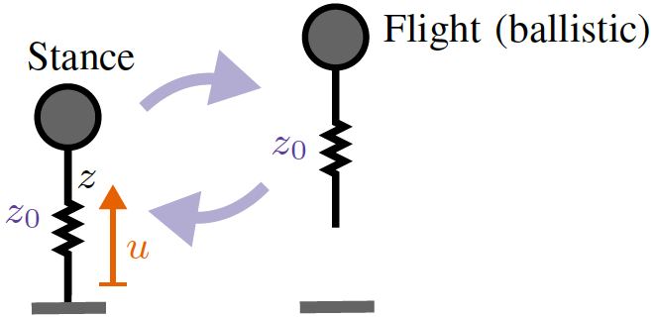
  ≈
  height
  steps
Interpretation: viscoelastic limb performs morphological computation (averaging)
De, Burden, Koditschek Submitted to IJRR (arXiv:1607.03795)
A hybrid dynamical extension of averaging

Slide 66
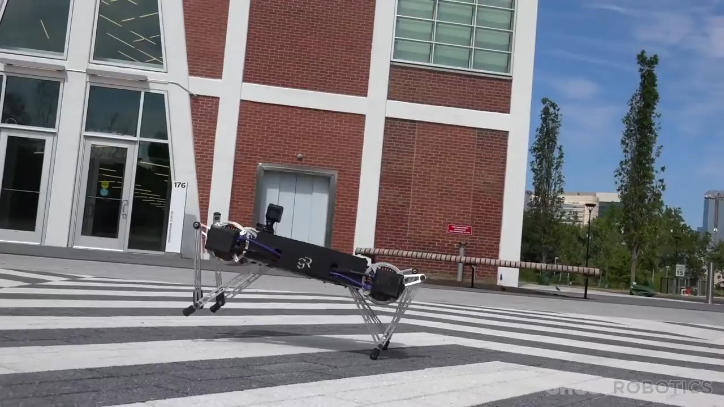

generalization of averaging to multiple limbs
Kenneally, De, Koditschek IEEE RAL 2016; http://ghostrobotics.io

Slide 67
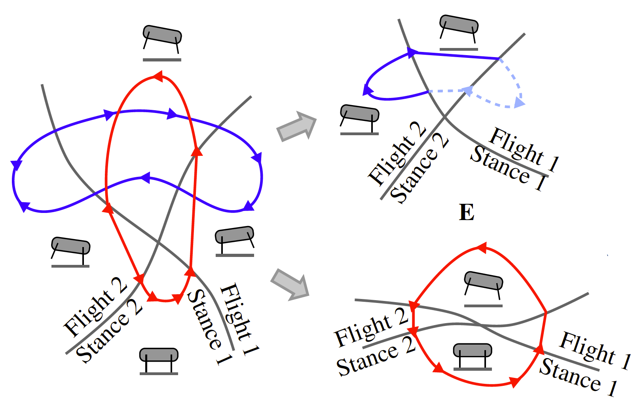
(why) does averaging generalize?
  bound
  trot
De, Burden, Koditschek Submitted to IJRR
A hybrid dynamical extension of averaging and its
application to the analysis of legged gait stability
De, Koditschek Submitted to IJRR
Vertical hopper compositions for preflexive and feedback-stabilized
quadrupedal bounding, pacing, pronking and trotting

Slide 68




  contractive
  expansive liftoff
  expansive impact
  contractive
Burden, Libby, Coogan (arXiv:1804.04122)
On contraction analysis for hybrid systems

Slide 69
today’s talk:
how do we enable humans to learn and control
contact-rich robot dynamics?
contact-rich robot
terradynamics
human sensorimotor
learning and control
human sensorimotor
learning and control

Slide 70
nonlinear system model
  start with system model in control-affine form
  under a technical condition* we change coordinates to
  system model is simpler in (ξ,ζ) coordinates
*strict relative degree – easily satisfied for mechanical systems

Slide 71
nonlinear inverse model
  start with simplified system model
  to obtain inverse model, apply input u_{d} that matches* γ—th derivative of desired output y_{d} :
*augment with feedback to correct for initial condition error

Slide 72
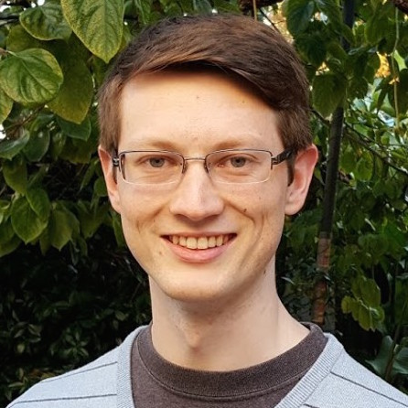
control with inverse models
  closed-loop dynamics have undesirable property:
  states in ζ are unobservable
  generally impossible to compute inverting input u_{d} using observations of y
  by restricting system dynamics, can bypass this issue:
Theorem (Robinson, Scobee, Burden, Sastry):
if system model M is infinitesimally contractive,
then feedforward input from internal model
asymptotically inverts system’s dynamics
Robinson, Scobee, Burden, Sastry SPIE-DSS 2016
Dynamic inverse models in human-cyber-physical systems

Slide 73



inversion with contractive model M
M, M⁻¹
output y
input u_{d}
Theorem implies:
  for contractive models, trajectories x₁ and x₂ converge to
  feedforward input “asymptotically inverts” dynamics
Robinson, Scobee, Burden, Sastry SPIE-DSS 2016
Dynamic inverse models in human-cyber-physical systems

