Slide 1

sensorimotor games: human/machine
collaborative learning and control
follow along! http://bit.ly/2021-sensorimotor-games
Sam Burden
Assistant Professor
Electrical & Computer Engineering
University of Washington
Seattle, WA USA
http://faculty.uw.edu/sburden
AMP Lab
http://depts.washington.edu/amplify
BioRobotics Lab
http://brl.ee.washington.edu

Slide 2
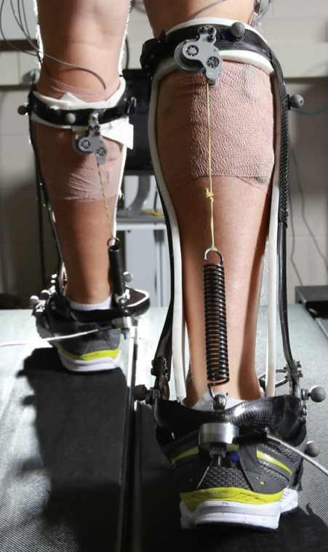
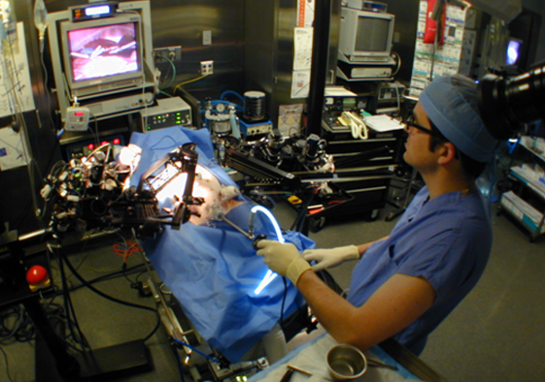
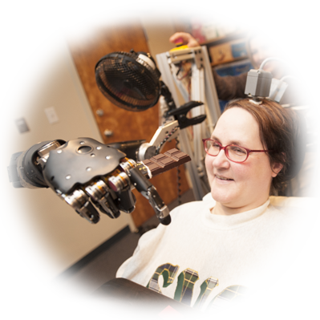



human interaction with the physical world
is increasingly mediated by machines
legal, ethical, and political concerns
ensure humans will remain in-the-loop
Hannaford, Rosen, Friedman, King, Roan, Cheng, Glozman, Ma, Kosari, White IEEE Tran Biomed Eng 2013 Raven-II: An Open Platform for Surgical Robotics Research
Wodlinger, Downey, Tyler-Kabara, Schwartz, Boninger, Collinger J Neural Eng 2015
Ten-Dimensional Anthropomorphic Arm Control in a Human Brain-Machine Interface
Collins, Wiggin, Sawicki Nature 2015
Reducing the Energy Cost of Human Walking Using an Unpowered Exoskeleton
Nothwang, Robinson, Burden, McCourt, Curtis IEEE Resilience Week 2016
The Human Should be Part of the Control Loop?

Slide 3
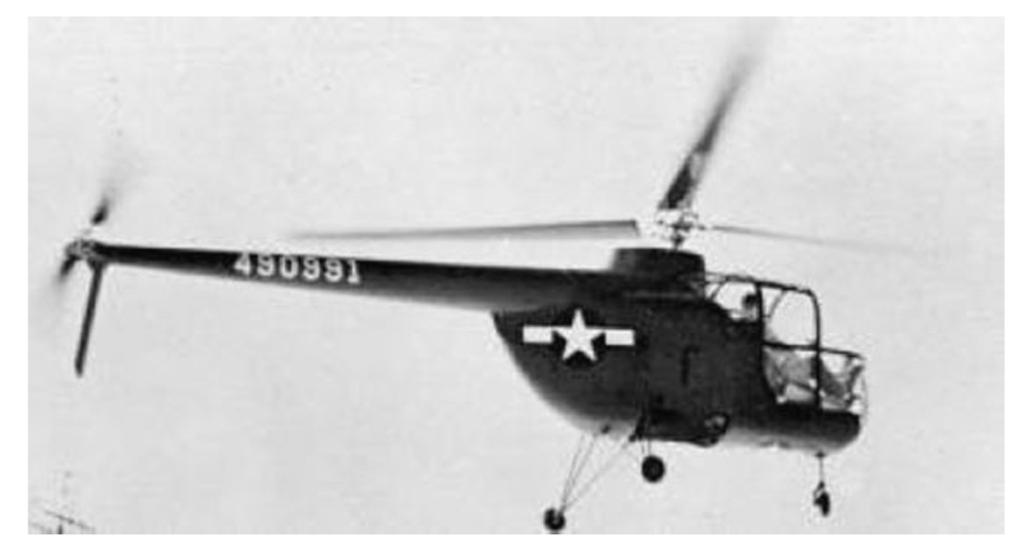
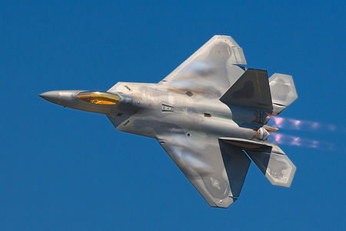
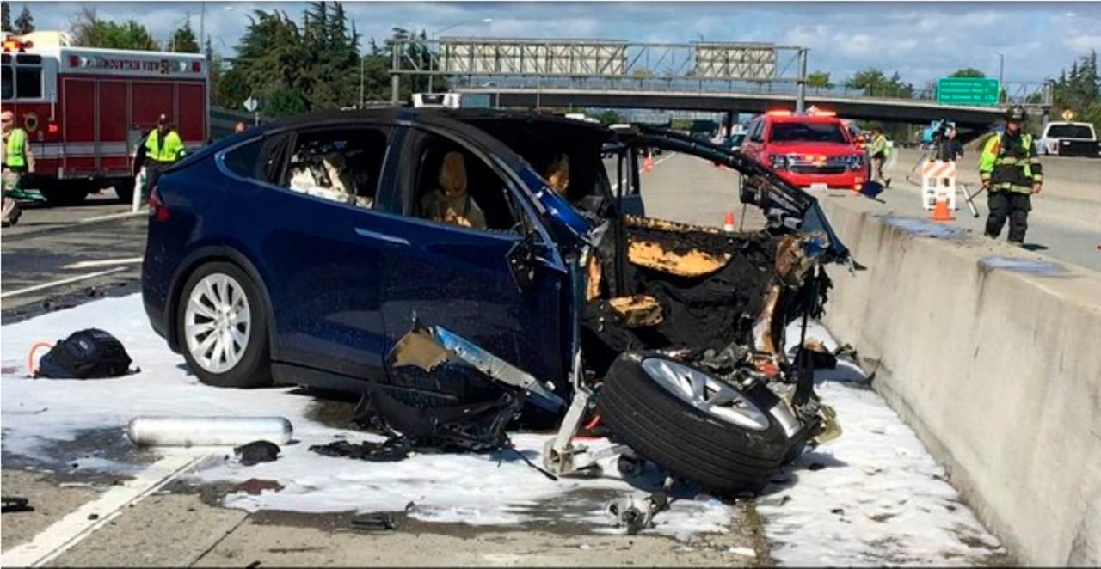
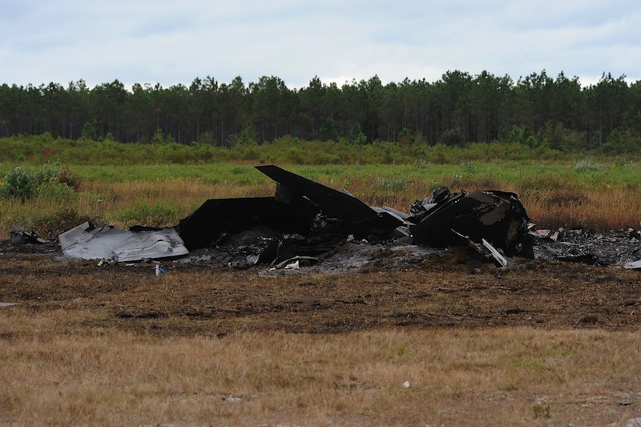
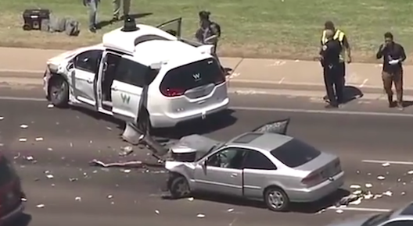
coupling humans and machines
  pilot-induced oscillations in rotory & fixed-wing aircraft
    McRuer, Krendal 1974; Hess J. Guid. Cont. Dyn. 1997
    Pavel et al. Prog. Aero. Sci. 2013
  overreliance on enhanced safety features in cars
    Rudin-Brown, Parker Traffic Psych. Behav. 2004;
    Moore, Zuby Proc. Enhanced Safety Vehicles 2013
naïve coupling can lead to performance loss
ranging from mild to catastrophic

Slide 4

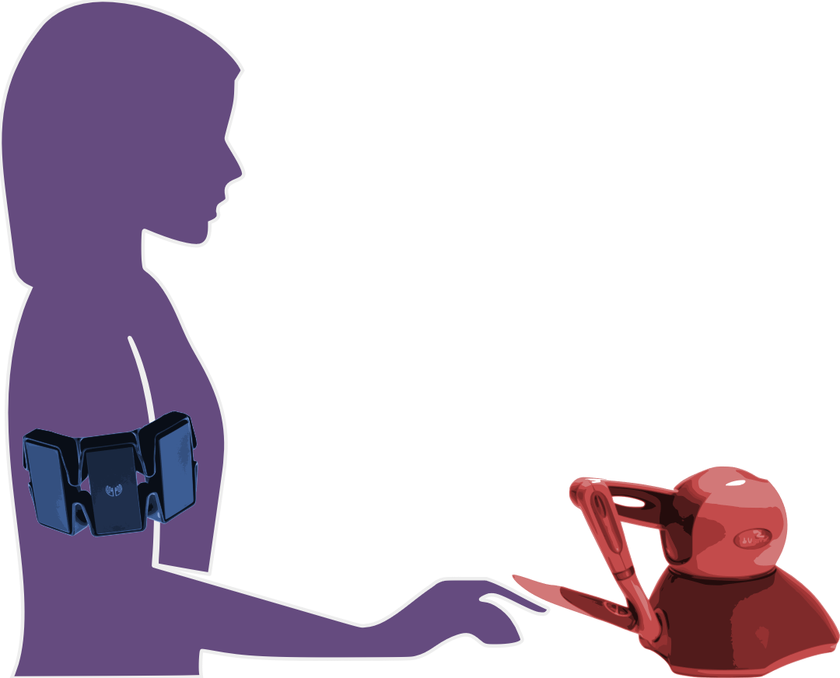
human/machine system:
robot teleoperation
human sensory inputs
human motor outputs
Chiawakum Creek Fire near Lake Wenatchee, WA © Michael Stanford 2015 http://yourshot.nationalgeographic.com/photos/4181903/

Slide 5
today’s talk:
how can we enable human/machine
collaborative learning and control?
human sensory inputs
human motor outputs
humans learn models of machines …
… so machines should learn models of humans

Slide 6
today’s talk:
how can we enable human/machine
collaborative learning and control?
humans learn models of machines …
… so machines should learn models of humans

Slide 7
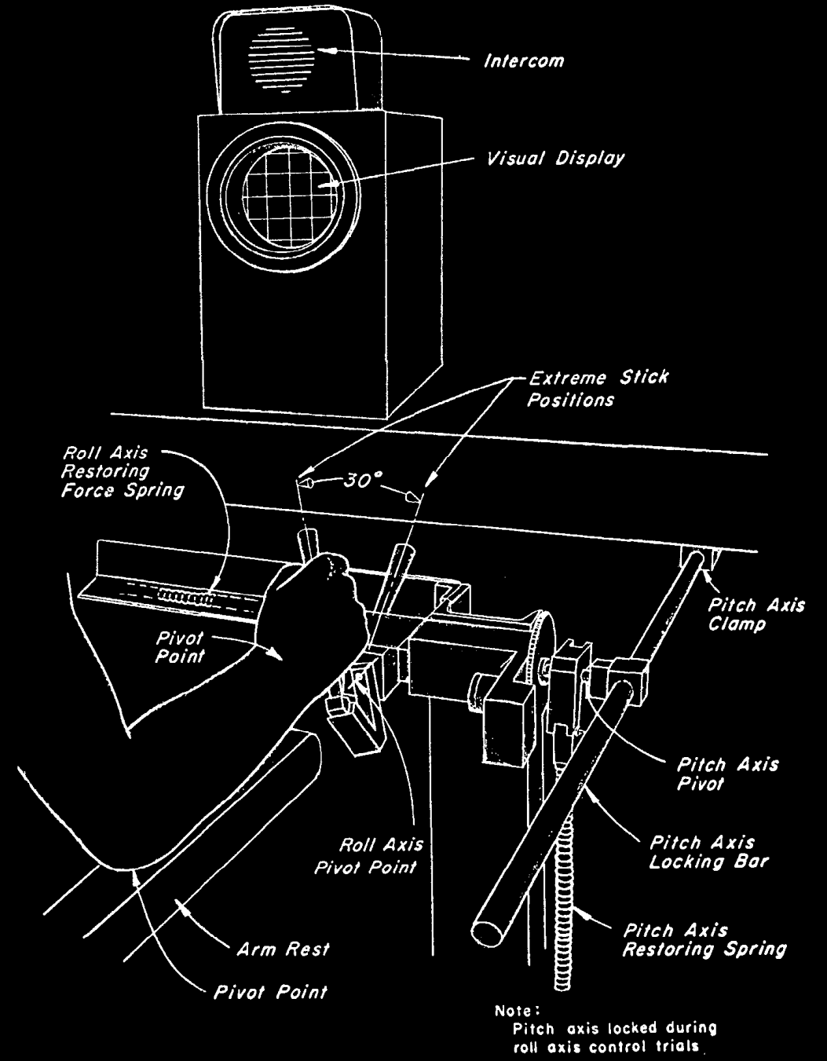
r
d
y
r
reference
y
output
u
disturbance
d
input
u
McRuer, Krendel J Franklin Institute 1959
The Human Operator as a Servo System Element
McRuer Automatica 1980
Human Dynamics in Man-Machine Systems

Slide 8
predicting behavior: what’s in ?
H
human/machine system
H
d
F
f
u
+
+
M
y
e
b
r
+
B
-

Slide 9

predicting behavior: what’s in ?
H
  theoretical and empirical evidence for pairing of system + inverse models
    Wolpert, Ghahramani, Jordan Science 1995
    Kawato Curr Opin Neurobiol 1999
feedforward ${F≈M}^{−1}$
system model
+
inverse model
  parallels in control theory, artificial intelligence: adaptive control, internal model principle, reinforcement learning
    Francis, Wonham Automatica 1976; Sastry, Bodson Prentice Hall 1989
    Sutton, Barto, Williams IEEE CSM 1992; Atkeson, Schaal ICML 1997
    Papavassiliou, Russell IJCAI 1999
Notes:
replace text with cartoon

Slide 10
human/machine system
H
d
F
f
u
+
+
M
y
e
b
r
+
B
-

Slide 11



H: humans use feedforward and feedback
human/machine system
feedforward
d
F
f
u
+
+
M
y
e
b
r
+
B
-
feedback
McRuer, Jex IEEE Transactions on Human Factors in Electronics 1967
A Review of Quasi-Linear Pilot Models
Yu, Gillespie, Freudenberg, Cook IEEE CDC 2014
Human control strategies in pursuit tracking with a disturbance input
Yamagami, Howell, Roth, Burden IFAC CPHS 2018
Contributions of feedforward and feedback control in a manual trajectory-tracking task

Slide 12

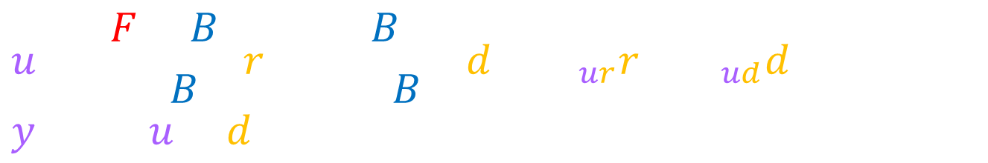
H: humans use feedforward and feedback
  test hypothesis:
  transcribe block diagram to algebraic equations
  solve equations for F, B
d
F
u
y
+
+
M
r
+
e
B
-
$$u=\frac{F+B}{1+BM}r+\frac{−BM}{1+BM}d=H_{ur}r+H_{ud}d, y=M(u+d)$$
  (1.)
$$F=\frac{H_{ur}+M^{−1}H_{ud}}{1+H_{ud}},B=\frac{−H_{ud}}{M(1+H_{ud})}$$
  (2.)
Roth, Hall, Daniel, Sponberg PNAS 2016
Integration of parallel mechanosensory and visual pathways resolved through sensory conflict
Yu, Gillespie, Freudenberg, Cook IEEE CDC 2014
Human control strategies in pursuit tracking with a disturbance input
Yamagami, Howell, Roth, Burden IFAC CPHS 2018
Contributions of feedforward and feedback control in a manual trajectory-tracking task

Slide 13
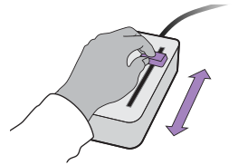


experiment: manual interface
  subjects use 1-dimensional joystick device to control cursor motion to track specified reference
Roth, Howell, Beckwith, Burden SPIE 2017
Toward experimental validation of a model for human sensorimotor learning and control in teleoperation
Yamagami, Howell, Roth, Burden IFAC CPHS 2018
Contributions of feedforward and feedback control in a manual trajectory-tracking task

Slide 14
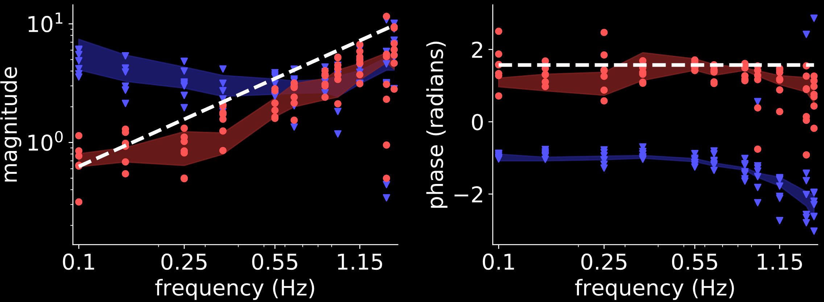





result: humans invert first-order model
$$(N=7)$$
d
$$M^{−1}$$
$$M=1/s$$
i.e. $\dot{y}=u$
(first-order)
F
u
y
+
+
M
$$F$$
r
+
e
B
-
$$B$$
Yamagami, Howell, Roth, Burden IFAC CPHS 2018
Contributions of feedforward and feedback control in a manual trajectory-tracking task

Slide 15
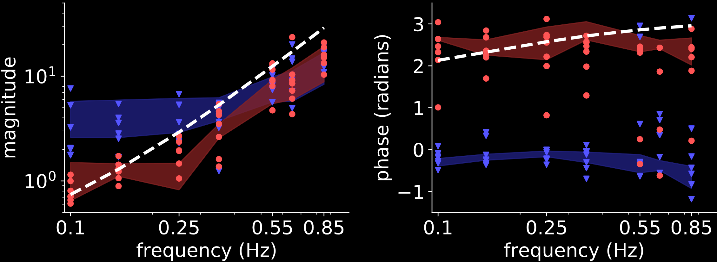


result: humans invert second-order model
$$(N=7)$$
d
$$M^{−1}$$
$$M=1/{s^{2}+s}$$
i.e. $\ddot{y}=u−\dot{y}$
(second-order)
F
u
y
+
+
M
$$F$$
r
+
e
B
-
$$B$$
Yamagami, Howell, Roth, Burden IFAC CPHS 2018
Contributions of feedforward and feedback control in a manual trajectory-tracking task

Slide 16
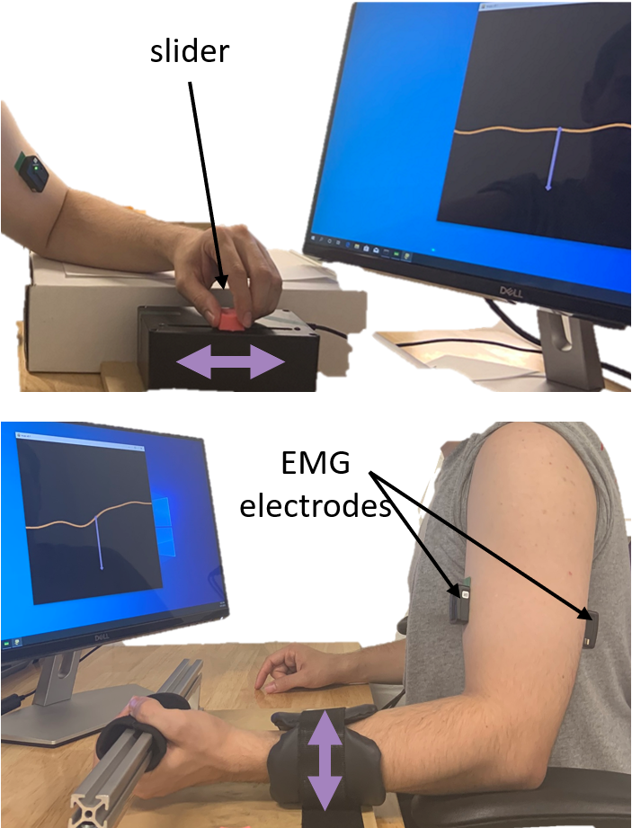
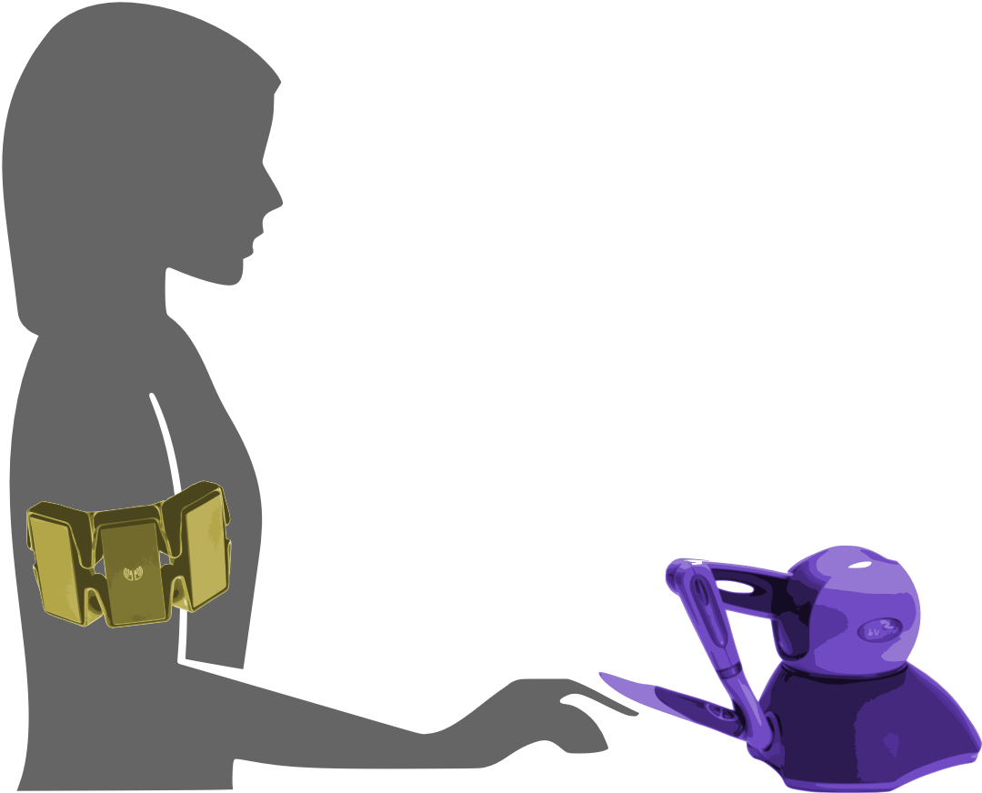

experiment: muscle vs manual
  manual: 1-dimensional joystick
  muscle: EMG on biceps/triceps
  task: reference tracking
Yamagami, Steele, Burden CHI 2020
Decoding intent with control theory: muscle vs manual interface performance

Slide 17
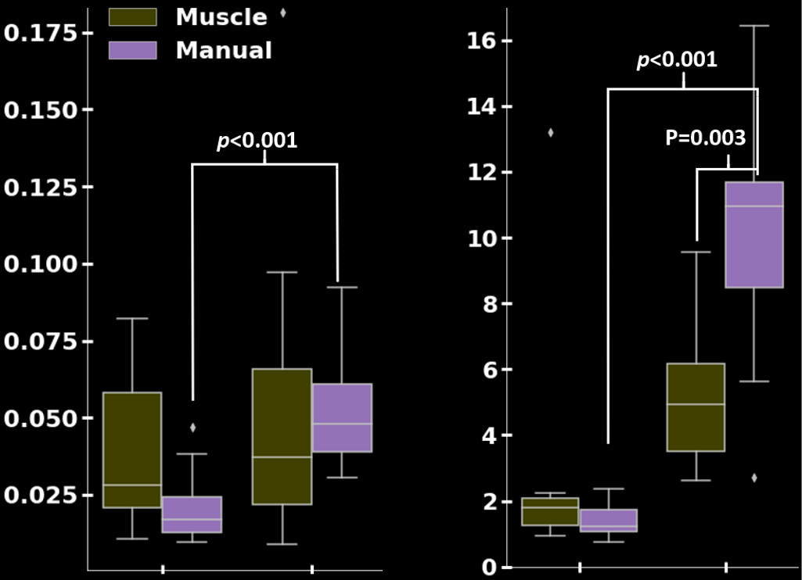









results:
muscle $≈$ manual
muscle $>$ manual
$$(N=11)$$
tracking error ${\left|r−y\right| }^{2}$
inversion error ${\left|F−M^{−1}\right| }^{2}$
$$\dot{y}=u$$
$$\ddot{y}=u−\dot{y}$$
$$\dot{y}=u$$
$$\ddot{y}=u−\dot{y}$$
Yamagami, Steele, Burden CHI 2020
Decoding intent with control theory: muscle vs manual interface performance

Slide 18
can we predict effect of motor impairment?
H: stroke affects feedback, not feedforward
human/machine system
feedforward
d
F
f
u
+
+
M
y
e
b
r
+
B
-
feedback
Hallett Brain research reviews 2001
Plasticity of the human motor cortex and recovery from stroke
Bastian Current opinion in neurobiology 2006
Learning to predict the future: the cerebellum adapts feedforward movement control

Slide 19
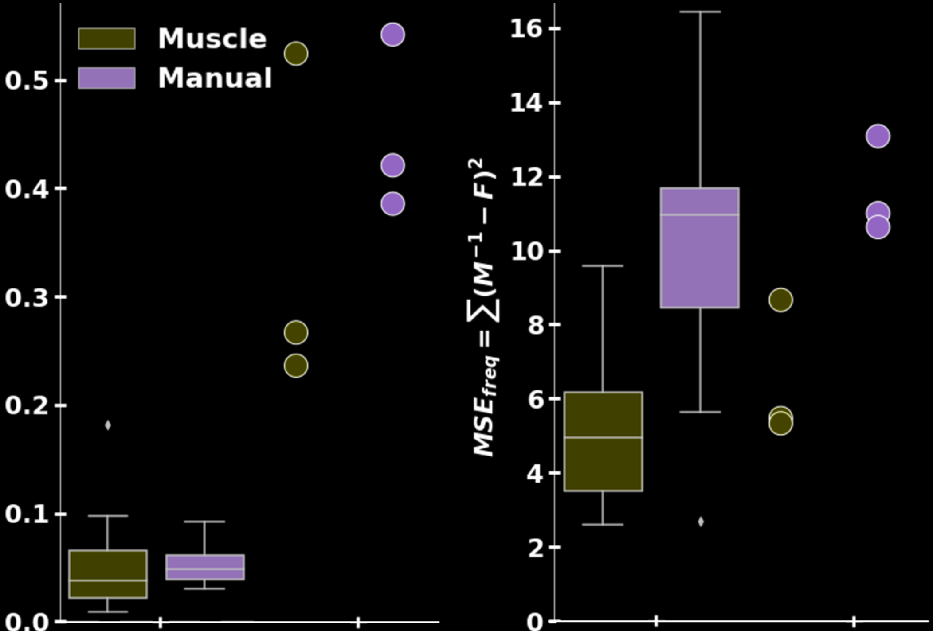






result*: stroke affects feedback, not feedforward
$$(N=3)$$
*preliminary; need larger $N$
tracking error ${\left|r−y\right| }^{2}$
inversion error ${\left|F−M^{−1}\right| }^{2}$
no stroke
post-stroke
no stroke
post-stroke
affected by $F$ and $B$
affected by $F$ (not $B$)
Yamagami, Steele, Burden CHI 2020
Decoding intent with control theory: muscle vs manual interface performance

Slide 20
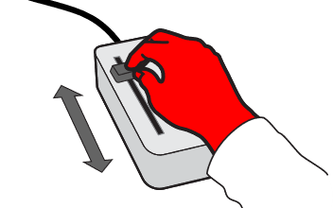
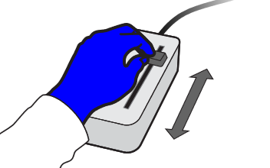

experiment: dominant vs non-dominant
  task: reference tracking + disturbance rejection
  group RL: dominant before non-dominant
  group LR: non-dominant before dominant
Yamagami, Peterson, Howell, Roth, Burden IEEE TCyb (in review)
Effect of Handedness on Learned Controllers and Sensorimotor Noise During Trajectory-Tracking (bioRxiv DOI:10.1101/2020.08.01.232454)

Slide 21
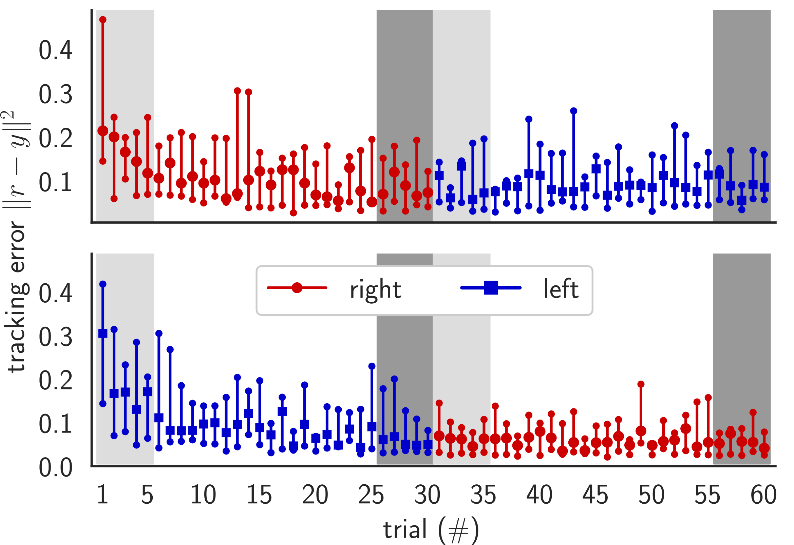
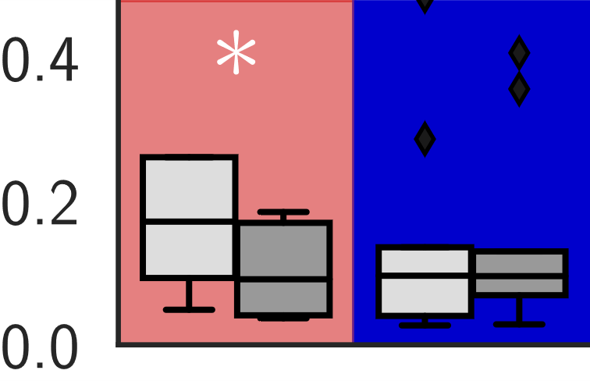
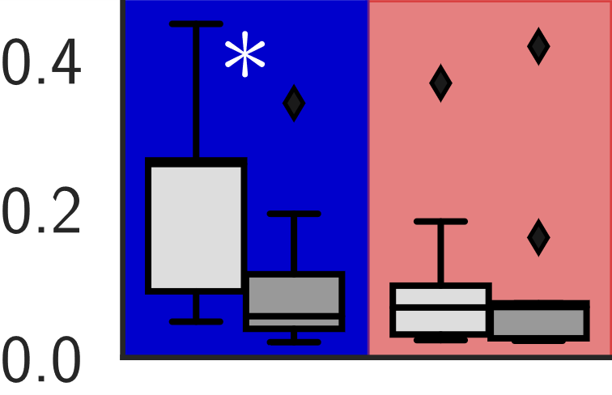




results:
dominant vs non-dominant
hands perform
the same
$${\left\|r−y\right\|}^{2}$$
RL
$$(N=9)$$
tracking transfers
$${\left\|r−y\right\|}^{2}$$
LR
$$(N=9)$$
Yamagami, Peterson, Howell, Roth, Burden IEEE TCyb (in review)
Effect of Handedness on Learned Controllers and Sensorimotor Noise During Trajectory-Tracking (bioRxiv DOI:10.1101/2020.08.01.232454)

Slide 22
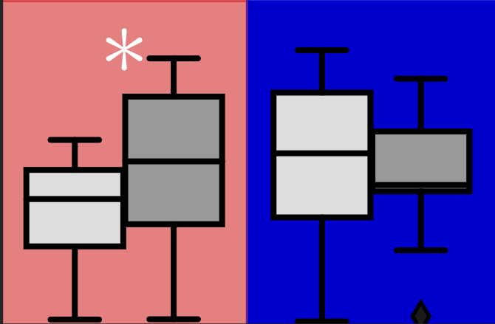
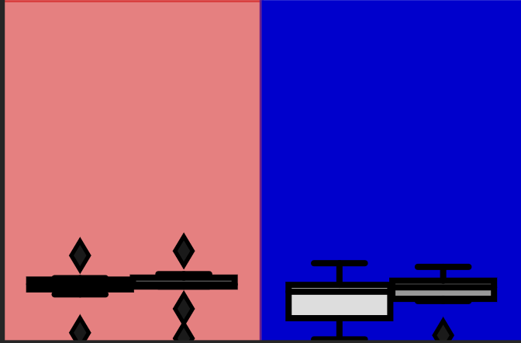
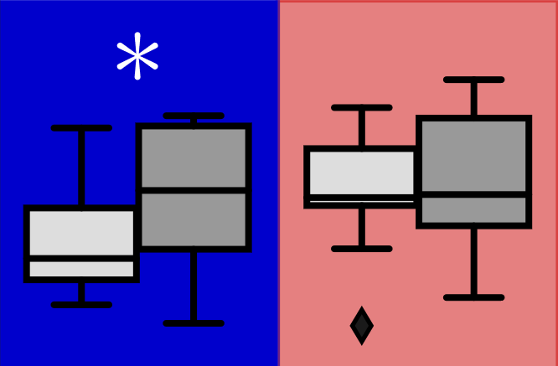
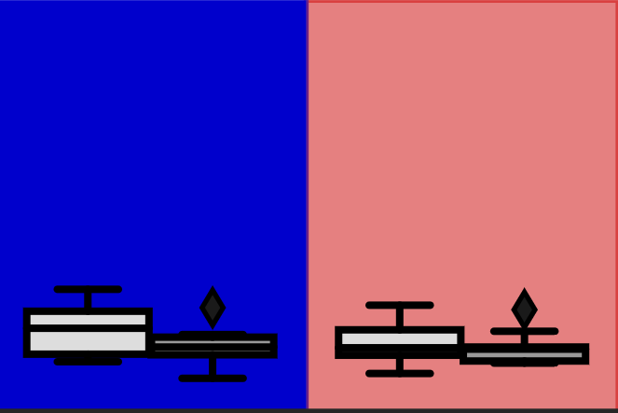








results:
feedback adapts …
… feedforward doesn’t
$$4$$
RL
$$2$$
$$(N=9)$$
$$0$$
$$\left\|B\right\|$$
$$\left\|F\right\|$$
$$4$$
LR
$$(N=9)$$
$$2$$
$$0$$
Yamagami, Peterson, Howell, Roth, Burden IEEE TCyb (in review)
Effect of Handedness on Learned Controllers and Sensorimotor Noise During Trajectory-Tracking (bioRxiv DOI:10.1101/2020.08.01.232454)

Slide 23
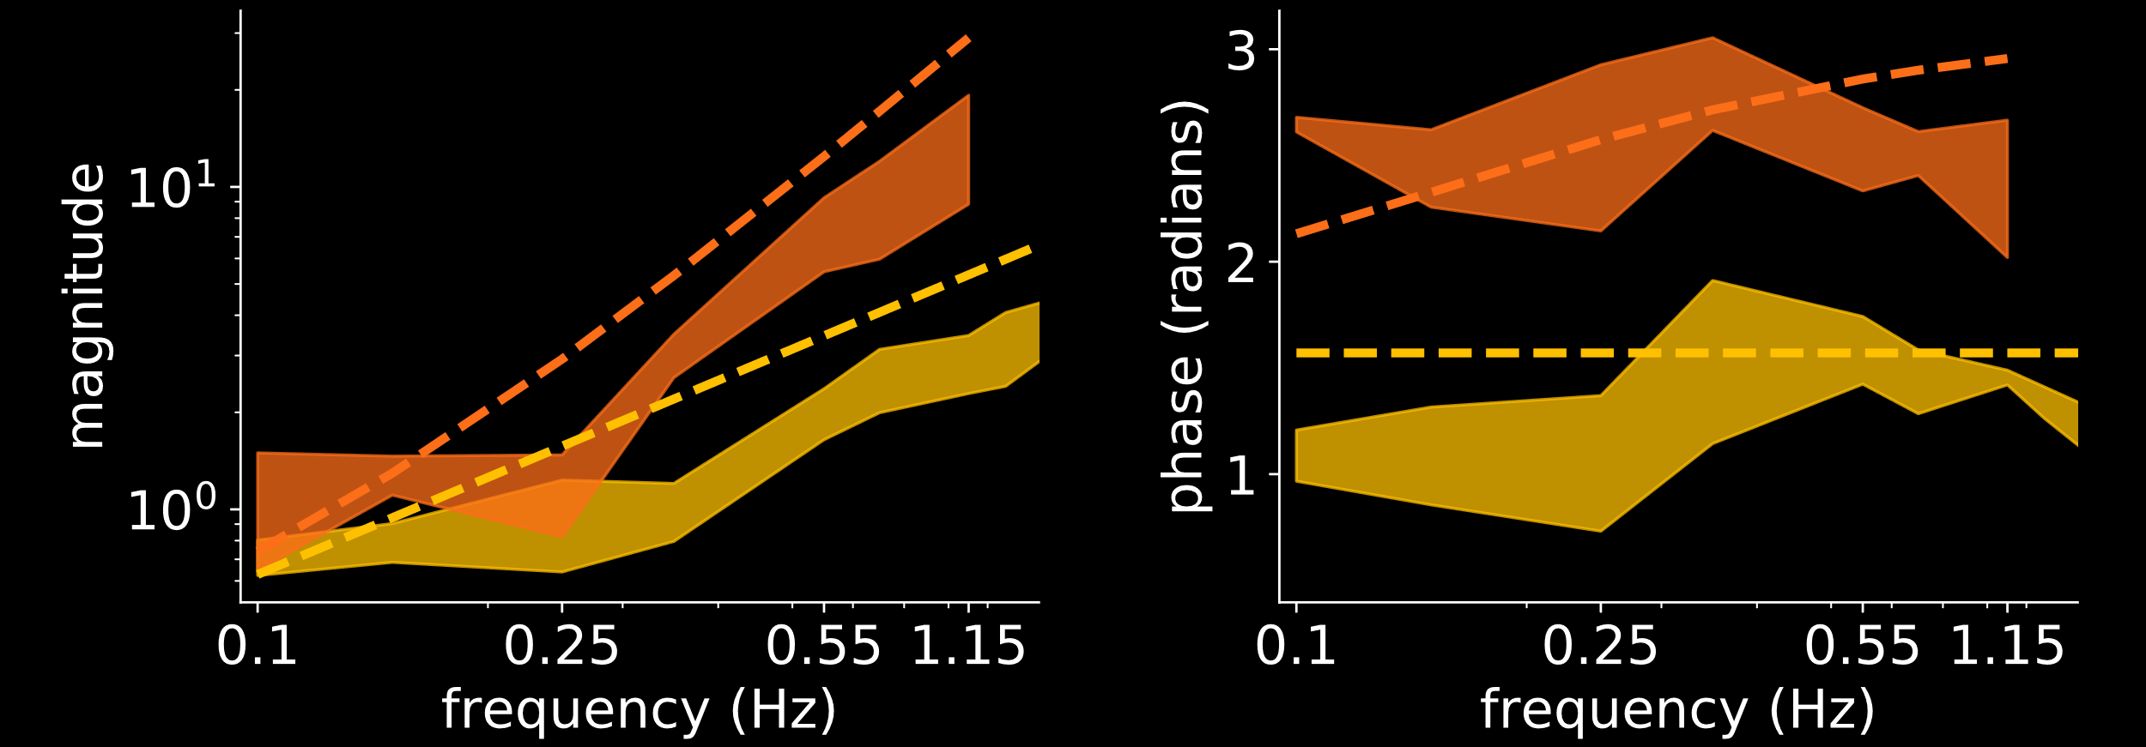


humans adapt to machines
d
H(M)
H(M)
vs.
H(M)
M
H
M
vs.
M
u
+
y
e
r
+
-
$$F≈M^{−1}=s^{2}+s$$
$$F≈M^{−1}=s$$

Slide 24

how can we enable human/machine
collaborative learning and control?
humans learn models of machines …
… so machines should learn models of humans
takeaway: humans learn to $≈$invert machine dynamics

Slide 25

how can we enable human/machine
collaborative learning and control?
humans learn models of machines …
… so machines should learn models of humans
takeaway: humans learn to $≈$invert machine dynamics

Slide 26




human/machine co-adaptation
d
H(M)
M(H)
H
M
u
+
y
e
r
+
-
co-adaptation is a sensorimotor game played between two decision-making agents: human and machine
Chasnov, Parsa, Yamagami, Ratliff SPIE 2019
Experiments with sensorimotor games in dynamic
human/machine interaction

Slide 27





decision-making agents have “bounded rationality”
Simon Decision and Organization 1972
Theories of Bounded Rationality
Russell, Wefald Artificial Intelligence 1991
Principles of Metareasoning
Gershman, Horvitz, Tenenbaum Science 2015
Computational Rationality: A Converging Paradigm for Intelligence in Brains, Minds, and Machines
Papadimitriou, Piliouras ACM SIGecom Exchanges 2018
Game Dynamics as the Meaning of a Game
H: humans and machines minimize cost $c$
using (stochastic) gradient descent
$$\dot{H}≈∂_{H}c_{H}(H,M)$$
$$\dot{M}≈∂_{M}c_{M} (H,M)$$
$$\min_{H}{c_{H}(H,M)}$$
$$\min_{M}{c_{M}(H,M)}$$
Notes:
One totally plausible thing is that they could try making small adjustments based on local information, namely gradient descent.
In this example, the machine and environment are static.
----------------------------------
For the single agent case, if you had a cost function, how would you go about minimizing it? Well, a good first order method is simply gradient descent.
Suppose the agent has a parabola-shaped cost function, single gradient descent will look like this
Here we
Decision making is also a dynamic process. Especially if you don’t know much about the environment or your cost function, you may need to explore/interact with the environment to ‘learn’ about it.
If there is a minimum, we expect gradient descent like updates to converge to it.
Suppose the human’s cost function is a \parabola shaped thing

Slide 28
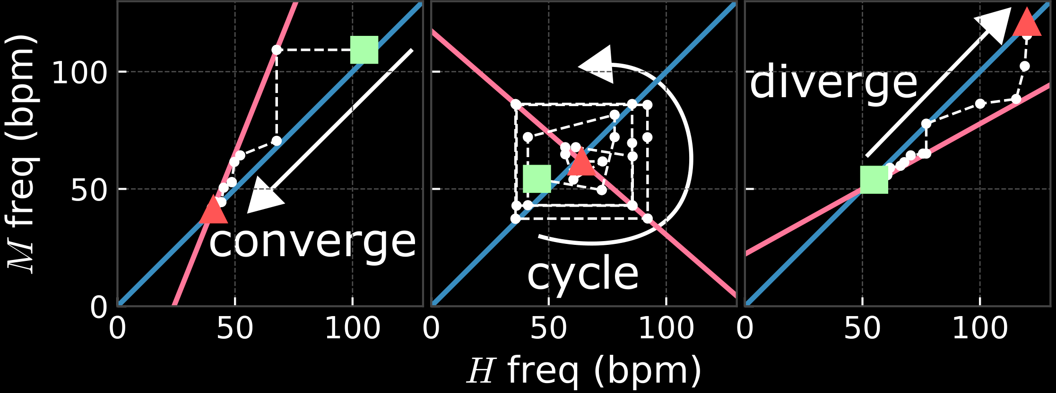



vignette: sensorimotor synchronization
gradient learning predicts these outcomes
Coleman, Sullivan, Chasnov CNT REU 2019
Analyzing co-adaptive models for human-computer sensorimotor synchronization tasks: a game theoretic framework
Van der Steen, Keller Frontiers in Human Neuroscience 2013
The ADaptation and Anticipation Model (ADAM) of sensorimotor synchronization
Repp Psychonomic Bulletin & Review 2005
Sensorimotor synchronization: a review of the tapping literature

Slide 29
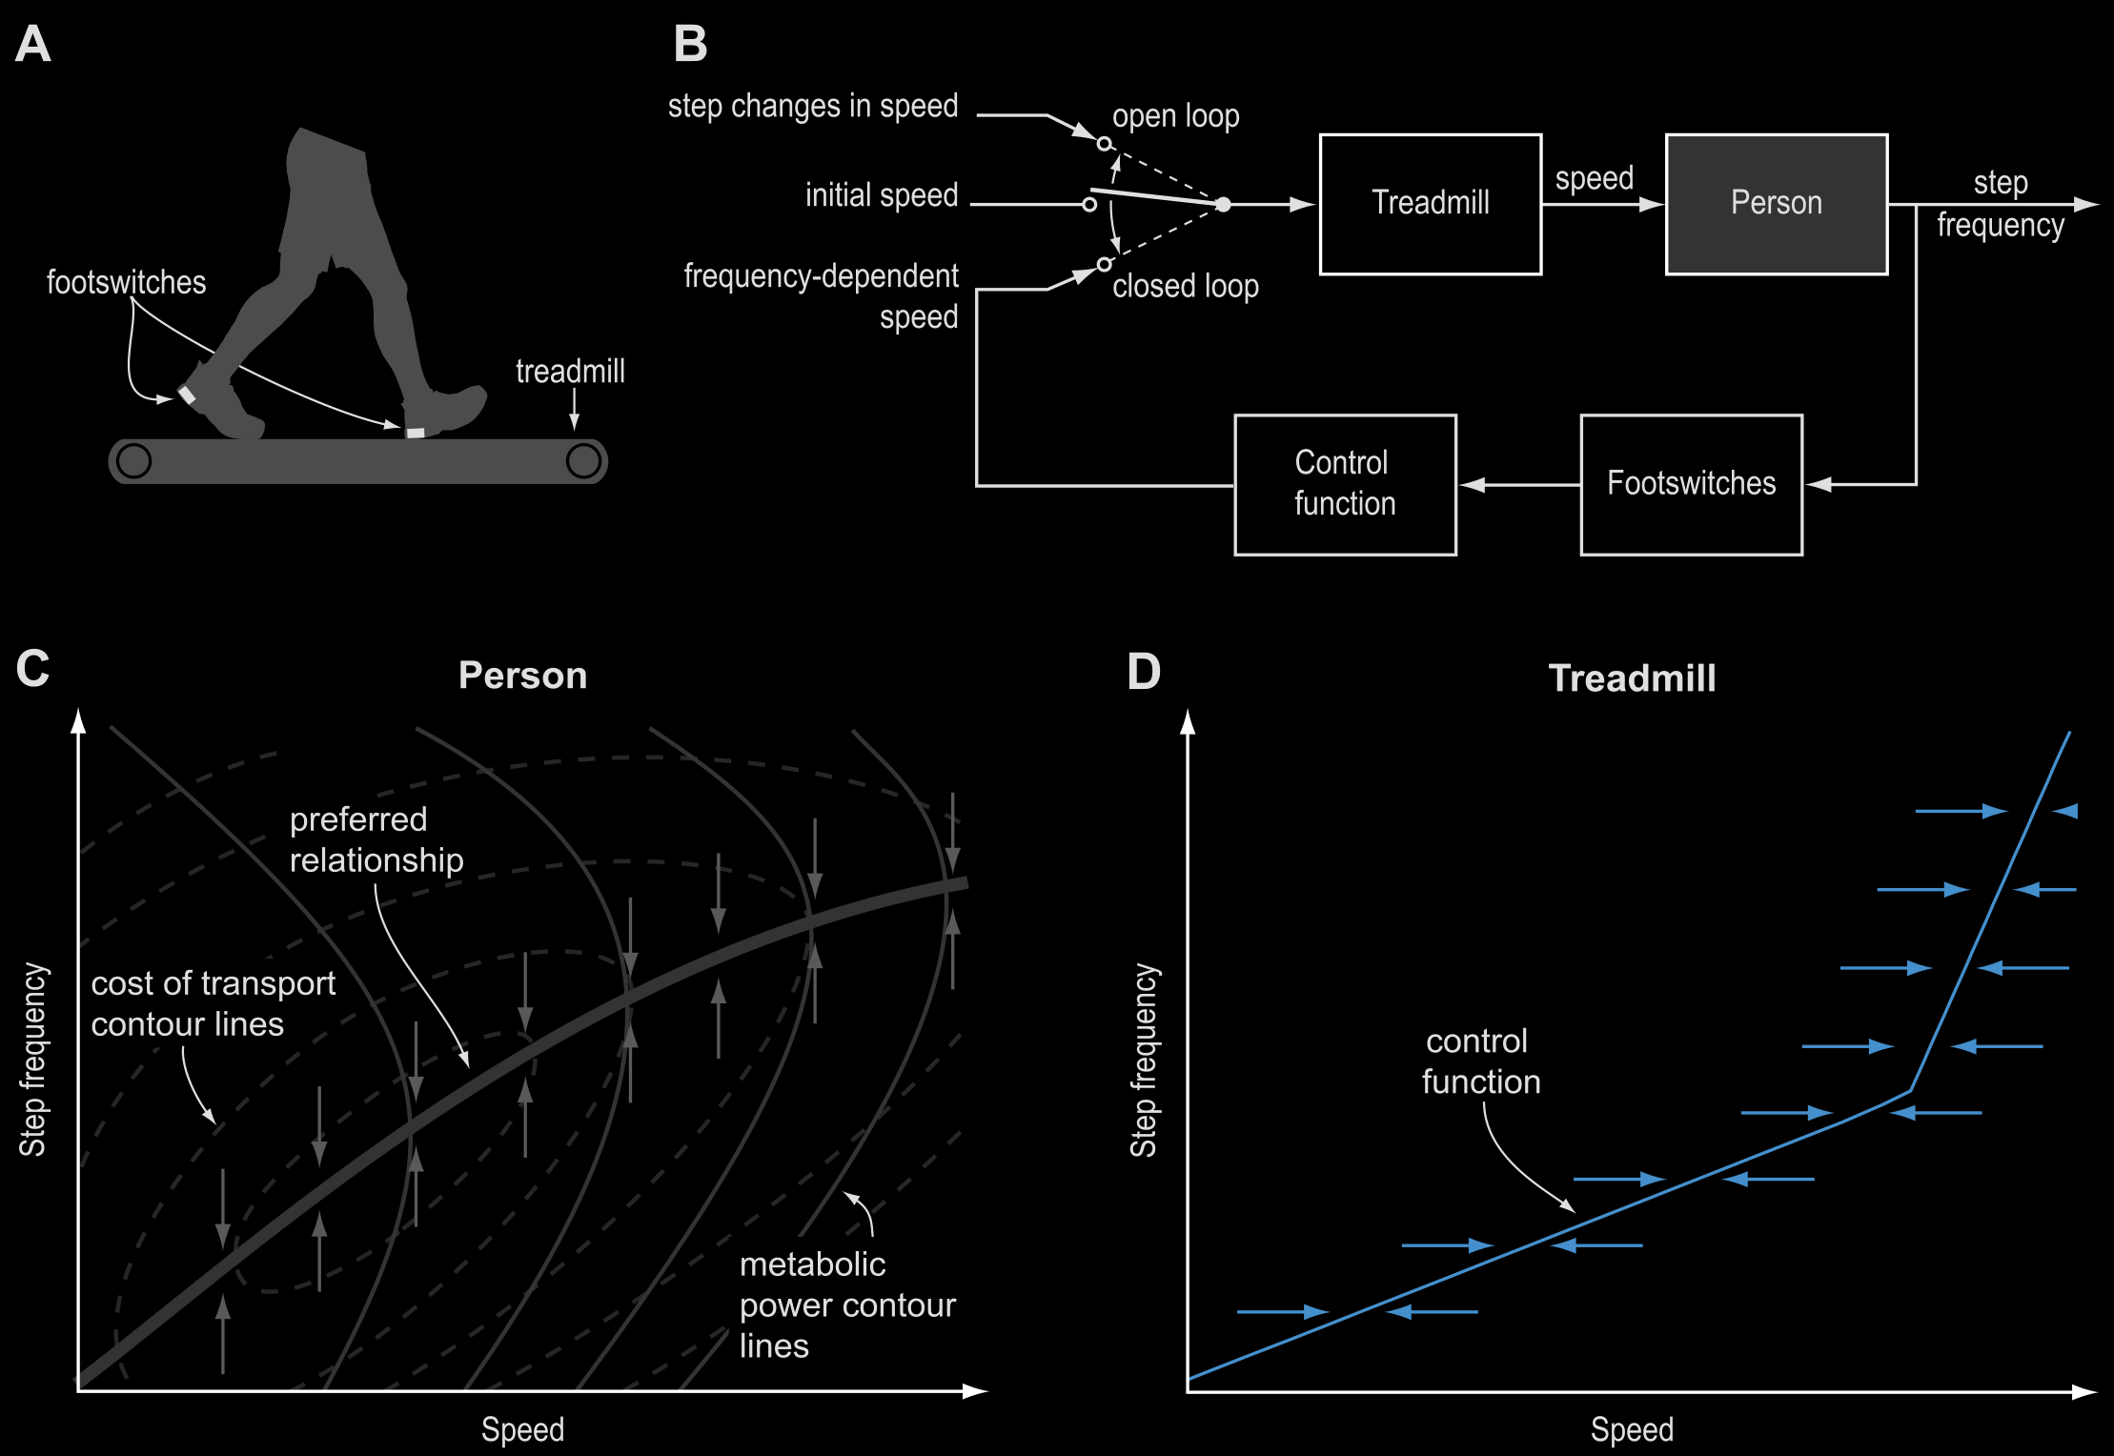
vignette: treadmill adaptation
human preference
machine preference
frequency
frequency
speed
speed
Snaterse, Ton, Kuo, Donelan J Applied Physiology 2011
Distinct fast and slow processes contribute to the selection of preferred step frequency during human walking

Slide 30
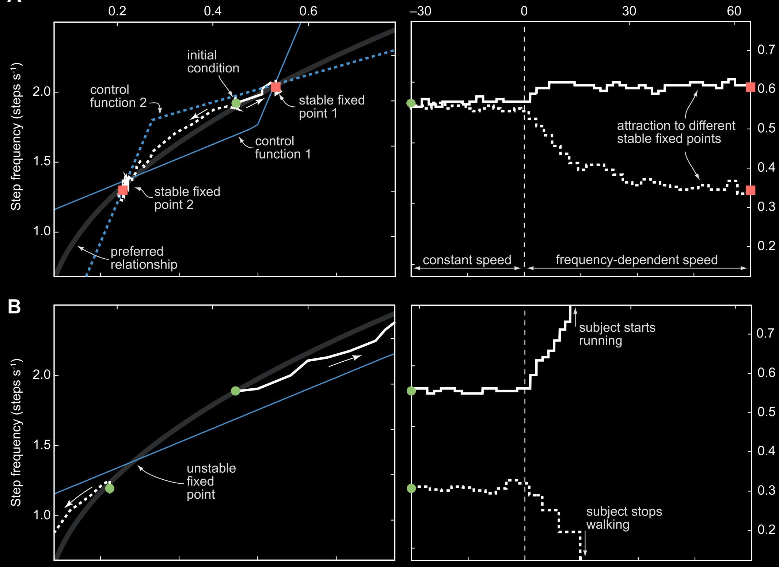
frequency (Hz)
frequency (Hz)
speed (m/sec)
time (sec)

Slide 31
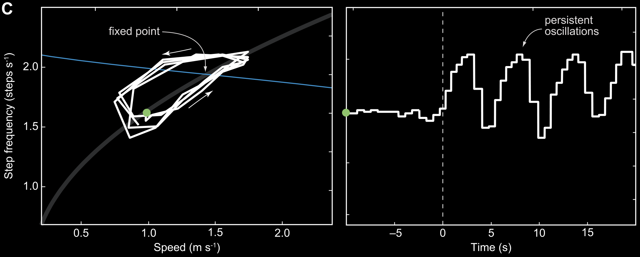
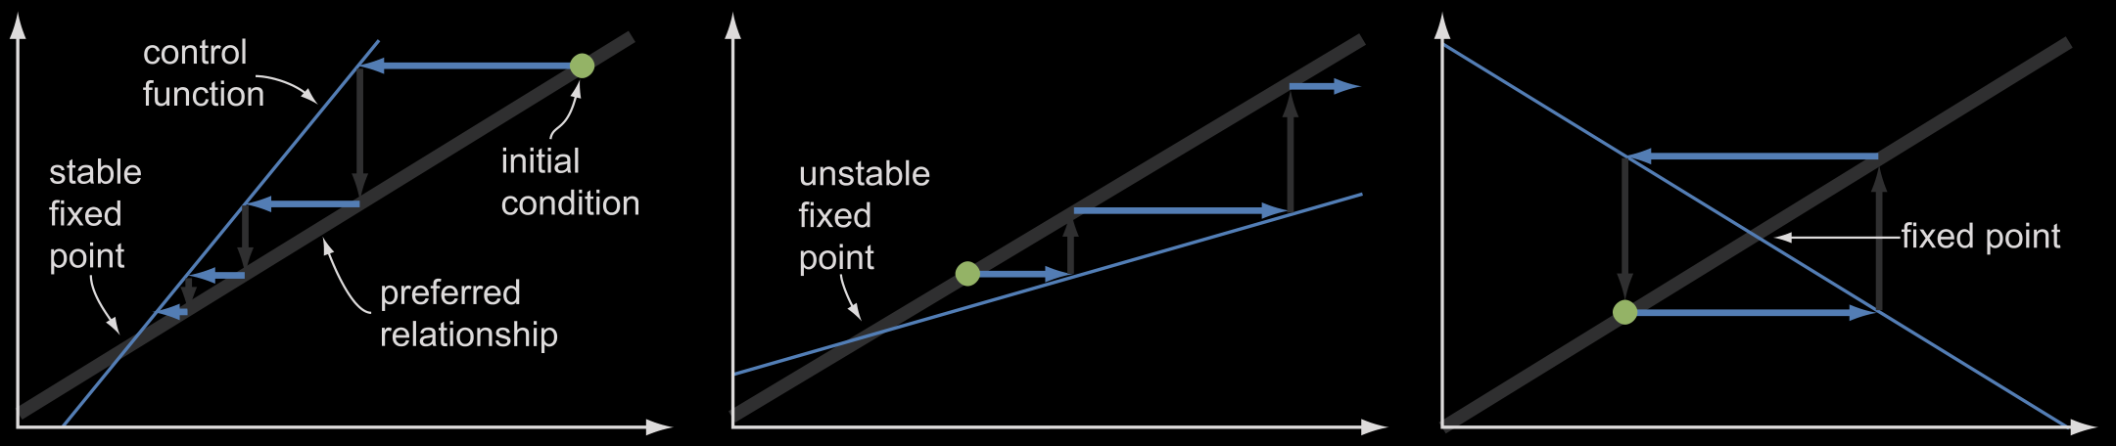
frequency (Hz)
speed (m/sec)
time (sec)
gradient learning predicts these outcomes

Slide 32



analysis of gradient learning model
$$\dot{H}≈∂_{H}c_{H}(H,M)$$
$$\dot{M}≈∂_{M}c_{M} (H,M)$$
(when) does co-adaptation converge?
what does it converge to? how fast?
can machine improve convergence?
Chasnov, Parsa, Yamagami, Ratliff SPIE 2019
Experiments with sensorimotor games in dynamic
human/machine interaction
Chasnov, Ratliff, Mazumdar, Burden UAI 2019
Convergence analysis for gradient-based learning in continuous games
Notes:
One totally plausible thing is that they could try making small adjustments based on local information, namely gradient descent.
In this example, the machine and environment are static.
----------------------------------
For the single agent case, if you had a cost function, how would you go about minimizing it? Well, a good first order method is simply gradient descent.
Suppose the agent has a parabola-shaped cost function, single gradient descent will look like this
Here we
Decision making is also a dynamic process. Especially if you don’t know much about the environment or your cost function, you may need to explore/interact with the environment to ‘learn’ about it.
If there is a minimum, we expect gradient descent like updates to converge to it.
Suppose the human’s cost function is a \parabola shaped thing

Slide 33

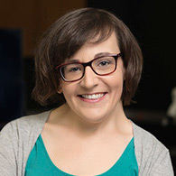


application: brain/machine interface
visual
target
visual
error
neural firing rates
decoder
output
t
e
f
y
B
M
brain
decoder
$$c_{M}\left(B,M\right)={\left\|e\right\|}^{2}+{\left\|M\right\|}^{2}$$
machine cost
$$c_{B}\left(B,M\right)={\left\|e\right\|}^{2}+{\left\|B\right\|}^{2}$$
H: brain cost
error
vs
effort
Wu, Black, Gao, Serruya, Shaikhouni, Donoghue, Bienenstock NeurIPS 2002
Neural Decoding of Cursor Motion Using a Kalman Filter
Gilja, Nuyujukian, Chestek, Cunningham, Yu, Ryu, Shenoy COSYNE 2010
High-Performance Continuous Neural Cursor Control Enabled by a Feedback Control Perspective
Müller, Vidaurre, Schreuder, Meinecke, von Bünau, Müller J Neural Eng 2017
A Mathematical Model for the Two-Learners Problem
Madduri, Burden, Orsborn IEEE NER 2021
A game-theoretic model for co-adaptive brain-machine interfaces
(bioRxiv DOI:10.1101/2020.12.11.421800)
Notes:
One totally plausible thing is that they could try making small adjustments based on local information, namely gradient descent.
In this example, the machine and environment are static.
----------------------------------
For the single agent case, if you had a cost function, how would you go about minimizing it? Well, a good first order method is simply gradient descent.
Suppose the agent has a parabola-shaped cost function, single gradient descent will look like this
Here we
Decision making is also a dynamic process. Especially if you don’t know much about the environment or your cost function, you may need to explore/interact with the environment to ‘learn’ about it.
If there is a minimum, we expect gradient descent like updates to converge to it.
Suppose the human’s cost function is a \parabola shaped thing

Slide 34





analysis: brain/machine interface
$$c_{M}\left(B,M\right)={\left\|e\right\|}^{2}+{\left\|M\right\|}^{2}$$
machine cost
$$c_{B}\left(B,M\right)={\left\|e\right\|}^{2}+{\left\|B\right\|}^{2}$$
H: brain cost
potential function
$$φ\left(B,M\right)={\left\|e\right\|}^{2}+{\left\|B\right\|}^{2}+{\left\|M\right\|}^{2}$$
learning dynamics
$$\dot{B}≈∂_{B}φ(B,M)$$
$$\dot{M}≈∂_{M}φ(B,M)$$
i.e. the brain learns to “invert” the decoder
stationary points
$${M^{∗}B}^{∗}=I$$
Monderer, Shapley Games and Economic Behavior 1996
Potential Games
Hespanha Princeton Univ Press 2017
Noncooperative Game Theory
Madduri, Burden, Orsborn IEEE NER 2021
A game-theoretic model for co-adaptive brain-machine interfaces
(bioRxiv DOI:10.1101/2020.12.11.421800)
Notes:
One totally plausible thing is that they could try making small adjustments based on local information, namely gradient descent.
In this example, the machine and environment are static.
----------------------------------
For the single agent case, if you had a cost function, how would you go about minimizing it? Well, a good first order method is simply gradient descent.
Suppose the agent has a parabola-shaped cost function, single gradient descent will look like this
Here we
Decision making is also a dynamic process. Especially if you don’t know much about the environment or your cost function, you may need to explore/interact with the environment to ‘learn’ about it.
If there is a minimum, we expect gradient descent like updates to converge to it.
Suppose the human’s cost function is a \parabola shaped thing

Slide 35
how can we enable human/machine
collaborative learning and control?
humans learn models of machines …
… so machines should learn models of humans
takeaway: humans learn to $≈$invert machine dynamics
takeaway: machines must learn how humans adapt

Slide 36
Q: how can we enable human/machine
collaborative learning and control?
humans learn models of machines …
… so machines should learn models of humans
A: need to study sensorimotor games

Slide 37





sburden@uw.edu
http://faculty.uw.edu/sburden
thank you!
Momona Yamagami
PhD candidate in ECE
Ben Chasnov
PhD student in ECE
Maneeshika Madduri
PhD student in ECE
NSF CPS CRII #1565529: Provably-safe interventions for human-cyber-physical systems
NSF CPS Medium #1836819:
Certifiable reinforcement learning for cyber-physical systems

