Slide 1








on infinitesimal contraction analysis for mechanical systems
subject to unilateral constraints
Sam Burden
Assistant Professor
Electrical & Computer Engineering
University of Washington
Seattle, WA USA
http://faculty.uw.edu/sburden
Prof Sam Coogan
Dr Tom Libby
Dr Andrew Pace
Joey Sullivan

Slide 2
on infinitesimal contraction analysis for mechanical systems
subject to unilateral constraints
tracking through contact-rich dynamics
Sam Burden
Assistant Professor
Electrical & Computer Engineering
University of Washington
Seattle, WA USA
http://faculty.uw.edu/sburden
Prof Sam Coogan
Dr Tom Libby
Dr Andrew Pace
Joey Sullivan

Slide 3
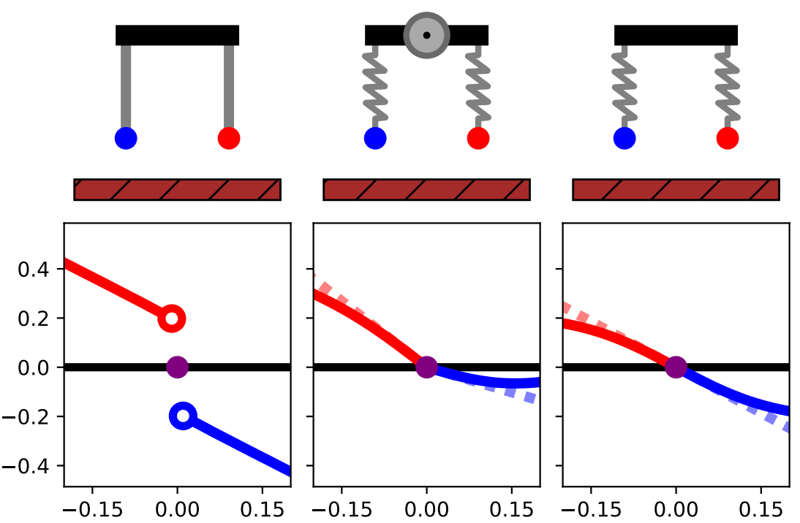



today’s talk:
tracking through contact-rich dynamics
1. what is it?
final rotational velocity
initial rotation
2. why is it hard?
3. how can we get it?
$$τ\left(y_{0}\right)>τ\left({\overline{x}}_{0}\right)>τ(z_{0})$$

Slide 4

today’s talk:
tracking through contact-rich dynamics
1. what is it?
final rotational velocity
initial rotation
2. why is it hard?
3. how can we get it?
$$τ\left(y_{0}\right)>τ\left({\overline{x}}_{0}\right)>τ(z_{0})$$

Slide 5
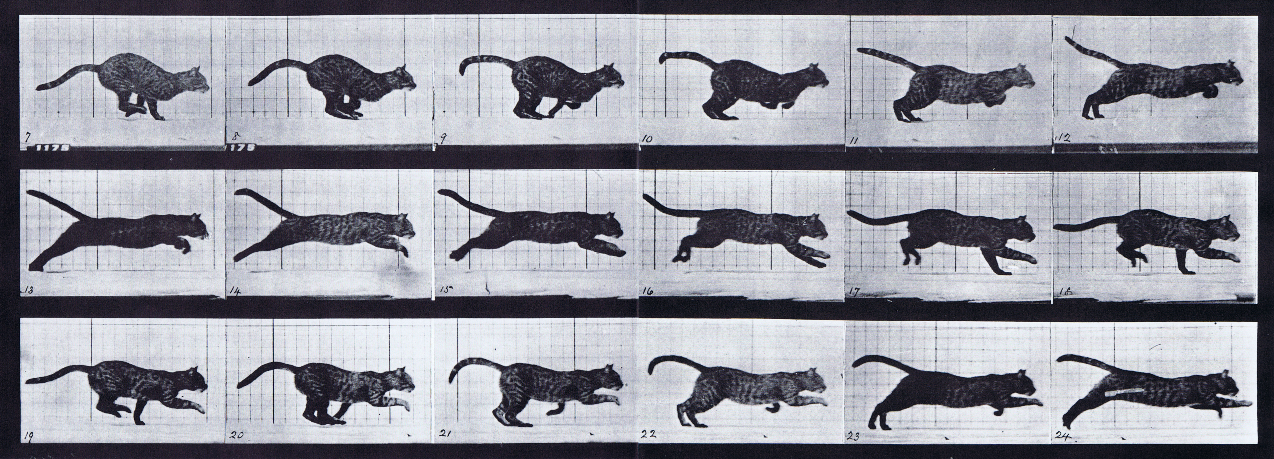

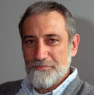
contact-rich dynamics are hybrid
Muybridge 1887 (reprinted by Dover in 1957)
  contact points (limbs, digits)
  non-penetration constraints
  continuous dynamics
  discrete dynamics
  (impact law)
Johnson, Burden, Koditschek IJRR 2016 (arXiv:1502.01538)
A hybrid systems model for simple manipulation and self-manipulation systems

Slide 6
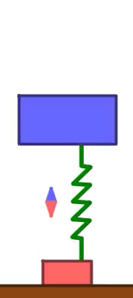

Slide 7
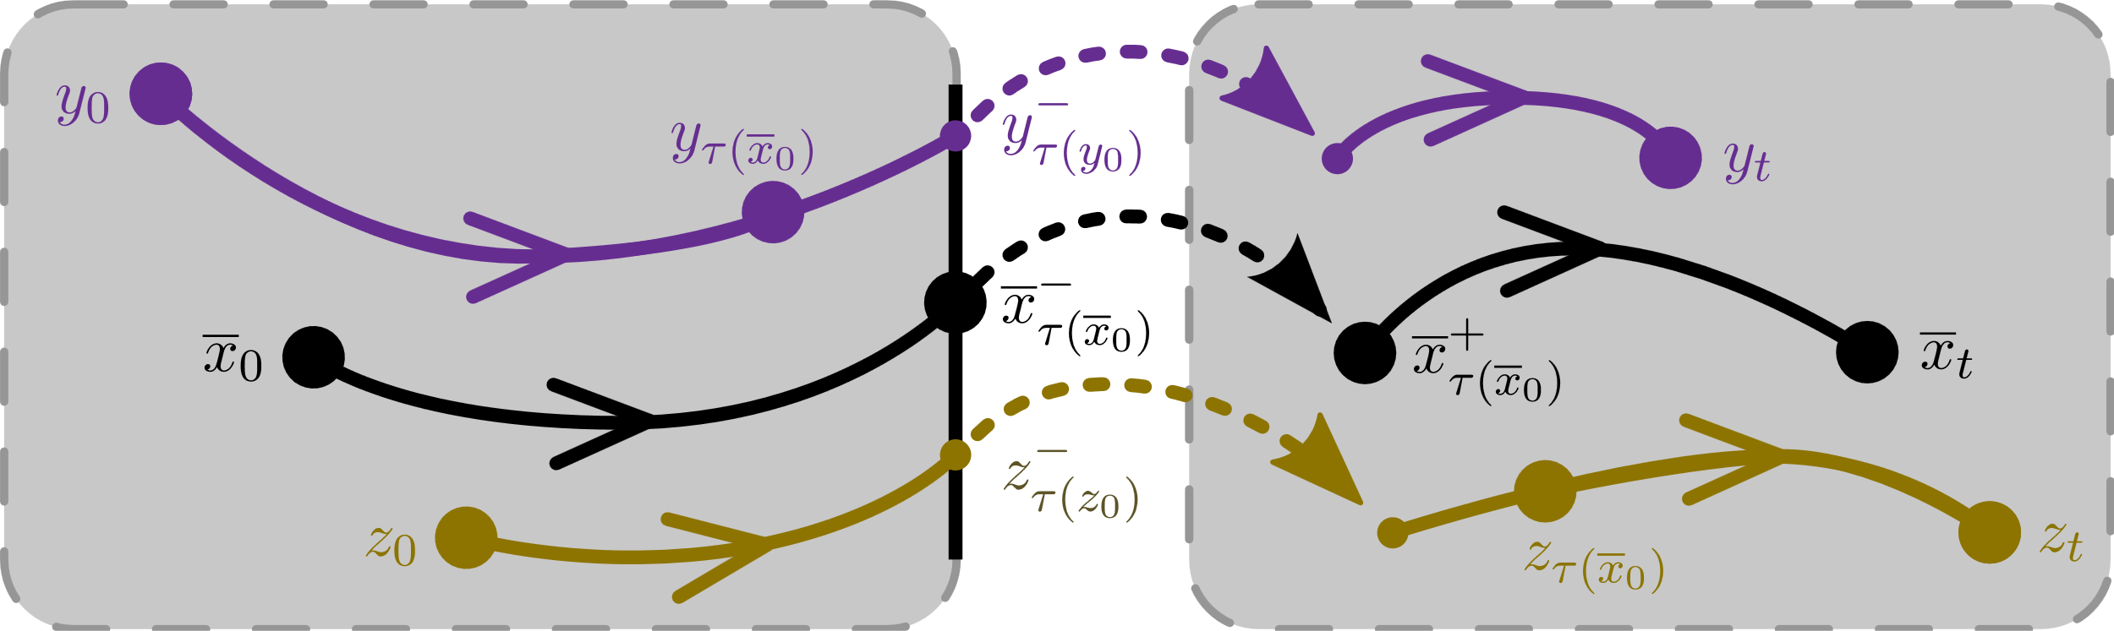







given: reference trajectory
in mechanical system subject to unilateral constraints
$$y_{0}$$
$${\overline{x}}_{0}$$
$$z_{0}$$
$$y_{t}$$
$${\overline{x}}_{t}$$
$$z_{t}$$

Slide 8
given: reference trajectory
in mechanical system subject to unilateral constraints
tracking through contact-rich dynamics
find: control , distance
s.t. trajectories converge at exponential rate:

Slide 9
tracking through contact-rich dynamics
decades of work – still an open problem
Brogliato et al 1997, 2005, 2010, ...
Tornambe et al 1999, 2001, ...
Grizzle et al 2003, 2011, ...
Teel et al 2013, ...
Hamed et al 2014, 2016, ...
Posa, Tedrake et al 2016, ...
Saccon, Nijmeijer et al 2016, 2019, ...

Slide 10
today’s talk:
tracking through contact-rich dynamics
1. what is it?
final rotational velocity
initial rotation
2. why is it hard?
3. how can we get it?
$$τ\left(y_{0}\right)>τ\left({\overline{x}}_{0}\right)>τ(z_{0})$$

Slide 11
today’s talk:
tracking through contact-rich dynamics
1. what is it?
final rotational velocity
initial rotation
2. why is it hard?
3. how can we get it?
$$τ\left(y_{0}\right)>τ\left({\overline{x}}_{0}\right)>τ(z_{0})$$

Slide 12

key challenge #1: impact time varies
$$τ\left(y_{0}\right)>τ\left({\overline{x}}_{0}\right)>τ(z_{0})$$
$$y_{0}$$
$${\overline{x}}_{0}$$
$$z_{0}$$
$$y_{t}$$
$${\overline{x}}_{t}$$
$$z_{t}$$

Slide 13
Theorem (Aizerman & Gantmacher):
if contact sequence doesn’t change,
final state varies differentiably w.r.t. initial state
Aizerman & Gantmacher 1958
Quarterly Journal of Mechanics and Applied Mathematics
Determination of Stability by Linear Approximation of a Periodic Solution of a System of Differential Equations with Discontinuous Right-Hand Sides

Slide 14

Idea (Saccon et al): if contact sequence doesn’t change, linearize and apply linearized controller
... but 0th order error remains ...
$$τ\left(y_{0}\right)>τ\left({\overline{x}}_{0}\right)>τ(z_{0})$$
key challenge #1: impact time varies
... and this doesn’t address key challenge #2 ...
Saccon, van de Wouw, Nijmeijer IEEE CDC 2014
Sensitivity Analysis of Hybrid Systems with State Jumps with Application to Trajectory Tracking
Rijnen, Saccon, Nijmeijer IEEE CDC 2015
On Optimal Trajectory Tracking for Mechanical Systems with Unilateral Constraints

Slide 15
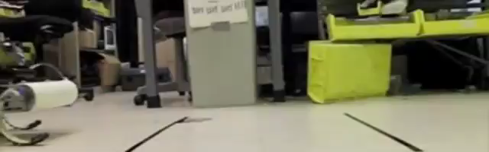

Galloway, Haynes, Ilhan, Johnson, Knopf, Lynch, Plotnick, White, Koditschek UPenn 2010
key challenge #1: contact sequence varies
Hyun, Seok, Lee, Kim IJRR 2014

Slide 17
Theorem (Hürmüzlü et al, Remy et al):
near simultaneous impacts, final state generally
varies discontinuously w.r.t. initial state
Hürmüzlü and Marghitu
International Journal of Robotics Research 1994
Rigid Body Collisions of Planar Kinematic Chains With Multiple Contact Points
Remy, Buffington, Siegwart
International Journal of Robotics Research 2010
Stability Analysis of Passive Dynamic Walking of Quadrupeds

Slide 18


impact reset is ${\dot{q}}^{+}={Δ(q)\dot{q}}^{−}$ where
$$Δ=I−\left(1+γ\right){⋅M}^{−1}⋅Da^{⊤}⋅{(Da^{⊤}⋅M^{−1}⋅Da)}^{−1}⋅Da$$
rigidly coupled limbs $⟹$
$⟹$ discontinuous flow $⟹$ not contractive

Slide 19
today’s talk:
tracking through contact-rich dynamics
1. what is it?
final rotational velocity
initial rotation
2. why is it hard?
3. how can we get it?
$$τ\left(y_{0}\right)>τ\left({\overline{x}}_{0}\right)>τ(z_{0})$$

Slide 20
today’s talk:
tracking through contact-rich dynamics
1. what is it?
final rotational velocity
initial rotation
2. why is it hard?
3. how can we get it?
$$τ\left(y_{0}\right)>τ\left({\overline{x}}_{0}\right)>τ(z_{0})$$

Slide 21


impact reset is ${\dot{q}}^{+}={Δ(q)\dot{q}}^{−}$ where
$$Δ=I−\left(1+γ\right){⋅M}^{−1}⋅Da^{⊤}⋅{(Da^{⊤}⋅M^{−1}⋅Da)}^{−1}⋅Da$$
orthogonal constraints ($Da^{⊤}⋅M^{−1}⋅Da$ diagonal)
$⟹$ impact resets commute
non-orthogonal constraints
orthogonal constraints

Slide 22
non-orthogonal
constraints:

Slide 23
orthogonal
constraints:

Slide 24


Theorem (Pace & Burden):
if constraints are orthogonal, final state varies
piecewise-differentiably w.r.t. initial state
Pace & Burden HSCC 2017 (arXiv:1610.05645)
Piecewise-differentiable trajectory outcomes in mechanical systems subject to unilateral constraints
Pace & Burden ICRA 2017 (arXiv:1609.04056)
Decoupled limbs yield differentiable trajectory outcomes through intermittent contact
Burden, Sastry, Koditschek, Revzen SIADS 2016 (arXiv:1407.1775)
Event-Selected Vector Field Discontinuities Yield Piecewise-Differentiable Flows

Slide 25
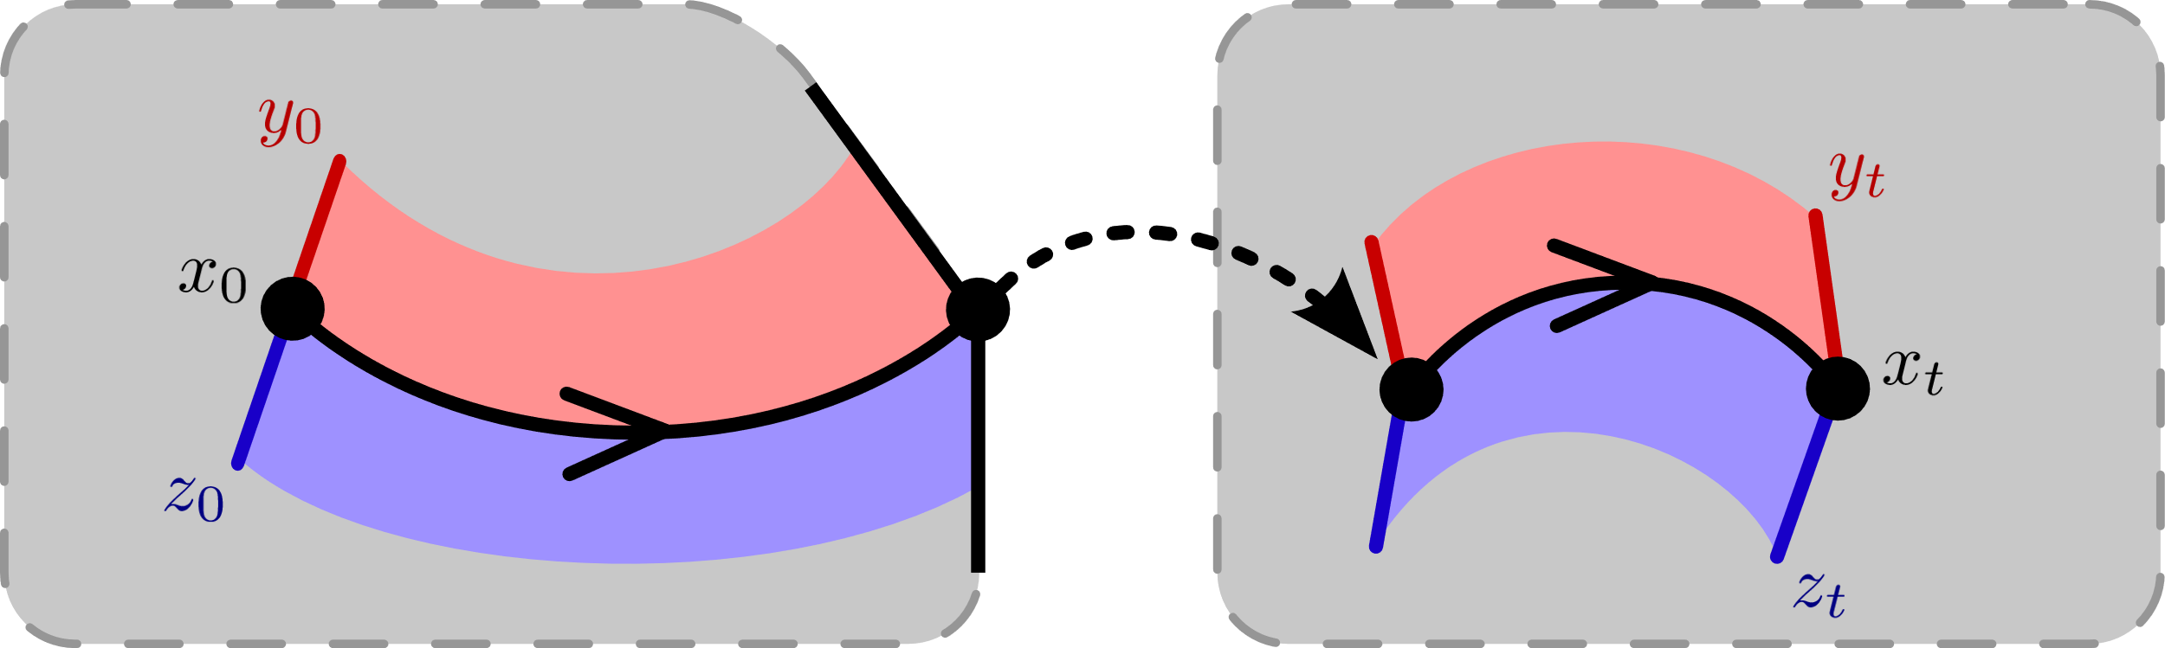
trajectories vary continuously ….

Slide 26
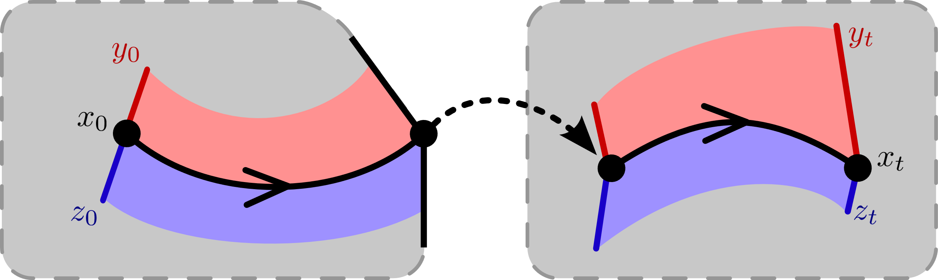
trajectories vary continuously ….
… do they
expand
or
contract?

Slide 27
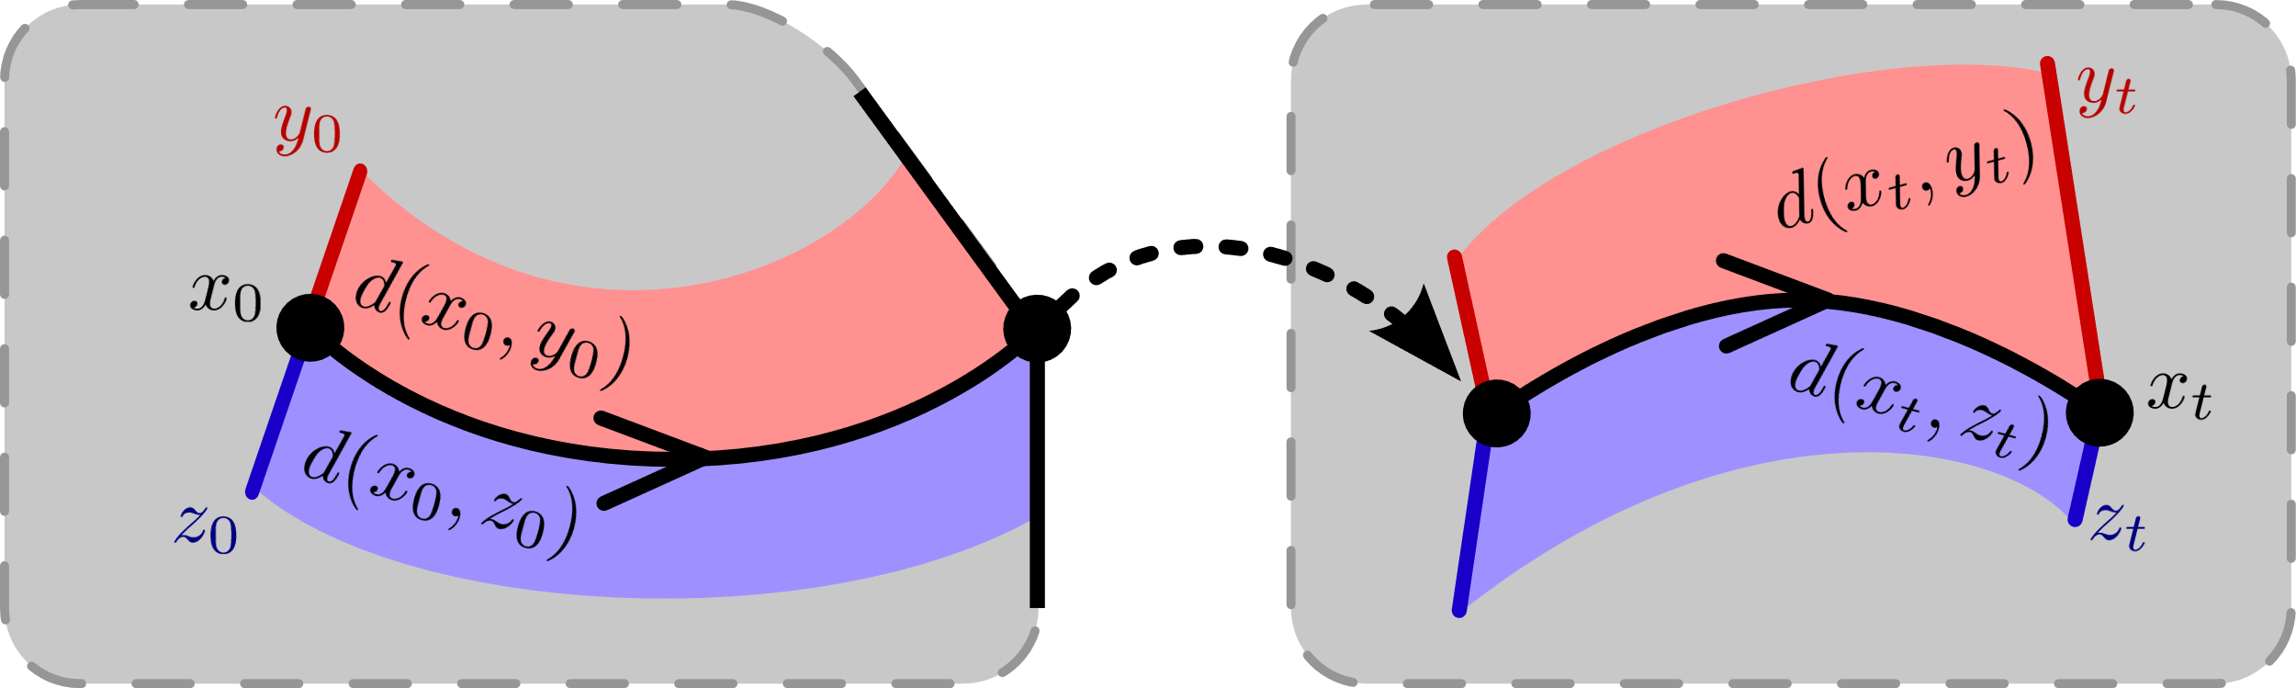


trajectories vary continuously ….
… do they
expand
or
contract?
$$d\left(x_{0},y_{0}\right)<d\left(x_{t},y_{t}\right)$$
$$d\left(x_{0},z_{0}\right)>d\left(x_{t},z_{t}\right)$$

Slide 28





how to measure distance?
d(
)=0
,
Theorem (Burden, Gonzalez, Vasudevan, et al):
d(x ⁻, x ⁺) = 0 determines a distance metric
compatible with topological quotient x ⁻ ~ x ⁺
Burden, Gonzalez, Vasudevan, Bajcsy, Sastry IEEE TAC 2015
Metrization and simulation of controlled hybrid systems

Slide 29




contraction in classical dynamics
Theorem (Lohmiller & Slotine): if the
or
dynamics are infinitesimally contractive,
or
then the dynamics are globally contractive,
i.e. distances decrease at an exponential rate
continuous-time
discrete-time
Lohmiller, Slotine Automatica 1998
On contraction analysis for nonlinear systems

Slide 30
contact-rich dynamics
  limbs in contact with ground
  ground penetration constraints
  continuous-time
  discrete-time (impact)
continuous-time and discrete-time interact in contact-rich dynamics
Johnson, Burden, Koditschek IJRR 2016 (arXiv:1502.01538)
A hybrid systems model for simple manipulation and self-manipulation systems

Slide 31
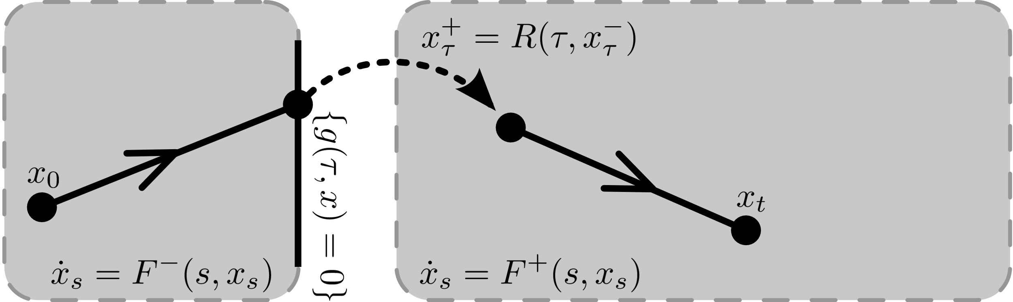

Slide 32
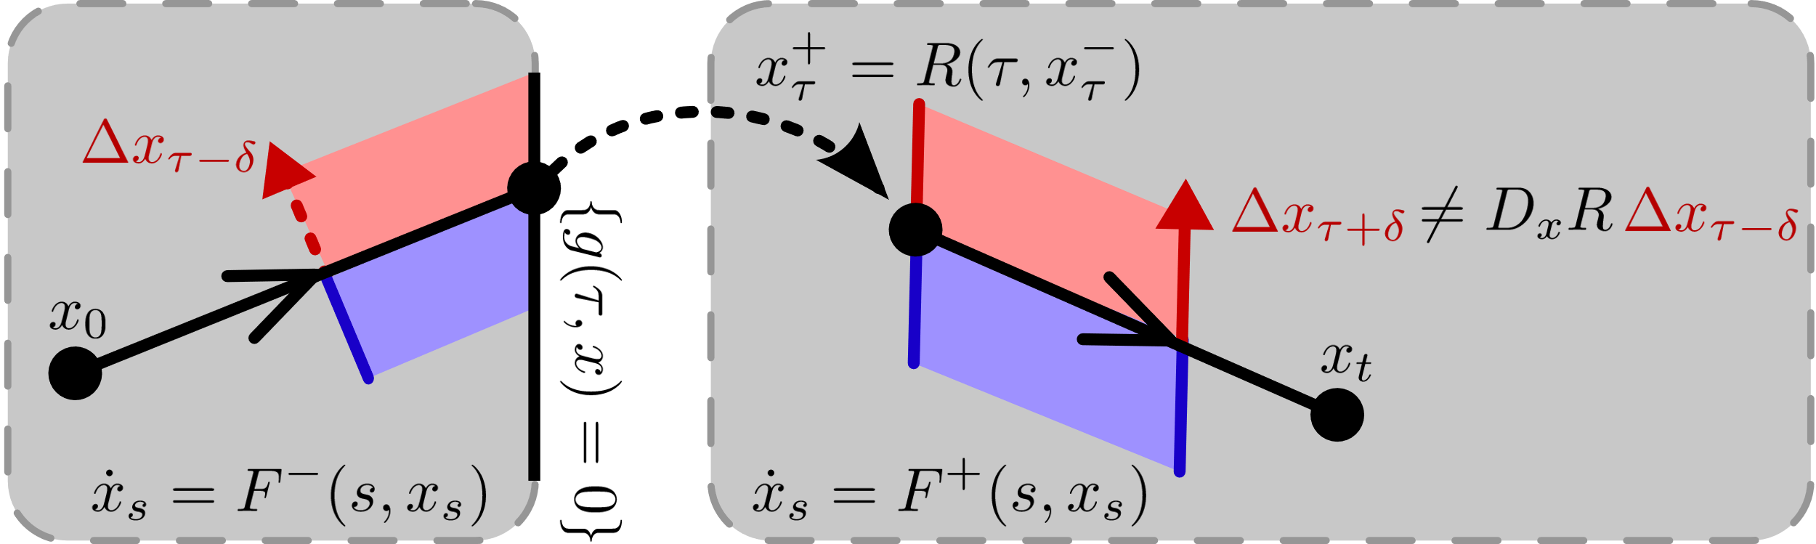
can’t look at discrete-time alone …

Slide 33
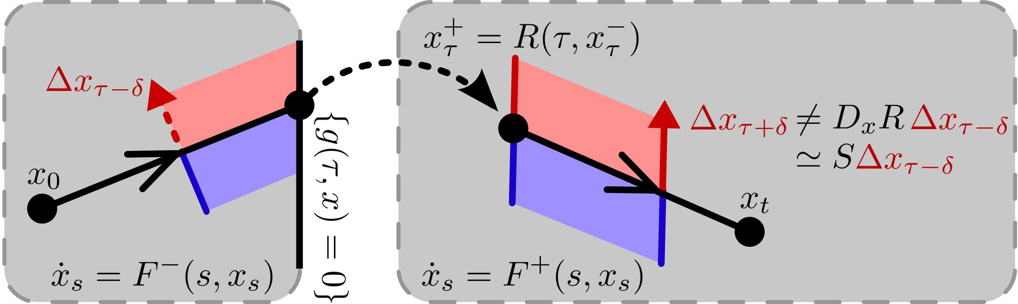
can’t look at discrete-time alone …
need interaction w/ continuous-time:
  “saltation matrix”
Aizerman & Gantmacher Quarterly Journal of Mechanics and Applied Mathematics 1958
Determination of Stability by Linear Approximation of a Periodic Solution of a System of Differential Equations with Discontinuous Right-Hand Sides

Slide 34


contraction in contact-rich dynamics
Theorem (Burden, Coogan): if the
and
dynamics are infinitesimally contractive,
and
then combined dynamics globally contractive,
i.e. distances decrease at an exponential rate
continuous-time
discrete-time
Burden, Coogan IEEE TAC (conditionally accepted, 2021)
On infinitesimal contraction analysis for a class of hybrid systems
Burden, Libby, Coogan (arXiv: 1804.04122v2)
On contraction analysis for hybrid systems

Slide 35



rigid: discontinuous
elastic: expansive
viscoelastic: contractive
body
body
body
foot
foot
foot
decoupled how?
decoupled
limbs
Burden, Libby, Coogan (arXiv: 1804.04122v2)
On contraction analysis for hybrid systems

Slide 36




  contractive
  (1 DOF, 1 rigid constraint)
  expansive liftoff
  (1 DOF, 1 soft constraint)
  expansive impact
  (2 DOF, elastic)
  contractive
  (2 DOF, viscoelastic)
Burden, Libby, Coogan (arXiv: 1804.04122v2)
On contraction analysis for hybrid systems

Slide 37
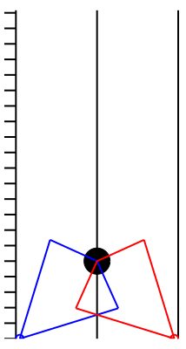
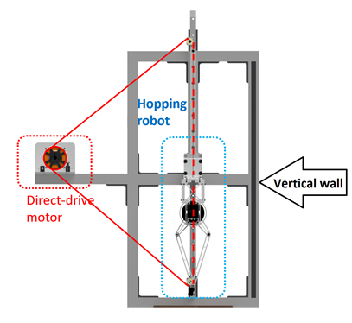


Sullivan, Libby, Burden (in prep)
On infinitesimal contraction analysis for tracking through contact-rich dynamics

Slide 38
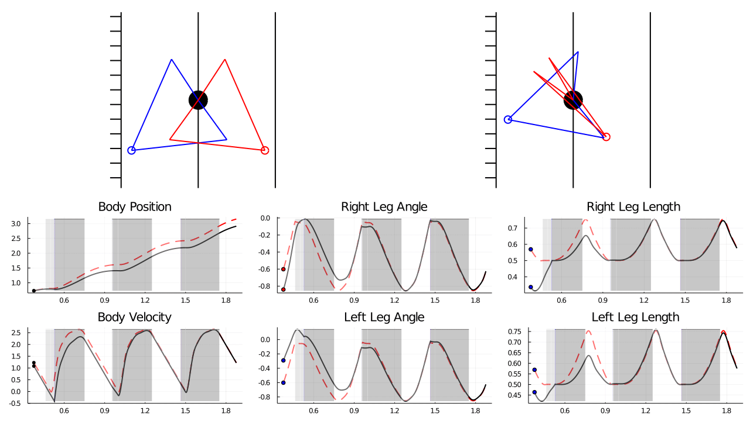
reference
perturbed trajectory
Sullivan, Libby, Burden (in prep)
On infinitesimal contraction analysis for tracking through contact-rich dynamics

Slide 39
today’s talk:
tracking through contact-rich dynamics
1. what is it?
final rotational velocity
initial rotation
2. why is it hard?
3. how can we get it?
$$τ\left(y_{0}\right)>τ\left({\overline{x}}_{0}\right)>τ(z_{0})$$

Slide 40
today’s talk:
tracking through contact-rich dynamics
1. what is it?
final rotational velocity
initial rotation
2. why is it hard?
3. how can we get it?
$$τ\left(y_{0}\right)>τ\left({\overline{x}}_{0}\right)>τ(z_{0})$$

Slide 41










organizers:
thank you!
Professor Yan Gu
Professor Abderrahmane Kheddar
Professor Alessandro Saccon
sburden@uw.edu
http://faculty.uw.edu/sburden
collaborators:
Prof Sam Coogan
Dr Tom Libby
Dr Andrew Pace
Joey Sullivan
funding:
ARO YIP #W911NF-16-1-0158: Predictive models for sensorimotor control of legged locomotion
NSF M3X CAREER #2045014: Human/Machine Collaborative Learning and Control of Contact-Rich Dynamics

