Slide 1


sensorimotor games: human/machine
collaborative learning and control
follow along! https://bit.ly/2021-MLMC-Games
Sam Burden
Assistant Professor
Associate Chair for Diversity, Equity, & Inclusion
Electrical & Computer Engineering
University of Washington
Seattle, WA USA
http://faculty.uw.edu/sburden

Slide 2
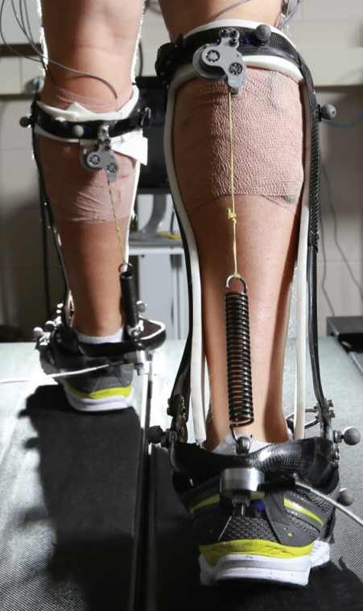
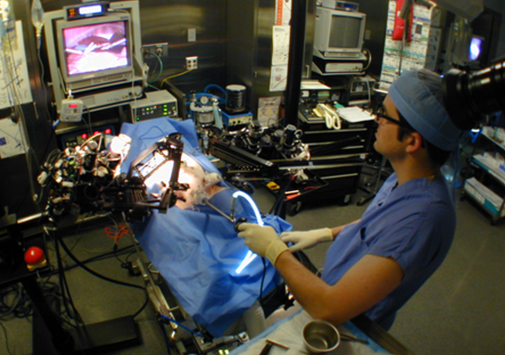
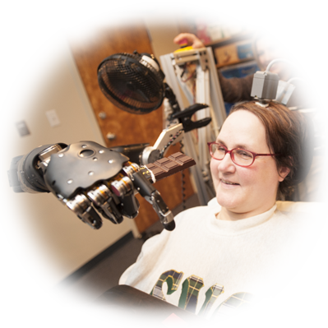



human interaction with the physical world
is increasingly mediated by machines
how can we enable human/machine
collaborative learning and control?
Hannaford, Rosen, Friedman, King, Roan, Cheng, Glozman, Ma, Kosari, White IEEE Tran Biomed Eng 2013 Raven-II: An Open Platform for Surgical Robotics Research
Wodlinger, Downey, Tyler-Kabara, Schwartz, Boninger, Collinger J Neural Eng 2015
Ten-Dimensional Anthropomorphic Arm Control in a Human Brain-Machine Interface
Collins, Wiggin, Sawicki Nature 2015
Reducing the Energy Cost of Human Walking Using an Unpowered Exoskeleton
Nothwang, Robinson, Burden, McCourt, Curtis IEEE Resilience Week 2016
The Human Should be Part of the Control Loop?

Slide 3
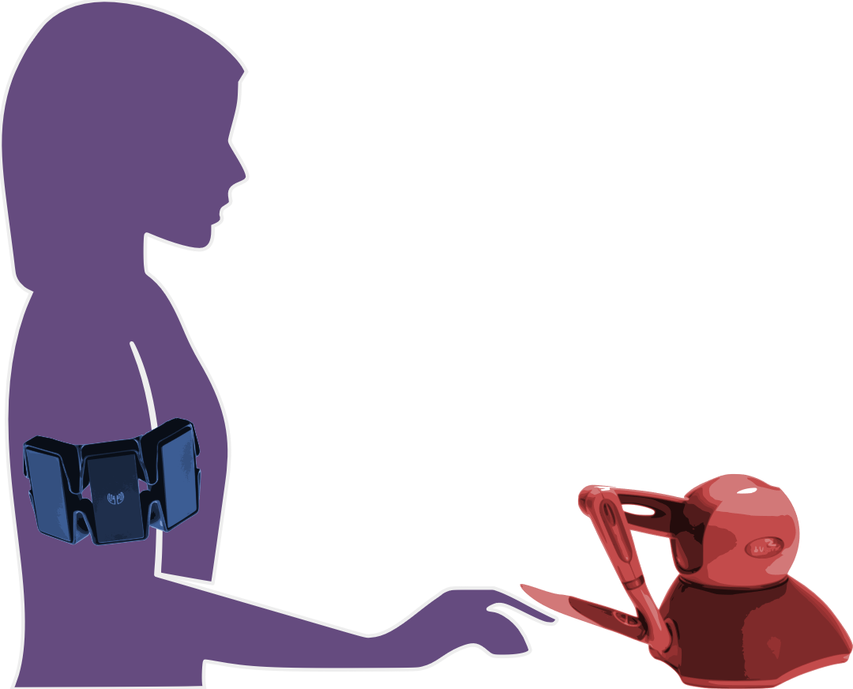
today’s talk:
how can we enable human/machine
collaborative learning and control?
humans learn models of machines …
… so machines should learn models of humans

Slide 4
today’s talk:
how can we enable human/machine
collaborative learning and control?
humans learn models of machines …
… so machines should learn models of humans

Slide 5
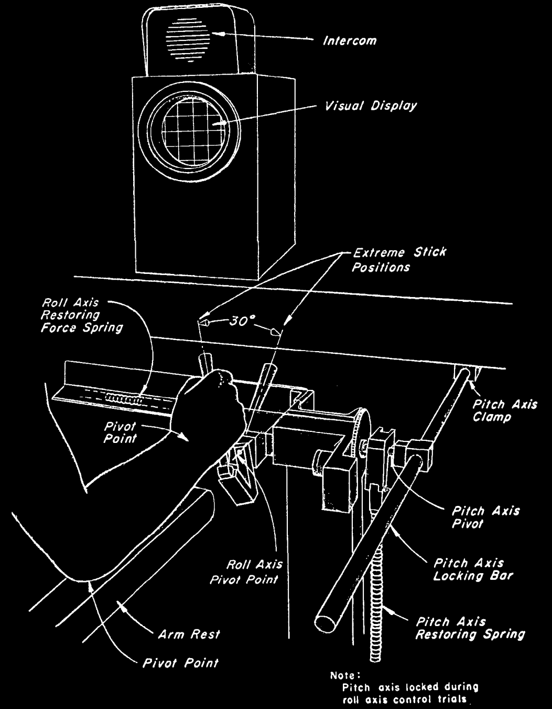
r
d
y
r
reference
y
output
u
disturbance
d
input
u
McRuer, Krendel J Franklin Institute 1959
The Human Operator as a Servo System Element
McRuer Automatica 1980
Human Dynamics in Man-Machine Systems

Slide 6
predicting behavior: what’s in ?
H
human/machine system
H
d
F
f
u
+
+
M
y
e
b
r
+
B
-

Slide 7

predicting behavior: what’s in ?
H
  theoretical and empirical evidence for pairing of system + inverse models
    Wolpert, Ghahramani, Jordan Science 1995
    Kawato Curr Opin Neurobiol 1999
feedforward ${F≈M}^{−1}$
system model
+
inverse model
  parallels in control theory, artificial intelligence: adaptive control, internal model principle, reinforcement learning
    Francis, Wonham Automatica 1976; Sastry, Bodson Prentice Hall 1989
    Sutton, Barto, Williams IEEE CSM 1992; Atkeson, Schaal ICML 1997
    Papavassiliou, Russell IJCAI 1999
Notes:
replace text with cartoon

Slide 8
human/machine system
H
d
F
f
u
+
+
M
y
e
b
r
+
B
-

Slide 9



H: humans use feedforward and feedback
human/machine system
feedforward
d
F
f
u
+
+
M
y
e
b
r
+
B
-
feedback
McRuer, Jex IEEE Transactions on Human Factors in Electronics 1967
A Review of Quasi-Linear Pilot Models
Yu, Gillespie, Freudenberg, Cook IEEE CDC 2014
Human control strategies in pursuit tracking with a disturbance input
Yamagami, Howell, Roth, Burden IFAC CPHS 2018
Contributions of feedforward and feedback control in a manual trajectory-tracking task

Slide 10

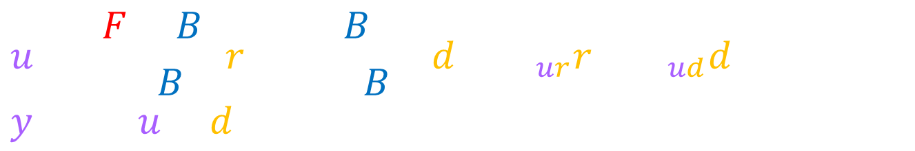
H: humans use feedforward and feedback
  test hypothesis:
  transcribe block diagram to algebraic equations
  solve equations for F, B
d
F
u
y
+
+
M
r
+
e
B
-
$$u=\frac{F+B}{1+BM}r+\frac{−BM}{1+BM}d=H_{ur}r+H_{ud}d, y=M(u+d)$$
  (1.)
$$F=\frac{H_{ur}+M^{−1}H_{ud}}{1+H_{ud}},B=\frac{−H_{ud}}{M(1+H_{ud})}$$
  (2.)
Cowan, Ankaralı, Dyhr, Madhav, Roth, Sefati, Sponberg, Stamper, Fortune, Daniel Int Comp Bio 2014
Feedback Control as a Framework for Understanding Tradeoffs in Biology
Yu, Gillespie, Freudenberg, Cook IEEE CDC 2014
Human control strategies in pursuit tracking with a disturbance input
Yamagami, Howell, Roth, Burden IFAC CPHS 2018
Contributions of feedforward and feedback control in a manual trajectory-tracking task

Slide 11
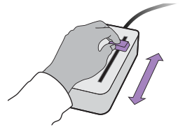


experiment: manual interface
  subjects use 1-dimensional joystick device to control cursor motion to track specified reference
Roth, Howell, Beckwith, Burden SPIE 2017
Toward experimental validation of a model for human sensorimotor learning and control in teleoperation
Yamagami, Howell, Roth, Burden IFAC CPHS 2018
Contributions of feedforward and feedback control in a manual trajectory-tracking task

Slide 12
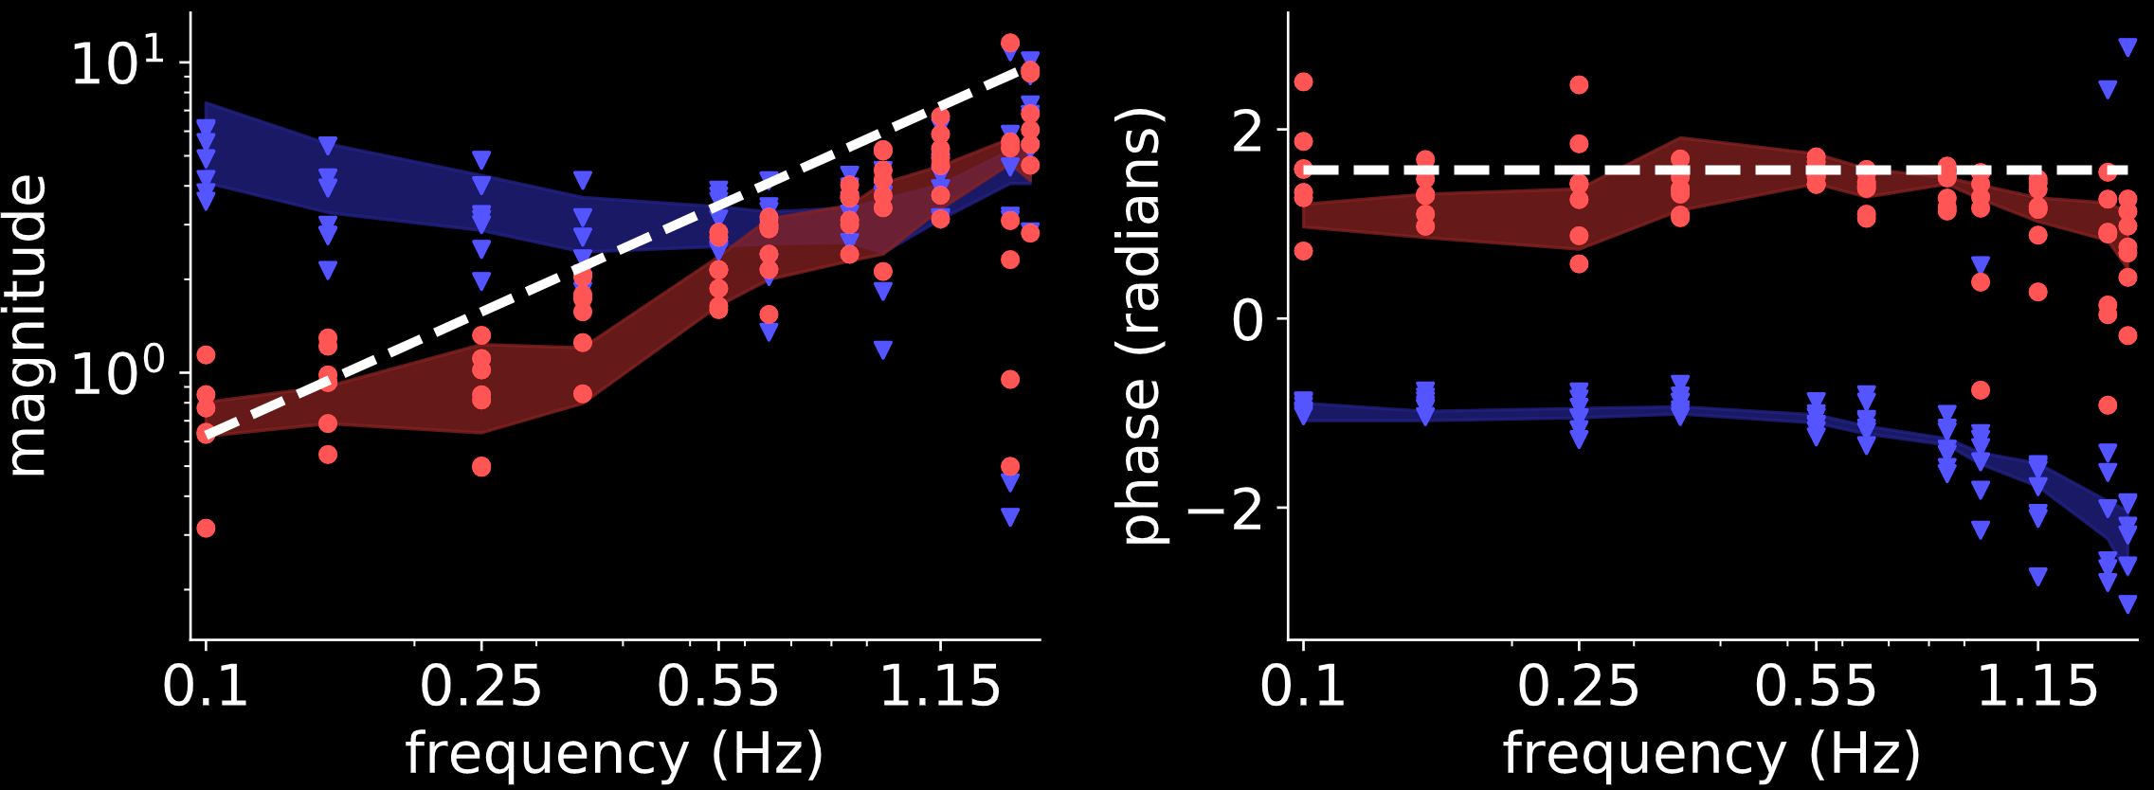





result: humans invert first-order model
$$(N=7)$$
d
$$M^{−1}$$
$$M=1/s$$
i.e. $\dot{y}=u$
(first-order)
F
u
y
+
+
M
$$F$$
r
+
e
B
-
$$B$$
Yamagami, Howell, Roth, Burden IFAC CPHS 2018
Contributions of feedforward and feedback control in a manual trajectory-tracking task

Slide 13
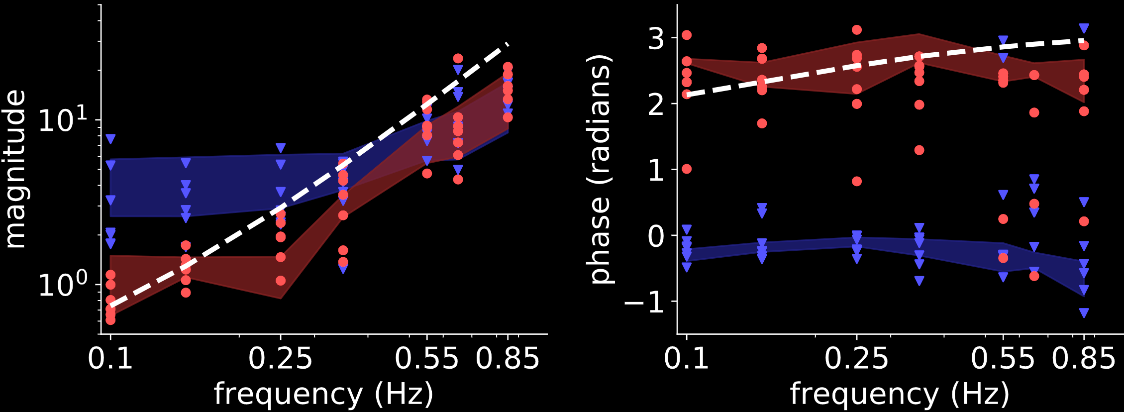


result: humans invert second-order model
$$(N=7)$$
d
$$M^{−1}$$
$$M=1/{s^{2}+s}$$
i.e. $\ddot{y}=u−\dot{y}$
(second-order)
F
u
y
+
+
M
$$F$$
r
+
e
B
-
$$B$$
Yamagami, Howell, Roth, Burden IFAC CPHS 2018
Contributions of feedforward and feedback control in a manual trajectory-tracking task

Slide 14
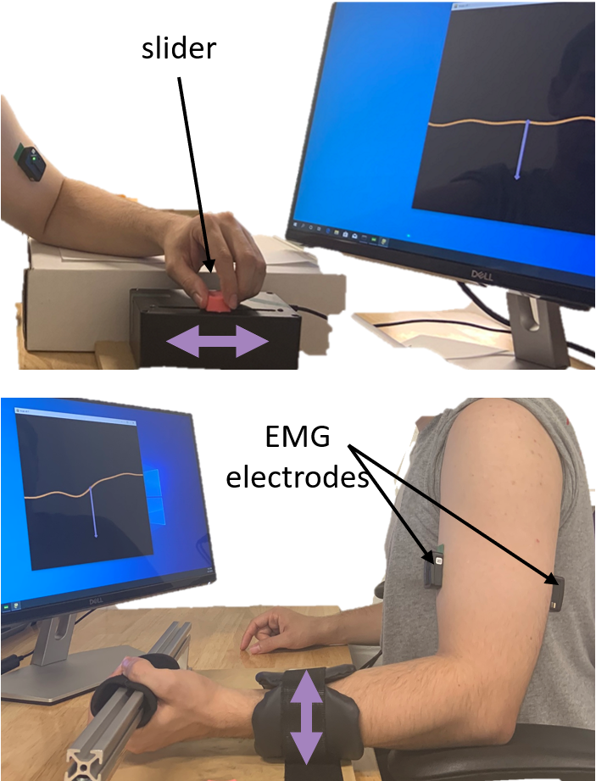
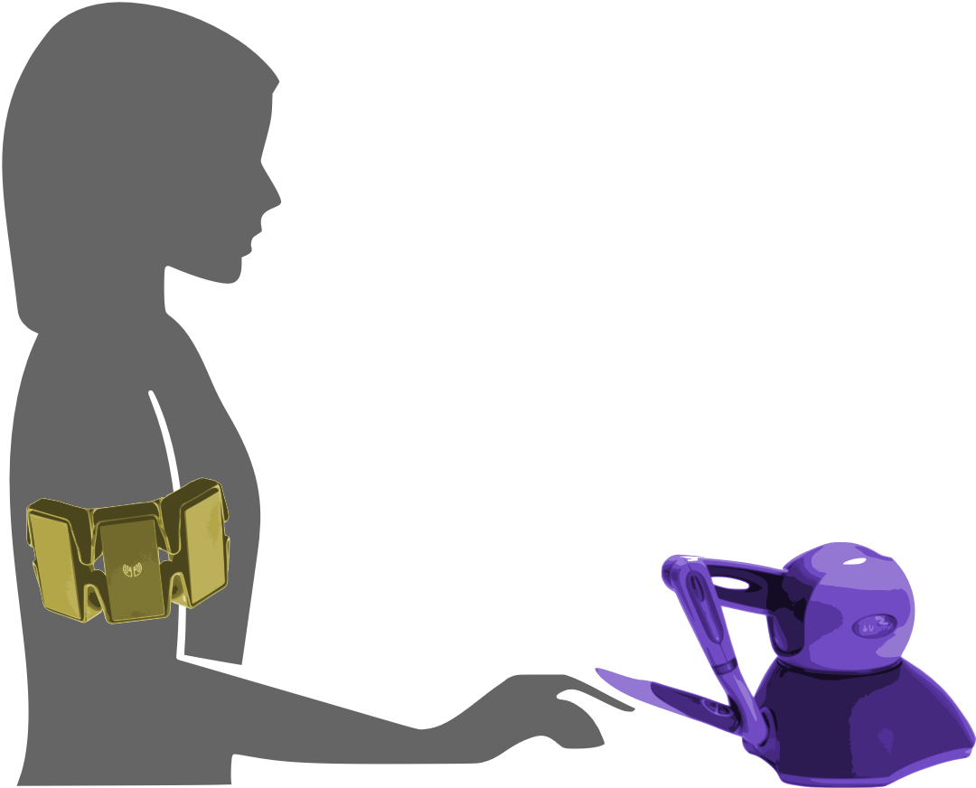

experiment: muscle vs manual
  manual: 1-dimensional joystick
  muscle: EMG on biceps/triceps
  task: reference tracking
Yamagami, Steele, Burden CHI 2020
Decoding intent with control theory: muscle vs manual interface performance

Slide 15
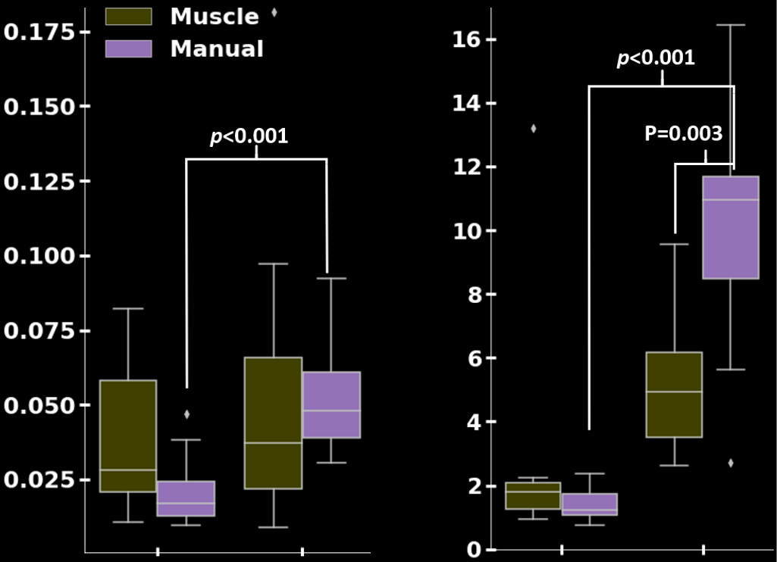









results:
muscle $≈$ manual
muscle $>$ manual
$$(N=11)$$
tracking error ${\left|r−y\right| }^{2}$
inversion error ${\left|F−M^{−1}\right| }^{2}$
$$\dot{y}=u$$
$$\ddot{y}=u−\dot{y}$$
$$\dot{y}=u$$
$$\ddot{y}=u−\dot{y}$$
Yamagami, Steele, Burden CHI 2020
Decoding intent with control theory: muscle vs manual interface performance

Slide 16
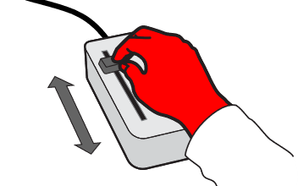
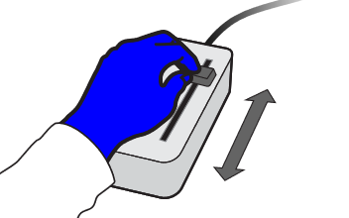

experiment: dominant vs non-dominant
  task: reference tracking + disturbance rejection
  group RL: dominant before non-dominant
  group LR: non-dominant before dominant
Yamagami, Peterson, Howell, Roth, Burden IEEE Tran Cybernetics 2021
Effect of Handedness on Learned Controllers and Sensorimotor Noise During Trajectory-Tracking

Slide 17
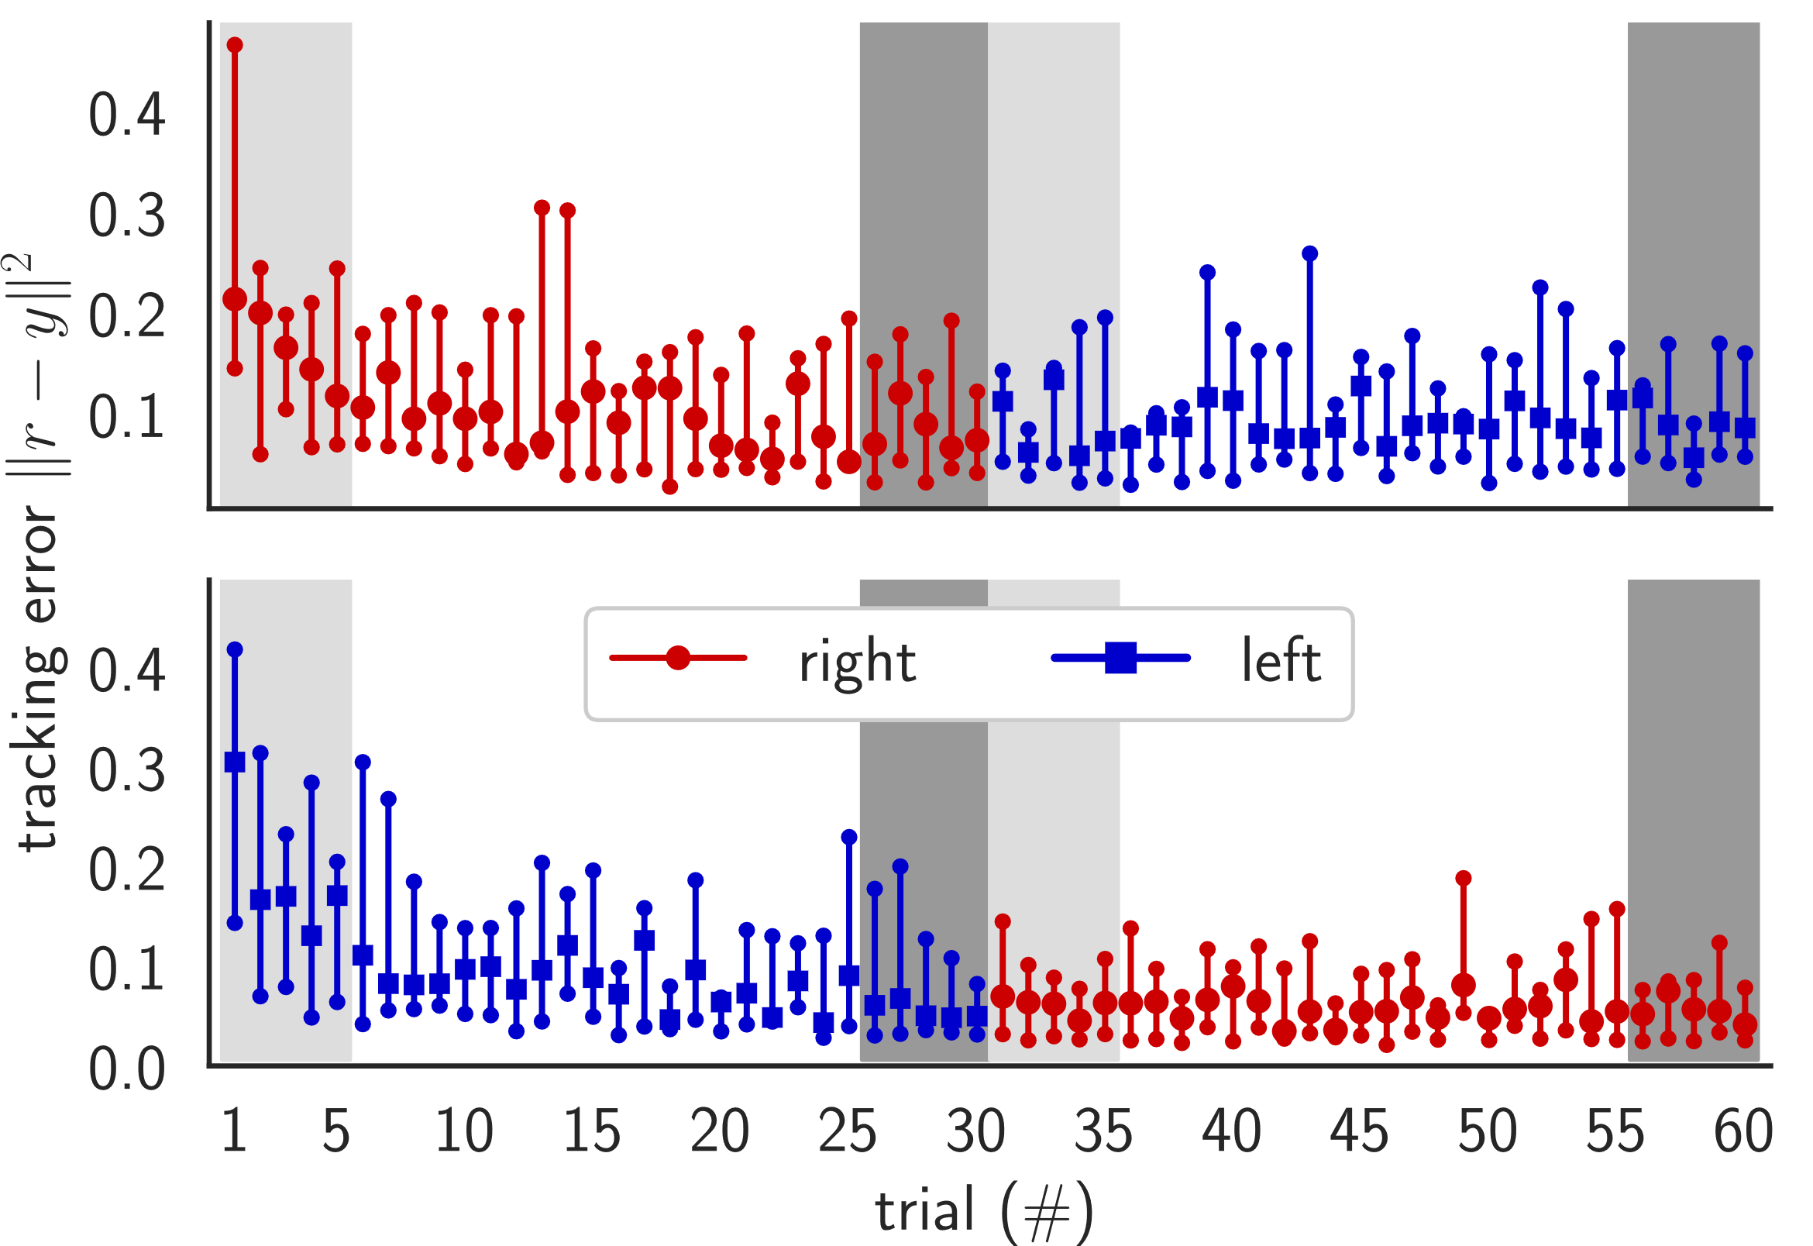
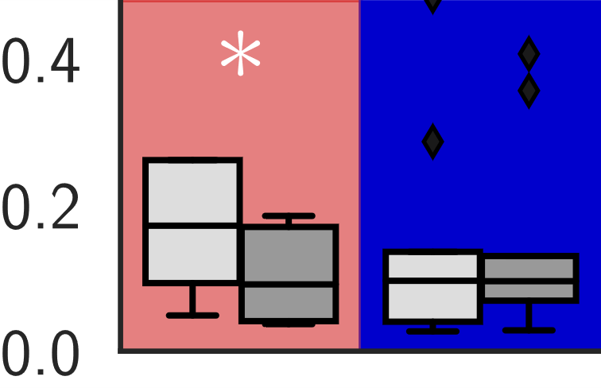
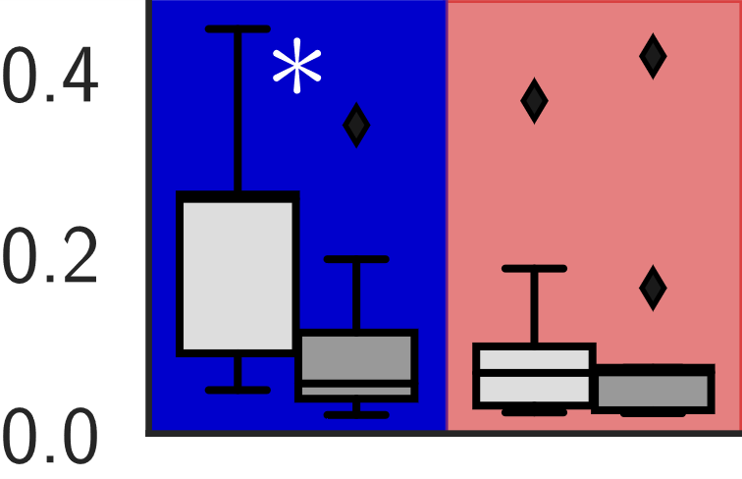




results:
dominant vs non-dominant
hands perform
the same
$${\left\|r−y\right\|}^{2}$$
RL
$$(N=9)$$
tracking transfers
$${\left\|r−y\right\|}^{2}$$
LR
$$(N=9)$$
Yamagami, Peterson, Howell, Roth, Burden IEEE Tran Cybernetics 2021
Effect of Handedness on Learned Controllers and Sensorimotor Noise During Trajectory-Tracking

Slide 18
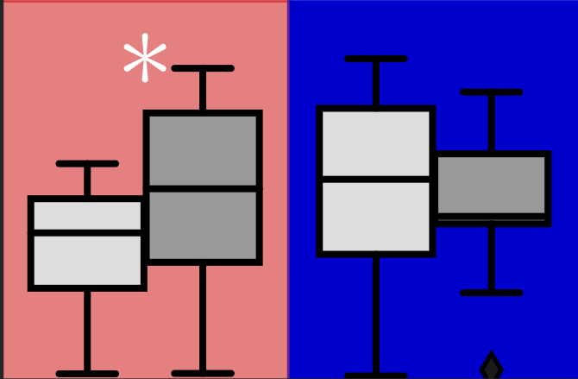
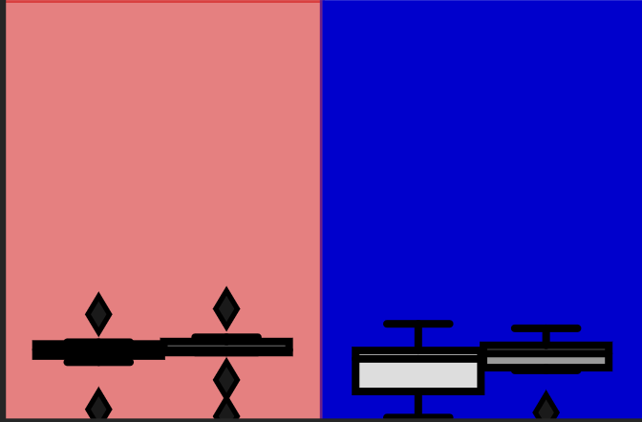
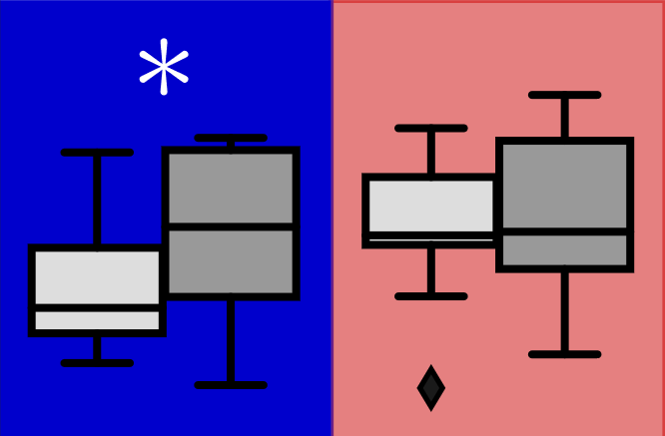
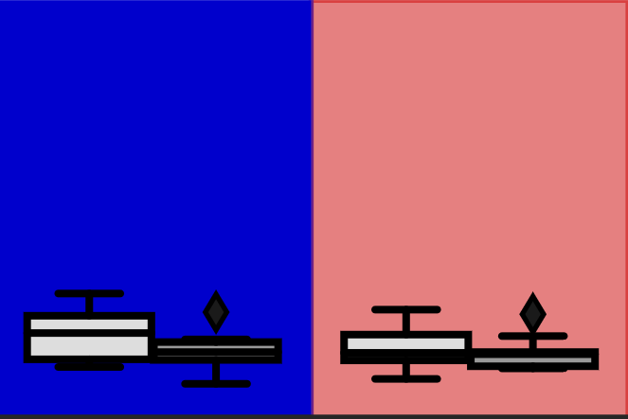








results:
feedback adapts …
… feedforward doesn’t
$$4$$
RL
$$2$$
$$(N=9)$$
$$0$$
$$\left\|B\right\|$$
$$\left\|F\right\|$$
$$4$$
LR
$$(N=9)$$
$$2$$
$$0$$
Yamagami, Peterson, Howell, Roth, Burden IEEE Tran Cybernetics 2021
Effect of Handedness on Learned Controllers and Sensorimotor Noise During Trajectory-Tracking

Slide 19
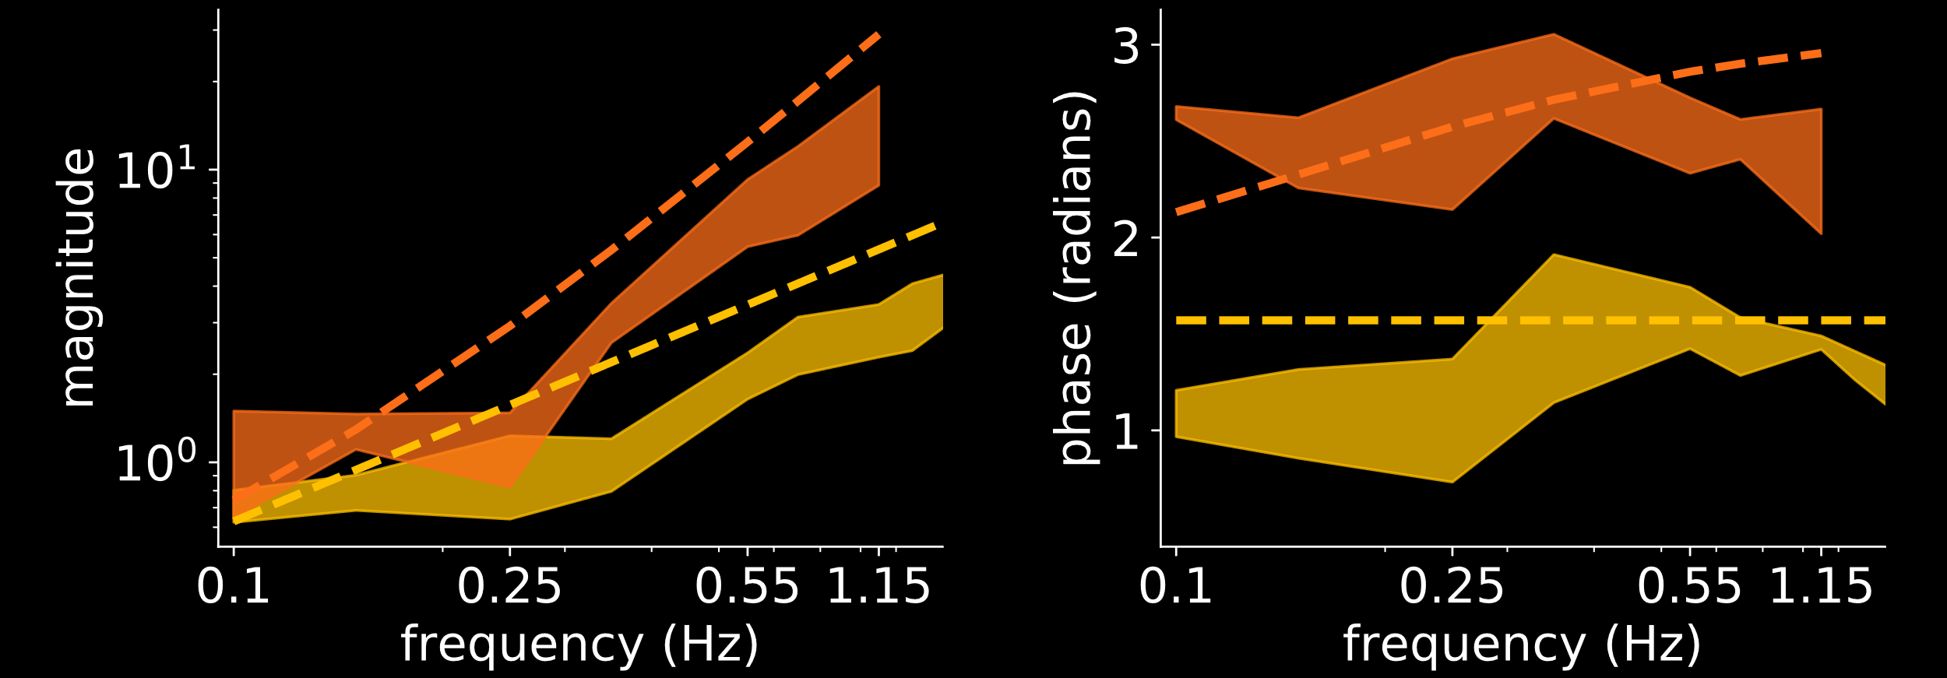


humans adapt to machines
d
H(M)
H(M)
vs.
H(M)
M
H
M
vs.
M
u
+
y
e
r
+
-
$$F≈M^{−1}=s^{2}+s$$
$$F≈M^{−1}=s$$

Slide 20

how can we enable human/machine
collaborative learning and control?
humans learn models of machines …
… so machines should learn models of humans
takeaway: humans learn to $≈$invert machine dynamics

Slide 21

how can we enable human/machine
collaborative learning and control?
humans learn models of machines …
… so machines should learn models of humans
takeaway: humans learn to $≈$invert machine dynamics

Slide 22




human/machine co-adaptation
d
H(M)
M(H)
H
M
u
+
y
e
r
+
-
co-adaptation is a sensorimotor game played between two decision-making agents: human and machine
Chasnov, Parsa, Yamagami, Ratliff SPIE 2019
Experiments with sensorimotor games in dynamic
human/machine interaction

Slide 23




humans and machines seek to minimize “cost”
Merel, Pianto, Cunningham, Paninski PLoS Computational Biology 2015
Encoder-Decoder Optimization for Brain-Computer Interfaces
Müller, Vidaurre, Schreuder, Meinecke, von Bünau, Müller J Neural Eng 2017
A Mathematical Model for the Two-Learners Problem
Li, Carboni, Gonzalez, Campolo, Burdet Nature Machine Intelligence 2019
Differential Game Theory for Versatile Physical Human–robot Interaction
$$\min_{H}{c_{H}(H,M)}$$
$$\min_{M}{c_{M}(H,M)}$$
decision-making agents have “bounded rationality”
Simon Decision and Organization 1972
Theories of Bounded Rationality
Russell, Wefald Artificial Intelligence 1991
Principles of Metareasoning
Gershman, Horvitz, Tenenbaum Science 2015
Computational Rationality: A Converging Paradigm for Intelligence in Brains, Minds, and Machines
Papadimitriou, Piliouras ACM SIGecom Exchanges 2018
Game Dynamics as the Meaning of a Game
$$\dot{H}≈∂_{H}c_{H}(H,M)$$
$$\dot{M}≈∂_{M}c_{M} (H,M)$$
Notes:
One totally plausible thing is that they could try making small adjustments based on local information, namely gradient descent.
In this example, the machine and environment are static.
----------------------------------
For the single agent case, if you had a cost function, how would you go about minimizing it? Well, a good first order method is simply gradient descent.
Suppose the agent has a parabola-shaped cost function, single gradient descent will look like this
Here we
Decision making is also a dynamic process. Especially if you don’t know much about the environment or your cost function, you may need to explore/interact with the environment to ‘learn’ about it.
If there is a minimum, we expect gradient descent like updates to converge to it.
Suppose the human’s cost function is a \parabola shaped thing

Slide 24


sensorimotor game: brain/machine interface
visual
target
visual
error
neural firing rates
decoder
output
t
e
f
y
B
D
brain
decoder
$$c_{D}\left(B,D\right)={\left\|e\right\|}^{2}+{\left\|D\right\|}^{2}$$
machine cost
$$c_{B}\left(B,D\right)={\left\|e\right\|}^{2}+{\left\|B\right\|}^{2}$$
H: brain cost
Wu, Black, Gao, Serruya, Shaikhouni, Donoghue, Bienenstock NeurIPS 2002
Neural Decoding of Cursor Motion Using a Kalman Filter
Gilja, Nuyujukian, Chestek, Cunningham, Yu, Ryu, Shenoy COSYNE 2010
High-Performance Continuous Neural Cursor Control Enabled by a Feedback Control Perspective
Müller, Vidaurre, Schreuder, Meinecke, von Bünau, Müller J Neural Eng 2017
A Mathematical Model for the Two-Learners Problem
Notes:
One totally plausible thing is that they could try making small adjustments based on local information, namely gradient descent.
In this example, the machine and environment are static.
----------------------------------
For the single agent case, if you had a cost function, how would you go about minimizing it? Well, a good first order method is simply gradient descent.
Suppose the agent has a parabola-shaped cost function, single gradient descent will look like this
Here we
Decision making is also a dynamic process. Especially if you don’t know much about the environment or your cost function, you may need to explore/interact with the environment to ‘learn’ about it.
If there is a minimum, we expect gradient descent like updates to converge to it.
Suppose the human’s cost function is a \parabola shaped thing

Slide 25

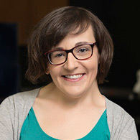

sensorimotor game: brain/machine interface
visual
target
visual
error
neural firing rates
decoder
output
t
e
f
y
B
D
brain
decoder
$$c_{D}\left(B,D\right)={\left\|e\right\|}^{2}+{\left\|D\right\|}^{2}$$
machine cost
$$c_{B}\left(B,D\right)={\left\|e\right\|}^{2}+{\left\|B\right\|}^{2}$$
H: brain cost
result:
error
vs
effort
i.e. the brain learns to “invert” the decoder
stationary points
$$D^{∗}B=I$$
Madduri, Burden, Orsborn IEEE NER 2021
A game-theoretic model for co-adaptive brain-machine interfaces
Notes:
One totally plausible thing is that they could try making small adjustments based on local information, namely gradient descent.
In this example, the machine and environment are static.
----------------------------------
For the single agent case, if you had a cost function, how would you go about minimizing it? Well, a good first order method is simply gradient descent.
Suppose the agent has a parabola-shaped cost function, single gradient descent will look like this
Here we
Decision making is also a dynamic process. Especially if you don’t know much about the environment or your cost function, you may need to explore/interact with the environment to ‘learn’ about it.
If there is a minimum, we expect gradient descent like updates to converge to it.
Suppose the human’s cost function is a \parabola shaped thing

Slide 26
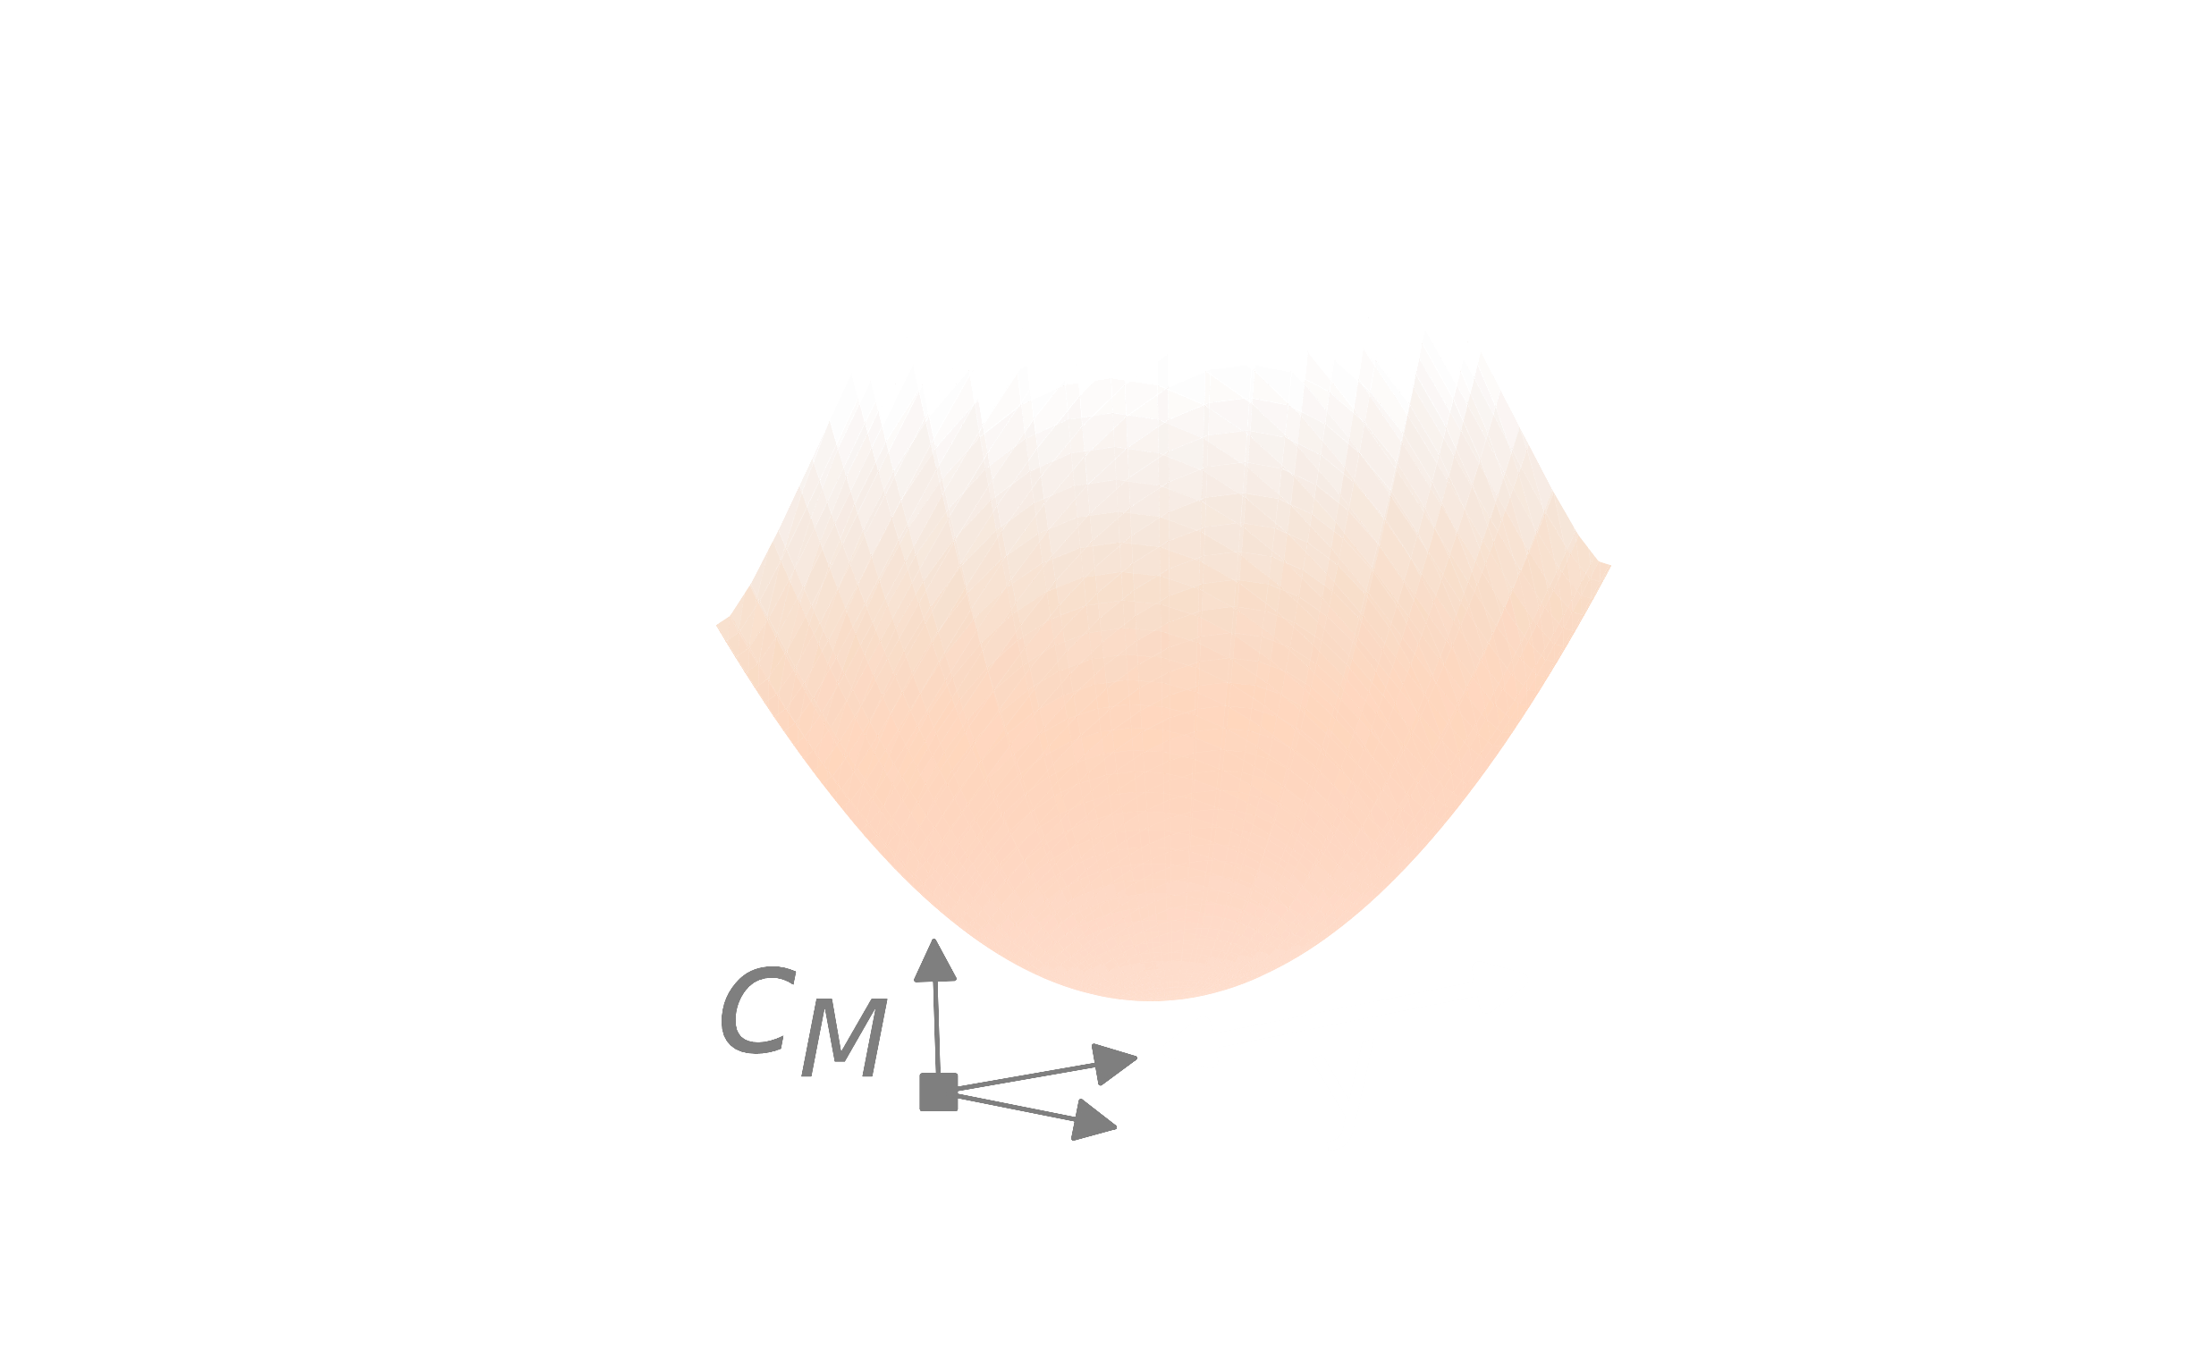
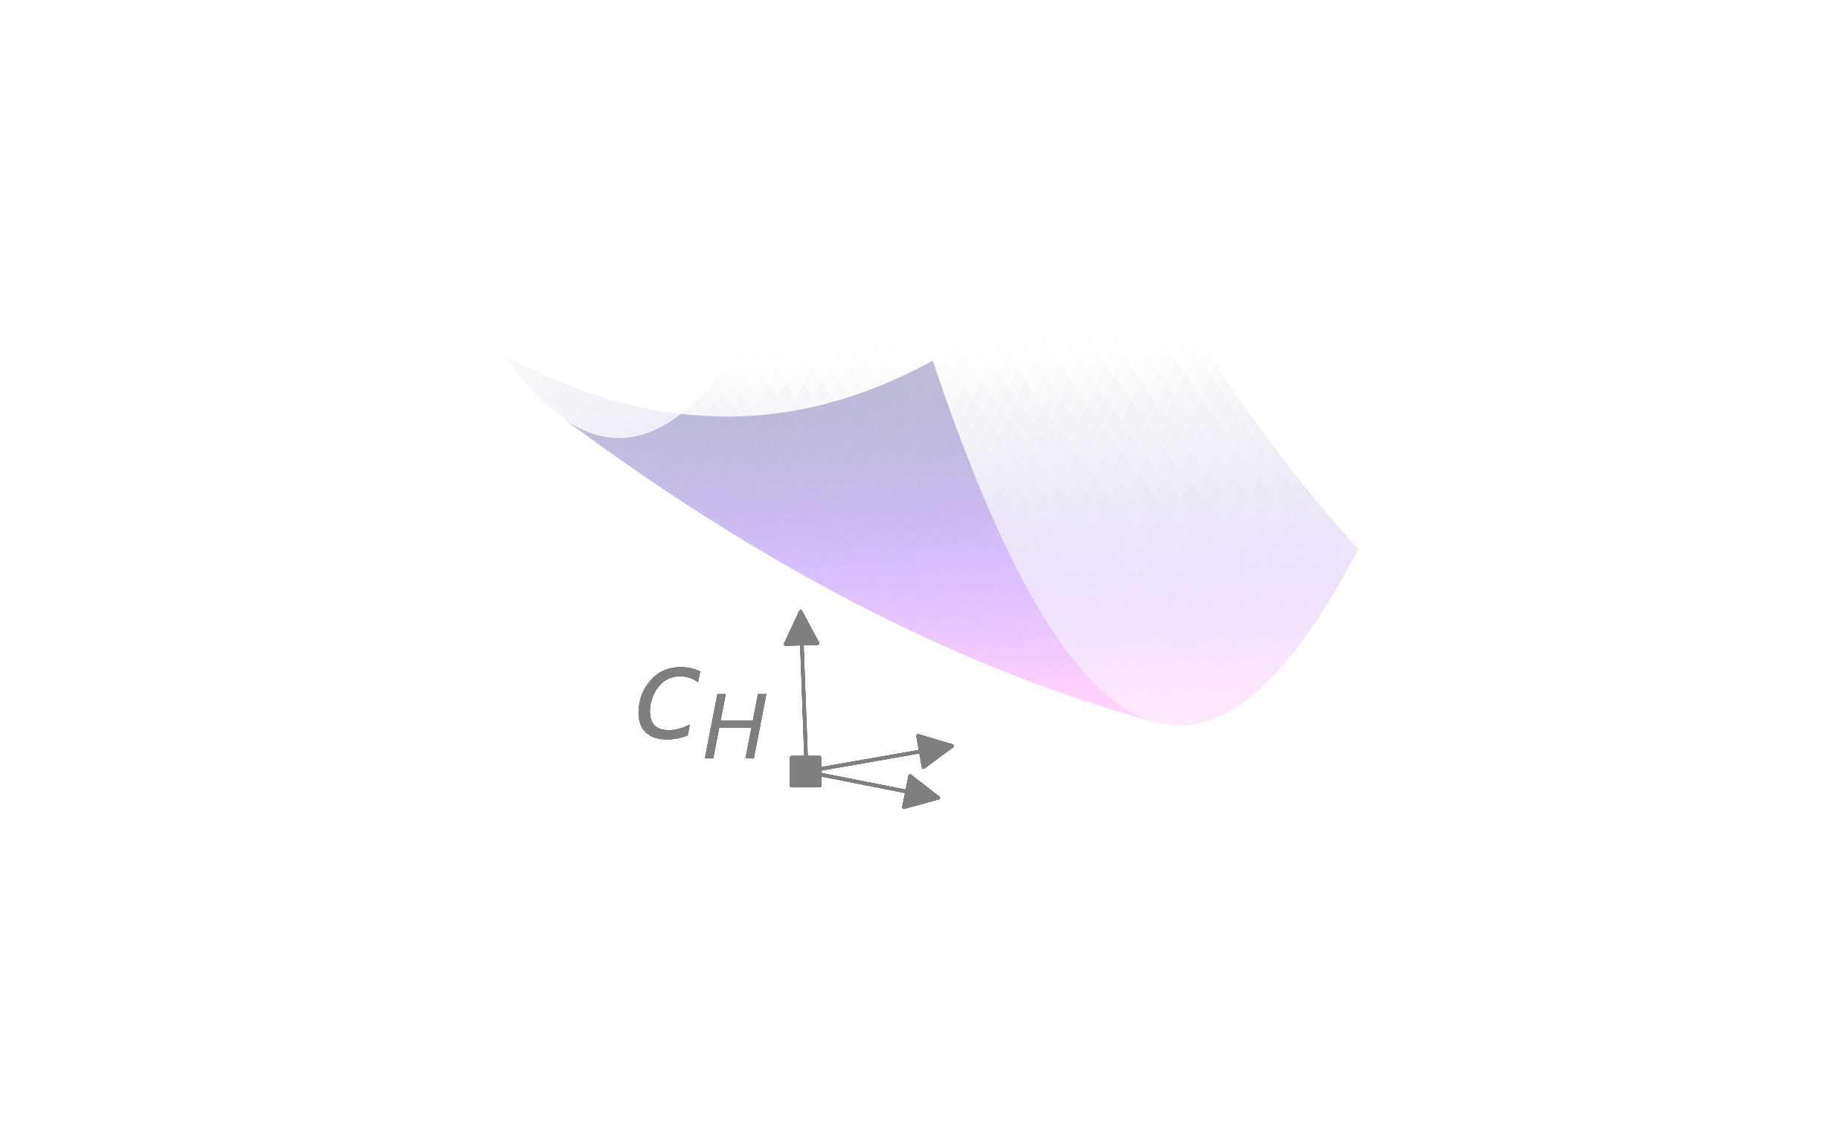






sensorimotor game: human/machine interaction
human’s cost $c_{H}(H,M)$
machine’s cost $c_{H}(H,M)$
global minima:
game equilibria:
$$\min_{H,M}{c_{H}(H,M)}$$
Nash
$$\min_{H,M}{c_{M}(H,M)}$$
Braun, Ortega, Wolpert
PLoS Comp Bio 2009
Nash Equilibria in Multi-Agent Motor Interactions
machine action M
best responses:
$$\min_{H}{c_{H}(H,M)}$$
$$\min_{M}{c_{M}(H,M)}$$
human action H

Slide 27
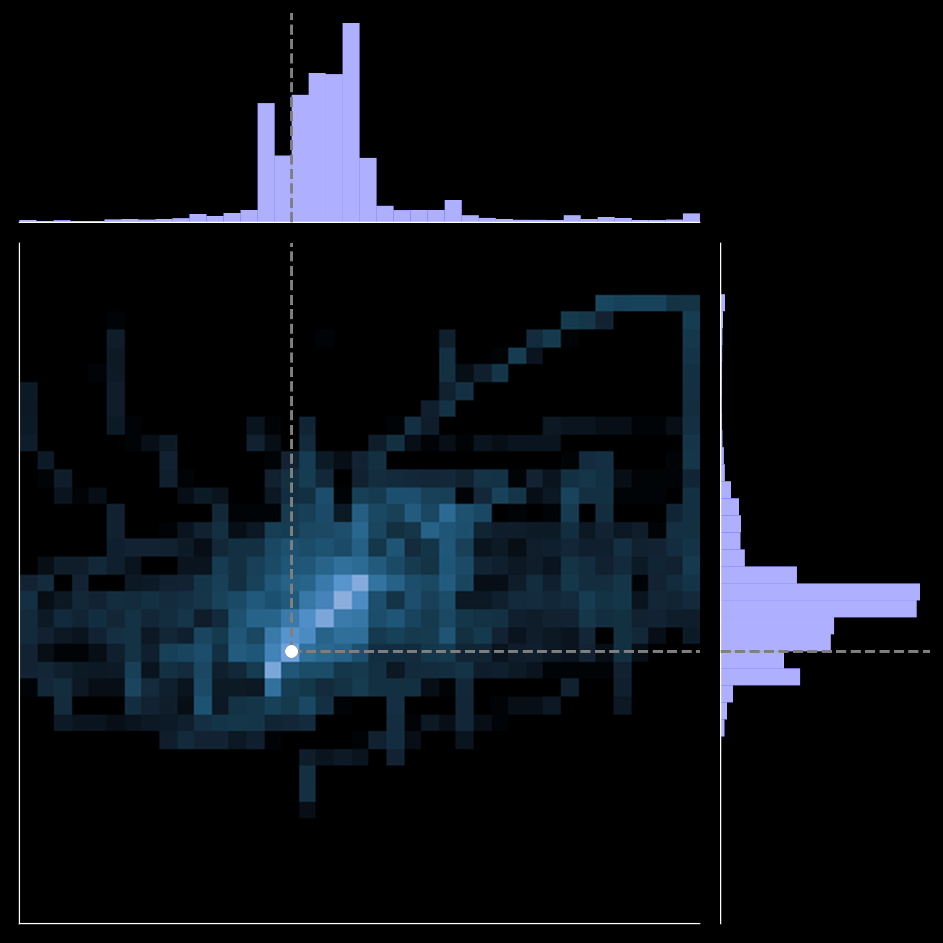



results:
$\dot{H}=$???
adaptation
scheme
$$(N=10)$$
$$\dot{M}=α ∂_{M}c_{M} (H,M)$$
prolific.co
machine action M
Nash
Chasnov, Ratliff
in prep
human action H

Slide 28
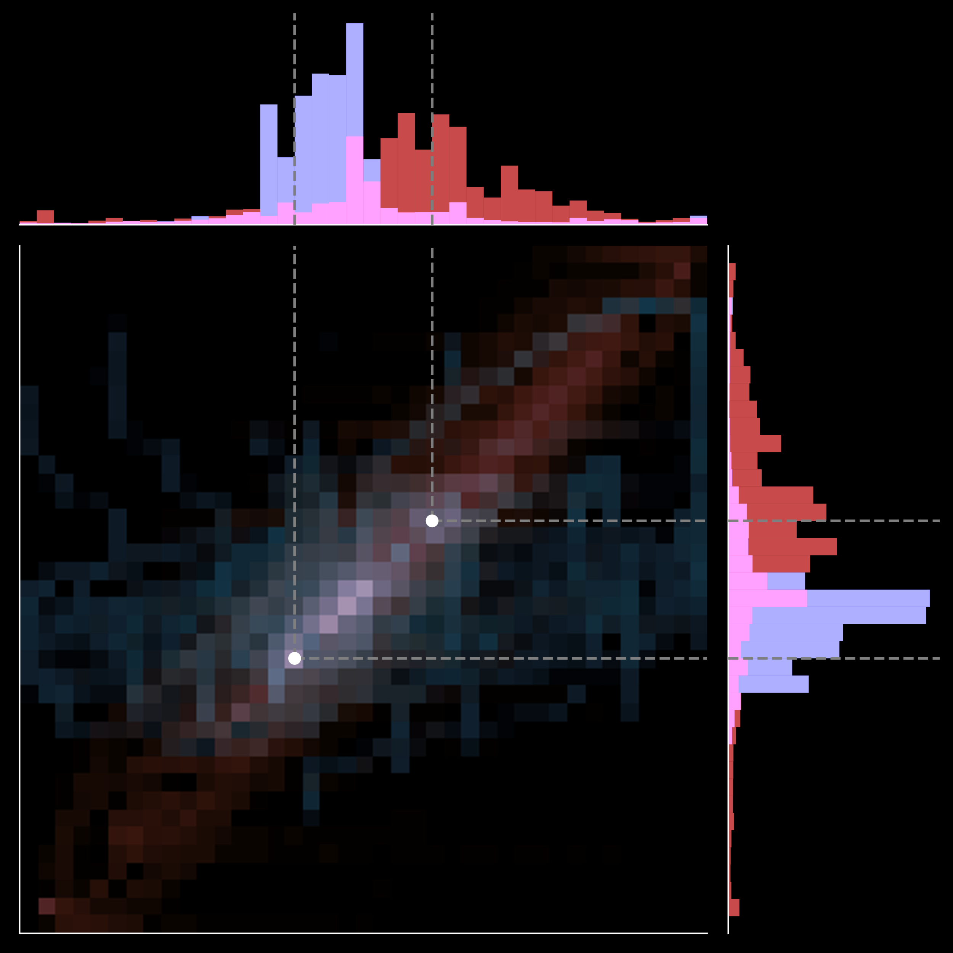


results:
$\dot{H}=$???
$$(N=10)$$
$$\dot{M}=α ∂_{M}c_{M} (H,M)$$
prolific.co
Stackelberg
($α$ large)
machine action M
Nash
($α$ small)
Chasnov, Ratliff
in prep
human action H

Slide 29


sensorimotor game: human/machine interaction
human’s cost $c_{H}(H,M)$
machine’s cost $c_{H}(H,M)$
global minima:
game equilibria:
$$\min_{H,M}{c_{H}(H,M)}$$
Nash
$$\min_{H,M}{c_{M}(H,M)}$$
Braun, Ortega, Wolpert
PLoS Comp Bio 2009
Nash Equilibria in Multi-Agent Motor Interactions
machine action M
best responses:
Stackelberg
(machine-led)
$$\min_{H}{c_{H}(H,M)}$$
$$\min_{M}{c_{M}(H,M)}$$
Hespanha Noncooperative Game Theory 2017
human action H

Slide 30
sensorimotor game: human/machine interaction
human’s cost $c_{H}(H,M)$
machine’s cost $c_{H}(H,M)$
global minima:
game equilibria:
$$\min_{H,M}{c_{H}(H,M)}$$
Nash
$$\min_{H,M}{c_{M}(H,M)}$$
Braun, Ortega, Wolpert
PLoS Comp Bio 2009
Nash Equilibria in Multi-Agent Motor Interactions
machine action M
best responses:
Stackelberg
$$\min_{H}{c_{H}(H,M)}$$
conjectural
$$\min_{M}{c_{M}(H,M)}$$
Jean-Marie, Querou, Tidball, Figuieres Theory of Conjectural Variations 2004
human action H

Slide 31
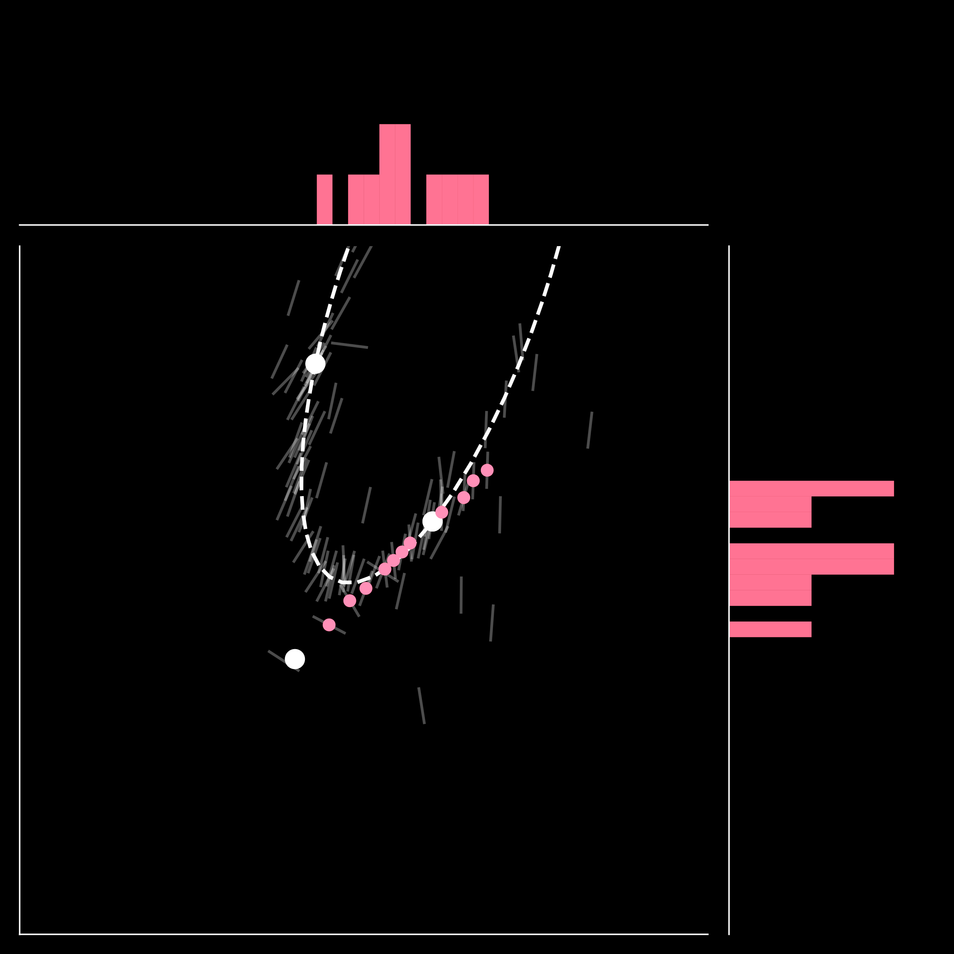


results:
$$H≈L_{H}(M−M_{H}^{∗})$$
adaptation
scheme
$$(N=11)$$
$$M≈L_{M}(H−H_{M}^{∗})$$
prolific.co
game equilibria:
Nash
Braun, Ortega, Wolpert
PLoS Comp Bio 2009
Nash Equilibria in Multi-Agent Motor Interactions
Stackelberg
Stackelberg
(machine-led)
machine action M
Nash
Hespanha Noncooperative Game Theory 2017
Chasnov, Ratliff
in prep
human action H

Slide 32
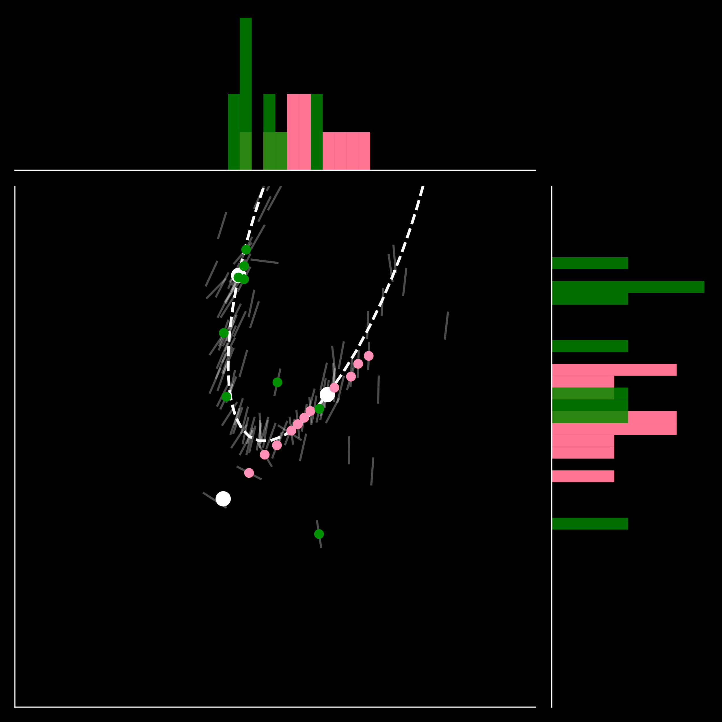
results:
$$H≈L_{H}(M−M_{H}^{∗})$$
adaptation
scheme
$$(N=11)$$
$$M≈L_{M}(H−H_{M}^{∗})$$
prolific.co
game equilibria:
conjectural
Nash
Braun, Ortega, Wolpert
PLoS Comp Bio 2009
Nash Equilibria in Multi-Agent Motor Interactions
Stackelberg
Stackelberg
(machine-led)
machine action M
Nash
Hespanha Noncooperative Game Theory 2017
conjectural
Jean-Marie, Querou, Tidball, Figuieres Theory of Conjectural Variations 2004
Chasnov, Ratliff
in prep
human action H

Slide 33
how can we enable human/machine
collaborative learning and control?
humans learn models of machines …
… so machines should learn models of humans
takeaway: humans learn to $≈$invert machine dynamics
takeaway: machines can learn how humans adapt

Slide 34
Q: how can we enable human/machine
collaborative learning and control?
humans learn models of machines …
… so machines should learn models of humans
A: need to study sensorimotor games

Slide 35





sburden@uw.edu
http://faculty.uw.edu/sburden
thank you!
on academic job market NOW
Momona Yamagami
PhD candidate in ECE
Maneeshika Madduri
PhD student in ECE
Ben Chasnov
PhD student in ECE
on job market next year
NSF CPS Medium #1836819:
Certifiable reinforcement learning for cyber-physical systems
NSF M3X CAREER #2045014: Human/Machine Collaborative Learning and Control of Contact-Rich Dynamics

